Slide 1
[Product / feature name]
Launch Brief & Go-to-Market Strategy
Owner: [Product Marketing Manager Name]
Version: v1.0 | Date: [MM/DD/YYYY]

Slide 2
Product Launch Overview
Instructions: Provide a high-level summary of the launch.
Product / Feature Name: [Product / feature name]
Launch Tier: [Tier 1 / 2 / 3]
Planned Launch Date: [MM/DD/YYYY] - or initial date
Product Area / Squad: Name of Product Area / Squad
PM Contact: Name of Product Manager / Owner responsible
PMM Contact:
Launch Status: [Planning / In Development / Ready / Live]
Internal Stakeholders: List them all [Sales, Support, CS, Legal, etc.]
Customer Segment: [SMB / Mid-Market / Enterprise / Developers]
Sales Impact: [New Logo / Expansion / Retention]

Slide 3
Product Launch Timeline
20XX
20XX
20XX
20XX
Internal release
Limited release
Launch
Post launch
Product available to internal teams for training, QA, and final enablement asset validation.
Feature released to select customers for feedback, usage tracking, and refinement before public launch.
General availability with full GTM support across marketing, sales, and customer success channels.
Performance monitoring, customer feedback analysis, and follow-up activities (e.g., testimonials, iterations).

Slide 4
Product Launch Goals & KPIs
Instructions: Clarify what success looks like.
Strategic Objective: | [Retention, Acquisition, Market Differentiation, etc.]
Primary KPIs: | Feature adoption within X days Revenue influenced / pipeline created % increase in engagement or NPS
Secondary KPIs: | Demo requests CTR on launch comms Usage by persona/segment

Slide 5
Problems & Opportunities
Instructions: Describe the market problem and the opportunity the product addresses.
Customer Problem Statement: | What pain point are we solving? How do customers experience it today?
Opportunity: | What are we enabling or unlocking for the customer?
Market Context: | Data, quotes, trends that validate the opportunity

Slide 6
Personas & Use Cases
Instructions: Define who you are building for.
Primary Personas: [e.g., Head of Finance, Bookkeeper, Developer] | Goals: Challenges: Tech Stack: Motivators:
Use Cases: | [Use Case 1]: Describe scenario [Use Case 2]: Describe scenario
Primary Personas: [e.g., Head of Finance, Bookkeeper, Developer] | Goals: Challenges: Tech Stack: Motivators:
Use Cases: | [Use Case 1]: Describe scenario [Use Case 2]: Describe scenario

Slide 7
Target Market & ICP Fit
Instructions: Define the market and customer profiles most aligned with this launch.
Ideal Customer Profile (ICP): | Industry: Size: Maturity level: Geography:
Customer Segments Targeted | [SMB / Mid-market / Enterprise] [Net new / Existing / Specific regions]
Market Readiness | Are customers educated and demanding this? Or is it disruptive?

Slide 8
Product Summary
Instructions: Define what is being launched.
Name and description: | 1-2 lines
What it does: | Description of the job-to-be-done of this product or feature.
How it works: | High-level description of how it works.
Key capabilities and limitations | Bullet lists or sentences

Slide 9
Product Summary
Instructions: Define what is being launched.
Value proposition: | What problem are we solving?
Target market: | Who are we solving this for?
Our differentiator: | What’s unique or why are we best suited to pursue this?
Product benefits: | What benefits do the customers get? Name them all.

Slide 10
Key Messaging & Positioning
Instructions: Translate the product into market-facing messaging.
Positioning Statement: | Use the following formula: “For [target persona], who [problem], [product] is a [category] that [value proposition]. Unlike [competitive alternative], it [differentiator]”.
Messaging Pillar 1: | [Persona A]: Value message [Persona B]: Value message
Messaging Pillar 1: | [Persona A]: Value message [Persona B]: Value message
Messaging Pillar 1: | [Persona A]: Value message [Persona B]: Value message

Slide 11
Competitive Landscape
Instructions: Compare with other solutions from competitors.
Competitor Name | Why We Win | Watchouts / Gaps to Acknowledge
[Competitor Name] | For each row, write a concise and compelling statement of how your solution delivers value. Prioritise clarity over buzzwords as the battlecard is used in sales calls. | List strengths or claims your competitor make in the market in that category (pull from sales enablement, analyst reports, or marketing collateral).
[Competitor Name] | For each row, write a concise and compelling statement of how your solution delivers value. Prioritise clarity over buzzwords as the battlecard is used in sales calls. | List strengths or claims your competitor make in the market in that category (pull from sales enablement, analyst reports, or marketing collateral).
[Competitor Name] | For each row, write a concise and compelling statement of how your solution delivers value. Prioritise clarity over buzzwords as the battlecard is used in sales calls. | List strengths or claims your competitor make in the market in that category (pull from sales enablement, analyst reports, or marketing collateral).
[Competitor Name] | For each row, write a concise and compelling statement of how your solution delivers value. Prioritise clarity over buzzwords as the battlecard is used in sales calls. | List strengths or claims your competitor make in the market in that category (pull from sales enablement, analyst reports, or marketing collateral).

Slide 12
Pricing & Packaging
Instructions: Describe how this fits into your commercial model.
Packaging: | Is this part of an existing plan or a new SKU?
Pricing Structure: | Per user / per usage / flat rate Free vs. paid tiers Discounting guidelines (if any)
Monetization Strategy: | Freemium to Paid? Retention play?

Slide 13
Cross-Functional Launch Readiness Checklist
Instructions: Track cross-functional GTM alignment.
Tasks | Collateral | Function | Status | Notes
Product Alignment | Product Brief / Data Sheet / Release Note | Product Management / Documentation | TO DO / ONGOING / DONE
Sales Enablement | Deck / Playbooks / Internal FAQ / Training | Sales / CS / SUPPORT | TO DO / ONGOING / DONE
Legal | Terms / billing | Legal / Finance | TO DO / ONGOING / DONE
Ops / CRM | Product IDs, SFDC mappings | Sales Operations / Marketing Operations | TO DO / ONGOING / DONE
Announcement | Email / In-app messages / LinkedIn | Marketing Automation / Brand Marketing | TO DO / ONGOING / DONE
Brand | Video | Graphic Design / Brand Marketing | TO DO / ONGOING / DONE

Slide 14
Marketing & Enablement Plan
Instructions: Plan your GTM tactics across the funnel. Include dates and links to each of them.
Launch Tiers & Channels: | Website update - DATE [MM/DD/YYYY] In-app messaging - DATE [MM/DD/YYYY] Email - DATE [MM/DD/YYYY] Blog - DATE [MM/DD/YYYY] Social, PR - DATE [MM/DD/YYYY] Webinars or events - DATE [MM/DD/YYYY]
Sales Materials: | Pitch decks - DATE [MM/DD/YYYY] One-pagers - DATE [MM/DD/YYYY] Competitive battlecards - DATE [MM/DD/YYYY]
Training: | Internal walkthroughs - DATE [MM/DD/YYYY] LMS or videos - DATE [MM/DD/YYYY]

Slide 15
Post-Launch Success Tracking
Instructions: Define what will be tracked and how. Include the owner and the cadence (how often they will be reviewed) or last time reviewed..
KPI to Monitor: | Adoption: Feature usage: Support tickets: Qualitative feedback: | Owner | Last time reviewed DATE [MM/DD/YYYY]
KPI to Monitor: | Adoption Feature usage Support tickets Qualitative feedback | Owner | Last time reviewed DATE [MM/DD/YYYY]
KPI to Monitor: | Adoption Feature usage Support tickets Qualitative feedback | Owner | Last time reviewed DATE [MM/DD/YYYY]
KPI to Monitor: | Adoption Feature usage Support tickets Qualitative feedback | Owner | Last time reviewed DATE [MM/DD/YYYY]

Slide 16
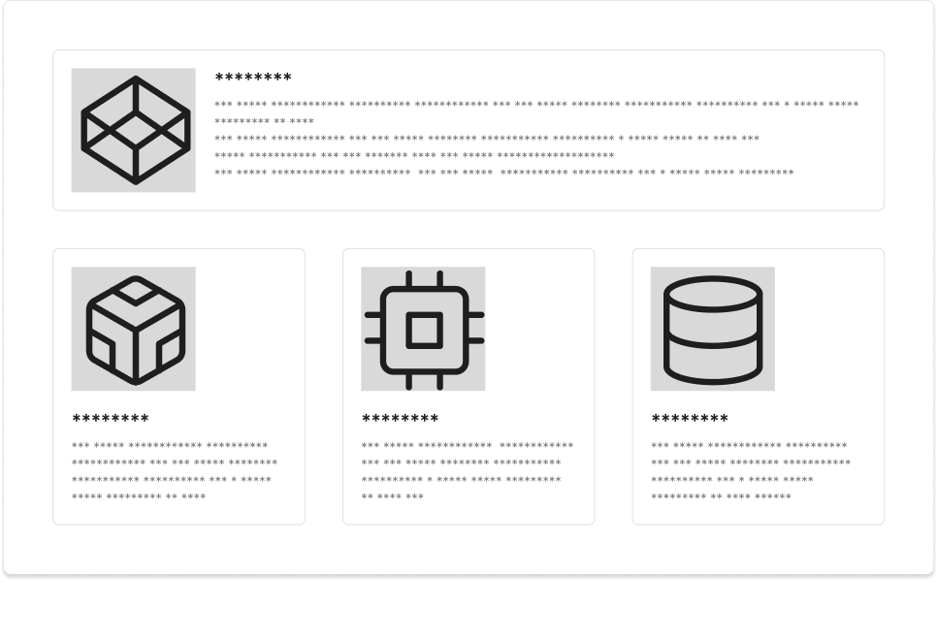
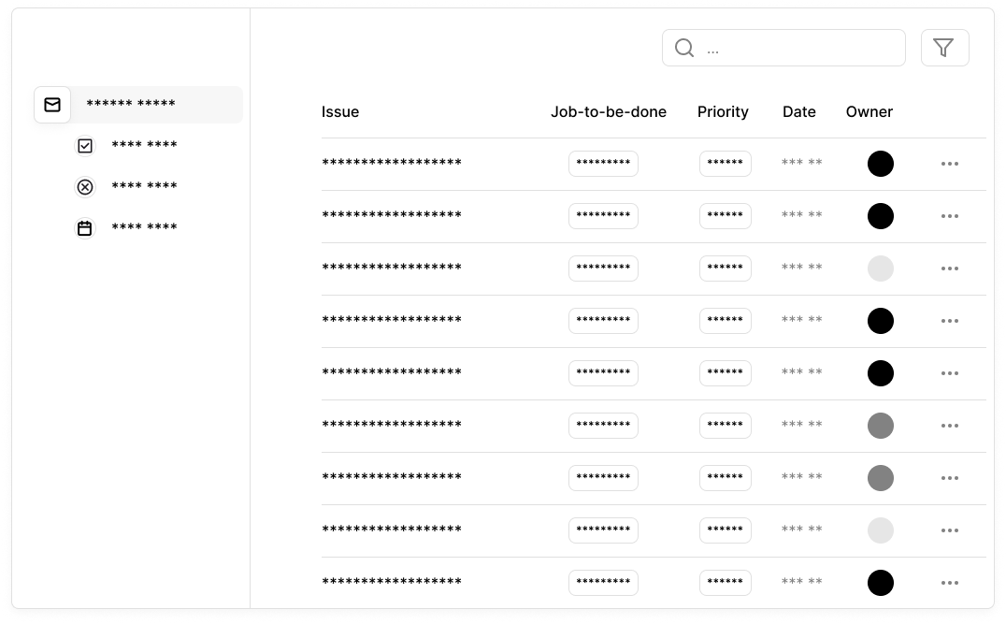
Appendix: Screenshots or Prototypes
Instructions: Include links to Figma or prototypes or screenshots to showcase the product

Slide 17
Appendix: Case Study (Early Access Program)
Instructions: Include links to Figma or prototypes or screenshots to showcase the product
Customer’s name and user’s name and title: | State name of the customer (company) and user’s name and title.
Location and industry: | Location, Industry:
Use case: | Customer quote or stats Use case and benefits

