Slide 1

Schemas
Learn Swagger and the Open API Specification
Defining Request and Response Bodies

Slide 2
Introduction
Covers
What is a schema?
References
Request bodies
Response bodies
Form data

Slide 3
Request and Response Bodies
Certain kinds of requests have extra data
POST, PUT, etc.
Called the request body
Typically data is formatted in JSON (or sometimes XML)
Nearly all responses return a response body
Also typically formatted in JSON

Slide 4
What is a schema?
The schema indicates the structure of the data
OAS schema object is based off the JSON Schema Specification
http://json-schema.org/
What are the keys in key/value pairs?
What type of data are the values?
Can be many levels

Slide 5
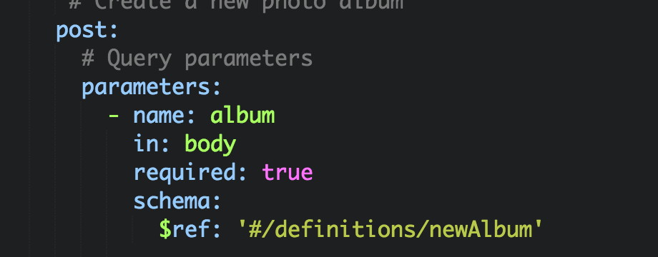
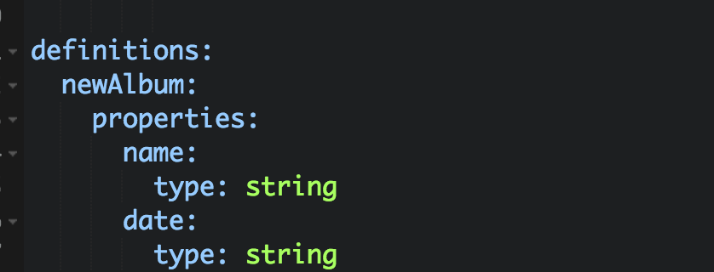
$ref
$ref is a special OAS key that indicates that the value is a reference to a structure somewhere else in the YAML file

Slide 6
Request Body
Under parameters:
name – just for reference (not shown in docs)
in – set to body
required – typically set to true
schema –
Add a level
Key of $ref
Value of the reference path, in quotes

Slide 7
Example Request Body

Slide 8
Schema section
Create a key called descriptions at the end of the file
Add a level and give it the name from the $ref value
Add a properties key
For each top level element in the JSON, add a key of its name.
Add a type key that says what type of data it is
Add other keys for other data (more later)

Slide 9
Example Schema

Slide 10
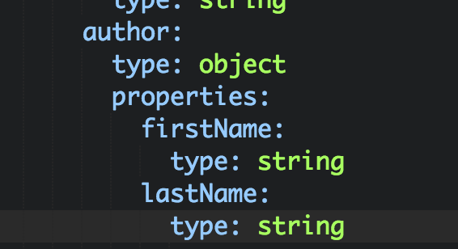
Schema objects
You can add other objects as values
Simply use a type of object
Then add a new level with properties:
And continue just like you did before

Slide 11
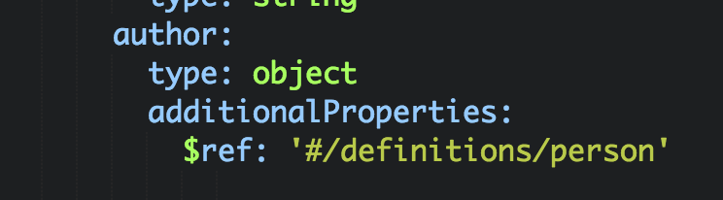
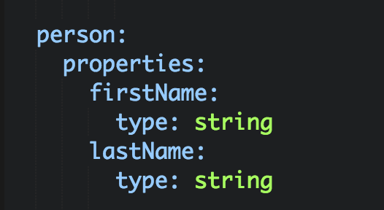
Schema objects with $ref
As you can imagine, this can add a lot of indentation
So you can use $ref from within your definition using the additionalProperties key

Slide 12
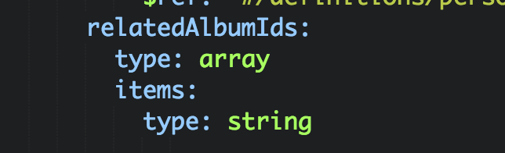
Schema array
You can also add arrays
Simply use a type of array
Then add a key of items
And define the type and any other properties

Slide 13
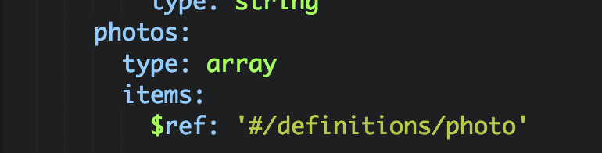
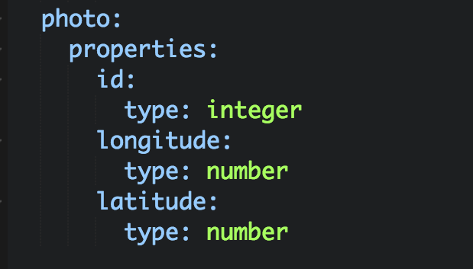
Schema array with $ref
For a more complex type, use $ref for the array items

Slide 14
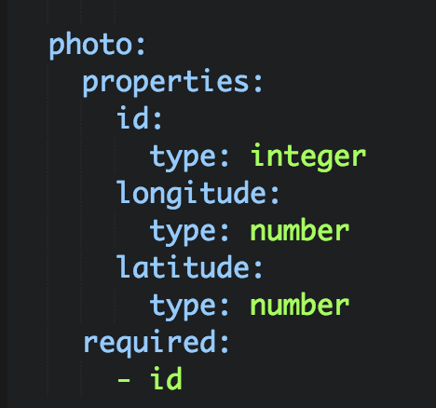
Required
In requests, you can specify that certain elements are required or optional
Use the required key for this
Contains a list of all properties that are required

Slide 15
Response Body
Under response:, under the response code
schema:
Add a level
Key of $ref
Value of the reference path, in quotes
If the response is an array instead of an object, then add:
type: array
Note: you can have different schemas for different response codes

Slide 16
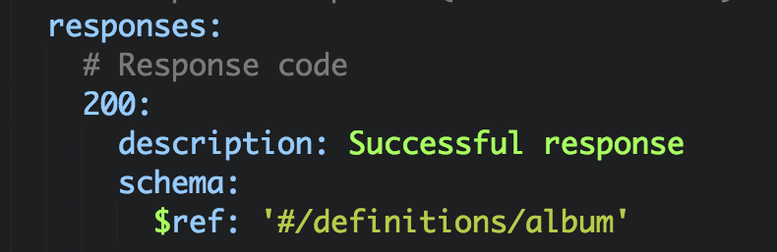
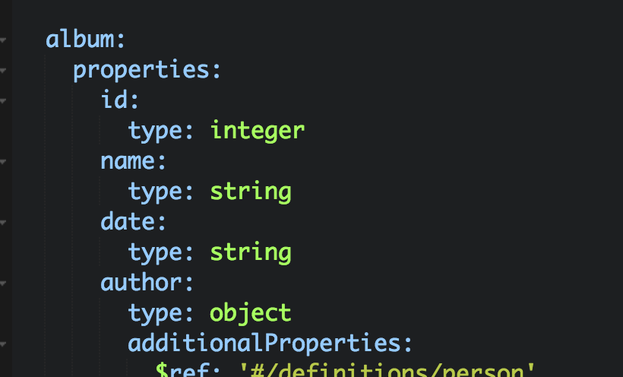
Example Response
Note: The album schema is identical to the newAlbum schema except it has an id

Slide 17
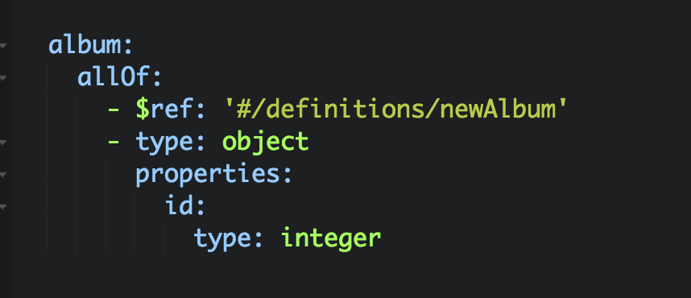
allOf
In the previous example, album and newAlbum had a lot of duplication
Can use the allOf key to combine several objects into one

Slide 18
Headers and Examples
Responses can also have custom headers
You can include example bodies in OAS files
Refer to the Open API Specification on how these work
(Just search on “Open API Specification”)

Slide 19
Form Data
It’s not common, but sometimes the request body uses form data instead of JSON
For form data, each parameter is a property
in key has value formData
parameters:
- name: firstFileName
in: formData
required: true
type: string

