Slide 1

Node - Express
por Adrian Naranjo y Sergio Redondo

Slide 2
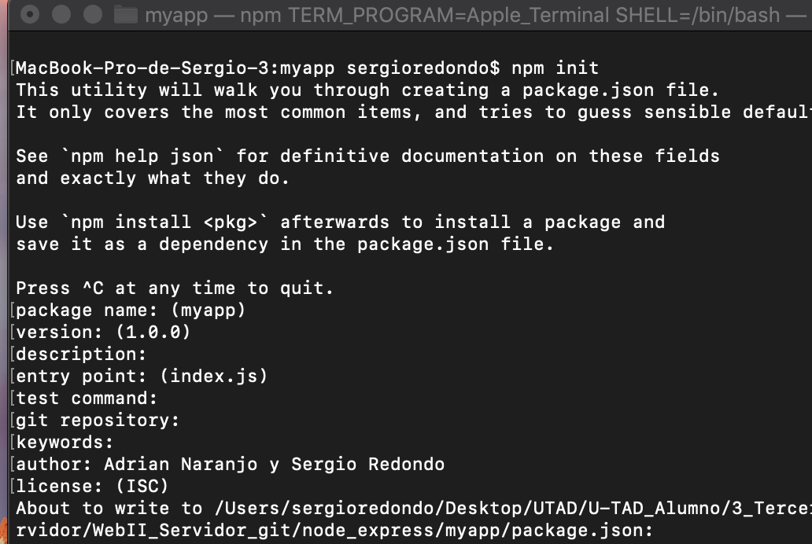
Instalación Node - Express

Slide 3
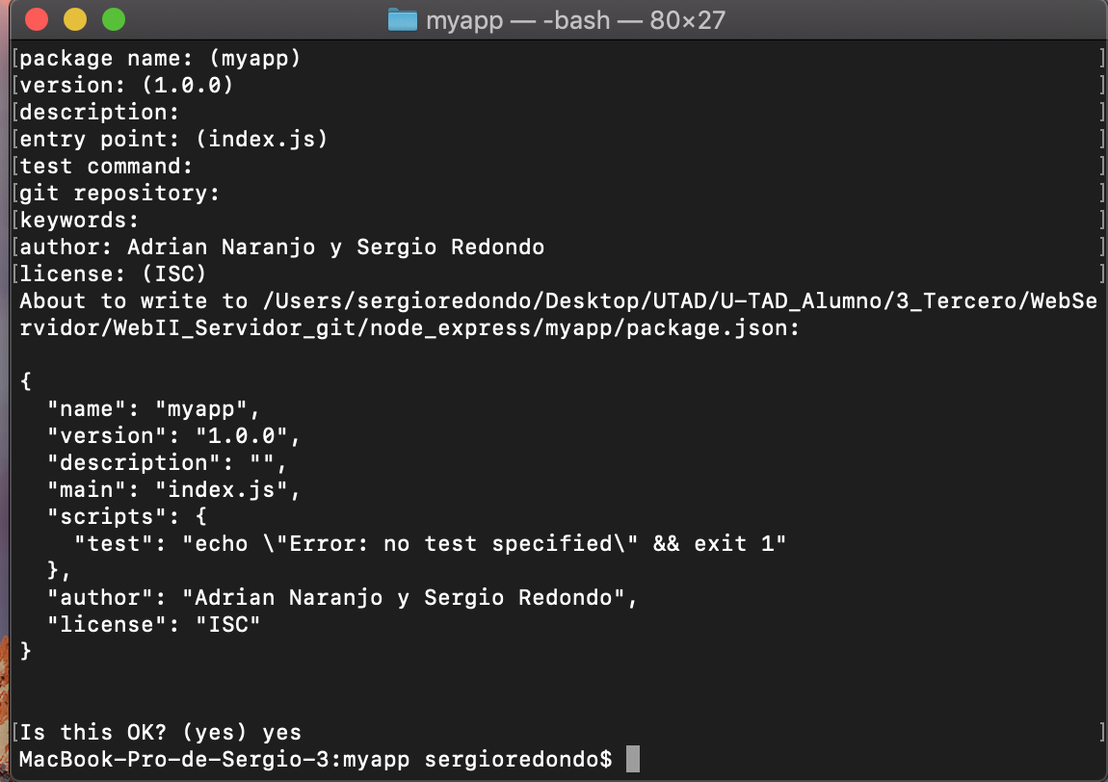
Instalación Node - Express

Slide 4
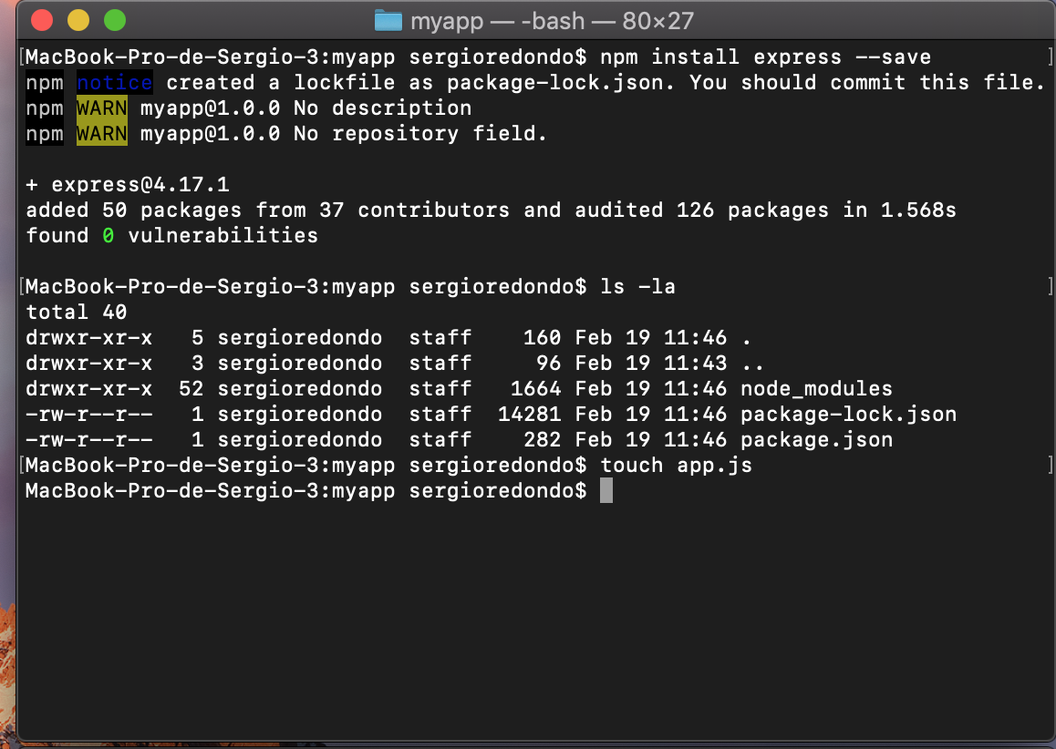
Instalación Node - Express

Slide 5
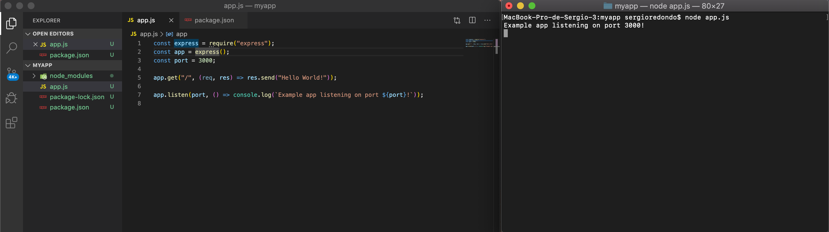
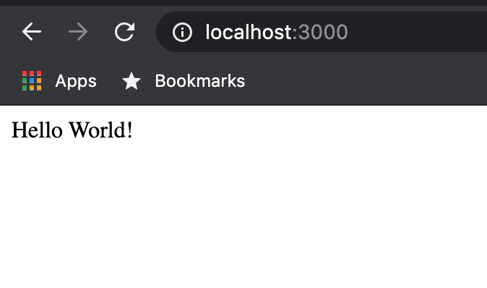
Instalación Node – Express

Slide 6
Diferencias
Virtual enviroment
Node – express
Python – flask
Puertos
Express por variable de entorno
Flask - run --port 7000 o por env
https://stackshare.io/stackups/expressjs-vs-flask-vs-php

Slide 7
https://expressjs.com/en/advanced/best-practice-performance.html
https://www.twilio.com/docs/usage/tutorials/how-to-set-up-your-node-js-and-express-development-environment#install-ngrok-for-local-development

