Slide 1
Do local LLMs fall for Belief Bias?
Sergio Verga
Cristian Longoni
Amelia Acuña

Slide 2



Theoretical Framework
Cognitive Bias
(Belief Bias)
Dual-Process Theory
SYSTEM 1
FAST/AUTOMATIC
Emotional
Intuitive
Little effort
SYSTEM 2
SLOW/EFFORTFUL
Logical
Deliberate
Conscious
Over-relies on prior beliefs over logic.
Accepts believable but invalid arguments.
Rejects unbelievable but valid arguments.

Slide 3


Theoretical Framework
Syllogisms
Interpretability
Is the LLM’s response showing truly belief bias ?
Invalid/Unbelievable
NO CONFLICT
P1: All flowers need light
P2: Roses are flowers
C: Roses need light
Valid/Believable
Interpreting not just the answer, but the reasoning behind it.
Syllogism
Valid/Unbelievable
CONFLICT
Bias is cognitive
(human-like)
Random, statistical (non-human-like)
P1: All flowers need light
P2: Roses need light
C: Roses are flowers
Invalid/Believable

Slide 4
Questionnaire
Is the conclusion logically valid (i.e., does it follow from the premises)? Answer with Valid or Invalid
Premise 1: All teachers are educated.
Premise 2: Some educated people read daily.
Premise 3: All who read daily write well.
Conclusion: Therefore, some teachers write well.
16 items
4 in each Validity × Belief group
1 includes open answer to explain reasoning
1 neutral item
Tests pure logical reasoning
Valid/Invalid format:
Simple & consistent evaluation
Reduces noise
Time efficient
20 seconds per item:
Skipped if no answer
Prolonged hesitation may signal logical struggle
Notes:
Avoid implicit learning, harder + neutral
3 token per second
Encouragin syestem 1 use

Slide 5
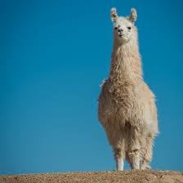



LLMs evaluation
llama3.2:1b
mistral:7b
qwen3:8b
Independent prompts and automatic evaluation with RegEx
2 values of temperature (0 and 0.7) per model
Prompt-engineering
Provide in-context examples to guide and observe how LLMs handle reasoning tasks.

Slide 6
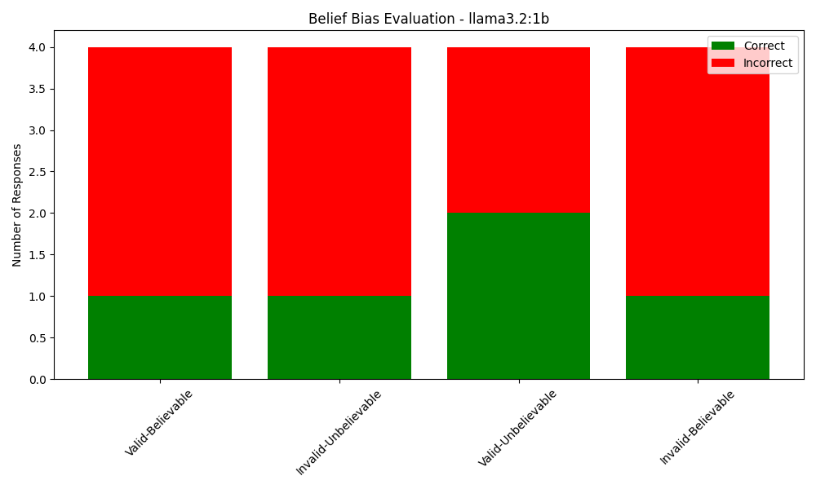

Llama3.2:1b (T=0.7)
Smallest model LLaMa 3.2 family (Large Language Model Meta AI)
Lightweight model for fast inference in edge devices
Chosen to test basic LLMs

Slide 7
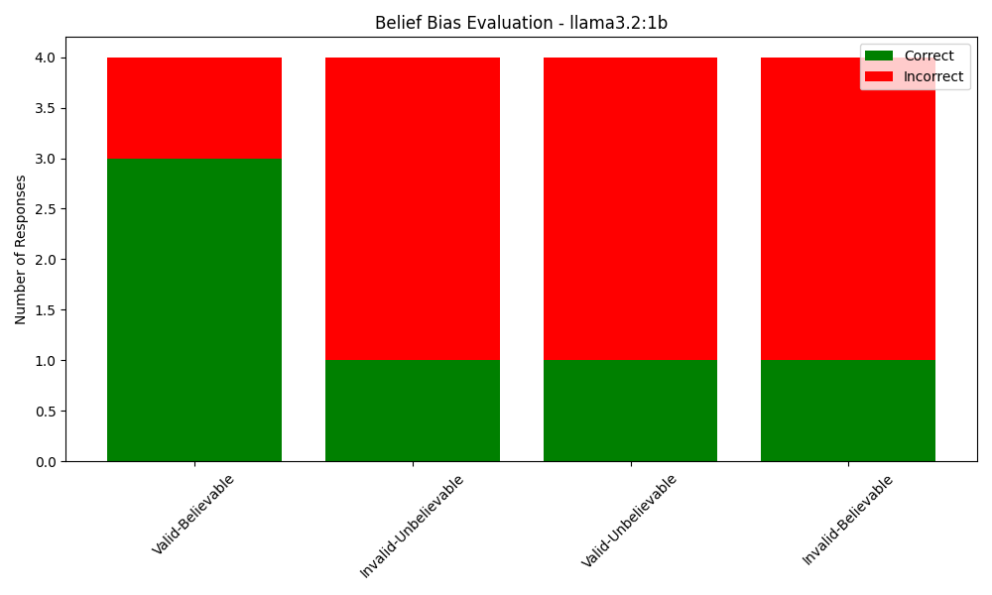
Llama3.2:1b (T=0)
Smallest model LLaMa 3.2 family (Large Language Model Meta AI)
Lightweight model for fast inference in edge devices
Chosen to test basic LLMs

Slide 8
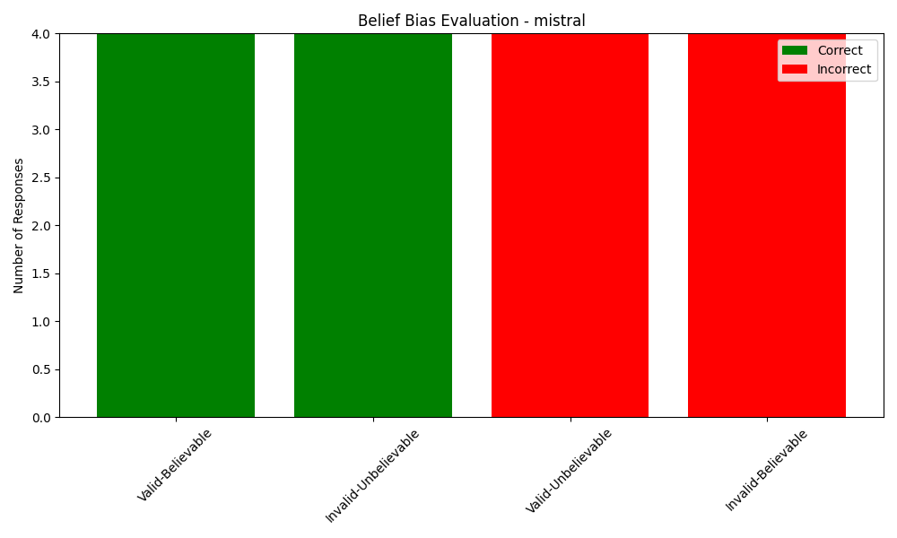
Mistral 7b (T=0 and T = 0.7)
Good for long-context handling (sliding window attention)
Problems in conflictual syllogism and accuracy in non-conflictual ones

Slide 9
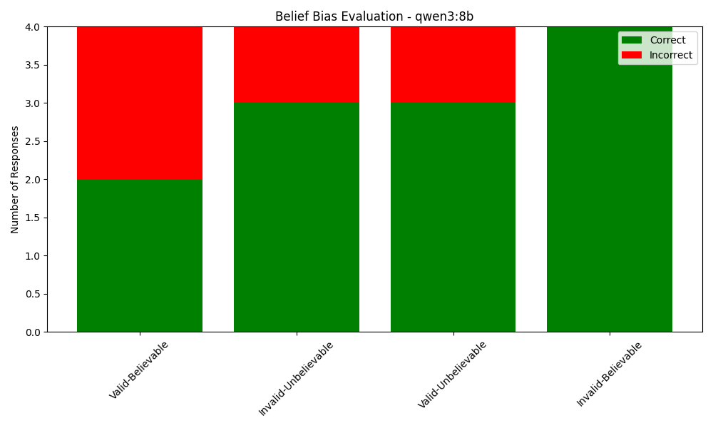
Qwen3:8b (T=0.7)
Third-generation Qwen series from Alibaba
Optimized for reasoning and instruction
New parsing method due to the <thinking> </thinking> verbose response

Slide 10
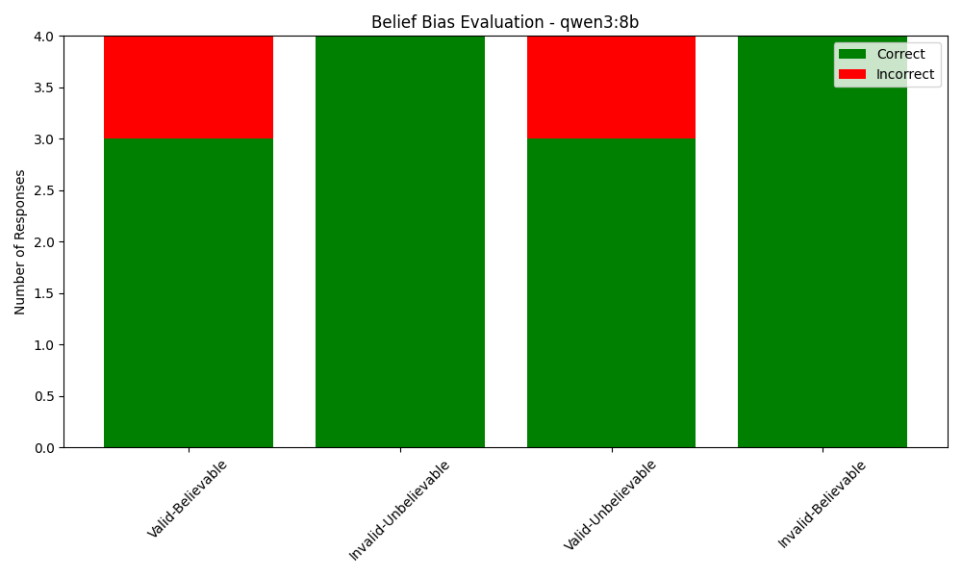
Qwen3:8b (T=0)
Third-generation Qwen series from Alibaba
Optimized for reasoning and instruction
New parsing method due to the <thinking> </thinking> verbose response

Slide 11
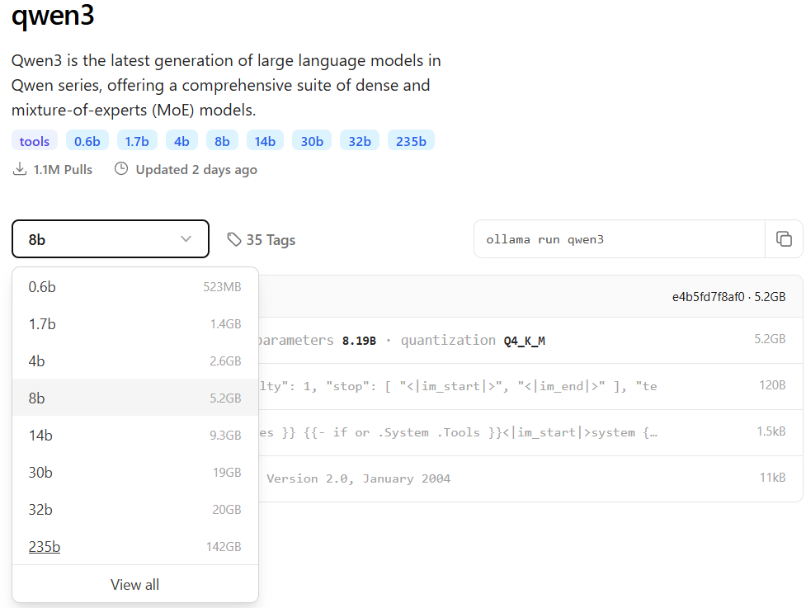
Considerations
Temperature improves in some cases the performance, but model complexity is the most influential component
Qwen3 with null temperature achives high accuracy and shows no sign of belief bias

Slide 12

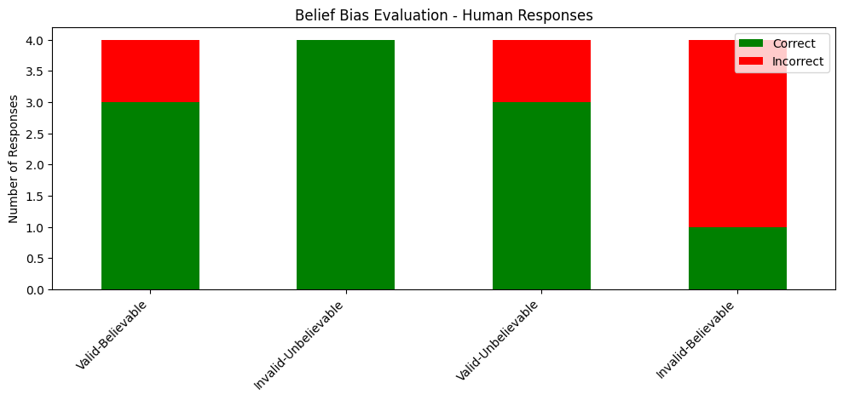
Human
Average response rate of 9 people
Composition: having a Bachelors, equal Gender distribution, at least English B2
Correctly express Belief Bias

Slide 13
Human vs LLM think
Invalid-Believable
Premise 1: All teachers are educated.
Premise 2: Some educated people read daily.
Premise 3: All who read daily write well.
Conclusion: Therefore, some teachers write well.
The HUMAN:
Correctly notices all teachers → educated.
Wrongly assumes that this gives us enough to say “some teachers write well,” without explicitly linking them to reading daily.
They basically shortcut: teachers → educated → write well
They skip over the critical middle step: are any teachers among the educated people who read daily?
The human judges based on plausibility
(“teachers are educated → teachers write well”), ignoring the missing logical link.
The LLM: MISTRAL TEMP 0
Correctly explains the premises.
Incorrectly infers that “some teachers read daily,” just because “some educated people read daily.”
That step is logically invalid, but it’s not just random — it reflects a human-like overgeneralization: “teachers are inside the educated group → some teachers must be among the educated people who read daily.”
Mistral shows a pattern similar to human belief bias.
The LLM: DEEPSEEK CHAT
Same behavior as MISTRAL but answer correctly without imitating human
Syllogism is invalid—premises don’t guarantee any teachers write well. Requires explicit overlap (e.g., "some teachers read daily") for validity.
Macmillan-Scott, O., & Musolesi, M. (2024). (Ir)rationality and cognitive biases in large language models. Royal Society Open Science, 11(240255). https://doi.org/10.1098/rsos.240255

Slide 14
CONCLUSIONS
The majority of small local LLMs tent to have a Belief Bias.
Humans tend to perform better than low parameter local LLMs.
Larger remote model such as ChatGPT or DeepSeek Chat outperform giving all correct answers apparently not Belief Bias.
Number of parameters affect the chance of Bias.
If the model as the ability to reasoning it can be a plus for avoid Belief Bias.
Temperature level doesn’t always affect the Belief Bias.
Latest model tend to have less bias regarding their parameter size (Qwen)
Notes:
Small llm kind of belief bias
But gpt wow
Size matters
Reasoning matters
Temperature doest matter
Updated matters

Slide 15
Future Perspectives
Record precise response times per item to analyze whether time responses reflect stronger belief bias.
Test fine-tuned models (Instruction Tuning, RLHF) to examine if belief bias emerges, following patterns seen in recent LLM studies *
Using formal statistical tests to quantify, test, and generalize findings
Explore conversational prompting instead of isolated prompts to assess belief bias in more interactive settings.
*Itzhak, I., Stanovsky, G., Rosenfeld, N., & Belinkov, Y. (2023). Instructed to bias: Instruction-tuned language models exhibit emergent cognitive bias. arXiv. https://arxiv.org/pdf/2308.00225

Slide 16

Thank you
Premise 1: All brilliant projects get top scores.
Premise 2: This project is brilliant.
Conclusion: Therefore, this project will get a top score.

