Slide 1




TESSERACT ‘26
Problem Statement Title – AI-powered ADAPTIVE STEM learning digital platform
Track - Ed-tech & AI
Problem Statement ID- SDG 4, 9, 10
Team Name- Nexis
Team Members- Sanskruti Bhambhure , Prashant Gharge , Archit Jedge , Mansi Jangale , Arya Badadale , Atharva Warkad
VIDEO DEMO:
https://drive.google.com/drive/folders/1dWzc4CYbvKGo6_7VdiOQMD6rClIQOPFK?usp=sharing
@sig_realityspectra
1

Slide 2

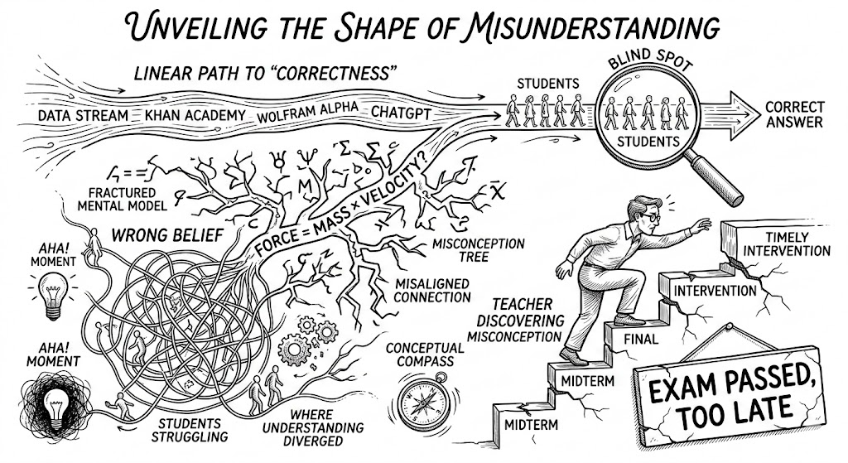
Nexis
CHAPTER-I: The Origin
Students across every level of STEM education fail not because they lack access to information, but because their mental model of how concepts connect is fundamentally wrong.
No existing platform — not ChatGPT, not Khan Academy, not Wolfram Alpha — shows a student where their understanding diverged from the truth
They all give the correct answer. None of them show the shape of the wrong belief.
Teachers face the same blindspot from the other side. By the time a teacher discovers which misconception broke an entire class, the exam has already happened. Intervention arrives too late.
@sig_realityspectra
2

Slide 3
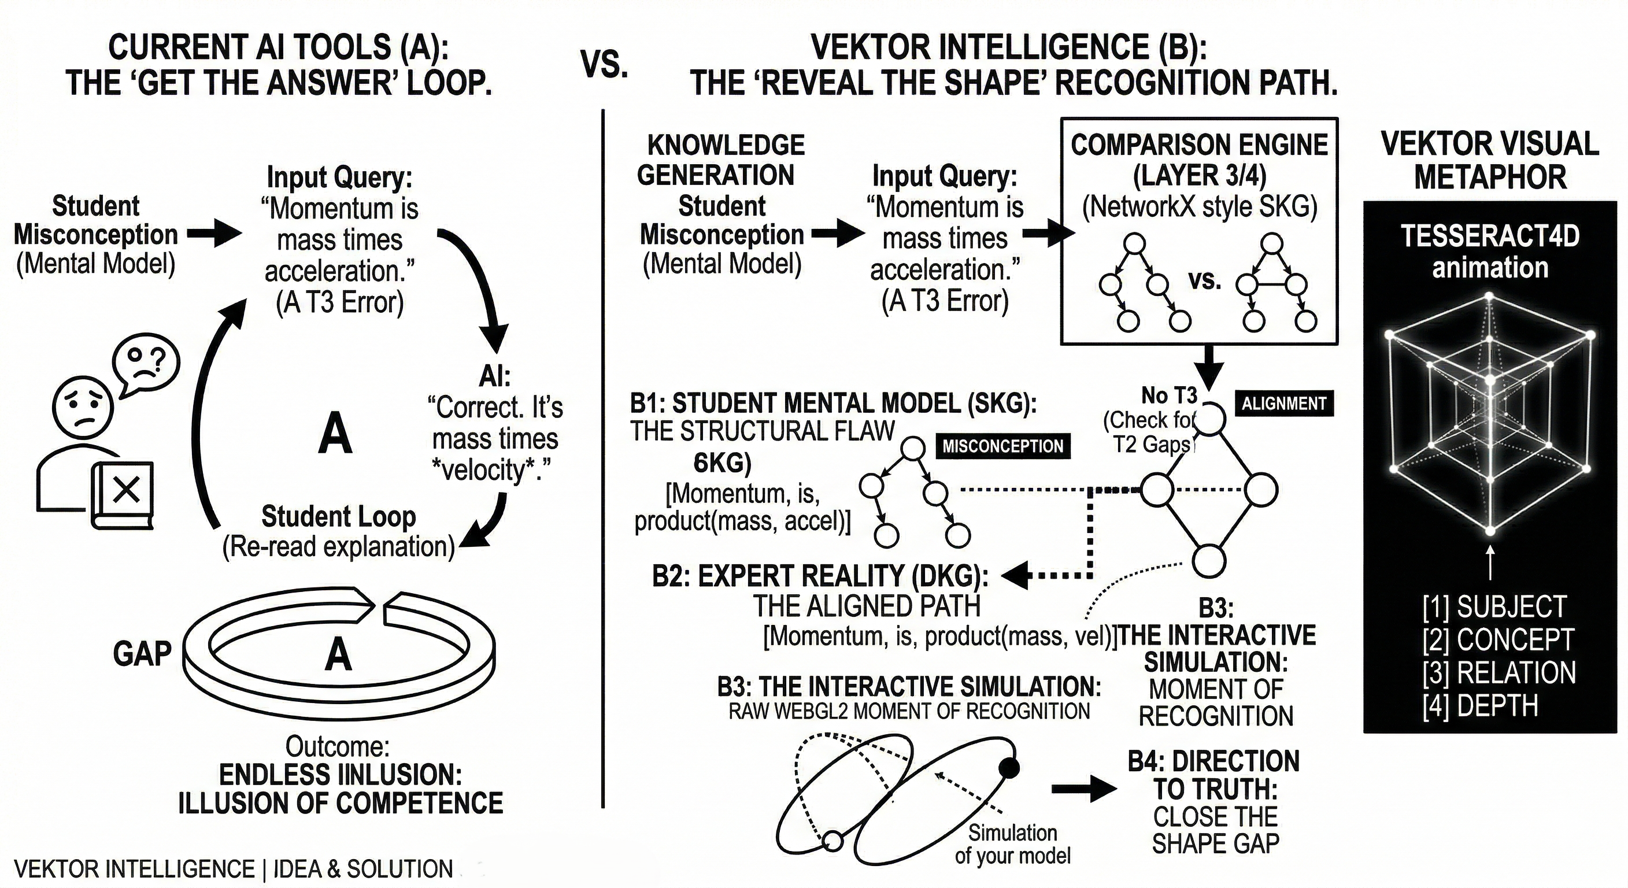
Nexis
CHAPTER-II: The Solution
VEKTOR Intelligence is a STEM intelligence platform that maps what a student currently believes as a Student Knowledge Graph (SKG)
Compares it against the expert-validated Domain Knowledge Graph (DKG), and renders both side-by-side in real-time WebGL
The gap between the two graphs is the lesson. The direction from one to the other is the teaching.
@sig_realityspectra
3

Slide 4
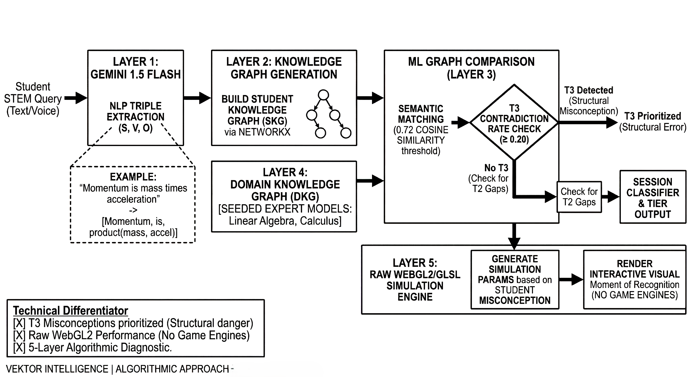
CHAPTER-III:
TECHNICAL APPROACH
Nexis
@sig_realityspectra
4

Slide 5
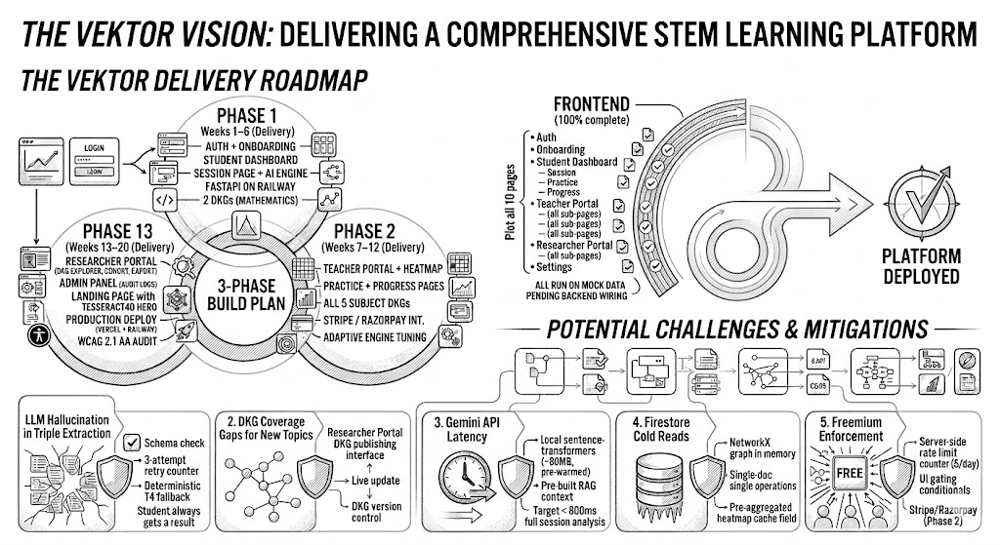
CHAPTER-IV: FEASIBILITY AND VIABILITY
Nexis
Phase | Deliverables
Phase 1 | Auth + Onboarding · Student Dashboard (Session, Practice, Progress) · Session Page + AI Engine · FastAPI on Railway · 2 DKGs (Mathematics — Linear Algebra + Calculus)
Phase 2 | Teacher Portal + real-time heatmap · Practice + Progress pages · All 5 subject DKGs · Stripe / Razorpay Pro plan integration · Adaptive learning engine tuning
Phase 3 | Researcher Portal (DKG explorer, cohort comparison, export) · Admin Panel (feature flags, audit logs) · Landing page with Tesseract4D WebGL hero · Production deploy to Vercel + Railway · WCAG 2.1 AA accessibility audit
Frontend : Total 10 pages built — Auth, Onboarding, Student Dashboard (Session/Practice/Progress), Teacher Portal (all sub-pages), Researcher Portal (all sub-pages), Settings. All run on mock data pending backend wiring.
Next step: Deploy FastAPI to Railway, wire session page to real /api/session/analyze, replace mock data with live Firestore queries.
Backend : Full FastAPI application with 5-layer pipeline, 4 endpoints, 2 DKGs seeded, 62 passing tests across extractor / comparator / classifier / RAG context builder.
@sig_realityspectra
5

Slide 6
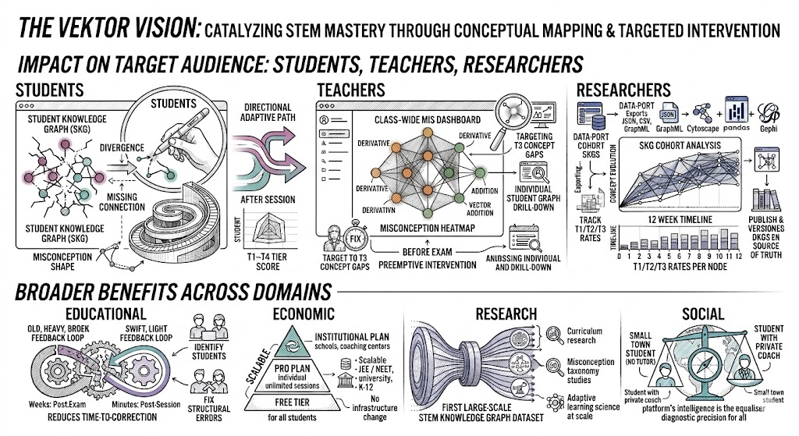
CHAPTER-V: IMPACTS & BENEFITS
Nexis
VEKTOR directly targets SDG 4.4 by reducing the 'Time-to-Correction' for STEM misconceptions from weeks to minutes
@sig_realityspectra
6

Slide 7
CHAPTER-VI: RESEARCH AND REFERENCES
Nexis
Frontiers in Computer Science (2026): Research on an intelligent tutoring system based on automatic construction of multimodal knowledge graphs and retrieval-augmented generation. PeerJ Computer Science (2025): LPITutor: an LLM based personalized intelligent tutoring system using RAG and prompt engineering.
MDPI Electronics (2025): KG-PLPPM: A Knowledge Graph-Based Personal Learning Path Planning Method.
IEEE Xplore (2025): Personalized Learning Path Recommendation Driven by Multi-Modal Knowledge Graphs and Large Models Collaboration.
National Academies Press: Using Insights About Learning to Inform Teaching.
ResearchGate: Usage of Graph Patterns for Knowledge Assessment Based on Concept Maps.
Taylor & Francis: Graph-theoretic approaches and tools for quantitatively assessing curricula coherence
For more details refer the URL:
https://drive.google.com/drive/folders/1dWzc4CYbvKGo6_7VdiOQMD6rClIQOPFK?usp=sharing
@sig_realityspectra
6

