Slide 1

Systematic Review on
IoT Systems Testing
Goian Sergiu

Slide 2
Why this topic?
-rapid growth in mainstream industries (such as healthcare, manufacturing, transportation)
-resource constraints (limited CPU / RAM / Storage / bandwidth) decrease reliability
-devices heterogeneity => insufficiency of traditional testing
-research gaps: while numerous studies exist, there is a lack of consolidated insights on which testing methodologies are most efficient and where automation falls short

Slide 3
Why Systematic Literature Review?
-well defined guidelines
-rigurous / efficient approach
-every decision is documented
-protocol driven (starting from a predefined plan (the protocol), which prevents picking only papers that support a single / personal opinion

Slide 4
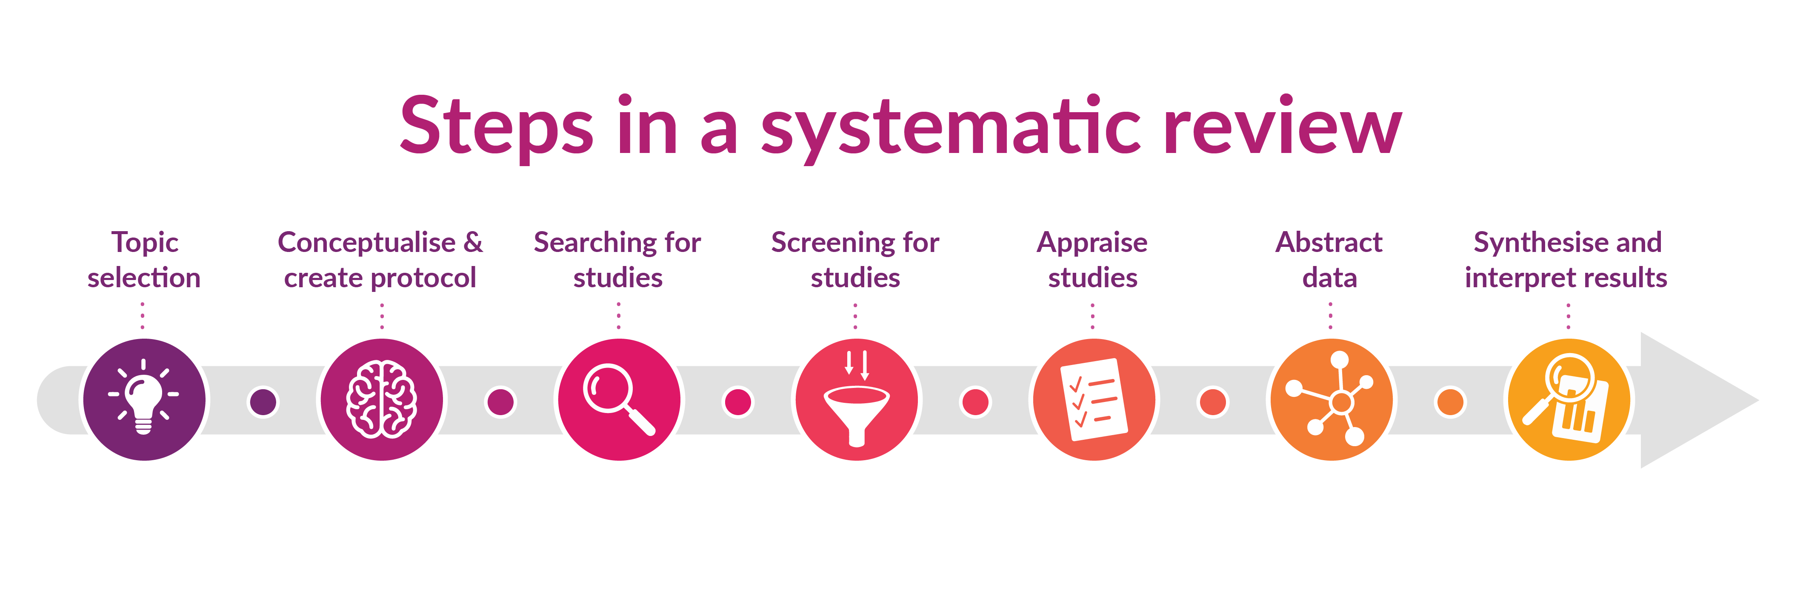
What is SLR?
-a series of guidelines, defined by Kitchenham (the „mother” of SLRs)
-helps us identify current trends, gaps, best practices (in our case, IoT testing)

Slide 5
Research Questions
1: Most prevalent testing methodologies for security, reliability and performance?
2: Main challenges preventing full test automation in integrated environments?

Slide 6
Methodology
-SLR
-Define keywords: IoT Testing, Quality
-Search: IEE, MDPI, ResearchGate, ArXiv
-Selection: initally 30 papers
-Filter: keep only the most relevant for our study => 10 primary studies

Slide 7
Data Extraction
-testing methodology
-quality focus (security, performance, reliability, etc.)
-tools / datasets
-results (trade-offs)

Slide 8
Tabulation (Papers Overview)
-table of the 10 selected papers and relevant extracted features / data
-keep only the most relevant information (to be used later for charts for a more visual experience)

Slide 9
Prevalent Methods
The focus was on Network / Edge layers
Security Methods:
-Fuzzing, Penetration Testing, ML-based using LSTM / RNN
Reliability Methods:
-Model-Based Testing (MBT), quality profiles for heterogenous IoT nodes following ISO/IEC 25010, protocol benchmarking (MQTT vs CoAP vs AMQP)

Slide 10
Quality Measurement Techniques
-metrics: latency implied, packet loss, fault tolerance
-energy efficiency and interoperability are prioritized
-recoverability and fault tolerance underdeveloped

Slide 11
Tools
-PatrIoT for automated integration and interoperability
-Fuzzing for vulnerability detection
-penetration testing + ML / blockchain frameworks

Slide 12
Trade-offs
-Blockchain: induces a significant latency of up to 20%
-ML: demands high computational cost
-Emulators: fail to fully replicate real world problems

Slide 13
Results
-Specialized IoT audits => +40% more vulnerabilities detected
-LSTM / RNN => 98% detection accuracy of network attacks
-MBT => reduced manual effort in CI pipelines

Slide 14
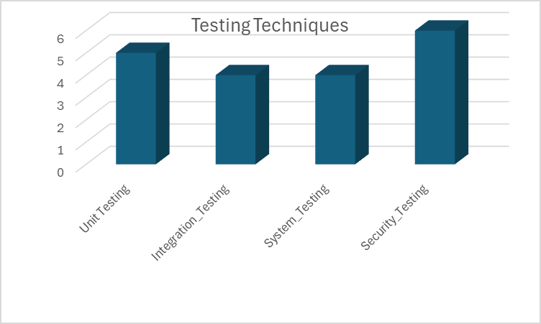
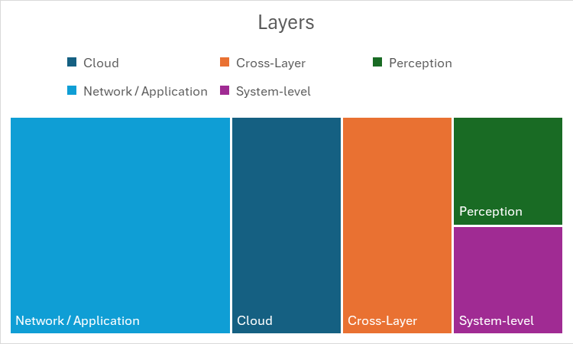
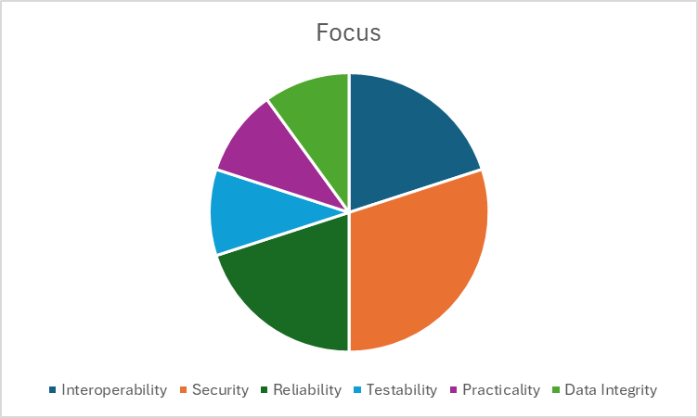
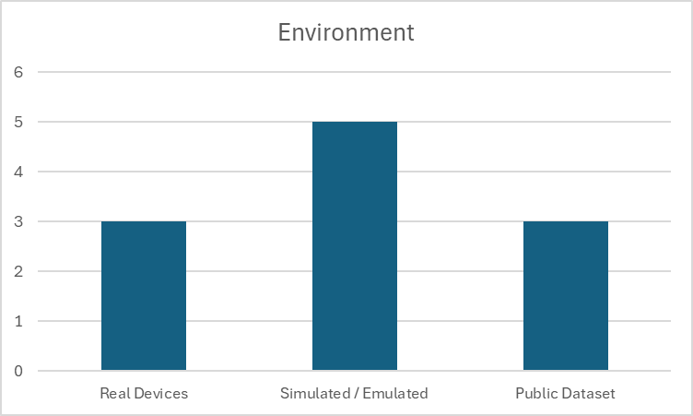
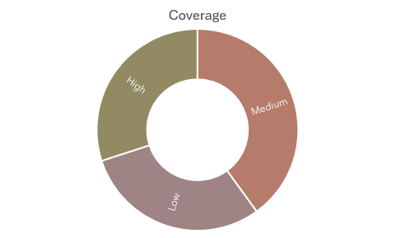
Visual Insights

Slide 15
Future Work and Discussion
-surveys => applied frameworks
-industry gap remains
-hybrid approaches like ML / Blockchain are promising but costly
-state-aware fuzzers needed, together with lightweight ML for perception layer testing
-well defined metrics for fault tolerance and recoverability

Slide 16
Conclusion
-IoT testing is evloving toward automated specialized frameworks
-MBT + ML + pentesting = most effective combination today
-industry adoption requires balancing latency, cost, accuracy

