Slide 1
Advantages of message-oriented middleware in enterprise systems
Goian sergiu

Slide 2
Enterprise systems
Systems designed to allow an organisation to manage its data and business processes;
Enterprise Resource Planning, Enterprise Content Management, Customer Relationship Management, BI & Analytics, etc;

Slide 3
middleware
Component that binds together multiple components of a system;
Data exchange, interoperability across heterogeneous systems, authentication / authorization, logging, error handling;
Core types:
Message Oriented;
Database Middleware: joins apps to the data persistence layer;
Web: sorts web traffic, requests across different components;
Transaction: manages distirbuted transaction across multiple systems;

Slide 4
Message-oriented middleware
Allows components of a distirbuted systems exchange data async by passing messages;
Publish-subscribe pattern: messages are sent to a topic and distirbuted to all interested subscribers;

Slide 5
components
Queue: used to temporarily store data if receiving system is slow / busy / down;
Broker: intermediary component / tool that manages routing of produced messages;
Producer: pushes messages to queue;
Consumer: pops messages from the queue;

Slide 6
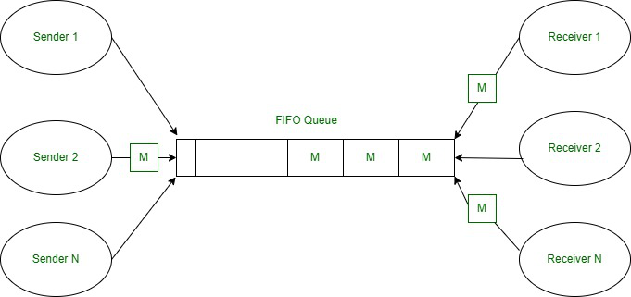

Slide 7
Tools
Implement the framework, easy to be integrated;
Most commonly used:
RabbitMQ: widely use dopen-source message broker;
Apache Kafka: high-throughput distirbuted streaming platform;
Amazon SQS / Azure Service Bus: cloud-based queueing services;

Slide 8
Rabbitmq - Main Components
Exchanges: handles message routing, receives messages from producers and decides to which queue to push them using routing keys;
Channels:
virtual lightweight connections unde one main TCP connection;
efficient: not needed to create multiple TCP connections;

Slide 9
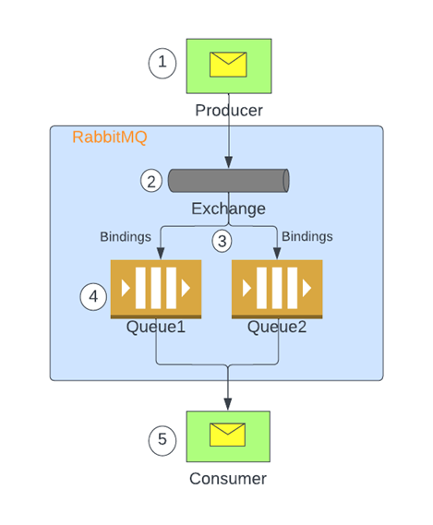

Slide 10
Rabbitmq - Routing
Fanout: broadcasts all messages to every bound queue (pub/sub);
Topic: routes messages using wildcard pattern matching on the routing key (for complex routing);
Direct: routes messages based on an exact routing key match;

Slide 11
advantages
Loose coupling: components operate independently;
Asynchronous: producers and consumers don’t need to be available simultaneously;
Reliability and fault tolerance: guaranteed message delivery, prevents data loss even if apps are down temporarily;

Slide 12
Usage scenario
Banking Enterprise System, customer / producer purchase triggers series of internal systems to process data async, trnasaction message generated and sent to RabbitMQ exchange;
Exchange dupplicates it to multiple queues:
Fraud detection queue: consumer that checks message integrity;
Accounting queue: consumer that checks customer’s balance and updates it;
Notification queue: notification broadcasted to all customer’s subscribed device;s

