Slide 1
8. Databases and JDBC
1. Introduction to Databases

Slide 2
Relational DBMS
A DBMS in which data is stored in tables and the relationships among the data are also stored in tables
The data can be accessed or reassembled in many different ways without having to change the table forms.
Infopulse Training Center

Slide 3
Relational DBMS
Commercial
  Oracle
  MS SQL Server
  DB2
Free
  Derby (Java DB)
  MySQL
Infopulse Training Center

Slide 4
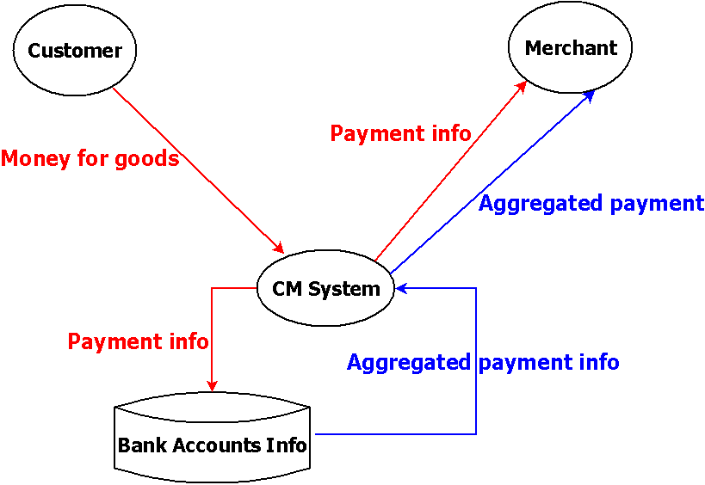
Cash Management System
Infopulse Training Center

Slide 5
Merchant Info
Name
Bank
Bank account
Charge percent
Aggregation period
Minimal sum
Infopulse Training Center

Slide 6
Customer Info
Name
Address
Email
Credit card No
Credit card type
Credit card maturity date
Infopulse Training Center

Slide 7
Payment info
Date
Customer
Merchant
Goods description
Sum
Infopulse Training Center

Slide 8
Java DB
Java DB is Oracle's supported distribution of the Apache Derby open source database
It supports standard ANSI/ISO SQL through the JDBC and Java EE APIs
Java DB is included in the JDK
http://www.oracle.com/technetwork/java/javadb/overview/index.html
Infopulse Training Center

Slide 9
Eclipse & Java DB
Creating a Driver Definition for Apache Derby
Creating an Apache Derby Connection Profile
Connecting to Apache Derby
Creating and Executing a SQL Query
Infopulse Training Center

Slide 10
Driver Definition (1 of 2)
Start Eclipse
Menu Window -> Preferences
Expand Data Management -> Connectivity -> Driver Definitions
Click Add button
Select “Derby Embedded JDBC Driver” in Name/Type tab
Infopulse Training Center

Slide 11
Driver Definition (2 of 2)
Select derby.jar in Jar list tab and click Edit button
Select full path to derby.jar (usually C:\Program Files\Java\jdk1.7.0_40\db\lib)
Click Open button
Click Ok button
Infopulse Training Center

Slide 12
Eclipse & Java DB
Creating a Driver Definition for Apache Derby
Creating an Apache Derby Connection Profile
Connecting to Apache Derby
Creating and Executing a SQL Query
Infopulse Training Center

Slide 13
Connection Profile
Switch to the Database Development perspective
In Data Source Explorer, right-click Database Connections and select New
Select Derby, change Name of profile (optionally) and click Next
Select Database location and click Finish
Infopulse Training Center

Slide 14
Eclipse & Java DB
Creating a Driver Definition for Apache Derby
Creating an Apache Derby Connection Profile
Connecting to Apache Derby
Creating and Executing a SQL Query
Infopulse Training Center

Slide 15
Connecting to the Database
In the Database Development perspective, expand Database Connections in the Data Source Explorer
Right-click the connection profile that you created and select Connect
Infopulse Training Center

Slide 16
Eclipse & Java DB
Creating a Driver Definition for Apache Derby
Creating an Apache Derby Connection Profile
Connecting to Apache Derby
Creating and Executing a SQL Query
Infopulse Training Center

Slide 17
SQL Query
In the Database Development perspective, expand Database Connections in the Data Source Explorer
Right-click the connection profile that you created and select “Open SQL Scrapbook”
Select database
Create SQL query in the editor field
Right-click in the editor and select Execute All.
Infopulse Training Center

Slide 18
Merchant Info
Name
Bank
Bank account
Charge percent
Aggregation period
Minimal sum
Infopulse Training Center

Slide 19
Create Merchant Table
CREATE TABLE merchant
(
id INT NOT NULL GENERATED ALWAYS AS IDENTITY,
name VARCHAR(60) NOT NULL,
bankName VARCHAR (100) NOT NULL,
swift VARCHAR (40) NOT NULL,
account VARCHAR (20) NOT NULL,
charge DECIMAL(5,2) NOT NULL,
period SMALLINT NOT NULL,
minSum DECIMAL (19,2) NOT NULL,
total DECIMAL(19,2),
PRIMARY KEY (id)
);
Infopulse Training Center

Slide 20
Fill Merchant Table
INSERT INTO merchant
(name, charge, period, minSum,
bankName, swift, account)
VALUES('Jim Smith Ltd.', 5.1, 1, 100.0,
'Chase Manhatten', 'AA245BXW',
'247991002');
Infopulse Training Center

Slide 21
Display Merchant Data
select * from merchant;
ID | NAME | CHARGE | PERIOD | MINSUM | BANKNAME | SWIFT | ACCOUNT | TOTAL
1 | Jim Smith Ltd. | 5.10 | 1 | 100.00 | Chase Manhatten | AA245BXW | 247991002 | NULL
2 | Domby and sun Co. | 2.80 | 2 | 20.00 | Paribas | XTW2NNM | 1188532009 | NULL
3 | Victoria Shop | 3.40 | 3 | 500.00 | Swedbank | SWEE34YY | 557880234 | NULL
4 | Software & Digital goods | 4.90 | 1 | 160.00 | Credi Leone | FRTOPM | 367920489 | NULL
Infopulse Training Center

Slide 22
Create Customer Table
Customer Info
  Name
  Address
  Email
  Credit card No
  Credit card type
  Credit card maturity date
Infopulse Training Center

Slide 23
Create Customer Table
CREATE TABLE customer
(
id INT NOT NULL GENERATED ALWAYS AS IDENTITY,
name VARCHAR(60) NOT NULL,
address VARCHAR(300) NOT NULL,
email VARCHAR(90) NOT NULL,
ccNo VARCHAR(20) NOT NULL,
ccType VARCHAR(60) NOT NULL,
maturity DATE,
PRIMARY KEY (id)
);
Infopulse Training Center

Slide 24
Fill Customer Table
INSERT INTO customer
(name, address, email, ccNo, ccType, maturity)
values('Dan Nelis',
'Vosselaar st. 19, Trnaut, Belgium', 'Dan@adw.com',
'11345694671214',
'MasterCard',
'2014-07-31');
Infopulse Training Center

Slide 25
Display Customer Data
select * from customer
ID | NAME | ADDRESS | EMAIL | CCNO | CCTYPE | MATURITY
1 | Dan Nelis | Vosselaar st. 19, Trnaut, Belgium | Dan@adw.com | 11345694671214 | MasterCard | 2014-07-31
2 | Mark Wolf | Olaf st. 11, Stockholm, Sweden | mwolf@yahoo.com | 44402356988712 | Visa | 2012-09-30
3 | Stein Brown | Oxford st. 223, Stockholm, Sweden | steinB@yahoo.com | 41233576012434 | Visa | 2015-11-30
Infopulse Training Center

Slide 26
Create Payment Table
Payment info
  Date
  Customer
  Merchant
  Goods description
  Sum
Infopulse Training Center

Slide 27
Create Payment Table
CREATE TABLE payment
(
id INT NOT NULL GENERATED ALWAYS AS IDENTITY,
dt TIMESTAMP NOT NULL,
merchantId INT CONSTRAINT mer_fk references merchant,
customerId INT CONSTRAINT cust_fk references customer,
goods VARCHAR(500),
total DECIMAL(15,2),
charge DECIMAL(15,2),
PRIMARY KEY (id)
);
Infopulse Training Center

Slide 28
Fill Payment Table
insert into payment
(dt, merchantId, customerId, goods, total)
values('2012-07-12 10:00:14', 3, 1,
'CD Europe Maps', 12.08);
Infopulse Training Center

Slide 29
Display Payment Data
Select * from payment
ID | DT | MERCHANTID | CUSTOMERID | GOODS | TOTAL
1 | 2012-07-12 10:00:14.0 | 3 | 1 | CD Europe Maps | 12.08
2 | 2012-06-22 18:21:10.0 | 4 | 3 | NOD32 Antivirus | 33.80
3 | 2012-07-02 00:00:17.0 | 1 | 1 | Railway return ticket Brussel-Paris | 255.58
4 | 2012-07-06 11:22:40.0 | 1 | 2 | Railway ticket Stockholm - Oslo | 1325.00
5 | 2012-07-10 11:10:45.0 | 3 | 2 | CD African music | 7.65
6 | 2012-06-30 12:00:00.0 | 2 | 1 | Acer computer | 654.00
7 | 2012-07-02 22:28:50.0 | 4 | 2 | NOD32 Antivirus | 33.80
8 | 2012-07-09 02:12:53.0 | 4 | 3 | MS Office | 400.23
9 | 2012-07-15 22:28:50.0 | 2 | 2 | Dell computer | 768.00
Infopulse Training Center

Slide 30
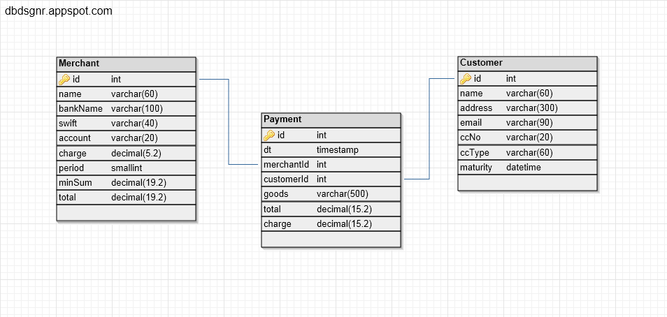
CM Database Schema
Infopulse Training Center

Slide 31
Select Statement
Don’t use * in select!
Infopulse Training Center

Slide 32
Select Statement
SELECT dt, merchantId, customerId, goods, total FROM payment WHERE merchantId = 3;
Infopulse Training Center

Slide 33
Select Statement
SELECT dt, merchantId, customerId, goods, total FROM payment WHERE merchantId = 3;
DT | MERCHANTID | CUSTOMERID | GOODS | TOTAL
2012-07-12 10:00:14.0 | 3 | 1 | CD Europe Maps | 12.08
2012-07-10 11:10:45.0 | 3 | 2 | CD African music | 7.65
Infopulse Training Center

Slide 34
Select Statement
SELECT dt, merchantId, customerId, goods, total FROM payment ORDER BY merchantId;
Infopulse Training Center

Slide 35
Select Statement
SELECT dt, merchantId, customerId, goods, total FROM payment ORDER BY merchantId;
DT | MERCHANTID | CUSTOMERID | GOODS | TOTAL
2012-07-06 11:22:40.0 | 1 | 2 | Railway ticket Stockholm - Oslo | 1325.00
2012-07-02 00:00:17.0 | 1 | 1 | Railway return ticket Brussels-Paris | 255.58
2012-07-15 22:28:50.0 | 2 | 2 | Dell computer | 768.00
2012-06-30 12:00:00.0 | 2 | 1 | Acer computer | 654.00
2012-07-10 11:10:45.0 | 3 | 2 | CD African music | 7.65
2012-07-12 10:00:14.0 | 3 | 1 | CD Europe Maps | 12.08
2012-07-09 02:12:53.0 | 4 | 3 | MS Office | 400.23
2012-07-02 22:28:50.0 | 4 | 2 | NOD32 Antivirus | 33.80
2012-06-22 18:21:10.0 | 4 | 3 | NOD32 Antivirus | 33.80
Infopulse Training Center

Slide 36
Select Statement
SELECT sum(total) FROM payment WHERE customerId = 2;
Infopulse Training Center

Slide 37
Select Statement
SELECT sum(total) FROM payment WHERE customerId = 2;
Output is 2134.45
Infopulse Training Center

Slide 38
Select Statement
SELECT merchantId, count(*) as n, sum(total) as total FROM payment GROUP BY merchantId;
Infopulse Training Center

Slide 39
Select Statement
SELECT merchantId, count(*) as n, sum(total) as total FROM payment GROUP BY merchantId;
MERCHANTID | N | TOTAL
1 | 2 | 1580.58
2 | 2 | 1422.00
3 | 2 | 19.73
4 | 3 | 467.83
Infopulse Training Center

Slide 40
Select Statement
SELECT customerId, sum(total) FROM payment GROUP BY customerId HAVING count(*)>2;
Infopulse Training Center

Slide 41
Select Statement
SELECT customerId, sum(total) FROM payment GROUP BY customerId HAVING count(*)>2;
CUSTOMERID | 2
1 | 921.66
2 | 2134.45
Infopulse Training Center

Slide 42
Join Operations
SELECT p.dt, m.name as merchant, c.name as customer,
p.goods, p.total
FROM payment p
LEFT OUTER JOIN merchant m on m.id = p.merchantId
LEFT OUTER JOIN customer c on c.id = p.customerId;
SELECT p.dt, m.name as merchant, c.name as customer, p.goods, p.total
FROM payment p, merchant m, customer c
WHERE m.id = p.merchantId and c.id = p.customerId;
Infopulse Training Center

Slide 43
Join Operations
DT | MERCHANT | CUSTOMER | GOODS | TOTAL
2012-07-12 | Victoria Shop | Dan Nelis | CD Europe Maps | 12.08
2012-06-22 | Software & Digital goods | Stein Brown | NOD32 Antivirus | 33.80
2012-07-02 | Jim Smith Ltd. | Dan Nelis | Railway return ticket Brussel-Paris | 255.58
2012-07-06 | Jim Smith Ltd. | Mark Wolf | Railway ticket Stockholm - Oslo | 1325.00
2012-07-10 | Victoria Shop | Mark Wolf | CD African music | 7.65
. . . . . | . . . . . . | . . . . . | . . . . . . . | . . . .
2012-07-15 | Domby and sun Co. | Mark Wolf | Dell computer | 768.00
Infopulse Training Center

Slide 44
Update Payments
DATE | MER_ID | GOODS | TOTAL | CHARGE
2012-07-12 | 3 | CD Europe Maps | 12.08 | NULL
2012-06-22 | 4 | NOD32 Antivirus | 33.80 | NULL
2012-07-02 | 1 | Railway return ticket Brussel-Paris | 255.58 | NULL
2012-07-06 | 1 | Railway ticket Stockholm - Oslo | 1325.00 | NULL
2012-07-10 | 3 | CD African music | 7.65 | NULL
2012-06-30 | 2 | Acer computer | 654.00 | NULL
2012-07-02 | 4 | NOD32 Antivirus | 33.80 | NULL
2012-07-09 | 4 | MS Office | 400.23 | NULL
2012-07-15 | 2 | Dell computer | 768.00 | NULL
Infopulse Training Center

Slide 45
Update Statement
UPDATE payment SET charge = total * 0.034 WHERE id = 1;
Infopulse Training Center

Slide 46
Update Statement
UPDATE payment SET charge = total * 0.034 WHERE id = 1;
DATE | MER_ID | GOODS | TOTAL | CHARGE
2012-07-12 | 3 | CD Europe Maps | 12.08 | 0.41
2012-06-22 | 4 | NOD32 Antivirus | 33.80 | NULL
2012-07-02 | 1 | Railway return ticket Brussel-Paris | 255.58 | NULL
2012-07-06 | 1 | Railway ticket Stockholm - Oslo | 1325.00 | NULL
2012-07-10 | 3 | CD African music | 7.65 | NULL
2012-06-30 | 2 | Acer computer | 654.00 | NULL
2012-07-02 | 4 | NOD32 Antivirus | 33.80 | NULL
2012-07-09 | 4 | MS Office | 400.23 | NULL
2012-07-15 | 2 | Dell computer | 768.00 | NULL
Infopulse Training Center

Slide 47
Update Statement
UPDATE payment
SET charge = (SELECT p.total * m.charge / 100.0
FROM payment p, merchant m
WHERE m.id = p.merchantId and p.id = 2)
WHERE id = 2;
Infopulse Training Center

Slide 48
Update Statement
DATE | MER_ID | GOODS | TOTAL | CHARGE
2012-07-12 | 3 | CD Europe Maps | 12.08 | 0.41
2012-06-22 | 4 | NOD32 Antivirus | 33.80 | 1.65
2012-07-02 | 1 | Railway return ticket Brussel-Paris | 255.58 | NULL
2012-07-06 | 1 | Railway ticket Stockholm - Oslo | 1325.00 | NULL
2012-07-10 | 3 | CD African music | 7.65 | NULL
2012-06-30 | 2 | Acer computer | 654.00 | NULL
2012-07-02 | 4 | NOD32 Antivirus | 33.80 | NULL
2012-07-09 | 4 | MS Office | 400.23 | NULL
2012-07-15 | 2 | Dell computer | 768.00 | NULL
Infopulse Training Center

Slide 49
Update Statement
UPDATE payment p SET charge = total * (SELECT charge FROM merchant m WHERE m.id = p.merchantId) / 100.0
Infopulse Training Center

Slide 50

Update Statement
DATE | MER_ID | GOODS | TOTAL | CHARGE
2012-07-12 | 3 | CD Europe Maps | 12.08 | 0.41
2012-06-22 | 4 | NOD32 Antivirus | 33.80 | 1.65
2012-07-02 | 1 | Railway return ticket Brussel-Paris | 255.58 | 13.03
2012-07-06 | 1 | Railway ticket Stockholm - Oslo | 1325.00 | 67.57
2012-07-10 | 3 | CD African music | 7.65 | 0.26
2012-06-30 | 2 | Acer computer | 654.00 | 18.13
2012-07-02 | 4 | NOD32 Antivirus | 33.80 | 1.65
2012-07-09 | 4 | MS Office | 400.23 | 19.61
2012-07-15 | 2 | Dell computer | 768.00 | 21.50
Infopulse Training Center

Slide 51
Update Merchants
ID | NAME | MINSUM | TOTAL
1 | Jim Smith Ltd. | 100.00 | NULL
2 | Domby and sun Co. | 20.00 | NULL
3 | Victoria Shop | 500.00 | NULL
4 | Software & Digital goods | 160.00 | NULL
Infopulse Training Center

Slide 52
Update Merchants
UPDATE merchant m SET total =
(SELECT sum(total - charge)
FROM payment p WHERE p.merchantId=m.id)
Infopulse Training Center

Slide 53
Update Merchants
ID | NAME | MINSUM | TOTAL
1 | Jim Smith Ltd. | 100.00 | 1499.98
2 | Domby and sun Co. | 20.00 | 1382.19
3 | Victoria Shop | 500.00 | 19.06
4 | Software & Digital goods | 160.00 | 442.92
Infopulse Training Center

Slide 54
Manuals
http://docs.oracle.com/javadb/10.8.2.2/ref/refderby.pdf
http://docs.oracle.com/javadb/10.8.2.2/devguide/derbydev.pdf
Infopulse Training Center

