Slide 1


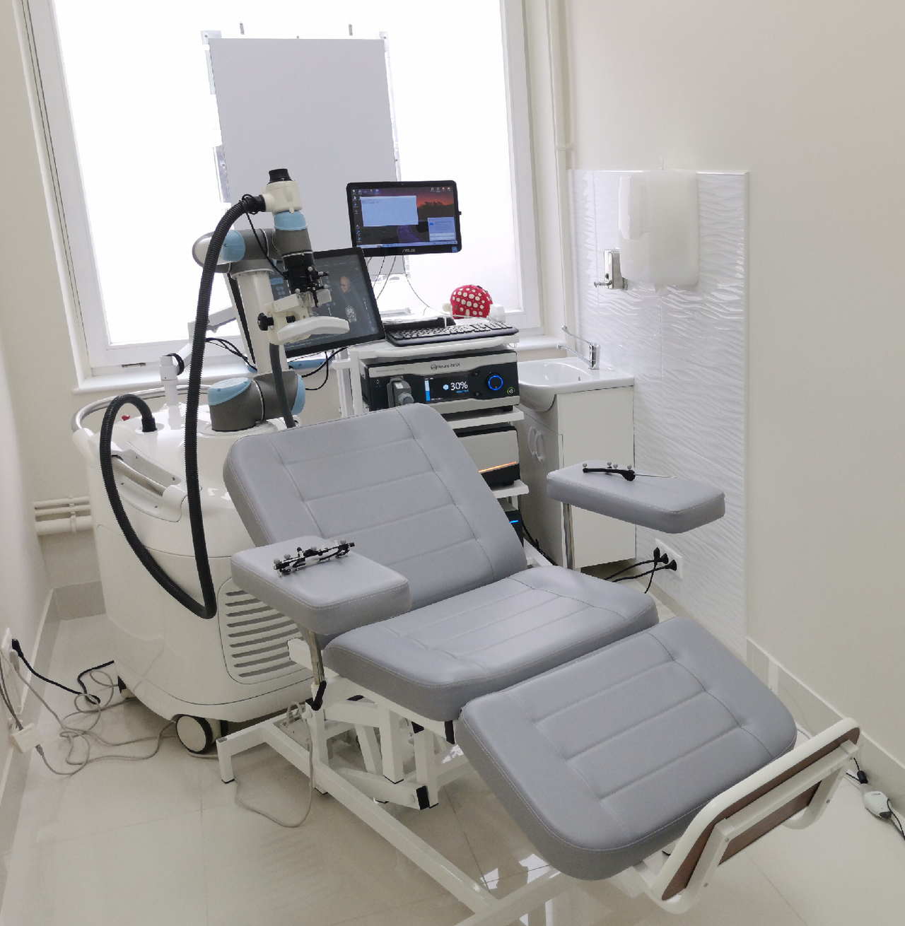
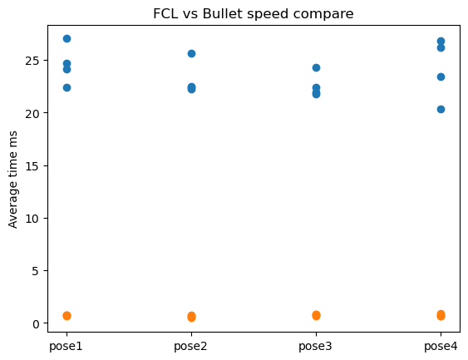
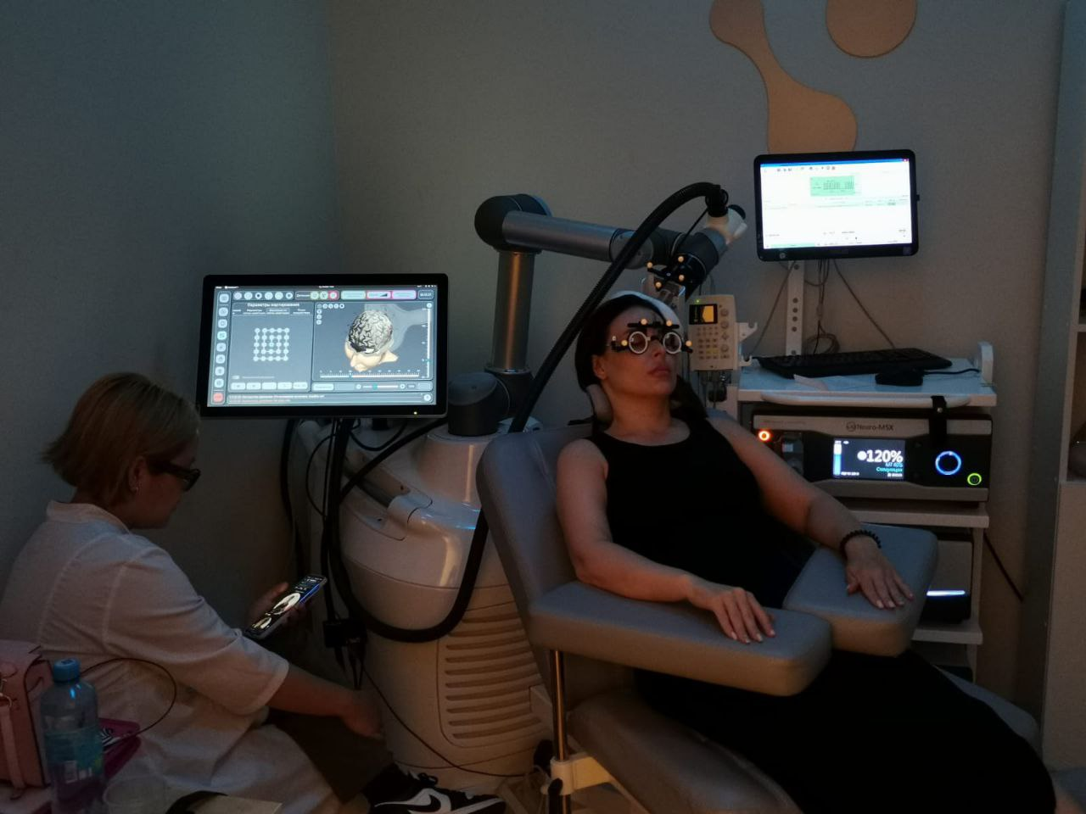
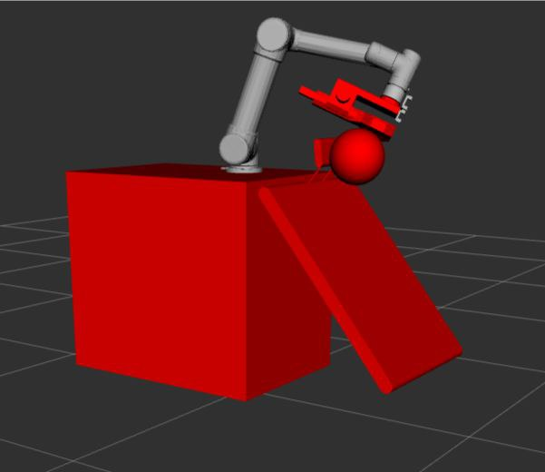

Development of a control algorithm for Universal Robots’ UR5e or UR5 collaborative manipulators with dynamic obstacle avoidance function
Sergei Smetankin
Engineering Systems
(ISR lab)
Dzmitry Tsetserukou
NEUROROBOT is robot-assisted TMS navigation system for the brain for neurorehabilitation and pre-radiation preparation of patients. During the procedure, the robot is surrounded by additional equipment: chairs, monitors, TMS devices, etc. All of the above items change their location or state over time depending on the convenience of the doctor and the patient. It is equally important to note that the equipment is expensive, so it is necessary to reduce the risk of damage to it.
The main objective was to implement a collision avoidance system into the project, which would help in real time in telecontrol mode to keep the equipment intact and ensure patient safety in the event of possible operator errors (prevent the robot from colliding with objects when controlled by a joystick).
Initially, it was planned to use an algorithm based on the Artificial Potential Field, i.e. to add a repulsive force to the end-effector when approaching objects that the robot should not collide with. But it turned out that in this case, the robot would be affected by unwanted accelerations that prevented the robot from being positioned correctly. Therefore, it was decided to adapt the “Threshold distance method”, implemented in the default moveit_servo from the Moveit framework and based on the FCL library, to our needs.
We decided to replace default FCL library with the Bullet.
After modifying the original moveit_servo, I was able to make the new collision avoidance method via OOP C++ easy to integrate into the project. I implemented the Bullet library, already modified for ROS, and measured the speed of calculations. The speed gain was times 30, which allowed us to fit within the 125 Hz refresh rate and check collision in real time
NEUROROBOT
During the practice, an algorithm for avoiding collisions in the joystick control mode was implemented in the Neurorobot project. An optimal method was found that corresponded to the initial task of correct positioning of the TMS device, and the problems that arose were consistently solved.
This work will be included in subsequent software updates on the real robot.
This approach to avoiding collisions between the robot and itself and the environment is not yet used by competing companies.
During the practice, an algorithm for avoiding collisions in the joystick control mode was implemented in the neurobot project. An optimal method was found that corresponded to the initial task of correct positioning of the TMS device, and the problems that arose were consistently solved. This work will be included in subsequent software updates on the real robot.
For extended report in .pdf format follow QrCode

