Slide 1

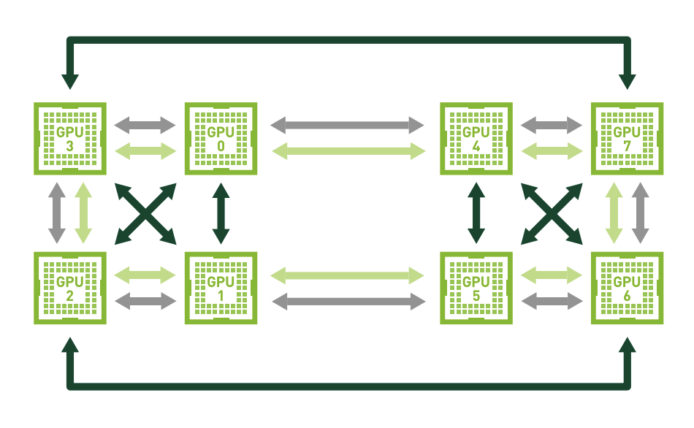
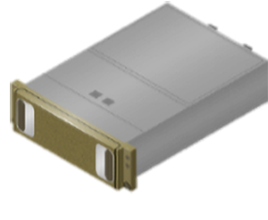
tf.keras Model
Model Output
Automatic
Mixed Precision
XLA
Compiler
Pretrained BERT module
bert_uncased_L-12_H-768_A-12
BERT
Model Input
Efficient Multi-GPU Training with Horovod

Slide 2
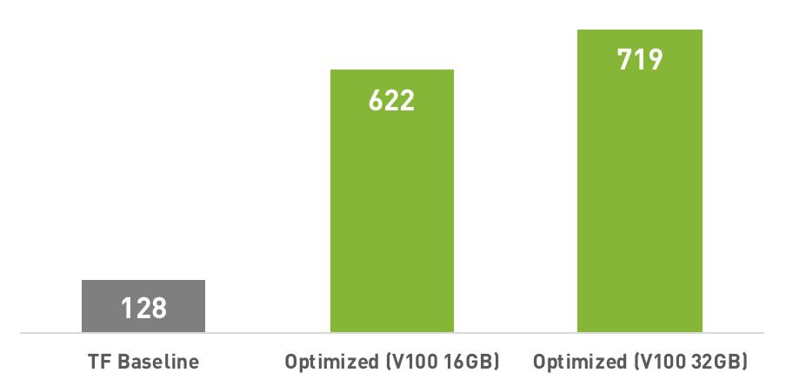
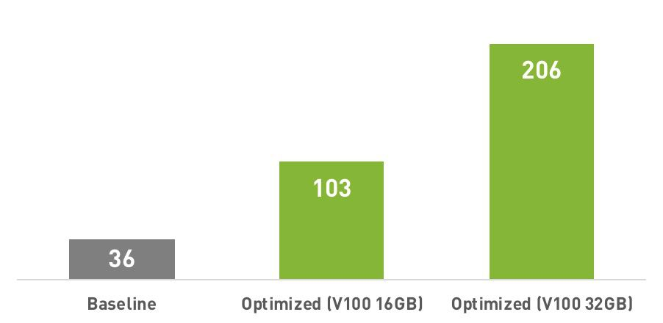
Overall Performance Improvements
Training examples per second on DGX-1V (Max-Q mode)
Fine-tuning BERTBASE
Fine-tuning BERTLARGE
4.9×
2.9×

Slide 3
