Slide 1
HATE SPEECH DETECTION

Slide 2
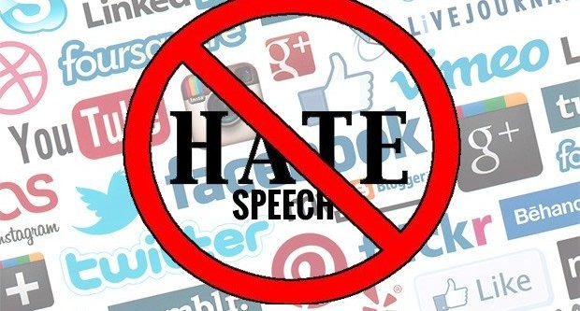
Hate speech Detection key steps : >Importing library >Cleaning Data > Accuracy of matrix >Analysis of Data >Data Transformation

Slide 3
Problem Statement
In recent years, social media platforms like Twitter have become critical channels for communication, news, and public discourse. However, they have also been exploited for spreading hate speech, which can incite violence, perpetuate discrimination, and harm individuals and communities. Hate speech on Twitter poses significant challenges due to the platform's vast user base, high volume of content, and the nuanced nature of language, including slang, sarcasm, and evolving terms. Traditional moderation methods, relying heavily on manual review, are insufficient to address the scale and speed at which harmful content can spread.
The objective of this project is to develop an automated system capable of accurately detecting hate speech on Twitter. This system must handle large-scale data, distinguishing between hate speech and non-offensive content while considering context and linguistic subtleties. Key challenges include:
- Data Variability: Tweets often contain slang, abbreviations, and emojis, making natural language processing (NLP) complex.
- Context Sensitivity: Understanding the context is crucial, as words deemed offensive in one context might be innocuous in another.
- Evolving Language: Hate speech evolves rapidly, requiring the model to adapt to new terms and phrases continually.
- Balancing Accuracy and Freedom of Speech: Ensuring the system minimizes false positives to avoid unjust censorship while effectively identifying hate speech.

Slide 4

Steps : >Import dataset >Read CSV file >Data Inspection on CSV file >Data cleaning >Remove symbols >Check datatypes >Data accuracy and matrix

Slide 5
Steps : >Validate nltk >Check Accuracy matrix >univariate analysis >Data accuracy and matrix >Data Transfer

Slide 6
Conclusion : The project demonstrated the feasibility and effectiveness of using advanced NLP and machine learning techniques to detect hate speech on Twitter. While the models developed show promising results, ongoing efforts to address challenges like data quality, contextual understanding, and ethical concerns are essential. With continuous improvements and collaboration across disciplines, technology can play a significant role in mitigating the spread of hate speech online, fostering a safer and more inclusive digital environment.

