Slide 1



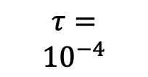












$$M_{\tilde{θ}}^{lap}$$
$$\tilde{θ}$$
$$∞$$
$$3$$
$$∞$$
$$τ=$$
$${10}^{−4}$$
$$∞$$
$$2$$
$$1$$
$$∞$$
$$0.05$$
$$ε^{∗}(\tilde{θ})$$
$$∞$$
$$ξ(\tilde{θ})$$
$$ε_{c}$$
$$∞$$

