Slide 1

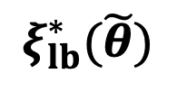






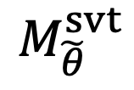


$$\tilde{θ_{1}}$$
$$M_{\tilde{θ}}^{svt}$$
$$1.7$$
Mid
$$2.17$$
$$2.8$$
$$ξ_{lb}^{∗}(\tilde{θ})$$
$$ε^{∗}(\tilde{θ})$$
$$ε_{c}$$
$$1.0$$
High
$$1.1$$
$$1.2$$

