Slide 1

CPEN211:DATABASE MANAGEMENT SYSTEM GROUP 4 LIBRARY MANAGEMENT SYSTEM
UNIVERSITY OF GHANA
(All rights reserved)
DEPARTMENT OF COMPUTER ENGINEERING
SCHOOL OF ENGINEERING SCIENCES

Slide 2
Members
Kathleen Nicole Brown 10980830
Bani Beres Etornam 10948391
Daniels Del-Chris 10980292
AMANGBO IKECHUKWU SAMUEL 10943349
Farouk Sedick 10947554
Boniface Delali Dakey 10969344
Luqman Nartey Quarshie 10975589
Prince Charles – 10956252
Ofaobasi Patrick Effiong - 10939470

Slide 3
INTRODUCTION
Purpose
The school library currently operates without a digital system for managing resources , relying on a manual check-in and check-out process. This has led to inefficiencies, errors, and difficulties in tracking the availability of resources. To address these challenges, our group initiated a database management system project for the library. The project's primary objective is to improve the efficiency and effectiveness of the library's operations, with specific goals that include automating resource management, tracking resource availability, and ensuring data security. By achieving these goals, the system will enable the library to operate more efficiently and effectively, improving the overall experience for library staff and students.

Slide 4
System Overview
Description of the system's features
The school library database management system is a comprehensive software system that provides a range of features designed to automate and streamline key library management processes. Here are some key features of the school library database management system:
Resource Management: The system allows for the efficient tracking and organization of resources within the library's collection. This includes the creation and maintenance of a comprehensive catalog of resources, with fields for essential information such as author, title, publication date, and isbn of a book.
User Management: The system enables the management of student accounts, including student details, borrowing history, and overdue materials. This allows library staff to enforce lending policies and ensure that resources are available to all users.

Slide 5
5
Availability Tracking: The system allows for the tracking of resource availability, with functionality for checking in and out materials, identifying materials as stolen or , and generating reports on the status of resources in the collection.
Security : The system includes robust security features to protect sensitive information about students and resources, with user authentication and access control mechanisms in place.

Slide 6
Database Design
Database Design
Data model for the database
Entity Relationship Diagram (ERD)
Schema design

Slide 7
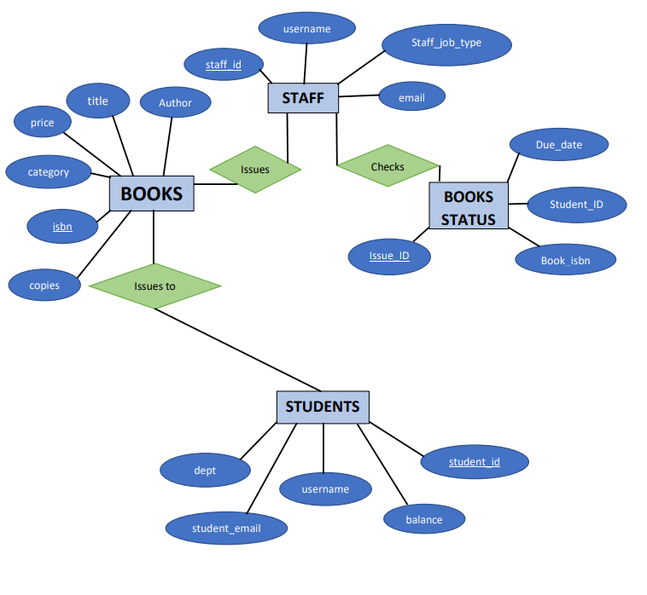
ER DIAGRAM

Slide 8
Implementation
Choice of database management system
For the implementation of the school library database management system, PostgreSQL has been chosen as the database management system due to its robustness, scalability, SQL compliance, and security features. PostgreSQL offers strong support for complex data types, built-in indexing, full-text search, and extensibility through custom functions and procedures, making it an ideal choice for managing the diverse data associated with the library's resources and patrons. Additionally, PostgreSQL has a large and active community of developers and users, providing extensive documentation, tutorials, and support resources to ensure the ongoing evolution and success of the system.

Slide 9
Data population and migration
For data population and testing purposes, mockaroo will be used to generate mock data that will be used to test the functionality and performance of the school library database management system. Mockaroo is a powerful data generation tool that allows for the creation of custom data sets with a wide range of data types and formats. The tool is designed to produce realistic and diverse data that accurately reflects real-world scenarios and use cases.

Slide 10
Mockaroo will be used to generate data for various entities in the library database, including books, authors, publishers, students, and transactions. The generated data will be imported into the PostgreSQL database using appropriate tools and techniques, ensuring that the data is accurately mapped to the database schema and is consistent with the system's requirements and specifications.
The mock data generated by mockaroo will be used to test the system's functionality, performance, and scalability under different scenarios and conditions. The tests will be designed to identify and address any issues or bottlenecks in the system, and to ensure that the system meets the needs and requirements of the library staff and patrons.
Overall, using mockaroo to generate mock data for testing purposes will ensure that the school library database management system is thoroughly tested and refined, with any issues or concerns being addressed before the system is deployed in a production environment.

