Slide 1
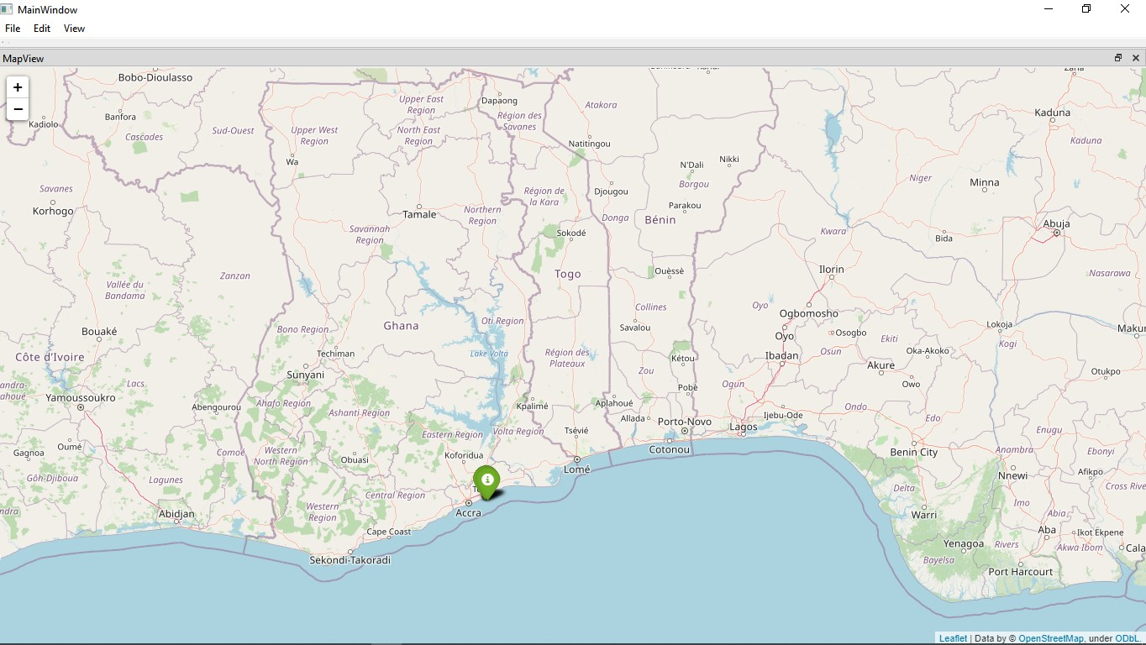
SigTrack
Overview
Introduction
SigTrack origin
Where we are now
Future

Slide 2
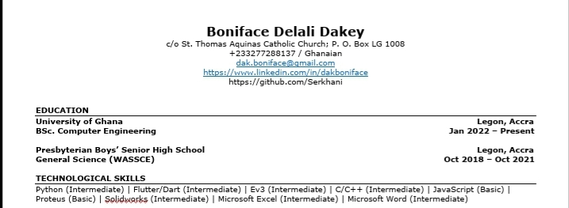

EXPERIENCE
Broomin, work-study
Soko Aerial Robotics, internship

Slide 3

So SigTrack

Slide 4
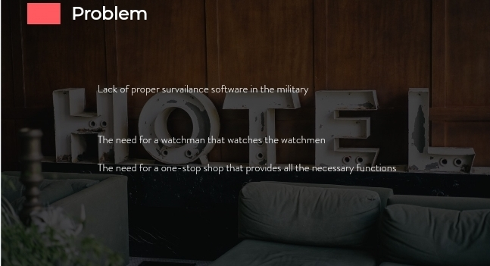

Slide 5
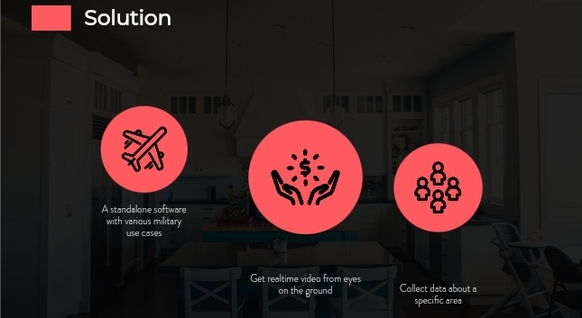

Slide 6
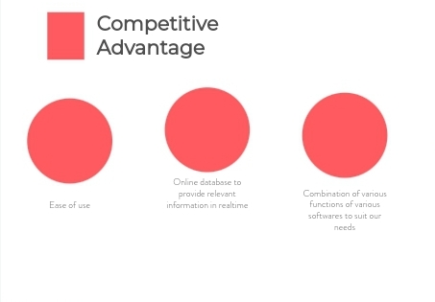

Slide 7


