Slide 1
Non-textual data extraction assignment POKER
9
4
10
9
4
10
5
A
5
A

Slide 2
Motivation
J
Effortlessly find and acquire poker cards user desires, for collection or gameplay.
Card identification in training application.
2
2
J
2
2

Slide 3
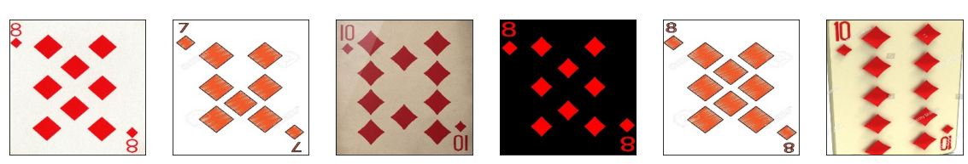
Harris+ Histogram of Oriented Gradients
Hog Descriptor
WinSize: 220 x 220
blockSize: 112 x 90
cellSize: 56 x 45
Nbins : 16
Harris Corner
blockSize: 2
Ksize: 3
K: 0.04

Slide 4
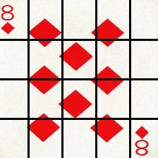
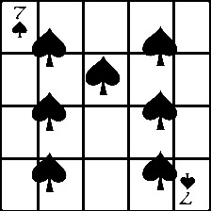
Histogram Descriptor
7
40
48
48
48
40
40
48
48
48
7
40
56
56
56
56
56
56
56
56

Slide 5










Histogram Descriptor
7
7
$$χ^{2}$$
$$χ^{2}$$
$$χ^{2}$$
Mean

Slide 6
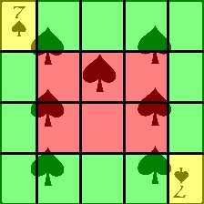
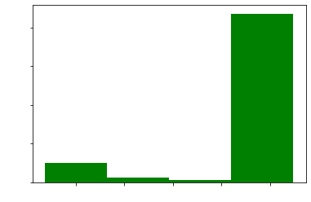
Histogram Descriptor
7
40
48
48
48
40
7
56
56
56
3 different levels with weights :
6 central quadrants:
60% total → 10% each
Top-left and bottom-right corners:
30% total → 15 % each
Remaining quadrants:
10% total → 0.83% each
56

Slide 7
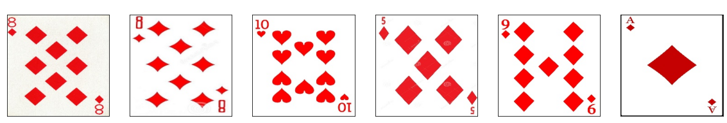
Histogram Descriptor
4
4

Slide 8
03 Combinations
9
7
8
9
4
7
8
Weighted combination
Combination of 2 layer descriptor
First HOG then Histogram
First Histogram then HOG
4
9
9

Slide 9
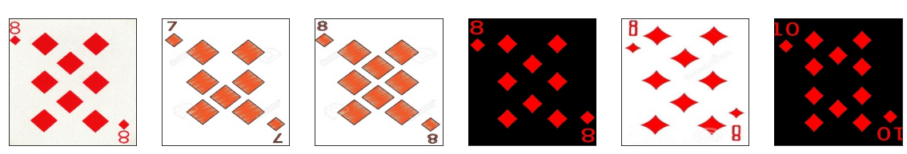
Weighted combination
A
9
A
9
Normalize distances
Histogram: 30%
Hog: 70%

Slide 10
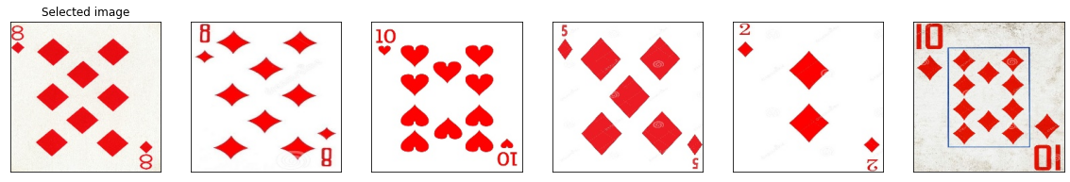
First HOG then Histogram
8
8
Prioritizing color over shape
First we get the top 20 ranking images based on the HOG descriptor

Slide 11
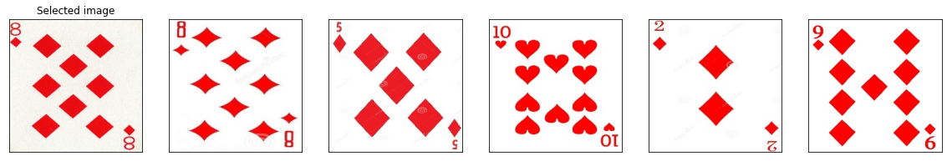
First Histogram then HOG
8
8
Prioritizing shape
The top 20 ranked images are identified based on the Histogram descriptor
2
2

