Slide 1

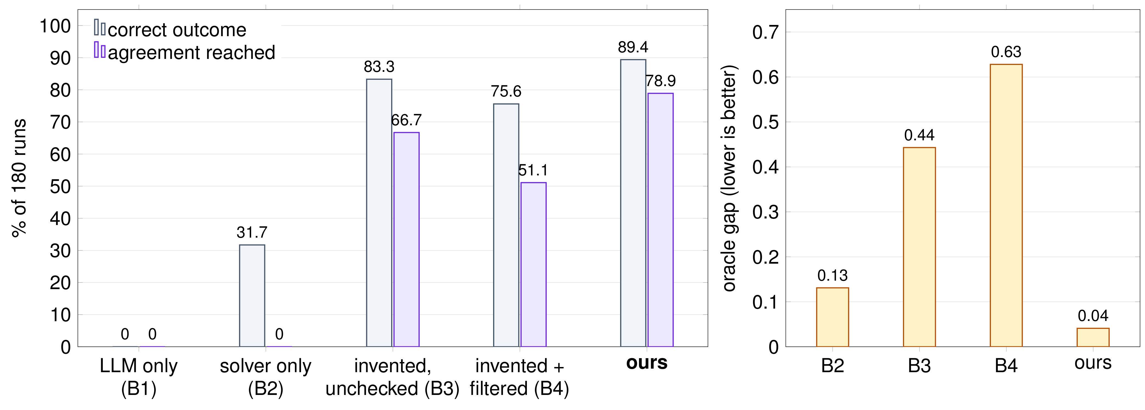
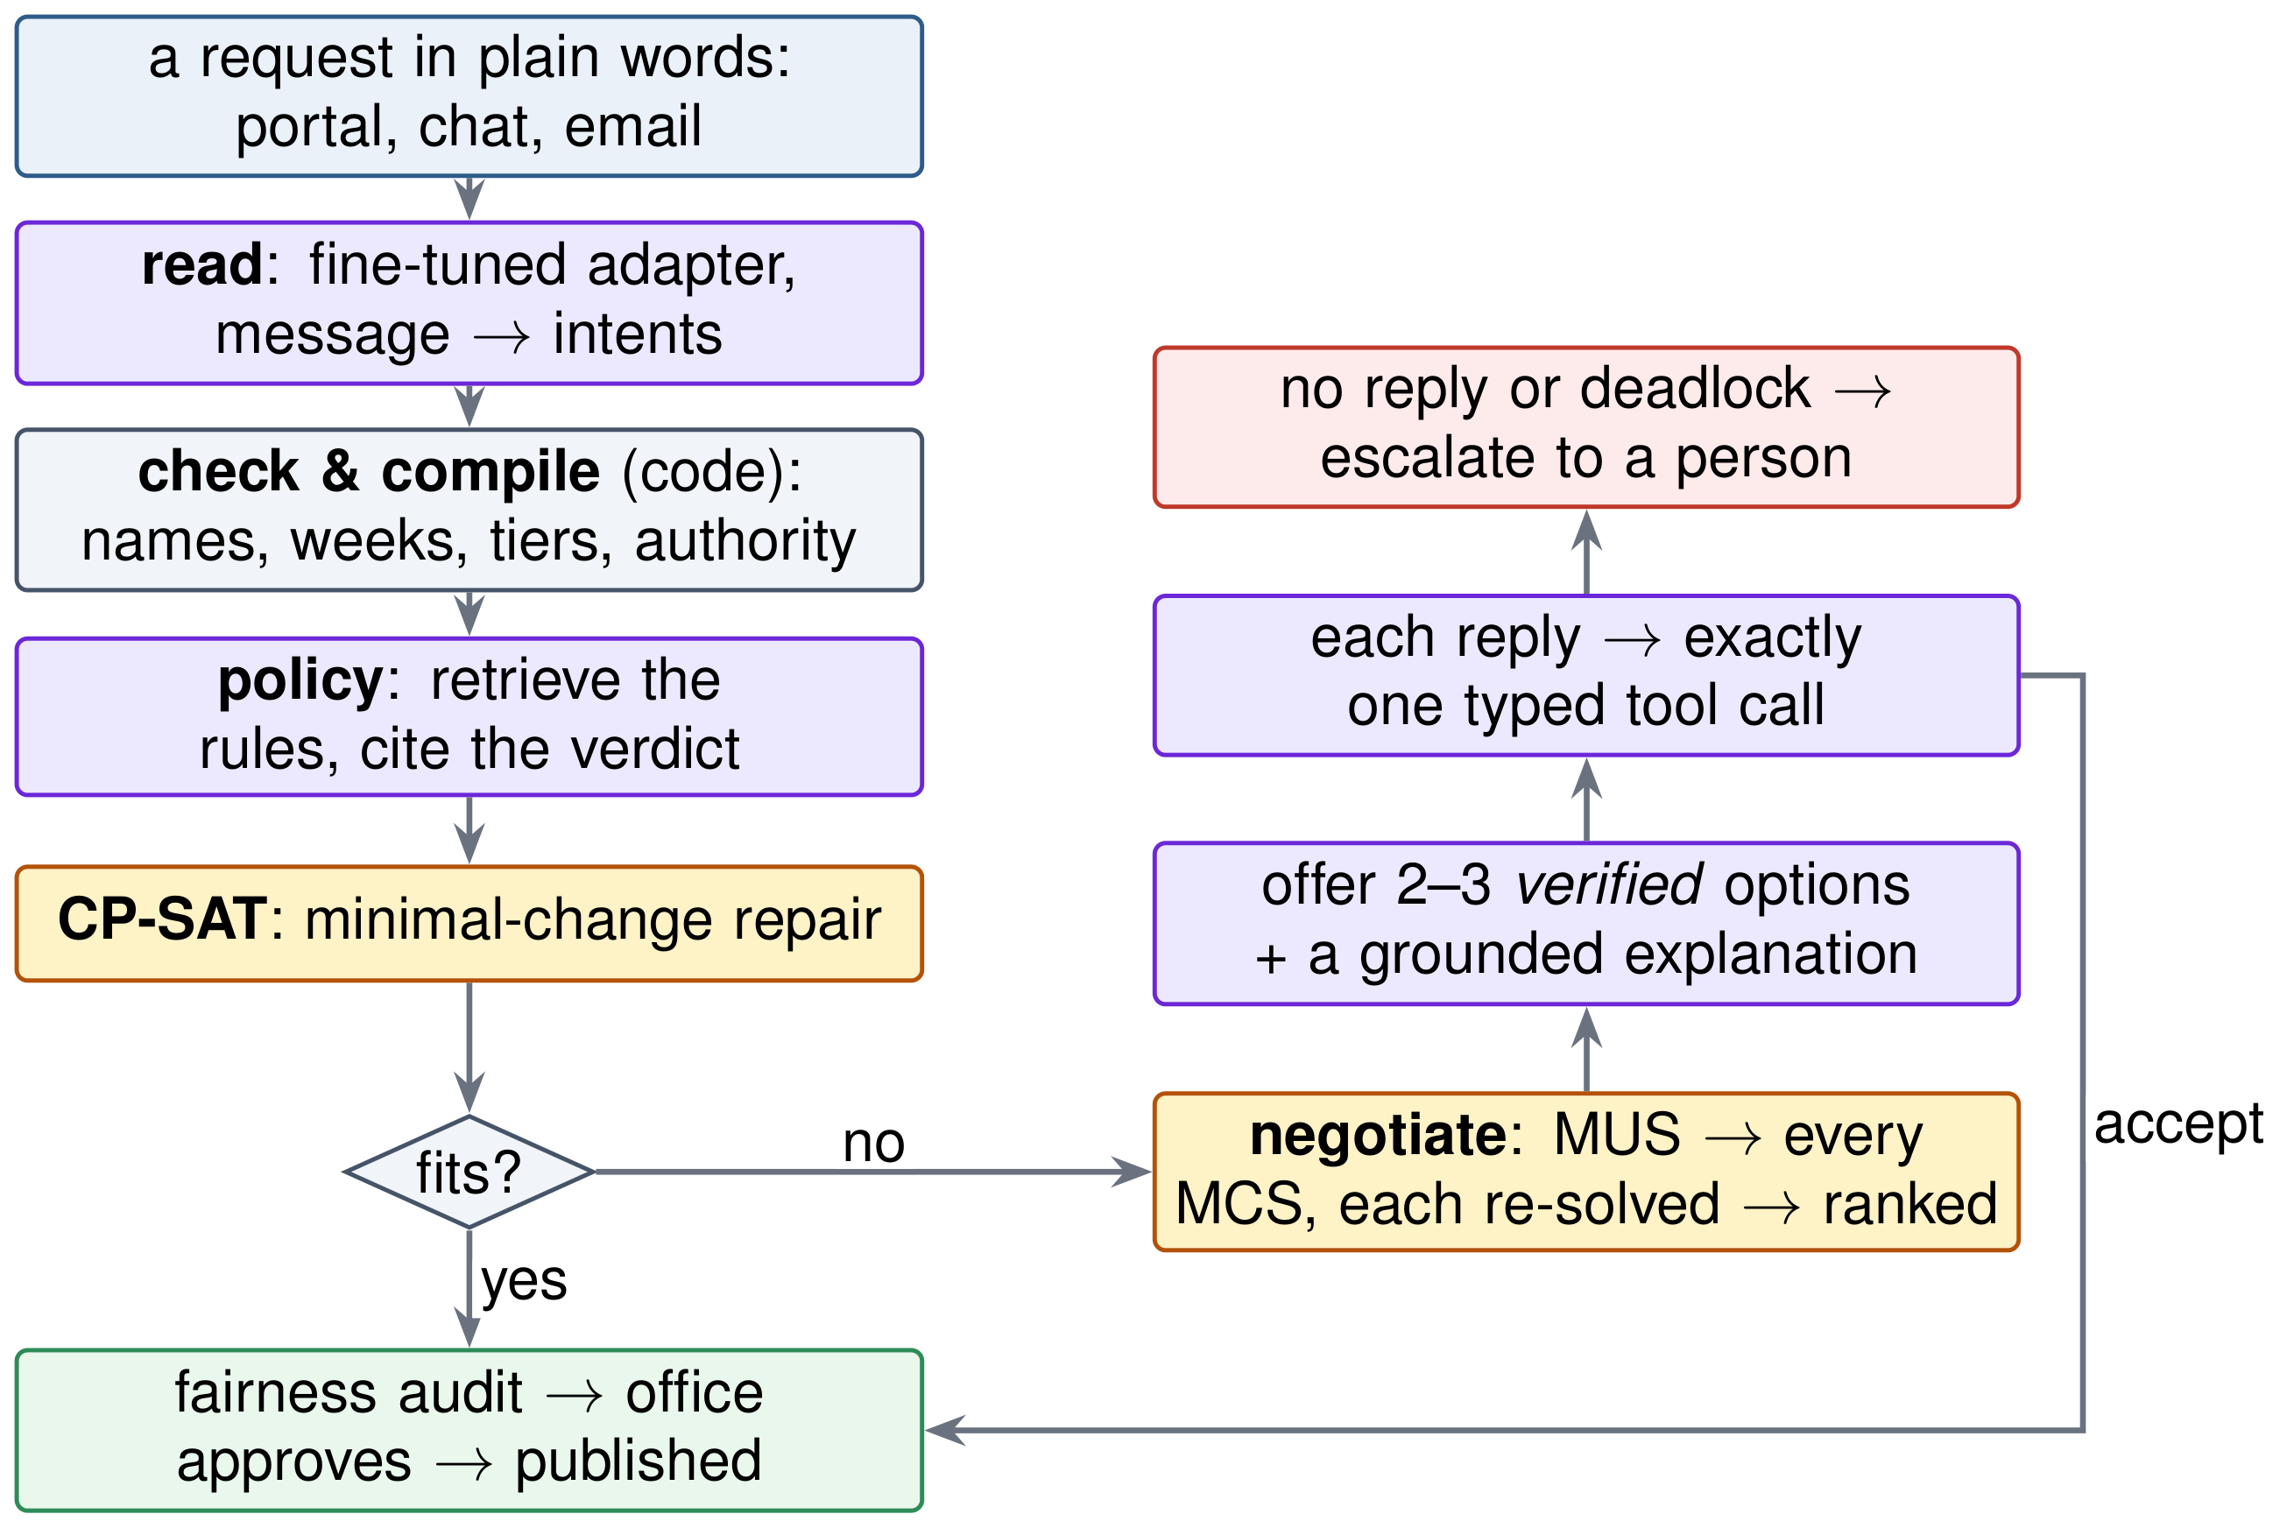
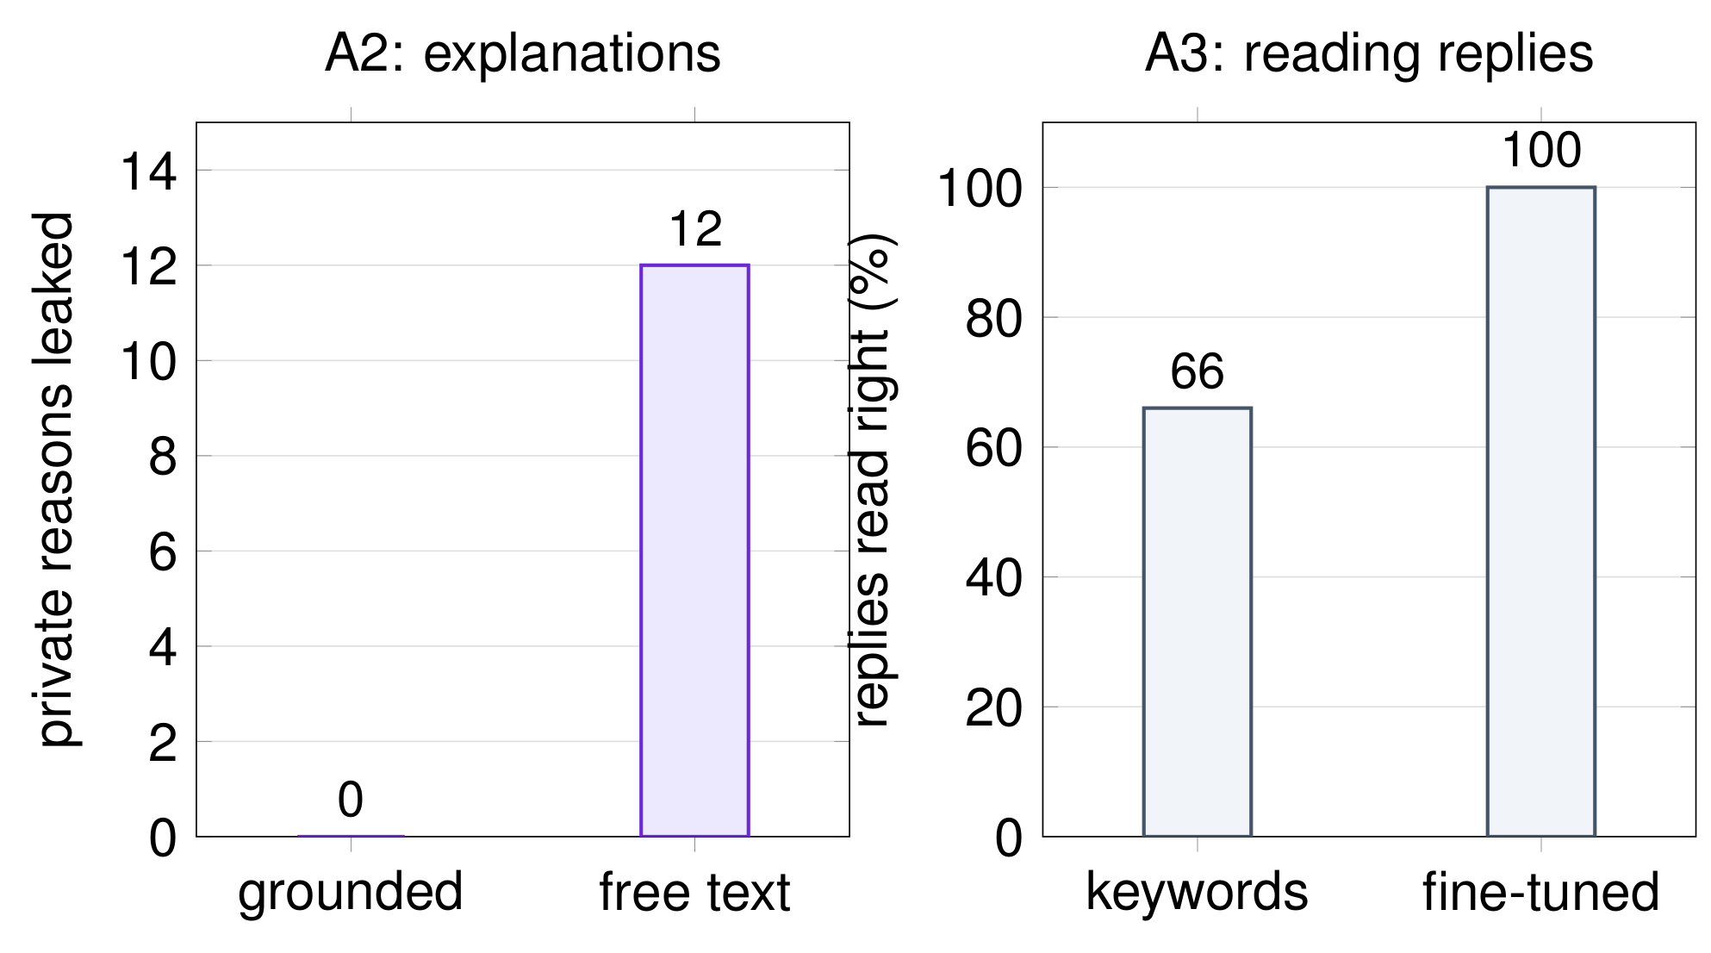
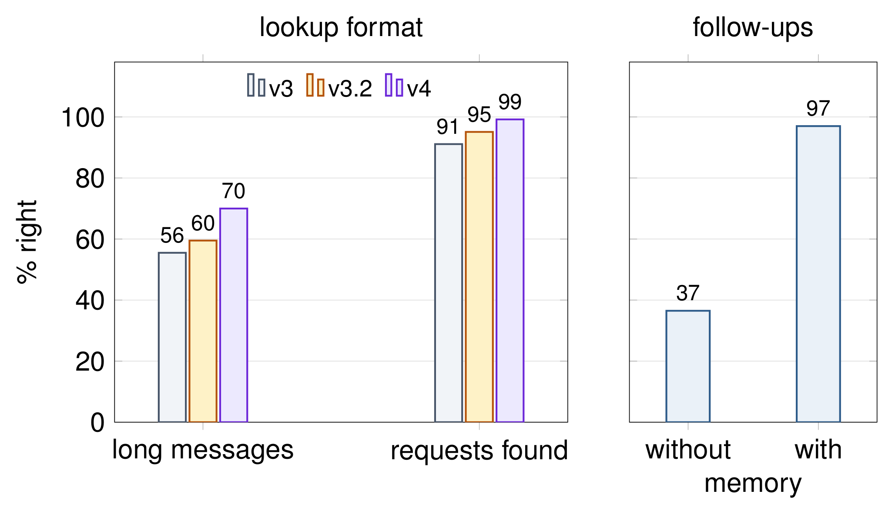
Negotiate, Then Solve
Solver-grounded negotiation for conflict-aware university timetabling
ABSTRACT
RESULTS
Farali Chevdo
University timetables change every week through plain-language requests that often conflict. We study solver-grounded negotiation: when a request cannot be met, the solver finds the conflict (MUS), lists every minimal repair (MCS) and re-solves each into a full timetable, and a language model may offer people only these verified options. Small fine-tuned models (Qwen3.5-4B, one LoRA adapter per task) only read language; code computes everything else. Over 180 paired runs, our system reaches the oracle's outcome in 89.4% of runs, against 75.6% when a model invents options and the solver filters them.
60 negotiation scenarios with planted conflicts and hidden flexibility, 3 seeds, scored against an oracle. Ours: 89.4% correct, oracle gap 0.04, no infeasible offer, on a 4B model against Gemini for the baselines. Invented options are infeasible half the time (B3); filtering them (B4) leaves fewer, worse offers: 75.6% (p = 4.6×10⁻⁶).
LMA Group Project 2026
CONCLUSION AND FUTURE WORKS
Let the solver decide what may be offered: 89.4% vs 75.6%, close to the oracle.
Small fine-tuned readers with code beat a large prompted model.
Next: real requests as training data, time and date ranges, sequences of conflicts for the ledger.
METHODOLOGY
LIMITATIONS
Models read language; code computes. A fine-tuned adapter reads each request into typed intents; code checks and compiles them; CP-SAT repairs the week. If it doesn't fit, the conflict's minimal correction sets become the only offers, explained from facts, and a person approves every change.
Data: synthetic, answers known by construction: 60 negotiation scenarios, 417 frozen test requests, 362 questions in 4 departments, 400 follow-ups.
The ledger did not yet spread the burden more evenly: one conflict per scenario.
All data synthetic; stakeholders are simulated.
Baselines on a larger model; no human ratings yet.
ABLATIONS
FINE-TUNED READERS
Each removes one part. Grounded explanations: 12 private-reason leaks without them, 0 with. Reading replies: keywords 66%, fine-tuned tool calls 100%. Flat weights: the same settlement; the ledger needs repeated conflicts to show its effect. No negotiation (B2): 31.7% correct.
One 4B base, one LoRA adapter per task, beating a larger prompted model: requests 96–98% (rules 52%), the make-up obligation 1.00 vs 0.21, replies 100%. A typed lookup vocabulary (v4) wins on long, mixed messages; memory lifts follow-ups from 37% to 97%. v3.2 and v4 share the same rows, so the format alone explains the gain.
ACKNOWLEDGMENT
We thank the LMA course instructors and TAs for their guidance and feedback.
Code: github.com/Seronic2001/negotiate-then-solve
REFERENCES
[1] Burke, Petrovic. Recent research directions in automated timetabling. EJOR, 2002.
[2] Perron, Didier. CP-SAT. Google OR-Tools.
[3] Liffiton, Sakallah. Algorithms for computing minimal unsatisfiable subsets of constraints. JAR, 2008.
[4] Kambhampati et al. LLMs can't plan, but can help planning in LLM-Modulo frameworks. ICML, 2024.
[5] Lewis et al. Retrieval-augmented generation for knowledge-intensive NLP tasks. NeurIPS, 2020.
[6] Hu et al. LoRA: Low-rank adaptation of large language models. ICLR, 2022.
Author names: Shubhadeep Mandal, Achyutananda Sahoo, Satyajit Priyadarshi, Rakesh C
email ID: {shubhadeep.mandal, achyutananda.sahoo, satyajit.priyadarshi}@students.iiit.ac.in

