Slide 1


QUIZ GENERATOR
ML PROJECT – By Esteban VINCENT

Slide 2
TABLE OF CONTENTS
01
02
INTRODUCTION
PROJECT DESCRIPTION
03
04
REALIZATION OF THE PROJECT
DEMO

Slide 3
01
INTRODUCTION

Slide 4
02
PROJECT DESCRIPTION

Slide 5
The project allow you to manage quiz and generate quiz by IA, with ChatGPT.

Slide 6
FUNCTIONNALITIES
01
02
Quizz with QCM
Quizz with questions
03
04
Show ranking
Delete quizz

Slide 7


PROJECT REALIZATION

Slide 8

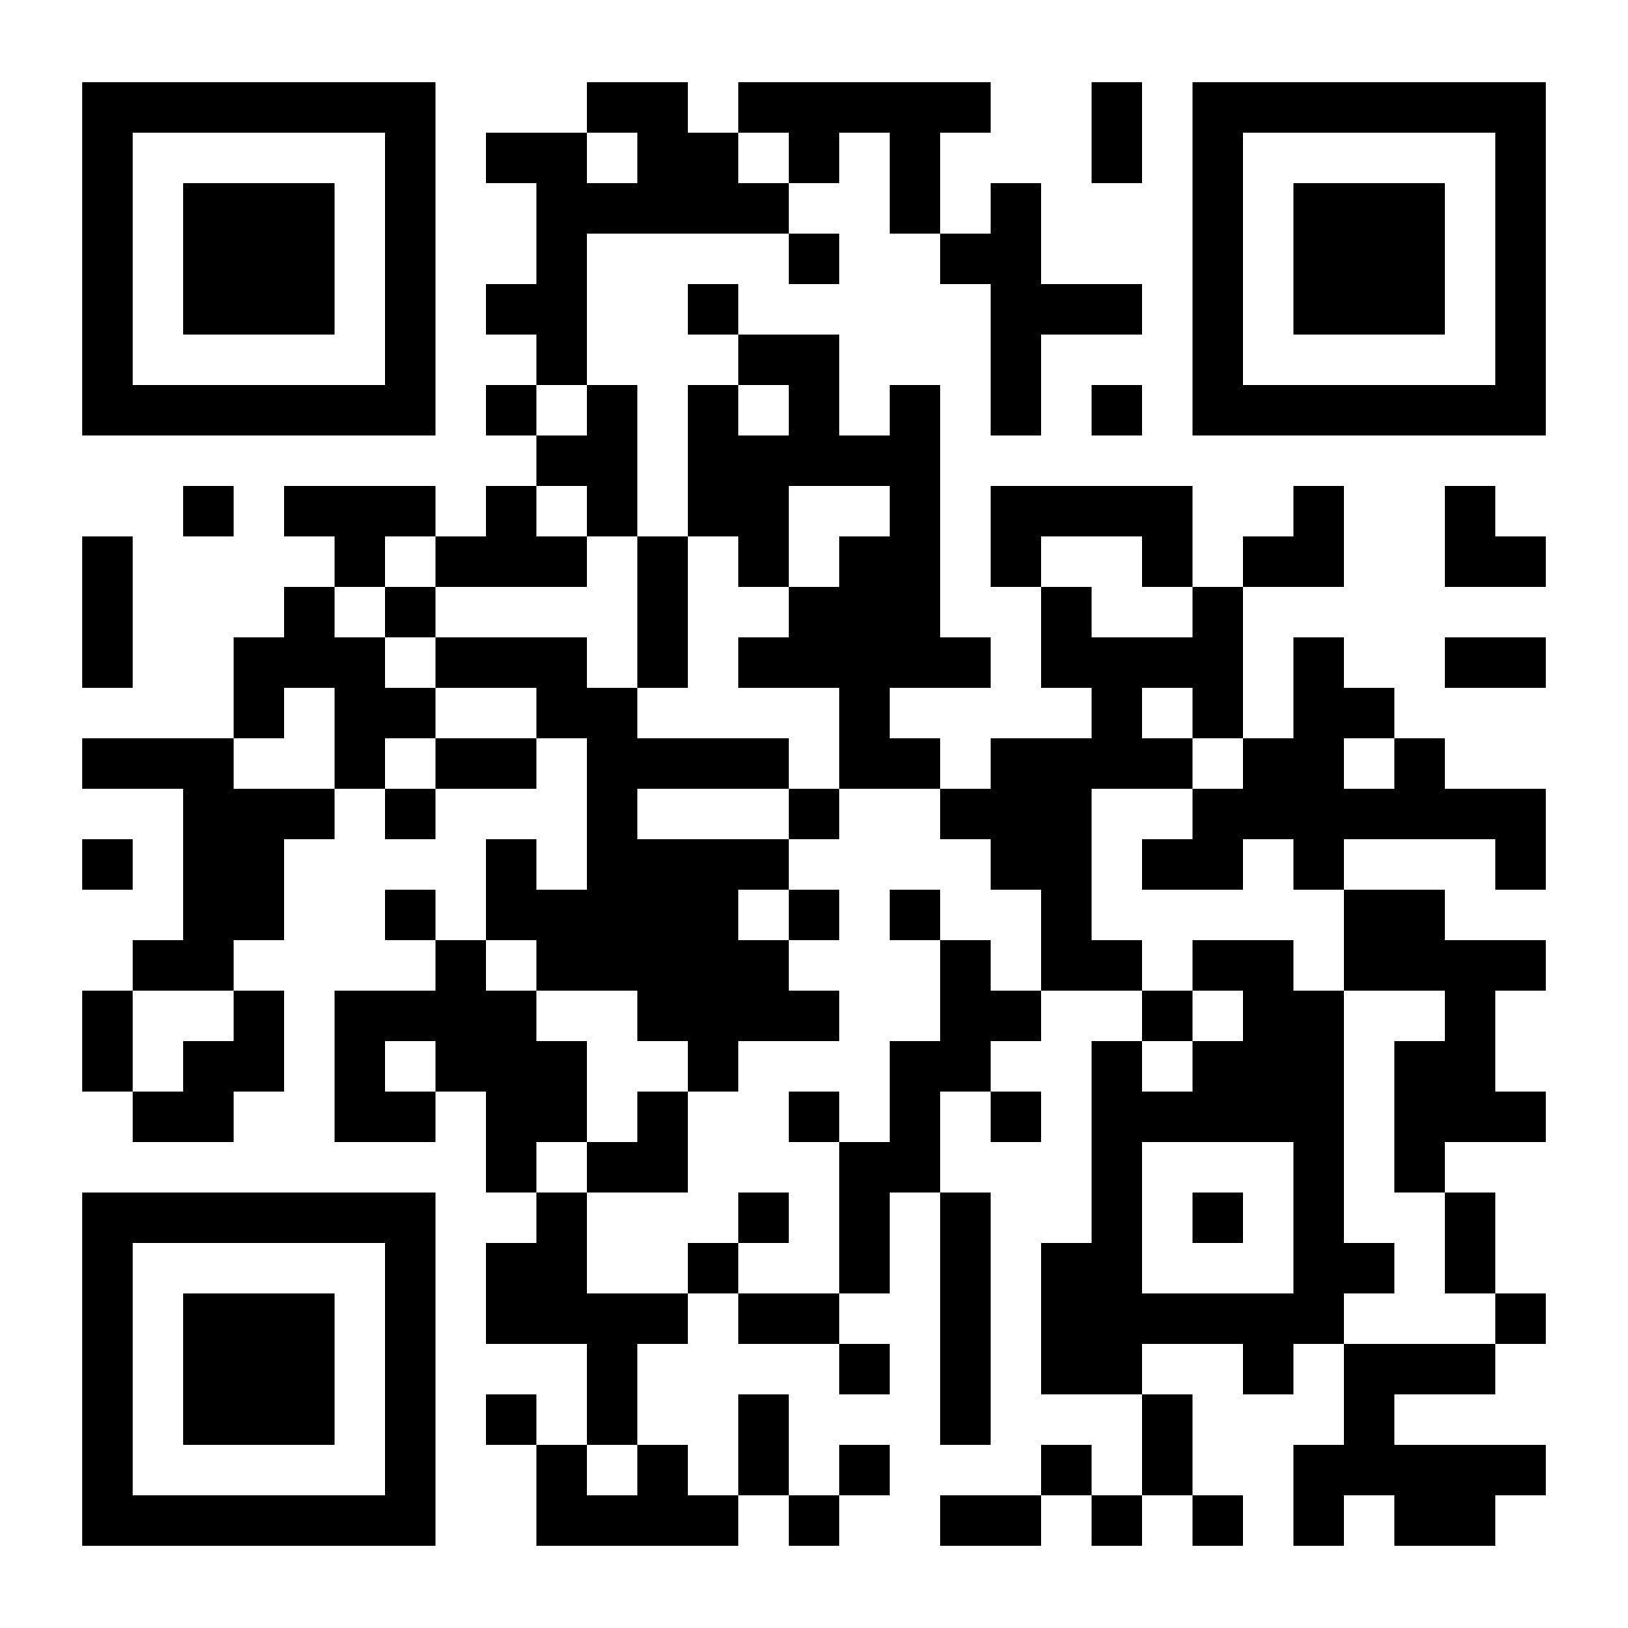
DEMO!
Now, it’s time for demo !
Scan the QRCode to join the Discord server and join the quizz !

