Slide 1
Netflix Watching Habits Analysis
Ahmet Sertaç Sarı - 32440

Slide 2
Hypothesis
My hypothesis is that my Netflix watching hours significantly decrease during exam periods, reflecting a shift in focus toward studying.

Slide 3
Motivation
Understand personal viewing patterns
Evaluate time management (especially during exam periods)
To better understand how I balance my time between fun and studying.
To assess whether my habits align with my goals for productivity, especially during critical periods like exams.

Slide 4
Data Collection & Cleaning
Source is from the data that Netflix provided. The folder name is ViewingActivity.csv
I used Python in order to clear the code.
Filtered to my profile name.
Converted timestamps to datetime, extracted daily hours.

Slide 5
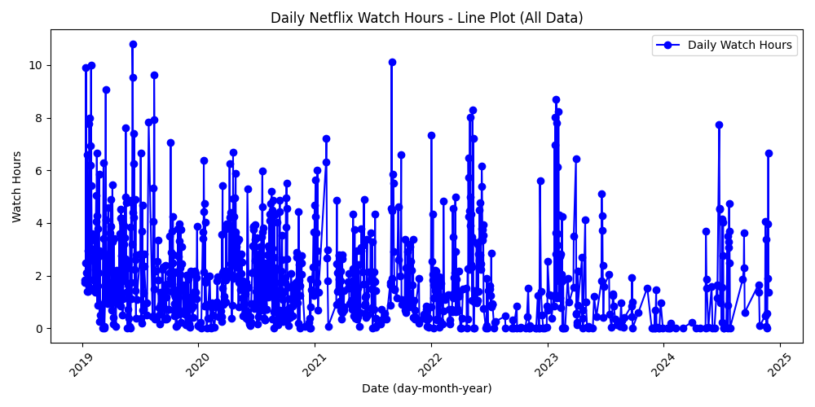
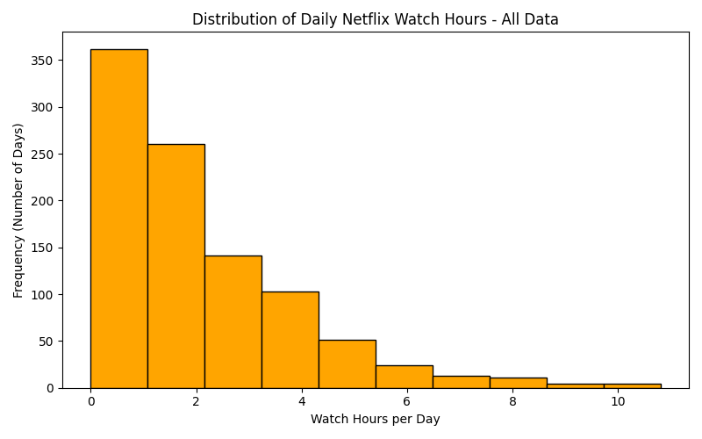
Data of the Viewing Activity

Slide 6
Plots & Exploratory Analysis
Daily line plot (all data)
Histogram of daily watch hours
Observations (peak times, distribution shape, etc.)

Slide 7
Filtering Since Sep 2022
Focusing on a narrower timeframe, which is the important data since comparing the exam and non exam period in university.
Additional line plot (Sep 2022 onward)
Why this timeframe? (e.g., start of academic term)

Slide 8
Exam vs. Non-Exam
Defined exam periods from academic calendar
Show mean watch hours & T-test results
Conclusion on significance (p-value)

Slide 9
3-Month Aggregation & Yearly Box Plot
3-month aggregated line chart
Yearly box plot to show distribution & outliers
Observations on periodic trends

Slide 10
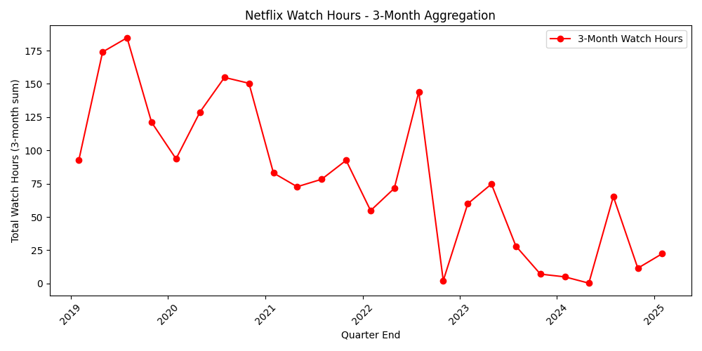
3-Month Aggregation

Slide 11
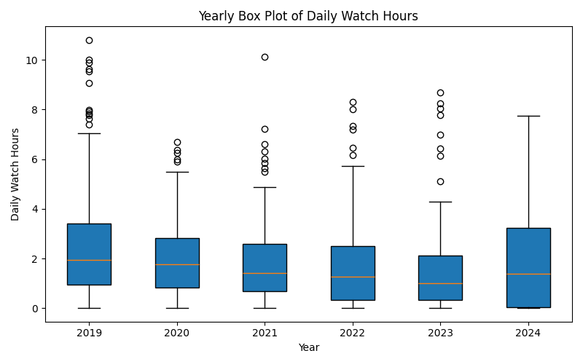
Yearly Box Plot

Slide 12
Machine Learning: kMM
Custom K-Means wrapper for clustering
Features: Day of week & Duration
Interpreting cluster centers & cluster distribution

Slide 13
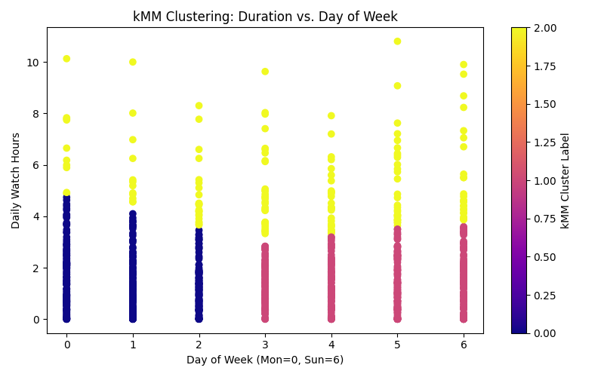
Purpose: Group days with similar viewing patterns
Duration (how many hours watched per day)
Day of Week (Monday=0, ..., Sunday=6)
Plot: Points represent individual days, colored by assigned cluster
Insights:
Each cluster might correspond to a distinctive watch pattern
The cluster boundaries show how the algorithm splits the data.
Conclusion: Clustering helps identify behavioral patterns in Netflix usage.

Slide 14
Machine Learning: KNN Regression
Predicting daily watch hours using day_of_week
Plot comparing actual vs. predicted

Slide 15
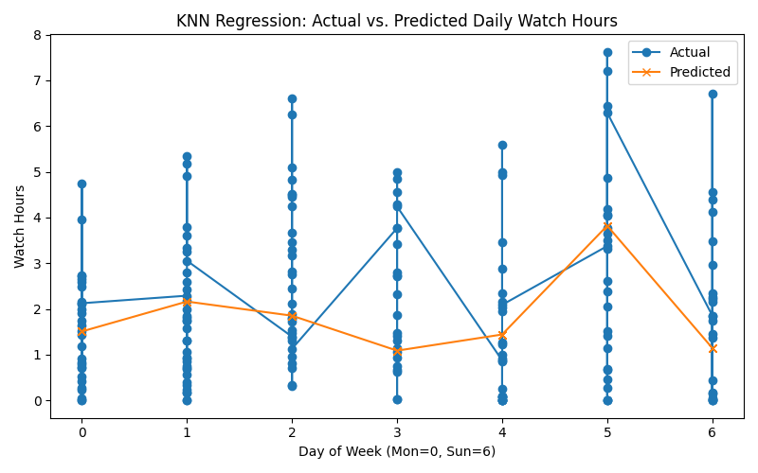
Goal: Predict daily Netflix watch hours using the day of the week (or additional features)
Method: K-Nearest Neighbors Regressor (e.g., k = 3)
Plot: Displays Actual vs. Predicted watch hours
Observations:
Model suggests a trend but not perfect.

Slide 16
Conclusion
The Python code’s output below:
=== Exam Period Mean: 0.75 hours/day ===
=== Non-Exam Period Mean: 2.04 hours/day ===
=== T-Test Results (All Exam Periods Combined) ===
T-statistic: -4.535
P-value: 0.001

Slide 17
Conclusion
Because p < 0.05, the difference in average watch hours between exam and non-exam periods is statistically significant.
This supports my hypothesis that "Netflix watching hours significantly decrease during exam periods," assuming that my exam period hours are in fact lower than non-exam hours in your dataset.
Therefore, we cannot reject the hypothesis.

Slide 18
Limitations and Possible Future Work
Limited Feature Set: Primarily day-of-week and exam vs. non-exam.
External Factors Missing: No inclusion of social life, deadlines, or unexpected life events
Other Platforms: Compare Netflix data with other streaming services or entertainment.
Refined ML Models: Consider advanced methods (e.g., Random Forest, ensemble models) or more robust feature engineering.
Long-Term Tracking: Gather data across multiple semesters or for more users to see evolving patterns.

