Slide 1
FHICT · Cyber Security
Security Analysis of Token
and Session Handling
in Modern Web Applications
"Authentication is correct. Session handling is not."
Andrii Kolodyazhniy
2026

Slide 2
Contents
01
Research questions
06
Lab evidence — S3: XSS token theft · S4: Broken logout
02
DOT framework — method per research question
07
Comparative evaluation — insecure vs. secure
03
Library research — key findings
08
CIA analysis + risk rating
04
Proof-of-concept architecture
09
Answers to research questions
05
Lab evidence — S1: Cookie flags · S2: Session fixation
10
Body of Knowledge subjects applied

Slide 3
Research questions
Main research question
Sub-questions
How secure is token and session handling in modern web applications, and which implementation choices create or reduce vulnerabilities?
Q1
What are the most common vulnerabilities in token and session handling?
Q2
How can insecure storage or transmission of tokens be exploited?
Q3
Which attack scenarios are realistic and feasible for a controlled PoC?
Scope
Flask PoC · Docker Compose · SQLite
4 scenarios: S1 – S4
INSECURE profile vs SECURE profile
5 DOT methods across 5 sub-questions
Q4
What is the security impact on confidentiality, integrity and availability?
Q5
Which defensive measures improve security most effectively?
Answered in Sprint 4

Slide 4
DOT framework — method per research question
Category
Method
Questions
Output
Library
Literature review
(OWASP, RFC 6265/7519, MDN)
Q1, Q2, Q3, Q5
Theoretical framework
& vulnerability checklist
Field
Teacher/supervisor consultation
(design review, feasibility check)
Q3, Q5
Validated scenario
selection & feedback
Lab
PoC implementation
& controlled attack testing
Q2, Q3, Q4, Q5
Practical evidence,
test results & comparison
Showroom
Comparative review
(insecure vs. secure variants)
Q4, Q5
Structured comparison
& justified redesign
Workshop
Peer design review
(2 cyber security students)
Q3, Q5
Refined decisions &
validated recommendations

Slide 5
Library research — key findings (Q1, Q2, Q3, Q5)
01
Four L1 vulnerability classes — OWASP ASVS V3 (Q1)
Missing cookie security attributes · Session fixation · JWT in localStorage · Absent server-side revocation. All are OWASP Top 10 A07:2021 findings requiring minimal attacker capability.
02
Root causes in published standards — RFC 6265 & RFC 7519 (Q2)
HTTP cookies are insecure by default without Secure/HttpOnly/SameSite flags (RFC 6265). JWTs are stateless bearer credentials valid until expiry unless a deny-list is maintained (RFC 7519).
03
All four scenarios confirmed realistic — OWASP Testing Guide (Q3)
OTG-SESS-002, -003, -006, -009 each map directly to one scenario. Classified as L1 (baseline) findings — reproducible without specialised tools or infrastructure.
04
Baseline defensive controls — OWASP Session Management Cheat Sheet (Q5)
Four highest-impact, lowest-complexity fixes identified: cookie security attributes (config only) · session.clear() on login (1 line) · HttpOnly cookie instead of localStorage (1 branch) · jti deny-list (1 DB lookup per request).

Slide 6
Proof-of-concept architecture
Flask application · Docker Compose · SQLite · Two configuration profiles
Browser
Flask Application
SQLite
DevTools visible
HTTP / HTTPS
Python 3.11
InsecureConfig / SecureConfig
Users · Notes
RevokedTokens
Cookie-session path
JWT bearer path
S1 Missing Secure/HttpOnly/SameSite flags S2 Session ID not regenerated on login
S3 JWT stored in localStorage + XSS sink S4 No server-side token revocation on logout
Switch between profiles = one config class change, no code changes required

Slide 7
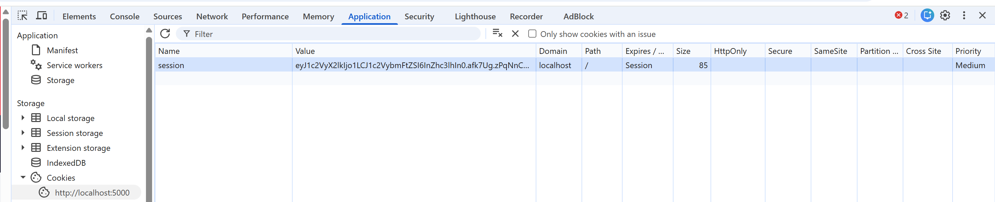
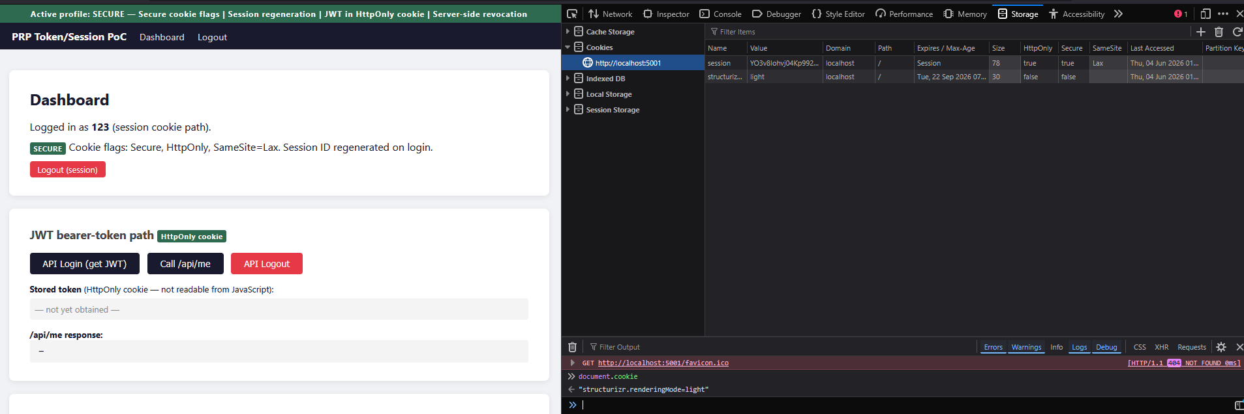
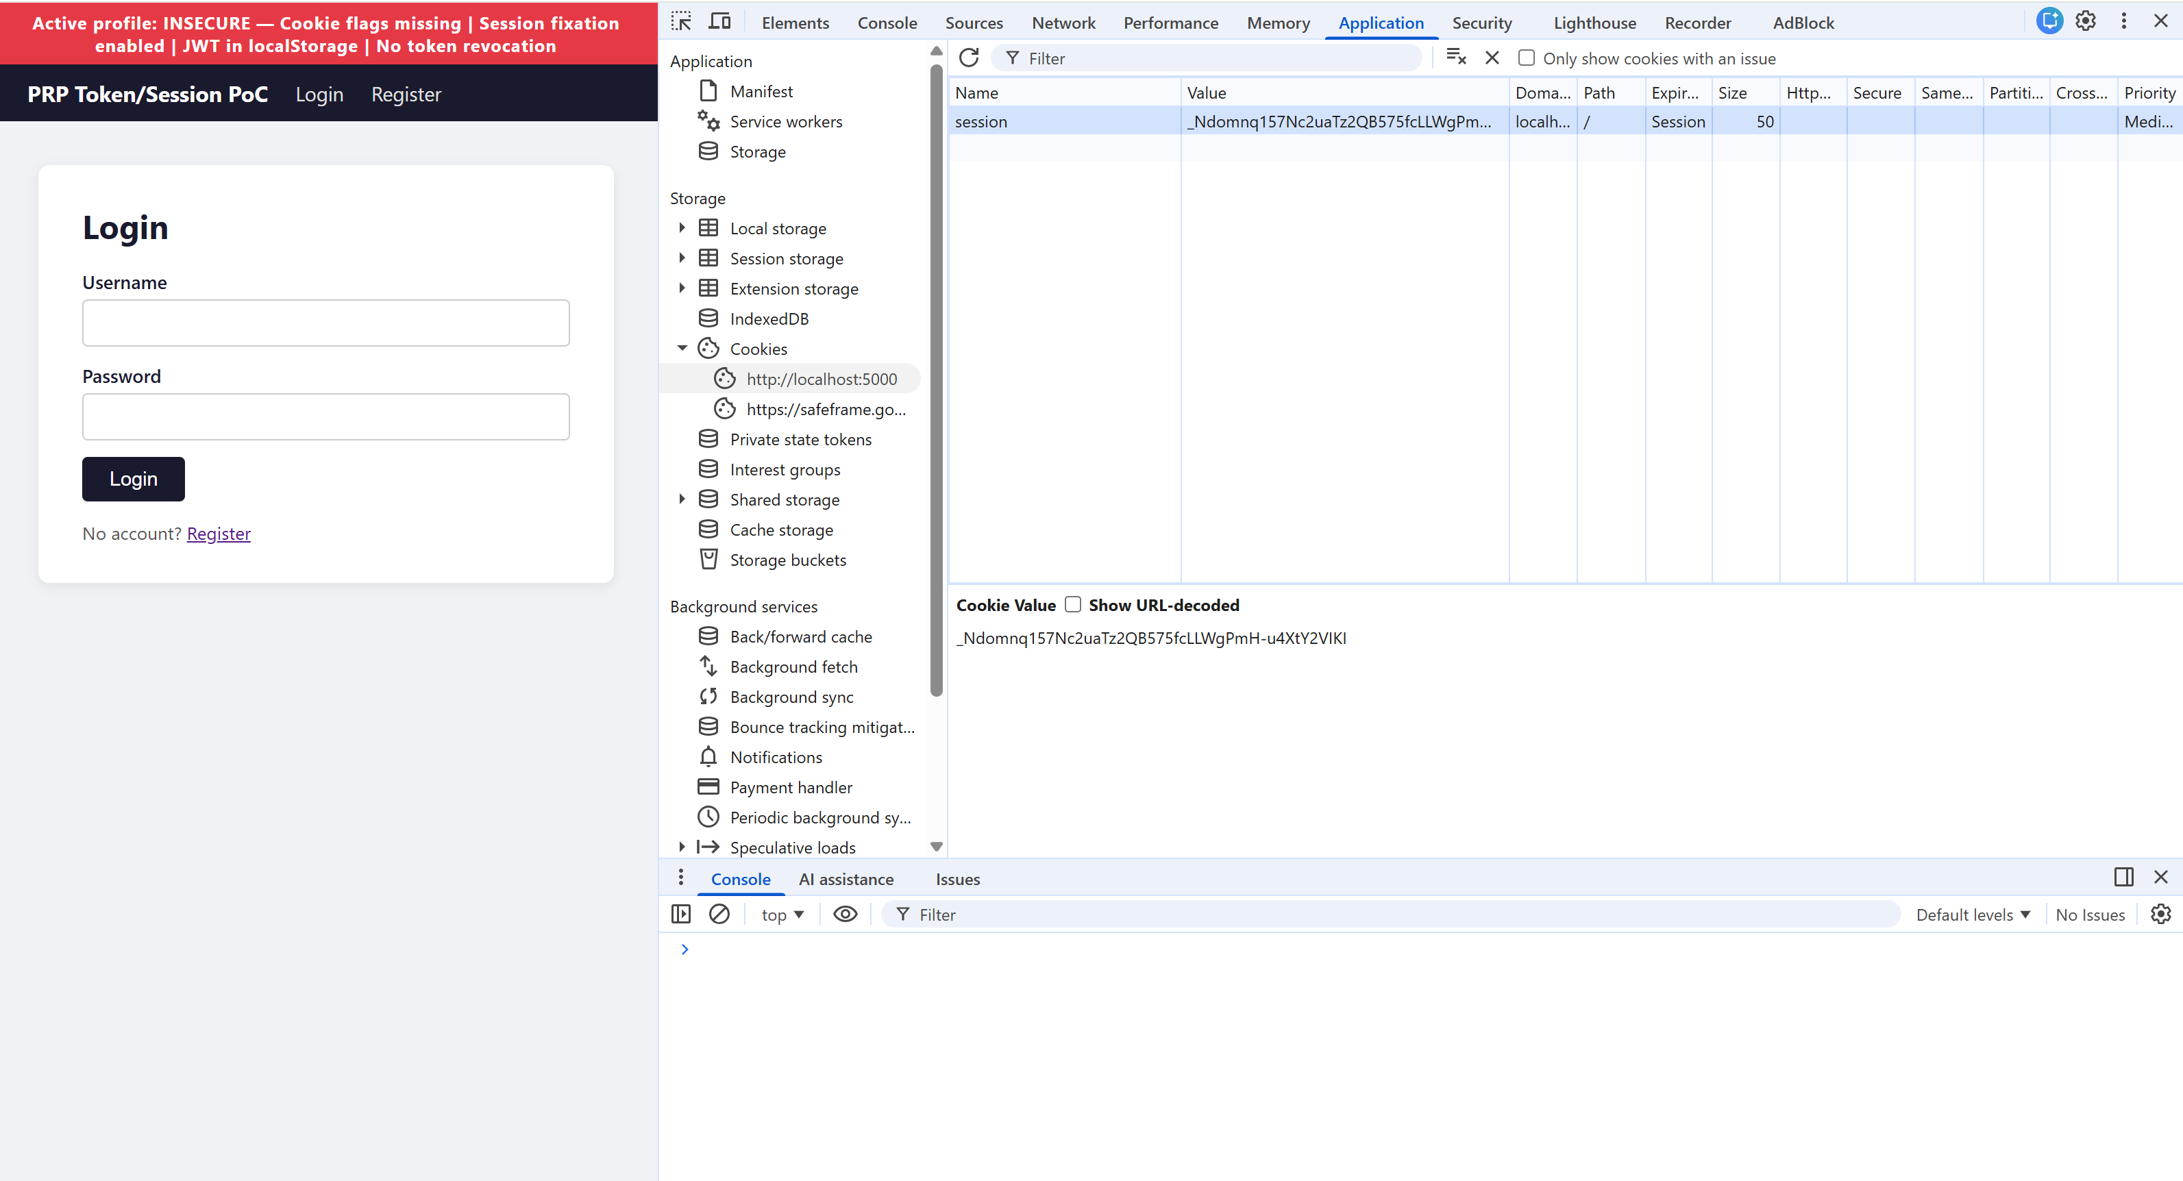
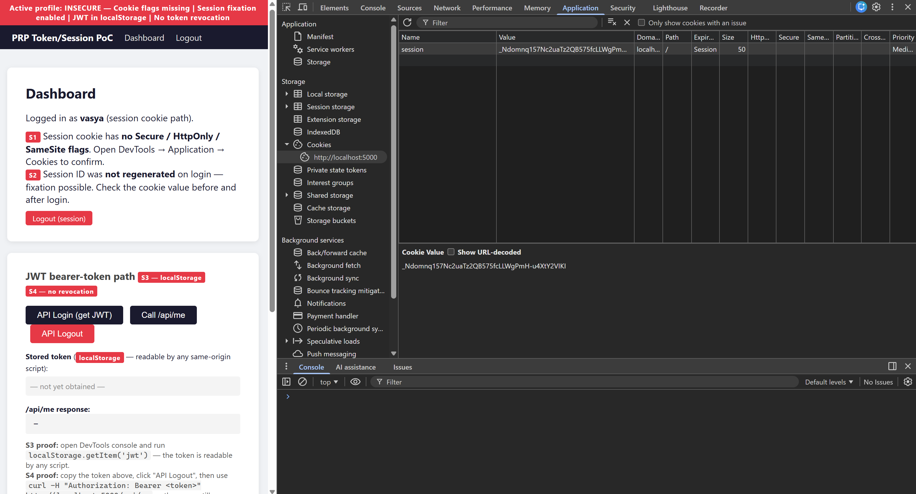
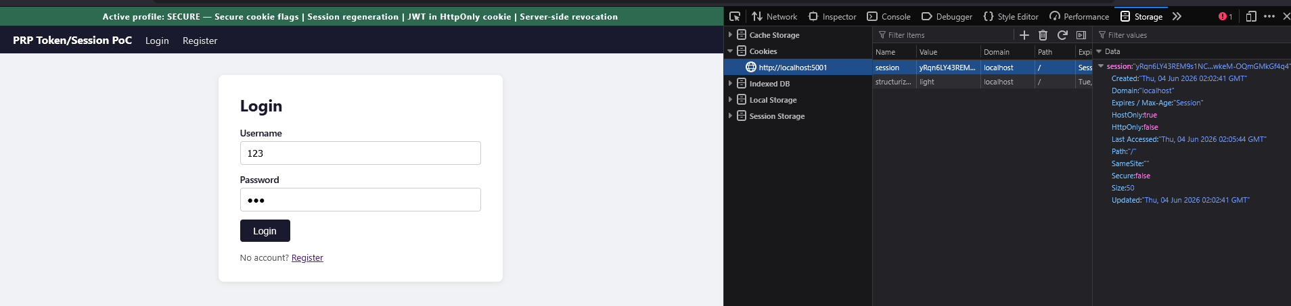
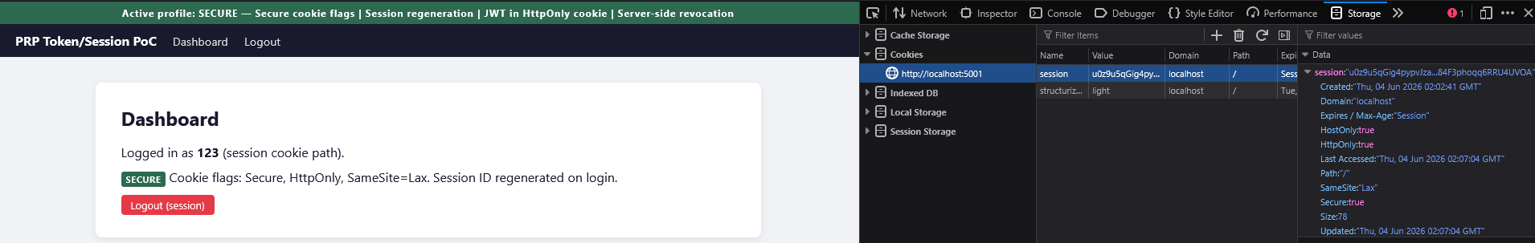
Lab evidence — S1: Missing cookie flags · S2: Session fixation
BEFORE — S1 (INSECURE): no cookie flags
AFTER — S1 (SECURE): flags applied
BEFORE — S2 (INSECURE): same session ID after login
AFTER — S2 (SECURE): new session ID on login
Before login
Before login
Attacker takes over
After login — different ID

Slide 8
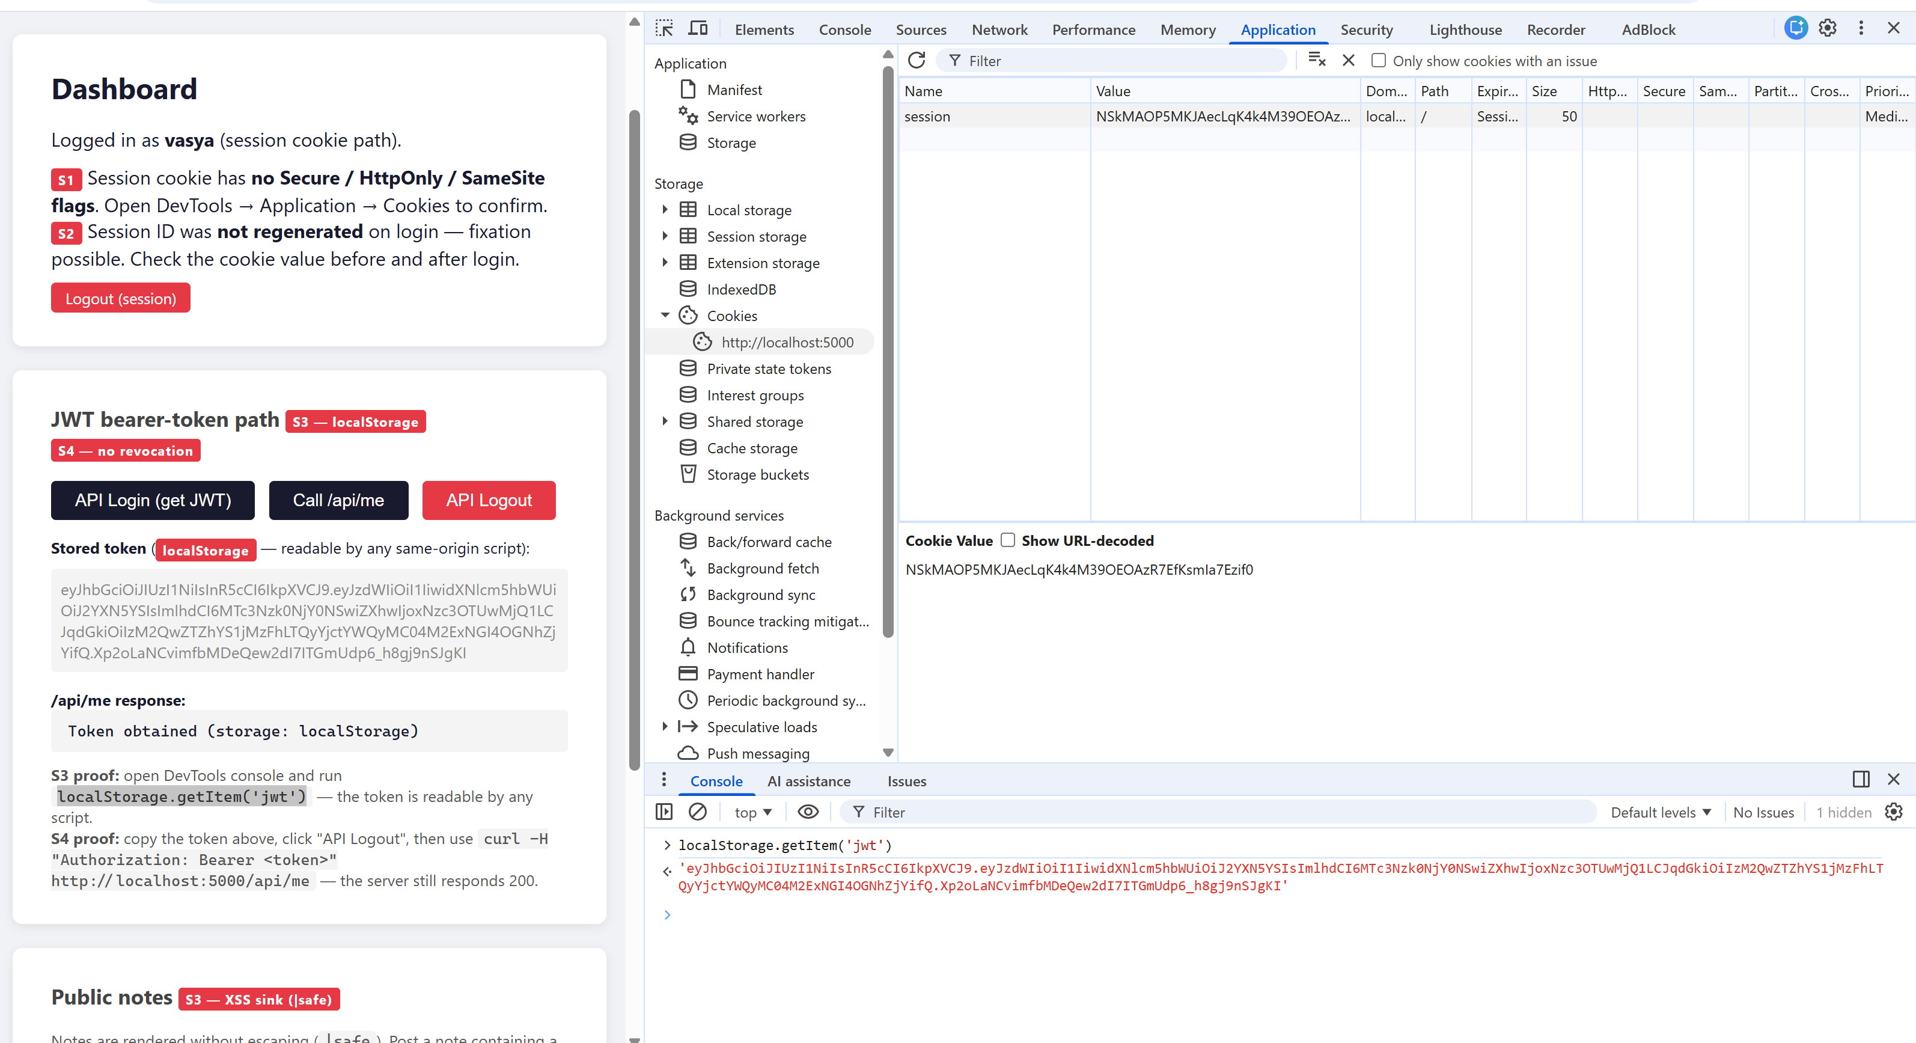
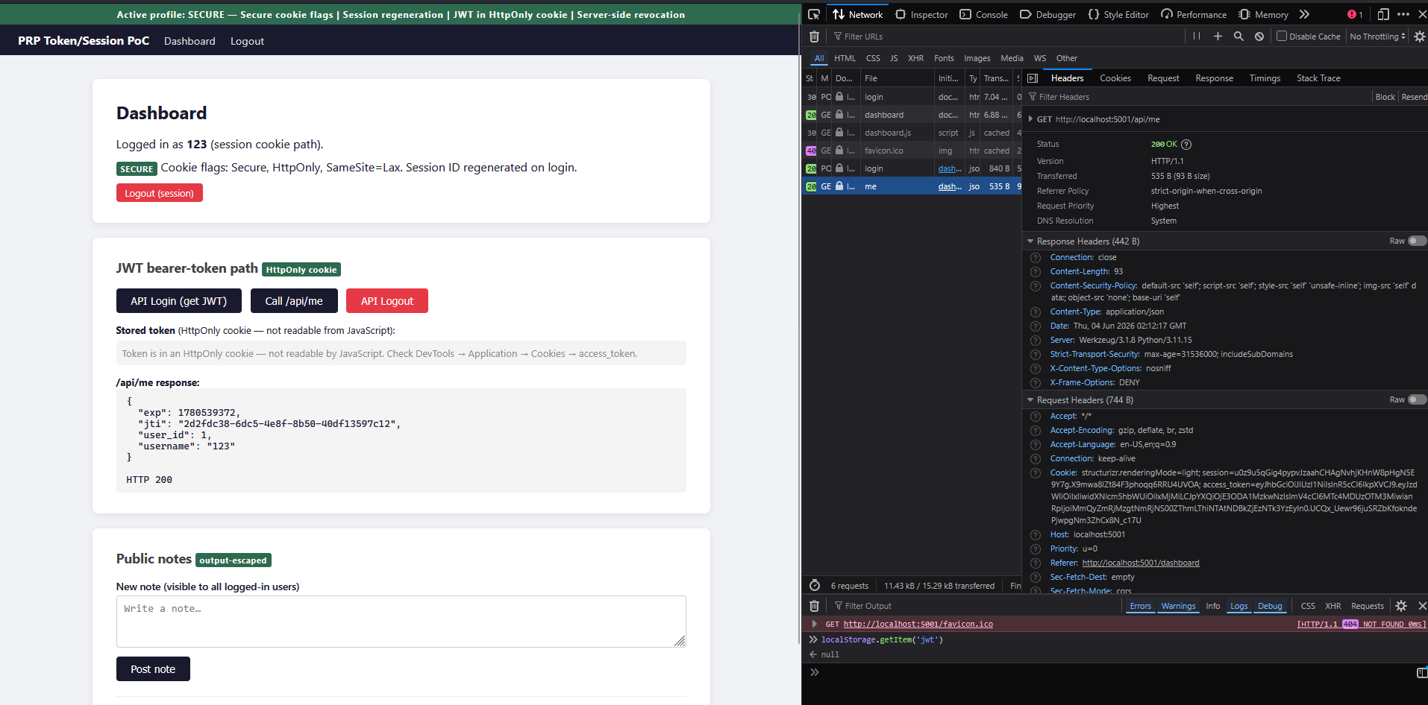
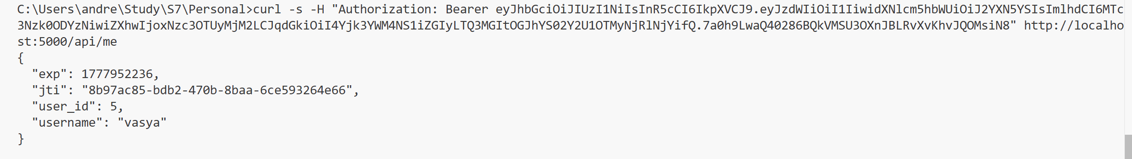
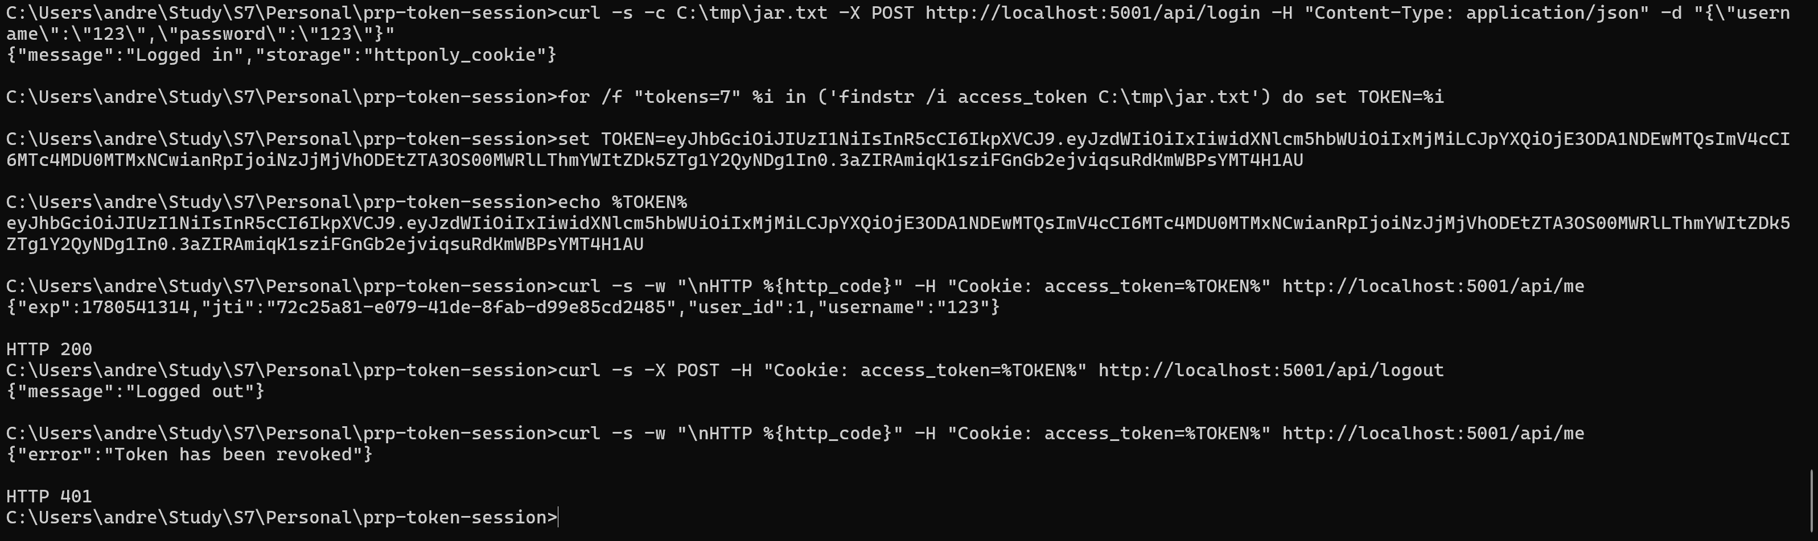
Lab evidence — S3: XSS token theft · S4: Broken logout
BEFORE — S3 (INSECURE): JWT in localStorage
AFTER — S3 (SECURE): token in HttpOnly cookie
tokens.log: 2026-05-05T02:07:22 | eyJhbGci…vasya
BEFORE — S4 (INSECURE): token valid after logout
AFTER — S4 (SECURE): jti deny-list enforced
Same token from tokens.log → HTTP 200 after logout click

Slide 9
Comparative evaluation — insecure vs. secure
Scenario
Weakness
INSECURE result
SECURE result
Residual risk
S1
Cookie flags
Secure/HttpOnly/SameSite absent
Cookie in cleartext pcap;
readable via document.cookie
Flags set in config;
document.cookie = ""
Very low
(HSTS applied)
S2
Fixation
Session ID unchanged
through login
Same cookie before & after;
attacker_dashboard_takeover
New ID on login;
planted ID orphaned
Low
S3
XSS theft
JWT in localStorage;
XSS sink in notes
JWT exfiltrated;
logged in tokens.log
localStorage → null;
CSP blocks fetch()
Low
(CSP + HttpOnly)
S4
Broken logout
No server-side
token revocation
HTTP 200 after logout
(server_after_logout.png)
HTTP 401
"Token has been revoked"
Very low
(jti deny-list)
All four attack scenarios failed against the SECURE profile.

Slide 10
CIA analysis + risk rating
CIA analysis
Risk rating (OWASP methodology)
Scenario
C
I
A
Scenario
INSECURE
SECURE
S1 — Cookie flags
HIGH
HIGH
LOW
S1
HIGH
LOW
S2 — Fixation
HIGH
HIGH
LOW
S2
HIGH
LOW
S3 — XSS theft
HIGH
HIGH
LOW
S3
CRITICAL
LOW
S4 — Broken logout
HIGH
HIGH
LOW
S4
HIGH
VERY LOW
Confidentiality and Integrity are HIGH for all scenarios.
Availability is LOW — none of the attacks disrupt service directly.
~10 lines of code · no new dependencies

Slide 11
Answers to the research questions
Q1
What are the most common vulnerabilities in token and session handling?
Missing Secure/HttpOnly/SameSite cookie flags · session fixation · JWT stored in localStorage · no server-side token revocation. All are OWASP ASVS L1 and Top 10 A07:2021.
Q2
How can insecure storage or transmission of tokens be exploited?
S1: passive network capture extracts cookie from cleartext HTTP. S3: one-line XSS payload exfiltrates JWT from localStorage to attacker server (logged in tokens.log). S4: captured token replays after logout, server returns HTTP 200.
Q3
Which attack scenarios are realistic and feasible for a controlled PoC?
All four: confirmed by OWASP Testing Guide OTG-SESS-002/-003/-006/-009. Each reproduced in Docker using only browser DevTools, tcpdump and curl — no specialised tools.
Q4
What is the security impact on confidentiality, integrity and availability?
Confidentiality HIGH · Integrity HIGH · Availability LOW for all four scenarios. Risk level: CRITICAL to HIGH in INSECURE profile → LOW to VERY LOW after applying SECURE controls.
Q5
Which defensive measures improve security most effectively?
Four baseline controls, in order of effort: cookie security attributes (config only) · session.clear() on login (1 line) · HttpOnly cookie instead of localStorage (1 branch) · jti deny-list (1 DB lookup per request). No new libraries required.
Main research question short answer: token and session handling is insecure by default. The fixes require configuration changes and ~10 lines of code — no new libraries, no architectural redesign.

Slide 12
Body of Knowledge subjects applied in this project
1
1.2 — Threat + Risk Analysis + CIA
CIA analysis applied to all four vulnerabilities (C=HIGH, I=HIGH, A=LOW). Qualitative risk matrix using OWASP Risk Rating — S3 rated CRITICAL in INSECURE profile.
2
1.4 — Law, Ethics + Responsible Disclosure
All experiments restricted to self-built PoC. /set endpoint blocked outside INSECURE mode. NCSC responsible disclosure guideline referenced throughout the research.
3
1.7 — XSS & CSRF
S3 is a stored-XSS token theft attack. SameSite=Lax/Strict addresses CSRF for both session cookie and JWT cookie. CSP (default-src 'self') applied as second line of defence.
4
1.8 — Network Scanning and Enumeration (Sniffing)
S1 uses tcpdump on the Docker bridge network to passively capture plaintext session cookies — a network sniffing attack requiring no active exploitation.
5
1.10 — Secure Remote Access (HTTPS)
Secure cookie flag enforces HTTPS transport per RFC 6265. HSTS header (max-age=31536000) applied in SECURE profile to prevent protocol downgrade attacks.
Questions?

