Slide 1
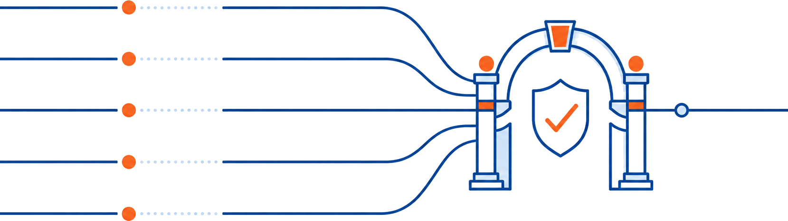
WHAT’S NEW · SINCE THE LUNCH & LEARN
Guardrails: What’s New
From one verified task to a whole team of them — running at once
David Maltby · A few weeks on from the Lunch & Learn · June 2026
github.com/Servant-Software-LLC/Guardrails · ServantSoftware.Guardrails v1.0.0-preview.19
Guardrails — What's New
1 / 10
Notes:
Last time I introduced Guardrails — the harness that makes a single AI task prove it worked before it counts as done. That was a few weeks ago. Since then the project has moved a long way, and the headline is a big one: Guardrails can now run many tasks IN PARALLEL, safely, and still keep every one of the guarantees we talked about. Today is a short 'what's new' — I'll recap in one slide, then spend most of our time on the new parallel engine.

Slide 2
Where We Left Off
RECAP · 60 SEC
① Write a Plan
Markdown
→
② Break It Down
/plan-breakdown
→
③ Review
/guardrails-review
→
④ Execute
guardrails run
The core promise: every task is verifiable, retryable, resumable. Action + deterministic guardrails that prove it worked.
WHAT CHANGED SINCE JUNE 15
We took that promise — prove every task worked — and made it hold while many tasks run at the same time.
Guardrails — What's New
2 / 10
Notes:
Quick refresher for anyone who wasn't here, and a reset for everyone who was. A plan becomes a DAG of tasks; each task does something and then has to pass executable checks — the guardrails. Failures retry with targeted feedback, and an unfixable failure halts honestly for a human instead of pretending it's done. Hold that picture — everything new keeps it true. The whole challenge of the last few weeks was: how do you run tasks concurrently without weakening a single one of those guarantees?

Slide 3
The Headline: Parallel Execution
Before — Serial
maxParallelism: 3
Now — Parallel
01 → 02 → 03 → 04
one task at a time
independent work waits its turn for no reason
01
02
03
three tasks in flight at once
04
04 waits on its deps, then runs
The DAG already knew which tasks were independent. Now the scheduler USES that — filling the parallel slots with work that doesn’t depend on each other.
Turn it on: maxParallelism: 3 in guardrails.json. Serial (1) stays the safe default — you opt in.
Guardrails — What's New
3 / 10
Notes:
This is the big one. The dependency graph always told us which tasks could run side by side — the doc-update task never needed to wait for the feature task. Before, we ran them one at a time anyway. Now the scheduler runs up to three at once by default. Three is deliberate — impressive in a demo, gentle on disk. And notice: serial is still the default. You opt INTO parallel; you don't get surprised by it. The hard part wasn't running things at once — it was doing it WITHOUT two agents stepping on each other. That's the next three slides.

Slide 4
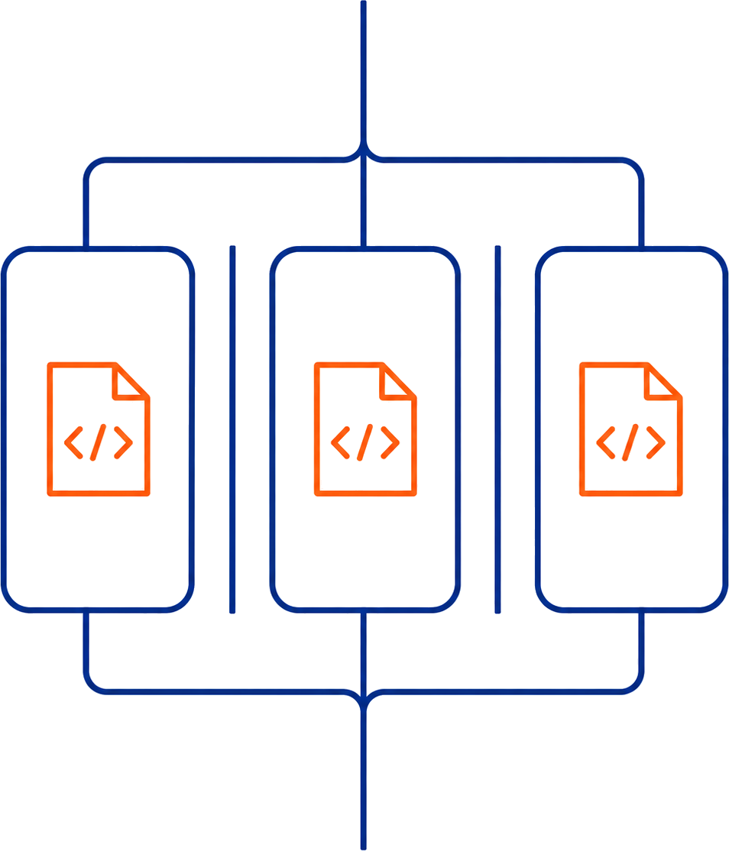
① Worktrees Isolate
The danger with concurrency: two agents writing the same workspace → corruption. The fix is physical, not clever.
Each running task gets its own git worktree — a separate working copy on its own branch. Each writes only its own tree; the harness merges results back one at a time.
“Agent B clobbered agent A’s edits” is structurally impossible — not mitigated. Impossible.
A linear chain reuses one worktree, passed along — so we don’t pay for trees we don’t need.
Guardrails — What's New
4 / 10
Notes:
The instinct is to solve concurrency with locks and cleverness. We didn't. Each task runs in its own physical copy of the repo — a git worktree — so there is simply no shared mutable workspace for two agents to fight over. The whole class of 'one agent overwrote the other's work' bug doesn't get reduced, it gets removed by construction. And we're careful about cost: if tasks form a straight line, they hand the same worktree down the chain instead of making a fresh copy each time. Git shares the history under the hood, so what multiplies is just the working files, not the whole repo.

Slide 5
② The Write-Scope Check
Each task can declare what it’s allowed to write — its writeScope. After the action runs, a deterministic, read-only check (just a git diff membership test) confirms the task only touched files inside that surface.
It buys us | How
Small, clean diffs | a task that strays outside its scope fails early and locally — a retry, not a tangled conflict later
TDD enforced for free | the implementation task’s scope EXCLUDES the test files — it literally cannot edit the tests to pass
Easier merges later | narrow, non-overlapping diffs rarely conflict when two parallel branches finally meet
It writes nothing and reverts nothing across tasks — it’s a pure check.
On a violation, only the out-of-scope files are rolled back, and the agent retries with “you touched files you weren’t allowed to — here’s the list.”
This replaced the older hash-capture machinery for protecting test files — same guarantee, far simpler.
Guardrails — What's New
5 / 10
Notes:
This replaced an older, fiddlier mechanism for protecting test files with something much simpler: just declare what a task is allowed to write, then deterministically check the diff stayed inside it. The elegant part is what it gives us almost for free. The TDD rule we care about — the code can't quietly edit the tests to make them pass — becomes a one-line scope: the implementation task's write-scope excludes the test files, so editing them is a guardrail failure, full stop. And small, well-scoped diffs are the thing that makes the next slide — merging concurrent work — tractable.

Slide 6
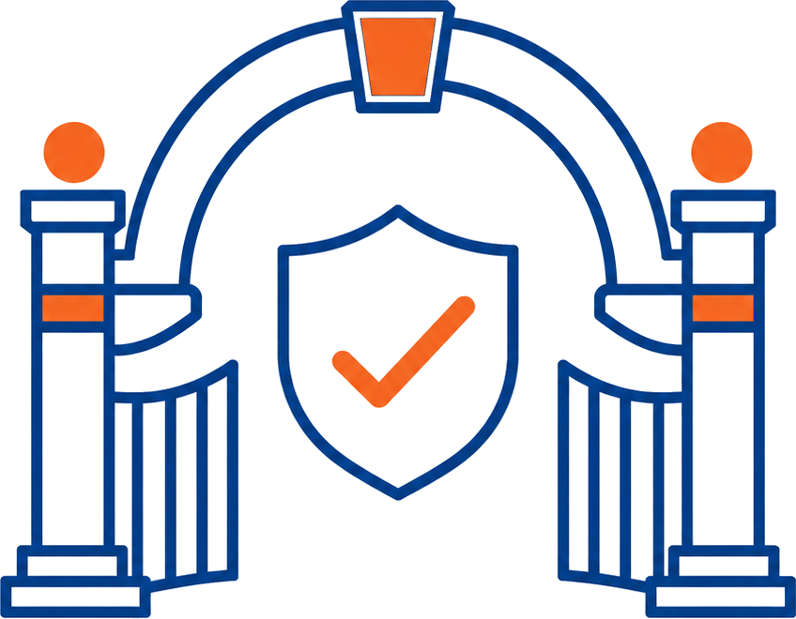
③ A Prompt Proposes, a Gate Certifies
git auto-merge
tries first
→
AI resolves conflict
BYTE producer — never the verdict
→
Deterministic re-verify
build + tests on merged bytes = the verdict
Two deterministic checks gate the AI’s bytes — no conflict markers left; only the conflicted files touched. The AI never gets a softer gate. Can’t pass → honest halt for a human.
“A prompt may propose — only a deterministic gate may certify.”
A final whole-repo gate runs once at the end and backstops every merge.
Guardrails — What's New
6 / 10
Notes:
This is the heart of the whole design, and the one sentence I'd want you to walk out with. We let an AI do something genuinely useful — resolve a merge conflict, which is fiddly, judgement-heavy work. But we never let the AI decide that it worked. Its output is just bytes. Those bytes only count after deterministic checks confirm it didn't cheat — no leftover conflict markers, no touching files outside the conflict — and then the real verdict is the same build-and-test re-verify that a clean automatic merge would face. The AI gets no discount. If it can't pass, the run halts honestly for a human. That principle — a prompt may propose, only a deterministic gate may certify — is what lets us use AI aggressively AND trust the result. It's the same idea as the guardrails themselves, now applied to merging.

Slide 7
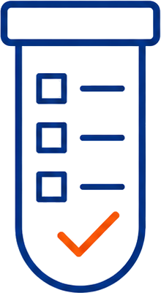

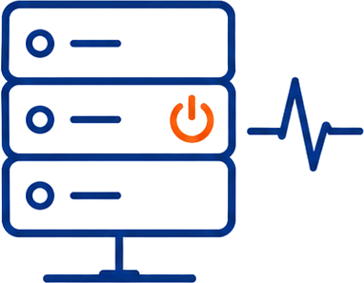
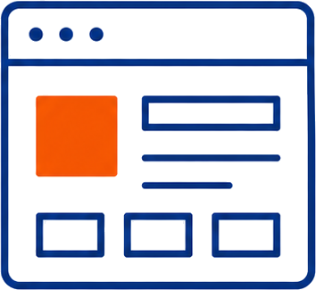
The Breakdown Skill Got Smarter
/plan-breakdown now generates better task folders out of the box:
Tests-first by default
No silent guesses
Writes the author-the-tests task BEFORE the implementation task. TDD is the default doctrine, not an afterthought.
If the test framework is ambiguous it ASKS you — instead of quietly picking one and surprising you.
Servers & executables get wired up
UI plans get real UI tasks
Inserts an entry-point-wiring task and a live smoke test: “does it actually start and respond?” — not just unit tests.
Implementation tasks plus UI-presence guardrails, so a “build the screen” plan can’t pass with an empty screen.
Guardrails — What's New
7 / 10
Notes:
The other half of the work went into the skill that turns your plan into the task folder. It's gotten a lot more opinionated in good ways. It defaults to test-driven — tests get authored first, as their own task. It refuses to guess silently: if it can't tell which test framework you use, it asks rather than picking one and surprising you. For anything that runs as a server or an executable, it now adds a task that actually wires up the entry point and a smoke test that boots it and checks it responds — because 'it compiles' isn't 'it runs'. And for UI work it generates real UI tasks with checks that the UI is actually present. The theme: push more correctness into the generated structure, before a human even reviews it.

Slide 8
Sharper Feedback & Clearer Eyes
The everyday-experience upgrades that make all of the above usable:
Upgrade | Why it matters
Verify, don’t replay | guardrails check the action’s recorded output — they don’t blindly re-run it and hope for the same answer
Streaming logs | the agent’s transcript and output stream to disk live — watch a task think in real time
Interactive DAG diagram | diagram.html — pan, zoom, full-screen, and click through to each task
Clickable log links | the run prints links straight to each task’s post-mortem logs
Honest budget halt | a per-run cost cap (maxCostUsd) stops the run cleanly when the dollar budget is hit
Guardrails — What's New
8 / 10
Notes:
None of this is glamorous, but it's what makes the engine pleasant to live with. Guardrails now verify the output the action actually produced rather than re-running things and hoping for determinism. Logs stream to disk as the agent works, so you can watch a long task unfold instead of staring at a spinner. The dependency graph is now an interactive HTML diagram you can pan, zoom, and click into. The run hands you clickable links straight to the logs for any task that needs a look. And there's a real cost cap — set a dollar budget, and when it's reached the run stops honestly instead of quietly burning money. Small things, but they're the difference between a demo and a tool you'd actually leave running.

Slide 9
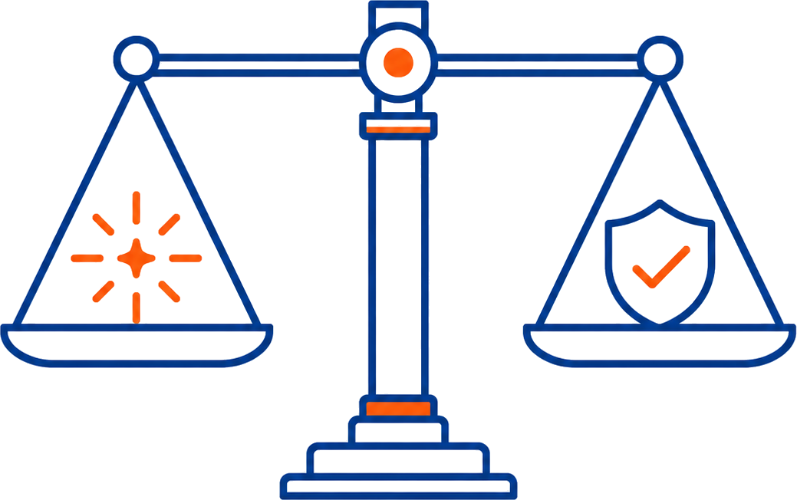
The One Idea
“A prompt may propose — only a deterministic gate may certify.”
New capability | The proposer (AI) | The certifier (deterministic)
Parallel execution | agents work concurrently | worktrees isolate; the harness merges
AI merge-resolution | AI resolves the conflict | 2 checks + build/test re-verify on merged bytes
Write-scope | the action edits files | a git diff membership check
Smarter breakdown | the skill proposes tasks | human review + the guardrails still gate
We let AI do more — by trusting it less. That’s the whole trick.
Guardrails — What's New
9 / 10
Notes:
If there's a single thread through all of this, it's that line. We gave AI agents MORE freedom this cycle — to run in parallel, to resolve merge conflicts, to scaffold richer task structures. And the way we made that safe was not to trust the AI more — it was to put a cheap, deterministic gate in front of every place the AI proposes something. More autonomy on one side, more verification on the other. That balance is the entire philosophy of the project, and the parallel engine is just the biggest example of it so far.

Slide 10
Getting Started & Questions
Update to the latest preview
Takeaways
dotnet tool update --global \
ServantSoftware.Guardrails --prerelease
guardrails skills install
# refresh /plan-breakdown & /guardrails-review
1
Parallel now
up to 3 tasks at once, isolated by git worktrees
Go parallel — in guardrails.json
AI merges conflicts
but only behind deterministic gates
2
{ "maxParallelism": 3 }
3
Smarter breakdown
TDD-first, smoke tests, UI tasks, no silent guesses
Requires git (worktree mode). Serial runs (1) need no git and keep the old model.
ServantSoftware.Guardrails · v1.0.0-preview.19
github.com/Servant-Software-LLC/Guardrails
4
One principle throughout
a prompt may propose, only a deterministic gate may certify
Guardrails — What's New
10 / 10
Notes:
To try it: update the tool, re-install the skills so you get the smarter breakdown, and add one line to your config to go parallel. The only new requirement is git, and only when you actually turn parallelism on — serial runs are unchanged. I'm dogfooding all of this on real work right now, including using Guardrails to build Guardrails. Happy to take questions, or to sit down and break down one of your real plans afterward.

