Slide 1
JSTL : JSP Standard Tag Library
pichet@sit.kmutt.ac.th
Notes:
ตายแล้วไปไหน เราเกิดมาเพื่ออะไร
เรา สำคัญกว่าทุกสิ่งอย่างในโลก

Slide 2
JSP Standard Tag Library (JSTL)
Encapsulates as tags the core functionality of many Web applications
Supports tasks such as:
Flow (iteration and conditionals)
Manipulation of XML documents
Internationalization tags
SQL tags
Java EE 1.4 includes both JSP tags and the JSTL
JSTL taglibs are included with Rational Application Developer / NetBean IDE
Notes:
Notes:
The JSTL is a collection of custom tag libraries that implement general-purpose functionality common to Web applications. This includes iteration and conditional processing, data management formatting, manipulation of XML, and database access. Although you learn later in this unit how to create your own tags, be sure to always consider existing tag libraries first. Especially consider the JSTL, which is included with Rational Application Developer as part of its support for JSP 2.0.
The Jakarta Project also makes available a wide selection of tag libraries. Some of these are also included in Rational Application Developer, but the entire set may be downloaded freely from http://jakarta.apache.org/taglibs/.
Instructor notes:
Purpose — Explain and motivate use of JSTL.
Details —
Additional information —
Transition statement — Next: Sample JSTL Tags

Slide 3
Sample JSTL tags
Set a variable in a specific scope to a value
<c:set var="name" scope="scope" value="expression"/>
Display a value, or an alternative if the first value is null
<c:out value="expr" default="expr" escapeXml="boolean"/>
Example:
Hello <c:out value="${user.name}" default="Guest"/>!
Conditional execution
<c:choose>, <c:when> and <c:otherwise>
<c:choose> <c:when test="${user.role == 'member'}"> <p>Welcome, member!</p> </c:when> <c:otherwise> <p>Welcome, guest!</p> </c:otherwise> </c:choose>
Notes:
Notes:
Instructor notes:
Purpose — Give examples of some useful but simple JSTL tags.
Details —
Additional information —
Transition statement — Next: ForEach Tag

Slide 4
forEach tag
The forEach tag provides flexible iteration through a set of items, Its targets include:
Collections, Maps, Iterators, Enumerations
Arrays
Comma-separated values (CSV) data
Example:
<table>
<c:forEach items="${customers}" var=“cust">
<tr>
<td>${cust.name}</td>
<td>${cust.addr}</td>
</tr>
</c:forEach>
</table>
Notes:
Notes:
Instructor notes:
Purpose — Explore the forEach tag.
Details —
Additional information —
Transition statement — Next: Anatomy of a Tag

Slide 5
Exercise

Slide 6
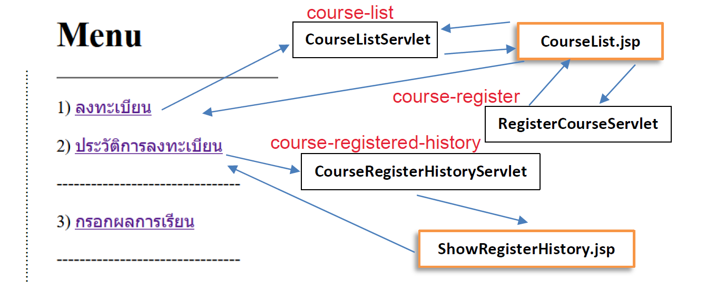
URL Mapping
register

Slide 7
Application State Management

Slide 8
The session problem
Servlets and JSP pages should be stateless
They should not have instance variables
They support multiple concurrent threads
Application state information specific to a user must be stored outside of the servlet
This is called Session State
Determining what to do with it is one of the most challenging problems in servlet programming
Session state is session data, and is only used for a set of linked Web pages (your Web application)
Notes:
Notes:
HTTP is a stateless protocol. It does not have the notion of a connection as other protocols (such as with TCP/IP sockets, LU6.2, and so forth) have. Each HTTP request-response pair is a unique entity unto itself, and does not have a relation (within the protocol) to other request-response pairs. However, a Web site needs to have certain client information shared among all of the servlets or CGI programs that provide its dynamic content.
For instance, the servlet that displays the contents of a shopping cart must know what has been previously placed in the shopping cart. This transient shared information is often called session data because it represents the connection (a user session) between the various programs or servlets that a user will touch during a visit. This should not be confused with transaction data that is permanently stored (usually in a database).
Don’t think of this as just HttpSession data; the use of the HttpSession support is just one way of managing the session state and session data.
Instructor notes:
Purpose — You cannot manage the client’s data from within the servlet and JSP page.
Details — Because client data must be stored outside of the servlet or JSP page, you are forced to have the client involved in the saving of the client related data. There are several approaches to this:
Hidden fields
Cookies
URL rewriting
Additional information —
Transition statement — To make your lives even more interesting, you have to worry about how your Web-based application scales to large traffic volumes. This could entail multiple systems processing servlets. Another twist to the session sharing problem is how to share data when different parts of the Web application may run on different systems during its life.

Slide 9
Session strategies: review
Session state can be stored on either the client or the server
Examine several session management strategies and figure out where each applies
Client Side
Server Side
Cookies
Hidden Fields
URL Rewriting
HTTP Session
Content Based Routing
Store state in a database
JWT: JSON Web Token
Notes:
Notes:
You continue looking at these strategies after you have covered the topics of Cookies, URL Rewriting, and HttpSession in more detail.
Instructor notes:
Purpose — Bridge between the overview and the detailed discussion.
Details — We’ve talked about storing session data in the client and saving it in the server. The next few units cover these approaches in detail, and summarize the pros and cons of each approach after the detail units.
Additional information —
Transition statement — The next units will look at Cookies, HTTP Sessions, and URL Rewriting. The unit following those summarizes the pros and cons of each approach.

Slide 10
Cookies
Cookies are a way to place persistent information on the client machine (accessible from the browser)
A good way to handle preferences or shortcuts
Cookies have a name and a value
Notes:
Notes:
A cookie is a piece of data passed between a Web server and a Web browser. The Web server sends a cookie that contains data that it requires the next time the browser accesses the server. The client returns the cookie on each subsequent request. This is one way to maintain the state between a browser and a server.
Cookies come in two flavors: persistent and non-persistent. They have a number of properties, including a name and a value. Cookies are frequently used to save user preferences and identification information.
Note that most browsers allow cookies to be disabled at the user’s option. Don’t write all of your application code with the assumption that they are available (more on how WebSphere handles that later).
Instructor notes:
Purpose —
Details —
Additional information — Cookies are a way to deal with the stateless nature of the HTTP protocol.
Transition statement — Next: Cookie API

Slide 11
Cookie API
Creating cookies
Cookie(String name, String value)
Sending a cookie back to the browser
HttpServletResponse.addCookie(Cookie aCookie)
Retrieving cookies
HttpServletRequest.getCookies()
Retrieving a cookie’s name
aCookie.getName()
Retrieving a cookie’s value
aCookie.getValue()
Changing a cookie's value
aCookie.setValue(String)
Notes:
Notes:
You can create a Cookie through the two-argument constructor.
Cookies are returned to the browser by adding them to the HTTP response stream. This is done by the addCookie() method on the HttpServletResponse object. To retrieve incoming cookies from the browser, use the getCookies() method on the HttpServletRequest object. Be aware that you cannot ask for the cookie with a specific key. You must ask for all cookies and find the specific one that you are interested in.
All cookie properties are exposed via getter and setter methods.
Instructor notes:
Purpose —
Details —
Additional information —
Remind them that the browser (client) ultimately controls whether cookies are accepted. The servlet doesn’t know whether the cookies were accepted until the next request is received and no cookies are returned. This topic is covered later in the unit, including some sample code that detects if the browser is accepting cookies.
Although the request returns all cookies, it really only returns all cookies that originated from the same domain.
Transition statement — Next: Cookie Example

Slide 12
Cookie usage example
public void doGet(HttpServletRequest req, HttpServletResponse res) {
String userType = "novice";
Cookie[] cookies = req.getCookies();
if (cookies != null) {
for (int i=0; i<cookies.length; i++) {
if(cookies[i].getName().equals("userType"))
userType = cookies[i].getValue();
}
}
if (userType.equals("expert"))
// do expert HTML
else
// do novice HTML
}
Notes:
Notes:
This simple example shows you how to get a cookie to determine which choice of two types of output to use. User preferences are good candidates for storage in cookies.
doGet() throws exceptions that were not included in the code above.
Instructor notes:
Purpose —
Details —
Additional information —
Transition statement — Next: Proper Cookie Usage

Slide 13
Proper cookie usage
Because cookies are stored as plain text on the client machine, cookies can be viewed and altered by the client
Cookies should not be used for information such as:
Validation information
Secure information (credit card numbers and the like)
Notes:
Notes:
Cookies can be disabled on the client browser. A client may do that if concerned about privacy issues with the use of cookies. Thus, you should use cookies with the respect of the client in mind.
On the client, cookies that are persisted (that is, which have maxAge > 0) can be viewed and altered by the client.
Instructor notes:
Purpose —
Details — Note that HttpSession support has not been discussed yet. If this is a normal class, you cover that in a later lecture topic. If this is a custom offering and the HttpSession support is NOT going to be covered, you should talk about it here to give this slide some context.
Additional information —
Transition statement — Next: Cookie Applicability

Slide 14
Cookie applicability
Cookies have an expiration date
setMaxAge(int expiryInSeconds)
Default expiration date is -1
This means that the cookie is not stored persistently
It lasts only as long as the browser is open
Can restrict the applicable URLs to which a cookie will be sent
setDomain(String)
setPath(String)
Notes:
Notes:
A MaxAge of 0 is a request for the browser to delete the cookie.
Two other properties control which URLs a cookie is to be delivered to. Domain specifies which hosts the cookie can be delivered to (the default is the host name of the server that created the cookie). If there is a tail match, the cookie will go through path matching to see if the cookie should be sent to the Web server.
For example: A domain attribute of .ibm.com will match host names www.ibm.com, www.ilscs01.ibm.com, and so on. Only hosts within the specified domain are allowed to set a cookie for that domain. The domain name must have two or three periods to prevent domain names of the form .com or .org. Domain names that don’t fall within the special top-level domains (COM, EDU, NET, ORG, GOV, MIL, and INT) must have three periods.
Path specifies which subset of URLs in a domain are valid for a cookie. Once the cookie has passed domain matching, the path name of the URL is compared with the path value specified in the cookie. If there is a match, the cookie is valid and is sent to the Web server for that request. The path /acc would match /accounting, /acc/index.html, and so on. If the path is not specified, it is assumed to be the same path as the document that contains the cookie.
You cannot detect if the client’s browser is accepting cookies in one HTTP request. Your application has to set the cookie on one response and then try to read it back in another request. If the cookie is on the second request, you know that the browser accepted the cookie.
Instructor notes:
Purpose —
Details — Transient and expired cookies will be deleted by the browser according to its own approach. When a cookie is returned, only the key-value is retrieved; all other settings (maxAge, domain, and so on) are not available.
Additional information — More information on testing browsers for cookies enablement is present in later slides in this unit.
Transition statement — Next: Client Data and Session Management by Cookies

Slide 15
Client data and session tracking with cookies
Cookies can be made to persist within or across browser interactions
Cookies are passed to the Web server in the header of the request
Any updates are passed back in the header of the response
Session data tracking via HTTP cookies is the most commonly used session tracking mechanism
Required to be supported by all Web containers
Notes:
Notes:
Cookies can be used to manage client data, such as maintaining client-side session state data.
When using the HttpSession support in the Servlet API, the application server’s Session Manager can use cookies to store a session ID on the browser. This cookie is not stored persistently. On WebSphere Application Server, the default name of this cookie is JSESSIONID, as mandated by the Servlet specification.
Instructor notes:
Purpose —
Details —
Additional information —
Transition statement — Next: Checking If Cookies Are Accepted on Browser

Slide 16
Http Session
The HttpSession interface, part of the Servlet API, provides an interface for managing application state on the server
Session Usage:
Servlet asks to bind to the Session object representing the current session:
A session is requested – request.getSession(boolean create)
The method returns the current HttpSession, if it exists
If create is true (or no parameter is specified) AND no current Session exists, a newly created session is returned
The session is unavailable when:
The client browser is closed
The session is explicitly invalidated
The session times out
Notes:
Notes:
Access to the session object is via the HttpServletRequest object. A request is on behalf of a specific client. Code can ask the request object for the session object associated with the current client via the getSession method. If a session object exists for the current client, it is returned by this method.
The parameter (if specified) determines the behavior of the method, if no current session exists for the client. If the parameter is true, a new session object is created on behalf of the client. If false, a null object is returned. There is a no-parameter version of this method, which is equivalent to getSesstion(true).
By default, IBM WebSphere Application Server uses a cookie as the mechanism to track the session id. A servlet should be able to handle cases in which the client chooses not to join a session, such as when cookies are intentionally turned off.
Until the client joins the session, isNew returns true. If the client chooses not to join the session, getSession will return a different session on each request, and isNew always returns true.
Sessions can also be managed by using URL rewriting, but additional programming is needed by the servlets to ensure that all of the links are properly encoded to support the URL rewriting.
Instructor notes:
Purpose —
Details —
Additional information —
Transition statement — Next: HttpSession Data Store

Slide 17
HttpSession data store
HttpSessions store application-specific information
Stored as <"key", object> pairs
void setAttribute(String, Object)
Object getAttribute(String)
Notes:
Notes:
The purpose of the HttpSession object is to act as a place to store arbitrary application data. This data is stored as <name, value> pairs. The methods to access the data are getAttribute() and setAttribute().
Standard session properties include information about the session, such as the session ID, creation time, and last date accessed.
The Application layer data can make the session object large. Be careful not to store large objects, such as graphs, because this can degrade performance. Instead, minimize the size by storing keys to data stored in other sources.
Instructor notes:
Purpose —
Details —
Additional information —
Transition statement — Next: Sessions at Run Time - Server

Slide 18
Sessions at run time
Browser
Application Server
Session Table
ID
value
MKA42O...
SessionR1
...
...
YM4YLEI...
SessionA3
Cookie List
cookie name
value
domain
SessionA3
"JSESSIONID"
YM4YLEI...
.ibm.com
key
value
"customer"
aCustomer
"name"
"Bob"
Notes:
Notes:
The end-to-end picture has a session ID stored in a Cookie on the browser. In addition, the session object is stored on the server, managed by the Session Manager, and associated with the session ID.
Instructor notes:
Purpose —
Details —
Additional information —
Transition statement — Next: Session Invalidation

Slide 19
Session invalidation
Release HttpSession objects when finished
An Application Server can only maintain a certain number of HttpSession objects in memory
Sessions can be invalidated either programmatically or through a timeout
session.invalidate
Removes all values from the session
The session timeout (inactive interval) can be set for the application server as a whole
The default timeout is 30 minutes
Also session.setMaxInactiveInterval(int) can provide session-specific timeout value
Notes:
Notes:
One problem with session management is the conceivably large number of sessions created, with little ownership for the responsibility of cleaning up abandoned sessions. A client can choose to go to another site or just close its browser, which orphans the corresponding session data.
Sessions are also assigned a maxInactiveInterval (or time to persist). The Session Manager keeps track of inactivity on sessions. When a session has been inactive for longer than its maxInactiveInterval, the Session Manager will invalidate the corresponding session.
Within WebSphere Application Server, you can set a maximum number of sessions. The base in-memory session pool size number has different meanings, depending on the session support configuration:
When sessions are being stored in memory, session access is optimized for up to this number of sessions.
When sessions are being stored in a database, it also specifies the cache size and the number of last access time updates that are saved in manual update mode.
After the base in-memory session pool size is surpassed, sessions are simply not cached, and session updates are automatically sent back to the database, without checking for their presence in the cache.
Note that increasing the base in-memory session pool size can necessitate increasing the stack sizes of the Java processes for the corresponding WebSphere application servers. By default, the number of sessions maintained in memory is specified by base in-memory session pool size. If you do not wish to place a limit on the number of sessions maintained in memory (and to allow overflow), set this value to true.
Allowing an unlimited amount of sessions can potentially exhaust system memory, and even allow for system sabotage. Someone could write a malicious program that continually hits your site and creates sessions, but ignores any cookies or encoded URLs and never utilizes the same session from one HTTP request to the next.
When overflow is disallowed, the Session Manager still returns a session with the HttpServletRequest's getSession(true) method if the memory limit has currently been reached, but it will be an invalid session that is not saved in any fashion.
With the WebSphere Application Server extension to HttpSession, com.ibm.Websphere.servlet.session.IBMSession, there is an isOverflow method that returns true if the session is such an invalid session. An application could check this and react accordingly.
Instructor notes:
Purpose —
Details —
Additional information —
Transition statement — Next: Session Invalidation Example

Slide 20
Session invalidation example
public class ApplicationLogoutServlet extends HttpServlet {
public void doGet(HttpServletRequest req, HttpServletResponse resp) throws ServletException, IOException {
HttpSession mySession = req.getSession(false);
// Invalidate session
if (mySession != null) {
mySession.invalidate();
}
// Perform additional application logoff processing
// and send output response to browser here
}
}
Notes:
Notes:
When a session is invalidated, it causes all of the values to be removed.
When the limiting number of HttpSessions in memory is reached, they are serialized and swapped to disk. In a high-volume system, the cost of serializing many abandoned HttpSessions can be quite high.
Instructor notes:
Purpose —
Details —
Additional information —
Transition statement — Next: Session Examples

Slide 21
Session serialization
Objects stored in a session must be serializable:
To share between servers in a clustered server configuration
For persistence to work
Make sure that objects reachable from the session are also serializable
When creating objects to be stored in the session, implement the serializable interface as follows :
public class NewObject implements java.io.Serializable {
...
}
Notes:
Notes:
Many application servers need to be able to serialize session objects. This may be to persist them to a data store, or to pass them around between a cluster of servers. In any case, a general rule of thumb is to not store any object on the session object which is not serializable.
WebSphere Application Server supports distributed sessions, both by session database persistence and session sharing across cluster members via memory-to-memory replication. (A cluster is a set of replicated servers, while a cluster member is an instance of a replicated server.)
Within an application that is marked as distributable, all HTTP requests that are part of an HttpSession can only be handled on a single VM at any one time. In addition, objects placed into HttpSession objects via the setAttribute method must implement the serializable interface. The Web container may throw an IllegalArgumentException if a non-serializable object is placed into the session.
Instructor notes:
Purpose —
Details —
Additional information —
Transition statement — Next: Servlet Objects (1 of 4)

Slide 22
Web Container
Application Context
USER A
JSP 1
Servlet A
HttpSession
request.getSesion()
USER B
Servlet B
request.getSesion()
JSP 2

Slide 23
Excercise

Slide 24
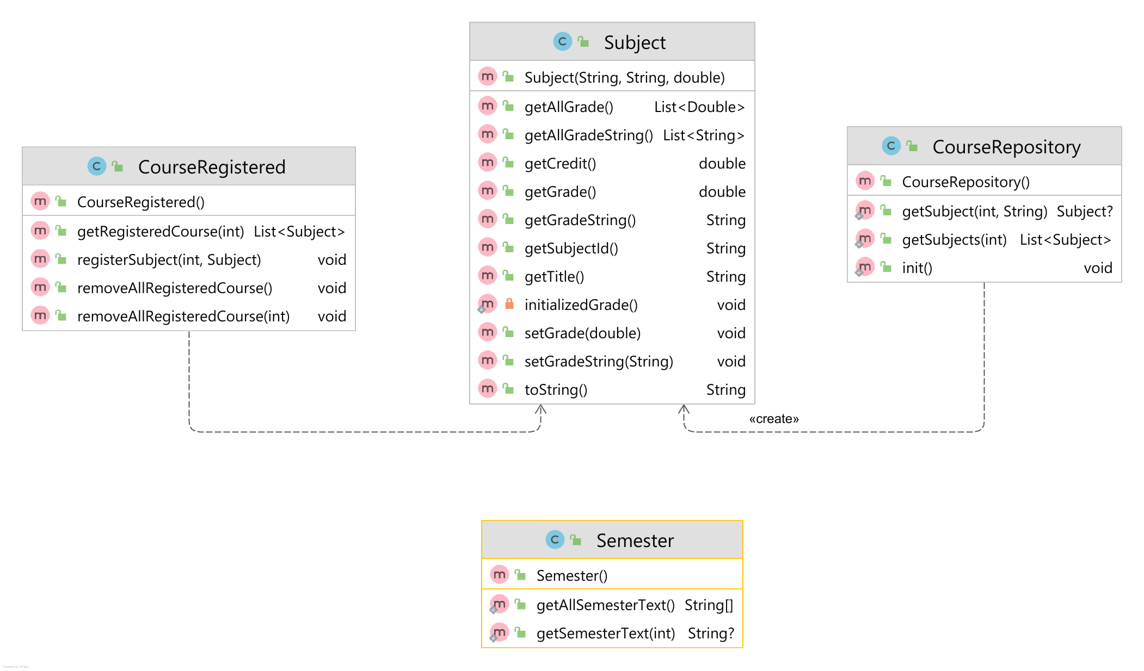
Model

Slide 25
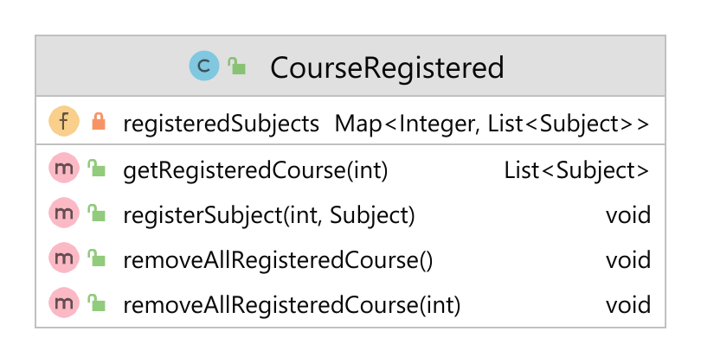
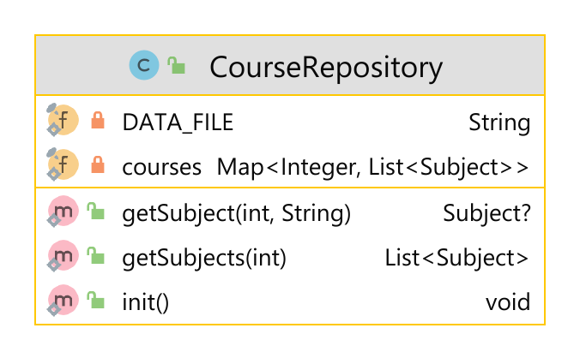
CourseRegistgered & CourseRepository

Slide 26
ข้อมูลในแต่ละ semester (resources/data.txt)
Semester: 1
INT100 Information Technology Fundamentals 3.0
INT101 Programming Fundamentals 3.0
INT102 Web Technology 1.0
INT114 Discrete Mathematics for IT 3.0
GEN101 Physical Education 1.0
GEN111 Man and Ethics of Living 3.0
LNG120 General English 3.0
LNG220 Academic English 3.0
Semester: 2
INT103 Advanced Programming 3.0
INT104 User Experience Design 3.0
INT105 Basic SQL 1.0
INT107 Computing Platforms Technology 3.0
INT200 Data Structures and Algorithms 1.0
GEN121 Learning and Problem Solving 3.0
LNG220 Academic English for Science 3.0

Slide 27
Semester: 8
INT322 Information Technology Seminar II 1.0
INTxxx INT Elective II 3.0
INTxxx INT Elective III 3.0
LNG304 Meetings and Discussions 1.0
XXXxxx Free Elective II 3.0
Semester: 9
INT372 Experiential Learning Project II 3
INTxxx INT Elective I 3
LNG224 Oral Communication I 3
GENxxx GEN Elective I 3
GENxxx GEN Elective II 3
XXXxxx Free Elective I 3
INT308 Security II 2
INT319 Information Technology Professional Practice 4
INT322 Information Technology Seminar II 1
LNG304 Meetings and Discussions 1
GEN351 Modern Management and Leadership 3
GENxxx GEN Elective II 3
XXXxxx Free Elective II 3

Slide 28
Creating Simple Course Registration App
Create new Project (Maven) Project
Name: register
Template: Web Application
Group: sit.int202
Application server: Tomcat 10.0.xxx
-------------------------------------------------
Version: Jakarta EE 9
Add Lombok, JSTL Dependency
Test test_css_jstl.jsp with BootStrap, JSTL & EL using code below
<div style="padding: 10px;display: block;width: 50%;margin: auto">
<c:forEach begin="1" end="100" var="value">
<div class="box">${value}</div>
</c:forEach>
</div>

Slide 29
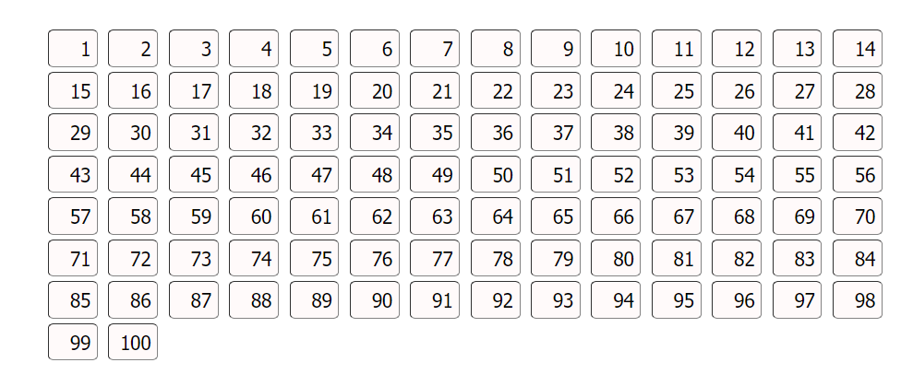
Output (Expected)

Slide 30
Creating Simple Course Registration App (2)
Create package sit.int202.register.models
Copy all models (4) to package sit.int202.register.models
Copy data.txt to resources
Create new servlet CourseListServlet then change url-mapping to course-list
place code below to doGet() method of CourseListServlet
request.setAttribute("semesters",Semester.getAllSemesterText());
getServletContext().getRequestDispatcher("/course_list.jsp").forward(request,response);

Slide 31
Creating Simple Course Registration App (3)
Create view : course-list.jsp
Modify course-list.jsp (download from MS-Teams)
Implementing code in method doPost of CourseListServlet
Map<String, String[]> parameterMap = request.getParameterMap(); request.setCharacterEncoding("UTF-8"); if (parameterMap.get("semester")==null) { doGet(request,response); return; } int semester = Integer.valueOf(parameterMap.get("semester")[0]); request.setAttribute("semesters", Semester.getAllSemesterText()); request.setAttribute("selectedSemester", semester); request.setAttribute("subjects", CourseRepository.getSubjects(semester)); getServletContext().getRequestDispatcher("/course-list.jsp").forward(request,response);

Slide 32
Creating Simple Course Registration App (4)
Create new servlet RegisterCourseServlet then change url-mapping to /register
Implementing code in method doPost of RegisterCourseServlet (use snipped code from next-slide)
Create new servlet CourseRegisterHistoryServlet then change url-mapping to /course-registered-history
Create view : user_registered.jsp
Implementing user_registered.jsp for display all registered subject from HttpSession (DIY)

Slide 33
RegisterCourseServlet.java
protected void doPost(HttpServletRequest request, HttpServletResponse response) throws ServletException, IOException { Map<String, String[]> parameterMap = request.getParameterMap(); int semester = Integer.valueOf(parameterMap.get("semester")[0]); HttpSession session = request.getSession(); CourseRegistered courseRegistered = (CourseRegistered) session.getAttribute("courseRegistered"); if(courseRegistered == null) { courseRegistered = new CourseRegistered(); session.setAttribute("courseRegistered", courseRegistered); } else { courseRegistered.removeAllRegisteredCourse(semester); } for(String subjectId : parameterMap.get("registeredSubjects")) { courseRegistered.registerSubject(semester, CourseRepository.getSubject(semester,subjectId)); } getServletContext().getRequestDispatcher("/index.jsp").forward(request,response); }

