Slide 1
MVC Using JPA

Slide 2
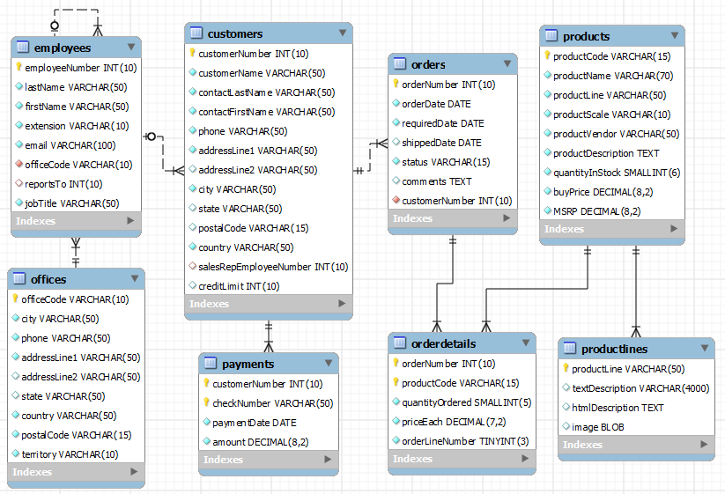
classicmodels

Slide 3
Classic Models Online Shop Web App
Create JavaEE project
Name: classicmodels
Template: Web Application
Group: sit.int202
Application server: Tomcat 10.0.xxx
-------------------------------------------------
Version: Jakarta EE 9
Dependencies:
Specifications:
Servlet
Persistence (JPA)
Implementations:
Hibernate
Hibernate Validator
Other Dependencies:
Project Lombok 1.18.2x
JSTL 3.0.x
MySQL Connector 8.0.3x
Eclipse Expressly 5.0.x

Slide 4
Create Office Entity
@Entity @Table(name = "Offices") public class Office { @Id private String officeCode; private String addressLine1; private String addressLine2; private String city; private String state; private String country; private String postalCode; private String phone; private String territory; @OneTomany(mappedBy= ”officeCode") private List<Employee> employeeList; }

Slide 5
Create Employee Entity & Modify Office Entity
@Entity @Table(name = "employees") public class Employee { @Id private Integer employeeNumber; private String firstName; private String lastName; private String extension; private String email; private String officeCode; private Integer reportsTo; private String jobTitle; @ManyToOne
@JoinColumn(name=”officeCode", nullable=false)
private Office office; }

Slide 6
Modify persistence.xml
<persistence-unit name=“classic-models">
<provider>org.hibernate.jpa.HibernatePersistenceProvider</provider> <class>sit.int202.classicmodelweb.entities.Office</class> <properties> <property name="jakarta.persistence.jdbc.driver"
value="com.mysql.cj.jdbc.Driver"/> <property name="jakarta.persistence.jdbc.url"
value="jdbc:mysql://localhost:3306/classicmodels"/> <property name="jakarta.persistence.jdbc.user" value="root"/> <property name="jakarta.persistence.jdbc.password" value=“mysql@sit"/>
<property name="hibernate.dialect"
value="org.hibernate.dialect.MySQL8Dialect"/> </properties> </persistence-unit>

Slide 7
Entity Manager Builder
import jakarta.persistence.EntityManager; import jakarta.persistence.EntityManagerFactory; import jakarta.persistence.Persistence; public class EntityManagerBuilder { private final static EntityManagerFactory emf = Persistence.createEntityManagerFactory("classic-models"); public static EntityManager getEntityManager() { return emf.createEntityManager(); } }

Slide 8
Office Repository
public class OfficeRepository { private EntityManager entityManager;
private EntityManager getEntityManager() { if (entityManager == null || !entityManager.isOpen()) { entityManager = EntityManagerBuilder.getEntityManager(); } return entityManager; } public List<Office> findAll() { return getEntityManager().createQuery(
"select o from Office o").getResultList(); } public Office find(String officeCode) { return getEntityManager().find(Office.class, officeCode); }
public void close() { if (entityManager != null && entityManager.isOpen()){
entityManager.close();
} }

Slide 9
Add insert(), delete(), update() methods to Office Repository
public boolean insert(Office office) { try { EntityManager entityManager = getEntityManager(); entityManager.getTransaction().begin(); entityManager.persist(office); entityManager.getTransaction().commit(); } catch (Exception e) { return false; } return true; }
public boolean delete(Office office) { if (office != null) { EntityManager entityManager = getEntityManager(); if (entityManager.contains(office)) { entityManager.getTransaction().begin(); entityManager.remove(office); entityManager.getTransaction().commit(); return true; } else { return delete(office.getOfficeCode()); } } return false; }
public boolean delete(String officeCode) { EntityManager entityManager = getEntityManager(); Office office = find(officeCode); if (office != null) { entityManager.getTransaction().begin(); entityManager.remove(office); entityManager.getTransaction().commit(); return true; } return false; } public boolean update(Office newOffice) { if (newOffice != null) { EntityManager entityManager = getEntityManager(); Office office = find(newOffice.getOfficeCode()); if (office != null) { entityManager.getTransaction().begin(); //set all attributes office with newOffice entityManager.getTransaction().commit(); return true; } } return false; }

Slide 10
Add Name Query to Office Entity
@NamedQueries({ @NamedQuery(name = "Office.FIND_BY_CITY_OR_COUNTRY", query = "select o from Office o where lower(o.city) like :city or lower(o.country) like :country") }) public class Office { @Id private String officeCode; private String addressLine1; private String addressLine2;
|
|

Slide 11
Add method findByCityOrCountry to Office Repository
public List<Office> findByCityOrCountry(String cityOrCountry) { cityOrCountry = cityOrCountry.toLowerCase()+'%'; Query query = getEntityManager().createNamedQuery("Office.FIND_BY_CITY_OR_COUNTRY"); query.setParameter("city", cityOrCountry); query.setParameter("country", cityOrCountry); return query.getResultList(); }

Slide 12
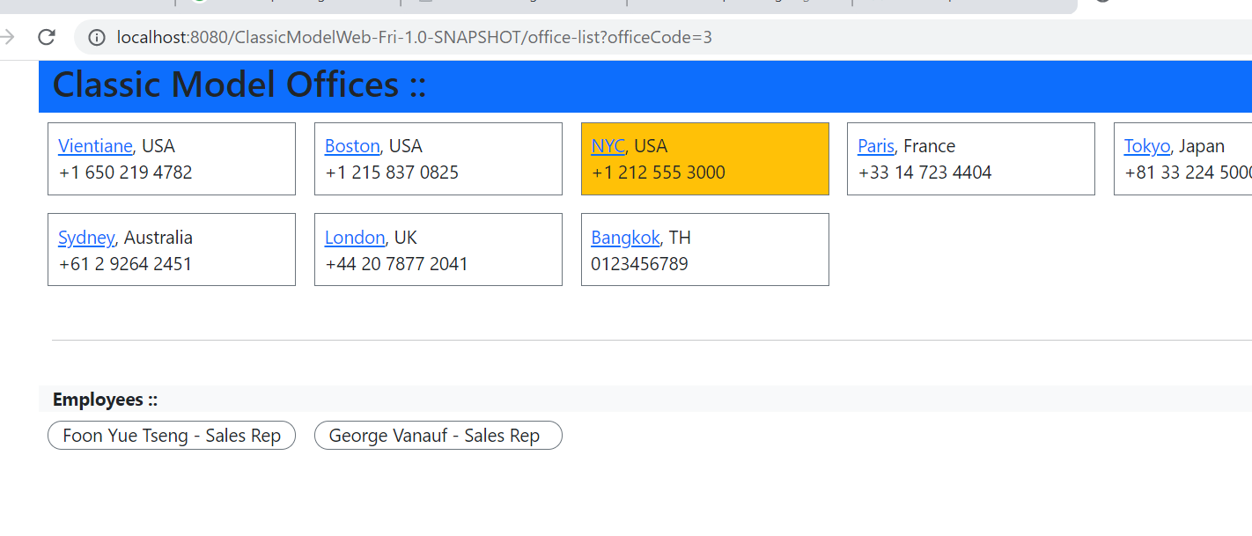
Practice: Office-Employee Listing

Slide 13
OfficeListServlet
@WebServlet(name = "OfficeListServlet", value = "/office_list") public class OfficeListServlet extends HttpServlet { @Override protected void doGet(HttpServletRequest request, …. { OfficeRepository officeRepository = new OfficeRepository(); request.setAttribute("offices", officeRepository.findAll()); String officeCode = request.getParameter("officeCode"); if (officeCode != null) { request.setAttribute("selectedOffice", officeRepository.find(officeCode)); } getServletContext().getRequestDispatcher("/OfficeList.jsp").forward(request, response); }

Slide 14
OfficeEmployeeList.jsp (1)
<body> <div class="container"> <div class="row bg-primary"> <h2>Classic Model Offices ::</h2> </div> <div class="row"> <c:forEach items="${offices}" var="office"> <div class="col-2 border border-secondary p-2 m-2 ${office.id == selectedOffice.id ? 'bg-warning' : ''}"> <div>
<a href="office-list?officeCode=${office.id}"> ${office.city}</a>, ${office.country} </div> <div> ${office.phone}</div> </div> </c:forEach> </div>

Slide 15
OfficeEmployeeList.jsp (2)
<br> <div class="row bg-light"> <b>Employees ::</b> </div> <div class="row"> <c:forEach items="${selectedOffice.employeeList}" var="employee"> <div class="col-2 pl-2 m-2 border border-secondary rounded-pill"> <div> ${employee.firstName}
${employee.lastName} - ${employee.jobTitle}
</div> </div> </c:forEach> </div> </div> </body>

Slide 16
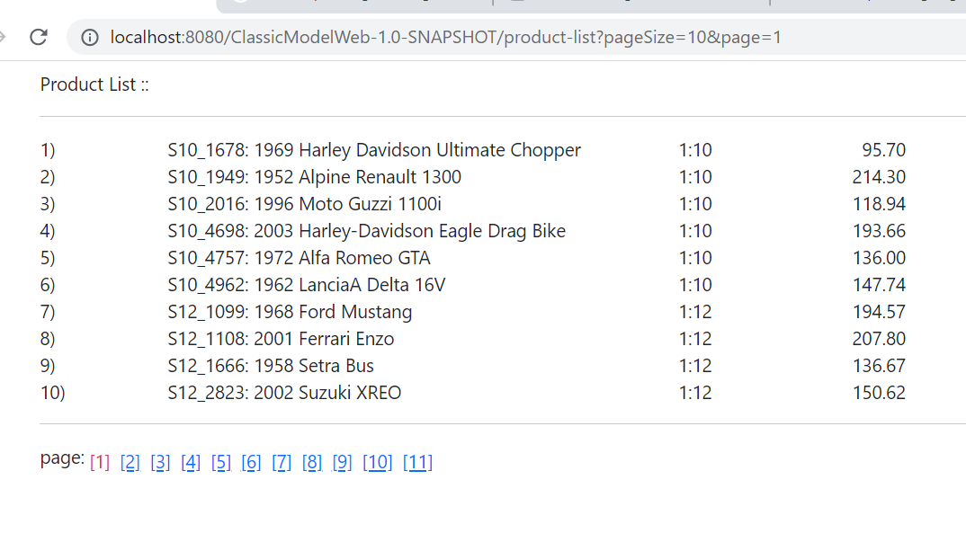
Practice: Product Listing

Slide 17
Product Entity
@NamedQueries({ @NamedQuery(name = "Product.FindAll", query = "SELECT p FROM Product p"), @NamedQuery(name = "Product.count", query = "SELECT count(p) as count FROM Product p") }) @Table(name = "products", indexes = { @Index(name = "productLine", columnList = "productLine") }) @Entity public class Product { @Id @Column(name = "productCode", nullable = false, length = 15) private String id; @Column(name = "productName", null

Slide 18
Product Repository
public class ProductRepository { private static int PAGE_SIZE = 10;
public int getDefaultPageSize() { return PAGE_SIZE; }
public List<Product> findAll(int page, int pageSize) { int startPosition = (page-1) * pageSize; EntityManager entityManager = getEntityManager(); Query query = entityManager.createNamedQuery("Product.FindAll"); query.setFirstResult(startPosition); query.setMaxResults(pageSize); List<Product> productList = query.getResultList(); entityManager.close(); return productList; }
public int countAll() { EntityManager entityManager = getEntityManager(); int number = ((Number) entityManager.createNamedQuery("Product.count").getSingleResult()).intValue(); entityManager.close(); return number; }

Slide 19
ProductListServlet
protected void doGet(HttpServletRequest request, … {
ProductRepository productRepository = new ProductRepository(); String pageParam = request.getParameter("page"); String pageSizeParam = request.getParameter("pageSize"); int page = pageParam==null ? 1 : Integer.valueOf(pageParam); int pageSize = pageSizeParam==null ? productRepository.getDefaultPageSize() : Integer.valueOf(pageSizeParam); List<Product> productList = productRepository.findAll(page, pageSize); request.setAttribute("products", productList); request.setAttribute("page", page); request.setAttribute("pageSize", pageSize); request.setAttribute("itemCount", productRepository.countAll()); getServletContext().getRequestDispatcher("/product_list.jsp").forward(request, response);
}

Slide 20
ProductList.jsp (1)
<body> <div class="container ml-2 p-2"> <div class="d-flex flex-row">Product List ::</div> <hr> <c:forEach items="${products}" var="p" varStatus="vs"> <div class="row"> <div class="col-1">${vs.count + (page-1)*pageSize})</div> <div class="col-4"> ${p.id}: ${p.productName}</div> <div class="col-1"> ${p.productScale}</div> <div class="col-1" style="text-align: right">${p.msrp}</div> </div> </c:forEach> <hr>

Slide 21
ProductList.jsp (2)
<div class="d-flex flex-row"> <div>page: </div> <c:forEach begin="1" end="${itemCount/pageSize + (itemCount%pageSize>0?1 :0)}" varStatus="vs"> <c:choose> <c:when test="${vs.count==page}"> <div class="p-1 text-danger">[${vs.count}]</div> </c:when> <c:otherwise> <div class="p-1">
<a href="product-list?pageSize=${pageSize}&page=${vs.count}">[${vs.count}]</a>
</div> </c:otherwise> </c:choose> </c:forEach> </div> </div> </body>

