Slide 1
MVC Using JPA with Ajax

Slide 2
AJAX
AJAX stands for Asynchronous JavaScript And XML. In a nutshell, it is the use of the XMLHttpRequest object to communicate with servers. It can send and receive information in various formats, including JSON, XML, HTML, and text files. AJAX’s most appealing characteristic is its "asynchronous" nature, which means it can communicate with the server, exchange data, and update the page without having to refresh the page.
The two major features of AJAX allow you to do the following:
Make requests to the server without reloading the page
Receive and work with data from the server

Slide 3
XMLHttpRequest
https://javascript.info/xmlhttprequest
Create XMLHttpRequest:
let xhr = new XMLHttpRequest();
Initialize it, usually right after new XMLHttpRequest:
xhr.open(method, URL, [async, user, password])
This method specifies the main parameters of the request:
method – HTTP-method. Usually "GET" or "POST".
URL – the URL to request, a string, can be URL object.
async – if explicitly set to false, then the request is synchronous, we’ll cover that a bit later.
user, password – login and password for basic HTTP auth (if required).
Please note that open call, contrary to its name, does not open the connection. It only configures the request, but the network activity only starts with the call of send.

Slide 4
XMLHttpRequest (2)
Send it out.
xhr.send([body])
This method opens the connection and sends the request to server. The optional body parameter contains the request body.
Some request methods like GET do not have a body. And some of them like POST use body to send the data to the server.
Listen to xhr events for response.
These three events are the most widely used:
load – when the request is complete (even if HTTP status is like 400 or 500), and the response is fully downloaded.
error – when the request couldn’t be made, e.g. network down or invalid URL.
progress – triggers periodically while the response is being downloaded, reports how much has been downloaded.

Slide 5
Ajax Example
let xhr = new XMLHttpRequest();
xhr.onload = function() {
if (xhr.status != 200) {
alert(`Error ${xhr.status}: ${xhr.statusText}`);
} else { // show the result
alert(`Done, got ${xhr.response.length} bytes`);
}
xhr.open('GET', '/article/xmlhttprequest/example/load');
xhr.send();
};

Slide 6
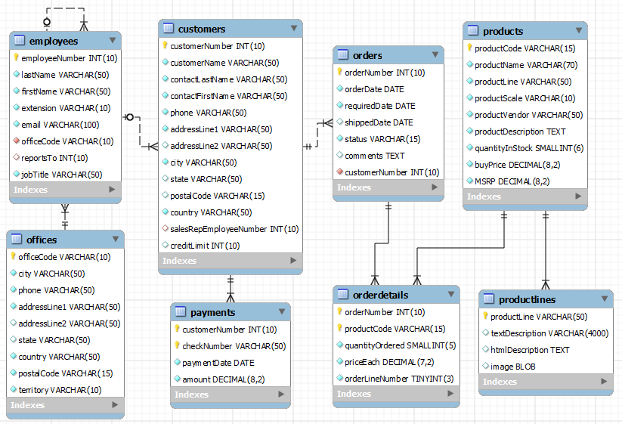
classicmodels

Slide 7
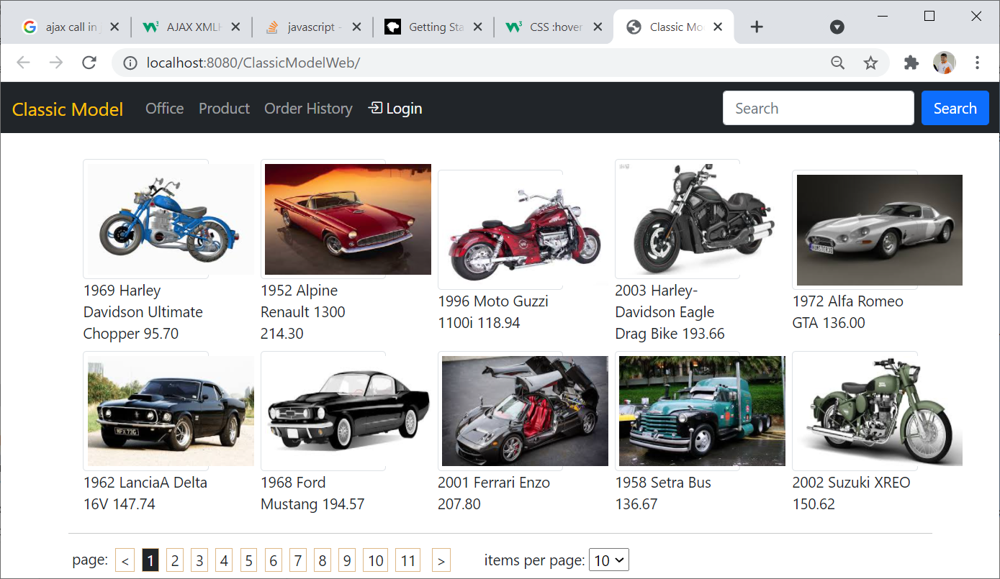

Slide 8
Index.jsp
<nav class="navbar navbar-expand-sm navbar-dark bg-dark"> <div class="container-fluid"> <a class="navbar-brand text-warning" href="javascript:void(0)">Classic Model</a> <button class="navbar-toggler" type="button" data-bs-toggle="collapse" > <span class="navbar-toggler-icon"></span> </button> <div class="collapse navbar-collapse" id="mynavbar"> <ul class="navbar-nav me-auto"> <li class="nav-item"> <a class="nav-link" href="javascript:loadOffice('')">Office</a> </li> <li class="nav-item"> <a class="nav-link" href="javascript:loadProduct(1,15)">Product</a> </li>

Slide 9
Body of Contents
<div class="container" id="body-content"> <h3>SIT-202: Classic Model Online</h3> <p>SIT-202 is a global online marketplace. <br> <p>SIT-202 is a young and dynamic company specialized in the online
sale of static collectible models and related accessories. Our location are distributed around the world. <br> … they are popular collectibles for every automobile fan.rs! .. </p> </div>

Slide 10
JavaScript
function loadOffice(officeCode) { const xhttp = new XMLHttpRequest(); xhttp.onload = function() { document.getElementById("body-content").innerHTML = xhttp.responseText; } xhttp.open("GET", "office-list?officeCode="+officeCode); xhttp.send(); } function loadProduct(page, pageSize=document.getElementById("itemsPage").value) { //alert('page: '+ page + ", size: "+ pageSize) const xhttp = new XMLHttpRequest(); xhttp.onload = function() { document.getElementById("body-content").innerHTML = xhttp.responseText; } xhttp.open("GET", "product-list?page="+page+"&pageSize="+pageSize); xhttp.send(); }

Slide 11
Product Entity
@NamedQueries({ @NamedQuery(name = "Product.FindAll", query = "SELECT p FROM Product p"), @NamedQuery(name = "Product.count", query = "SELECT count(p) as count FROM Product p") }) @Table(name = "products", indexes = { @Index(name = "productLine", columnList = "productLine") }) @Entity public class Product { @Id @Column(name = "productCode", nullable = false, length = 15) private String id; @Column(name = "productName", null

Slide 12
Product Repository
public class ProductRepository { private static int PAGE_SIZE = 10;
public int getDefaultPageSize() { return PAGE_SIZE; }
public List<Product> findAll(int page, int pageSize) { EntityManager em = getEntityManager(); int startPosition = (page - 1) * pageSize; Query query = em.createNamedQuery("Product.FindAll"); query.setFirstResult(startPosition); query.setMaxResults(pageSize); List<Product> productList = query.getResultList(); return productList; }
public int countAll() { EntityManager entityManager = getEntityManager(); int number = ((Number) entityManager.createNamedQuery("Product.count").getSingleResult()).intValue(); entityManager.close(); return number; }
private EntityManager getEntityManager() { return EntityManagerSerice.getEntityManager(); }

Slide 13
ProductListServlet
protected void doGet(HttpServletRequest request, … {
ProductRepository productRepository = new ProductRepository(); String pageParam = request.getParameter("page"); String pageSizeParam = request.getParameter("pageSize"); int page = pageParam == null ? 1 : Integer.valueOf(pageParam); int pageSize = pageSizeParam == null ? productRepository.getDefaultPageSize() :
Integer.valueOf(pageSizeParam); int itemCount = productRepository.countAll(); int totalPage = itemCount/pageSize + (itemCount%pageSize==0 ? 0 : 1) ; List<Product> productList = productRepository.findAll(page, pageSize); request.setAttribute("products", productList); request.setAttribute("page", page); request.setAttribute("pageSize", pageSize); request.setAttribute("totalPage",totalPage); getServletContext().getRequestDispatcher("/ProductList.jsp").forward(request, response);
}

Slide 14
ProductList.jsp (1)
<div class="row pt-4 align-items-center"> <c:forEach items="${products}" var="p" varStatus="vs"> <div class="row"> <div class="col-1">${vs.count + (page-1)*pageSize})</div> <div class="col-1">${p.id}</div> <div class="col-4">${p.productName}</div> <div class="col-1">${p.productScale}</div> <div class="col-1" style="text-align: right">${p.msrp}</div> </div>
</c:forEach>

Slide 15
ProductList.jsp (2)
<div class="d-flex flex-row"> <div class="px-1">page:</div> <div class="px-1 mx-1 div-link" onclick="loadProduct(page=${page<=1?totalPage:page-1}, ${pageSize})"> &lt; </div> <c:forEach begin="1" end="${totalPage}" varStatus="vs"> <c:choose> <c:when test="${vs.count==page}"> <div class="px-1 mx-1 div-link text-light bg-dark"> ${vs.count} </div> </c:when> <c:otherwise> <div class="px-1 mx-1 div-link" onclick="loadProduct(page=${vs.count}, ${pageSize})"> ${vs.count} </div> </c:otherwise> </c:choose> </c:forEach>

Slide 16
ProductList.jsp (2)
<div class="px-1 mx-2 div-link" onclick="loadProduct(page=${page>=totalPage?1:page+1}, ${pageSize})"> &gt; </div> <div class="px-4 mx-1"> items per page: <select id="itemsPage" onchange="loadProduct(1)"> <option value="5" ${pageSize==5?'selected':''}>5</option> <option value="10" ${pageSize==10?'selected':''}>10</option> <option value="15" ${pageSize==15?'selected':''}>15</option> <option value="20" ${pageSize==20?'selected':''}>20</option> <option value="50" ${pageSize==50?'selected':''}>50</option> </select> </div> </div>

Slide 17
New OfficeList.jsp
<%@ taglib prefix="c" uri="http://java.sun.com/jsp/jstl/core" %> <div class="row pt-4"> <h2>Classic Model Offices ::</h2> </div> <div class="row"> <c:forEach items="${offices}" var="office"> <div class="col-2 border border-secondary p-2 m-2 div-link ${office.id == selectedOffice.id ? 'bg-warning' : ''}" onclick="loadOffice(${office.id})"> <div> ${office.city}, ${office.country} </div> <div> ${office.phone}</div> </div> </c:forEach> </div>

Slide 18
OfficeList.jsp (2)
<br> <hr> <div class="row bg-light"> <b>Employees ::</b> </div> <div class="row"> <c:forEach items="${selectedOffice.employeeList}" var="employee"> <div class="col-2 pl-2 m-2 border border-secondary rounded-pill"> <div> ${employee.firstName} ${employee.lastName} - ${employee.jobTitle}</div> </div> </c:forEach> </div>

Slide 19
JavaScript
function loadOffice(officeCode) { const xhttp = new XMLHttpRequest(); xhttp.onload = function() { document.getElementById("body-content").innerHTML = xhttp.responseText; } xhttp.open("GET", "office-list?officeCode="+officeCode); xhttp.send(); } function loadProduct(page, pageSize=document.getElementById("itemsPage").value) { //alert('page: '+ page + ", size: "+ pageSize) const xhttp = new XMLHttpRequest(); xhttp.onload = function() { document.getElementById("body-content").innerHTML = xhttp.responseText; } xhttp.open("GET", "product-list?page="+page+"&pageSize="+pageSize); xhttp.send(); }

