Slide 1
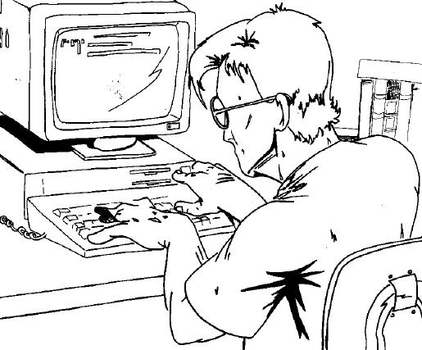
Simple Shopping Cart
PICHET LIMVAJIRANAN
pichet@sit.kmutt.ac.th

Slide 2
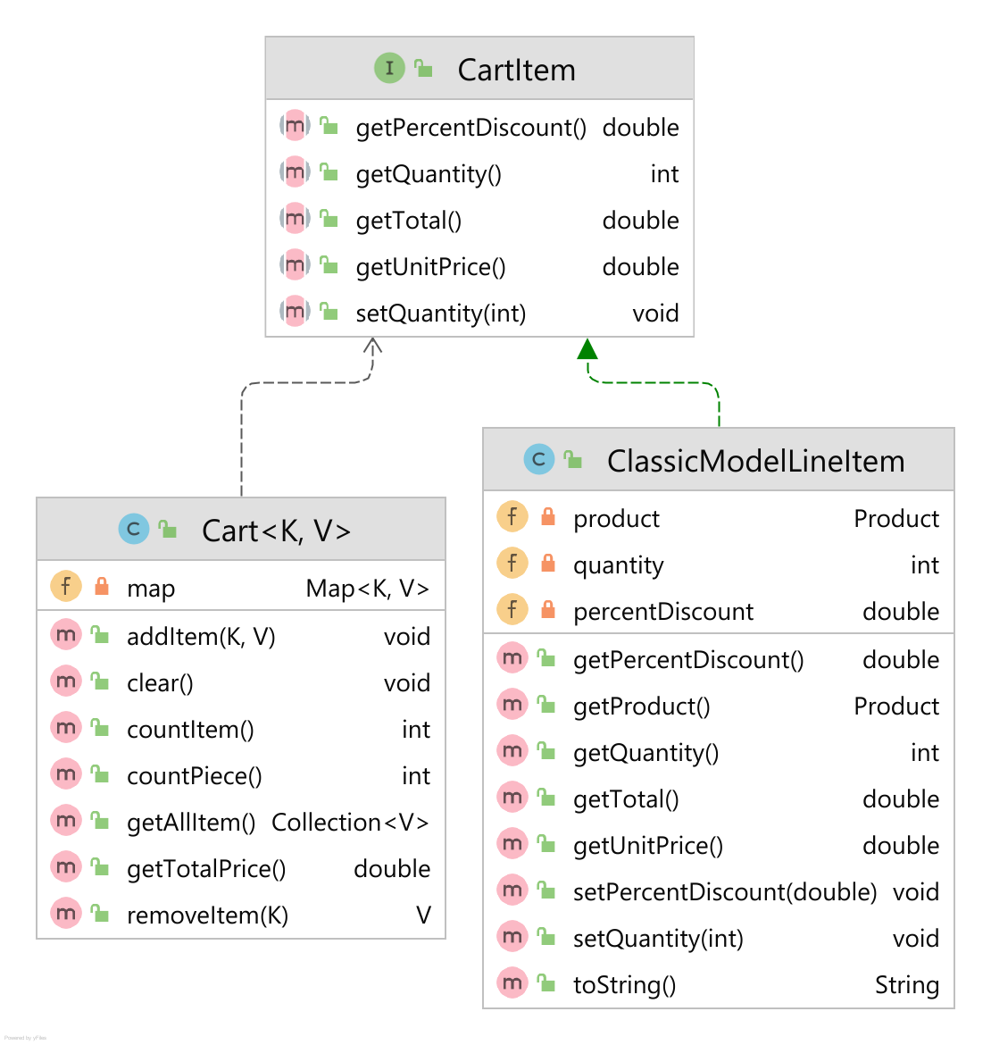
Simple Shopping Cart: Class Diagram

Slide 3
CartItem Interface
package sit.int202.classicmodelweb.models; public interface CartItem { public int getQuantity(); public void setQuantity(int quantity); public double getUnitPrice(); public double getTotal(); public double getPercentDiscount(); }

Slide 4
Generic Cart
public class Cart<K, V extends CartItem> { private Map<K, V> map; public Cart() { this.map = new HashMap<>(); } public int getNoOfItem() { return map.size(); } public int getQuantity() { return map.values().stream().mapToInt(o -> o.getQuantity()).sum(); }
public Collection<V> getAllItem() { return Collections.unmodifiableCollection(map.values()); }
public double getTotalPrice() { return map.values().stream().mapToDouble(o -> o.getTotal()).sum();
}

Slide 5
Generic Cart (2)
public void addItem(K key, V value) { V item = map.get(key); if (item == null) { map.put(key, value); } else { item.setQuantity(item.getQuantity() + value.getQuantity()); } } public V removeItem(K key) { return map.remove(key); } public void clear() { map.clear(); } }

Slide 6
ClassicModelCartItem
public class ClassicModelLineItem implements CartItem { private Product product; private int quantity ; private double percentDiscount; public ClassicModelLineItem(Product product) { this(product, 1, 0.0); } public ClassicModelLineItem(Product product, int quantity) { this(product, quantity, 0.0); } public ClassicModelLineItem(Product product, int quantity, double percentDiscount) { this.product = product; this.quantity = quantity; this.percentDiscount = percentDiscount; }

Slide 7
ClassicModelCartItem (2)
public Product getProduct() { return product; } @Override public int getQuantity() { return quantity; } @Override public void setQuantity(int quantity) { this.quantity = quantity; } @Override public double getUnitPrice() { return product.getMsrp().doubleValue(); }

Slide 8
ClassicModelCartItem (3)
@Override public double getTotal() { return getUnitPrice()*getQuantity() - getUnitPrice()*getQuantity()*percentDiscount; } @Override public double getPercentDiscount() { return percentDiscount; } public void setPercentDiscount(double percentDiscount) { this.percentDiscount = percentDiscount; } @Override public String toString() { return '{' + product.getProductName() + ", " + getUnitPrice() + ", " + quantity + ", " + percentDiscount + "% }"; } }

Slide 9
Testing Cart Model
public static void main(String[] args) { Cart<String, ClassicModelLineItem> cart = new Cart<>(); ProductRepository productRepository = new ProductRepository(); Product product = productRepository.findProduct("S10_1678"); cart.addItem(product.getId(), new ClassicModelLineItem(product,5)); product = productRepository.findProduct("S12_3380"); cart.addItem(product.getId(), new ClassicModelLineItem(product)); System.out.println(cart.countItem()); System.out.println(cart.countPiece()); System.out.println(cart.getTotalPrice()); System.out.println(cart.getAllItem()); cart.removeItem("S10_1678");
}

Slide 10
AddToCartServlet (add-to-cart)
protected void doGet(HttpServletRequest request, HttpServletResponse response) …
String productCode = request.getParameter("productCode"); HttpSession session = request.getSession(); Cart<String, ClassicModelLineItem> cart = (Cart) session.getAttribute("cart"); if (cart == null) { cart = new Cart<>(); session.setAttribute("cart", cart); } ProductRepository productRepository = new ProductRepository(); Product product = productRepository.findProduct(productCode); if (product != null) { cart.addItem(productCode, new ClassicModelLineItem(product)); } response.getWriter().print(cart.countPiece()); }

Slide 11
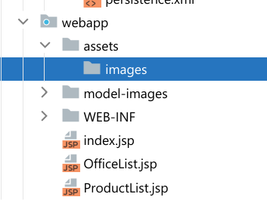
Cart UI
.cart-info { margin-left: -1em; border-radius: 12px; background-color: bisque; position: absolute; z-index: 100; border: none; padding-left: 5px; padding-right: 5px; display: none; }
<div style="margin-right: 20px"> <img src="assets/images/cart.png" width="42" onclick="viewCart()"/> <button id="noOfItemInCart" class="cart-info" onclick="viewCart()"></button> </div>

Slide 12
Modify index.jsp - Navbar (1)
<nav class="navbar navbar-expand-sm navbar-dark bg-dark">
<div class="container-fluid">
<a class="navbar-brand text-warning" href="javascript:void(0)">Classic Model</a>
<button class="navbar-toggler" type="button" data-bs-toggle="collapse" data-bs-target="#mynavbar">
<span class="navbar-toggler-icon"></span>
</button>
<div class="collapse navbar-collapse" id="mynavbar">
<ul class="navbar-nav me-auto">
:
:
<li class="nav-item">
<a class="nav-link" href="javascript:void(0)">Order History</a>
</li>
<li class="nav-item ml-4">
<a class="nav-link text-light" href="#"><i class="bi bi-box-arrow-in-right"></i> Login</a>
</li>
</ul>
<div style="margin-right: 20px">
<img src="assets/images/cart.png" width="42" onclick="viewCart()"/>
<button id="noOfItemInCart" class="cart-info" onclick="viewCart()"></button>
</div>
<form class="d-flex">
<input id="searchBox" class="form-control me-2" type="text" placeholder="Search">
<button class="btn btn-primary" type="button" onclick="search(thisContent)">Search</button>
</form>
</div>
</div>
</nav>

Slide 13
Modify index.jsp (2)
<style>
:
:
.div-link {
cursor: pointer;
border: 1px burlywood solid;
}
.div-link:hover {
background-color: bisque;
} :
.cart-info {
margin-left: -1em;
border-radius: 12px;
background-color: bisque;
position: absolute;
z-index: 100;
border: none;
padding-left: 5px;
padding-right: 5px;
display: none;
}
</style>
Add this div after body-content
<div class="d-flex justify-content-center modal d-none" id="loading">
<div class="spinner-border text-primary"
style="margin-top: 10%; width: 6rem; height: 6rem;"></div>
</div>
<script>
:
:
var thisContent = ‘’;
function setLoading(on_off) {
let loading = document.getElementById("loading");
if (on_off == 'on') {
loading.classList.remove("d-none");
loading.classList.add("d-inline");
} else {
loading.classList.remove("d-inline");
loading.classList.add("d-none");
}
}

Slide 14
Modify index.jsp (3)
<style>
:
:
.div-link {
cursor: pointer;
border: 1px burlywood solid;
}
.div-link:hover {
background-color: bisque;
}
.cart-info {
margin-left: -1em;
border-radius: 12px;
background-color: bisque;
position: absolute;
z-index: 100;
border: none;
padding-left: 5px;
padding-right: 5px;
display: none;
}
</style>
Add this div after body-content
<div class="d-flex justify-content-center modal d-none" id="loading">
<div class="spinner-border text-primary"
style="margin-top: 10%; width: 6rem; height: 6rem;"></div>
</div>
<script>
:
:
var thisContent = ‘’;
function setLoading(on_off) {
let loading = document.getElementById("loading");
if (on_off == 'on') {
loading.classList.remove("d-none");
loading.classList.add("d-inline");
} else {
loading.classList.remove("d-inline");
loading.classList.add("d-none");
}
}

Slide 15
Modify index.jsp (4)
Call setLoading() when loadProduct() & loadOfffice()
function loadProduct(page, pageSize = document.getElementById("itemsPage").value) {
thisContent = 'product-list';
//alert('page: '+ page + ", size: "+ pageSize)
setLoading('on')
:
:
xhttp.onload = function () {
setLoading('off’);
:
:
:
}
xhttp.open("GET", "product-list?page=" + page + "&pageSize=" + pageSize);
xhttp.send();
}

Slide 16
JavaScript: addToCart()
function addToCart(productCode) { setLoading('on') const xhttp = new XMLHttpRequest(); xhttp.onload = function () { setLoading('off'); cartInfo = document.getElementById("noOfItemInCart"); noOfItem = xhttp.responseText; if (noOfItem > 0) { cartInfo.style.display = 'inline' } else { cartInfo.style.display = 'none' } cartInfo.innerHTML = noOfItem; } xhttp.open("GET", "add-to-cart?productCode=" + productCode); xhttp.send(); }

Slide 17
ProductList.jsp
<div class="row pt-4 align-items-center"> <c:forEach items="${products}" var="p" varStatus="vs"> <div class="col-2 my-1 mx-3"> <div class="img-fluid img-thumbnail" title="${p.productCode}"> <img src="model-images/${p.productLine}/${p.productCode}.jpg"
height="120" width="180"/> </div> <div>${p.productName} <span style="text-align: right">${p.price}</span> <span style="color: darkred;margin-left: 2px;cursor: pointer"> <i class="bi bi-bag-plus" onclick="addToCart('${p.id}')"></span></i> </div> </div> </c:forEach> </div>

Slide 18
Modal Window for ViewCart()
<div class="modal" tabindex="-1" id="viewCartModal"> <div class="modal-dialog modal-dialog-centered modal-lg" role="document"> <div class="modal-content"> <div class="modal-header"> <h5 class="modal-title">Your Cart</h5> <button type="button" class="close" data-dismiss="modal" aria-label="Close" onclick="$('#viewCartModal').modal('hide')"> <span aria-hidden="true">&times;</span> </button> </div> <div class="modal-body" id="view-cart"> <p>Modal body text goes here.</p> </div> </div> </div> </div>

Slide 19
JavaScript: viewCart()
function viewCart() { setLoading('on') const xhttp = new XMLHttpRequest(); xhttp.onload = function () { setLoading('off'); document.getElementById("view-cart").innerHTML = xhttp.responseText; $('#viewCartModal').modal('show'); } xhttp.open("GET", "ViewCart.jsp"); xhttp.send(); }

Slide 20
ViewCart.jsp (1)
<%@ taglib prefix="c" uri="http://java.sun.com/jsp/jstl/core" %> <c:choose> <c:when test="${cart==null || empty cart.allItem}"> <h3 class="text-danger">No item in your shopping cart</h3> </c:when> <c:otherwise> <table class="table table-striped table-bordered w-100"> <thead> <th>#</th> <th>Code</th> <th>Description</th> <th>Quantity</th> <th>Price</th> <th>Total</th> </thead> <tbody>

Slide 21
ViewCart.jsp (2)
<c:forEach items="${cart.allItem}" var="lineItem" varStatus="vs"> <tr> <td>${vs.count}</td> <td>${lineItem.product.id}</td> <td>${lineItem.product.productName}</td> <td>${lineItem.quantity}</td> <td>${lineItem.product.msrp}</td> <td>${lineItem.total}</td> </tr> </c:forEach> <tr> <td colspan="5" style="text-align: right;margin-right: 5px">Total</td> <td>${cart.totalPrice}</td> </tr> </tbody> </table> </c:otherwise> </c:choose>

