Slide 1

Servlet (Web) Filtering
PICHET LIMVAJIRANAN
pichet@sit.kmutt.ac.th

Slide 2
Introducing filters
Filters:
Are reusable components
Transform (or filter) the content of HTTP requests, responses, and headers
Can be configured into chains of multiple filters
Are indirectly invoked by client request for a Web resource
Requested Web resource is at the end of the chain
Types of filter functionality include:
Process the request for a resource before it is invoked
Process the response for a resource after it is invoked
Modify the response or request object for a Web resource by wrapping the objects in a custom object
Transfer control to the next filter or Web resource in chain
Block execution of the filter chain
Notes:
Notes:
Some Web servers like Apache, IIS, and Netscape have implemented proprietary filtering or filtering-like schemes. The Servlet Filtering API is a Java EE standard (in Java EE V1.3 and later).
Instructor notes:
Purpose —
Details —
Additional information —
Transition statement — Next: Typical Uses of Filters

Slide 3
Typical uses of filters
The Servlet Filtering Specification notes the following as examples of typical filter uses:
Authentication filters
Logging and auditing filters
Data compression filters
Encryption filters
XSLT filters to transform XML content
Notes:
Notes:
Many other uses are possible. Tokenizing filters, for example, might be used with mobile devices to convert the output of an HTML tag to a special byte code that the device can interpret, in order to compress the response stream.
The Servlet Filtering API is included in the Java Servlet Specification, and can be viewed on the Web at http://jcp.org/aboutJava/communityprocess/final/jsr154/index.html.
Think of filters as pluggable components that can process common services in a standard way, without requiring changes to the core processing code of the filtered servlet. The function provided by filters can be added or deleted by changing only the deployment descriptor, and not the core processing code of the servlet.
Filters can be added or removed without changing the core function of the filtered code, thus allowing a set of services to be configured at run time, rather than during development. Instead of coding conditional logic in a servlet to use a set of ancillary services based on the settings of some flags, one can simply add or remove filters (and their corresponding services) by configuring the deployment descriptor.
Instructor notes:
Purpose —
Details —
Additional information —
Transition statement — Next: Filter Processing Flow

Slide 4
Filter processing flow
Container
Web resource requested by client
Filter
Access or modify the request
doFilter
Access or modify the response
Request
Response
Client request for Web resource
Notes:
Notes:
Filters are not explicitly seen by the client user. They are invoked when there is a request for a client resource, and that client resource has been configured to use filters. Entries in the Web deployment descriptor describe which filters are used for a particular resource: this is covered in more detail later in the unit.
At execution time, the filter typically accesses and possibly modifies the request object (preprocessing), transfers control to the Web resource via the doFilter method of the FilterChain class, and then accesses (and possibly modifies) the response object (post processing) after the doFilter method completes.
Each of these steps is performed within the same method in the filter. As part of the processing, the filter might query, modify, or customize the request and response objects to perform its function. The client request and response are passed to the next filter in the chain as parameters of doFilter.
Instructor notes:
Purpose —
Details —
Additional information —
Transition statement — Next: Filter Chain Processing

Slide 5
Filter chain processing
Filters can be configured in a chain
A FilterChain object describes the chain
Filters are invoked via nested calls
Web container invokes doFilter() in first filter in chain
Class: Implementation of javax.servlet.Filter
Parameters:
Request of type ServletRequest
Response of type ServletResponse
Chain of type FilterChain
First filter in chain calls doFilter() to invoke the next filter in chain
Referenced from input FilterChain object
Class: javax.servlet.FilterChain
Parameters:
Request of type ServletRequest
Response of type ServletResponse
Last entry in the chain is the Web resource
Notes:
Notes:
The filter chain is a key concept in servlet filtering.
Instructor notes:
Purpose —
Details —
Additional information —
Transition statement — Next: doFilter() Nested Calls

Slide 6
doFilter() nested calls
doFilter() {
chain.doFilter()
}
http://example.com/app/FilteredServlet
doFilter() {
chain.doFilter()
}
FirstFilter
doPost() {
……
…….
}
Request
SecondFilter
Response
FilteredServlet
Notes:
Notes:
This diagram illustrates how filters are nested. The client request is for the FilterServlet resource. The first filter in the chain (FirstFilter) has the filter’s chain passed (by the container) as an input parameter of doFilter().The filter then uses the doFilter() method of the chain object to call SecondFilter. SecondFilter likewise uses the same mechanism, but it executes the requested Web resource, which is at the end of the chain.
Upon return from the end of the chain, control transfers back through the nested calls. The request and response objects are passed as parameters on the chain.doFilter() methods.
Instructor notes:
Purpose —
Details —
Additional information —
Transition statement — Next: Typical doFilter() Pattern

Slide 7
Typical doFilter() pattern
Examine request object
Possibly wrap request or response object in new custom object
Invoke next filter in chain with doFilter() method
Possibly with wrapped objects
May end chain by not performing this step
Filter must complete response object
Process response object
Notes:
Notes:
This is a typical processing flow used within the doFilter() method of each of the filters. Note that if a filter chooses to end the chain, it is responsible for creating the response to be sent back to the client. Subsequent filters in the chain, which might have filled in the response object during the normal processing flow, are not available.
Instructor notes:
Purpose —
Details —
Additional information —
Transition statement — Next: Implementing a Filter

Slide 8
Implementing a filter
Create a class that implements the javax.servlet.Filter interface
Implement methods:
init()
doFilter()
destroy()
Describe the filter in the deployment descriptor with the filter element
Configure the filter’s chaining configuration in the deployment descriptor with the filter-mapping element
Notes:
Notes:
To implement a filter, the class must be created, and entries must be made in the Web deployment descriptor file (web.xml).
Instructor notes:
Purpose —
Details —
Additional information —

Slide 9
Application developer filter support
Creating a filter in the Intellij IDE
Right-click the Source package and click New → Web Filter
Creates a class that implements javax.servlet.Filter
Implement s methods in the class:
init
doFilter
destroy
Creates entries in deployment descriptor or use @WebFilter annotation to define filter with
urlPattern
servletNames
Notes:
Notes:
Rational Application Developer can create a skeleton of an implementing class for a filter, and create entries in web.xml file.
Instructor notes:
Purpose —
Details —
Additional information —
Transition statement — Next: Creating a New Filter in Application Developer

Slide 10
Example: Logger filter
A simple logging filter
Calculates servlet’s execution time in milliseconds
Displays the time in the server’s event log
Notes:
Notes:
The Logger filter displays the execution duration time of the Web resource that it filters in the Web server’s event log.
Instructor notes:
Purpose —
Details —
Additional information —
Transition statement — Next: Logger Filter: Deployment Descriptor

Slide 11
Logger filter: init() & destroy() methods
package com.ibm.filters;
@WebFilter(urlPatterns = "/*")
public class Logger implements Filter {
FilterConfig config;
public void init(FilterConfig arg0) throws ServletException {
config = arg0;
}
public void destroy() {
}
Notes:
Notes:
The init() method copies the FilterConfig object provided by the container to an instance variable for later use in doFIlter().
Instructor notes:
Purpose —
Details —
Additional information —
Transition statement — Next: Logger Filter: doFilter() Method

Slide 12
Logger filter: doFilter() method
public void doFilter (ServletRequest req, ServletResponse resp, FilterChain chain)
throws ServletException, IOException {
long before = System.currentTimeMillis();
chain.doFilter(req, resp);
long duration = System.currentTimeMillis() - before;
String msg = “Servlet duration: " + duration + “ ms";
config.getServletContext().log(msg);
}
Notes:
Notes:
Note that this method has the three parts typical of a doFilter() pattern: process request, transfer control to the next filter or Web resource, and process the response.
Instructor notes:
Purpose —
Details —
Additional information —
Transition statement — Next: Logger Filter: How It Works

Slide 13
Authentication Filter
@WebFilter(filterName = "AuthenticationFilter", servletNames = {“OrderHistoryServlet"} ) public class AuthenticationFilter implements Filter { private FilterConfig filterConfig; public void init(FilterConfig config) throws ServletException { this.filterConfig = config; } public void doFilter(ServletRequest request, ServletResponse response, FilterChain chain) throws … { HttpServletRequest httpServletRequest = (HttpServletRequest) request; HttpSession session = httpServletRequest.getSession(false); if (session==null ||session.getAttribute("user")==null) { httpResponse.sendError(HttpServletResponse.SC_UNAUTHORIZED); } else { chain.doFilter(request, response); } } }

Slide 14
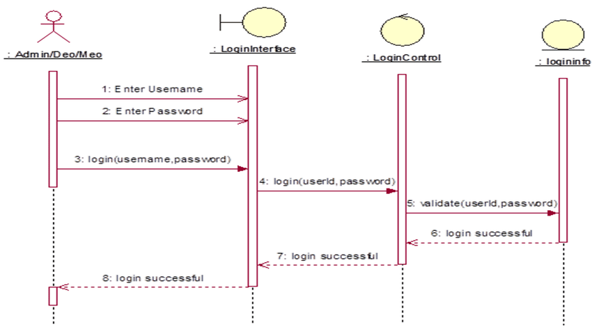
Authentication
Authentication is the process of recognizing a user’s identity.

Slide 15
Entity
@Entity
@NamedQueries({ @NamedQuery(name = "FIND_USER", query = "SELECT c FROM Customer c WHERE concat(trim(c.contactFirstName), ' ', trim(c.contactLastName)) = :user_account") }) public class Customer {
:
:
@Column(name = "contactLastName", nullable = false, length = 50) private String contactLastName; @Column(name = "contactFirstName", nullable = false, length = 50) private String contactFirstName; :
@Column(name = "password", length = 256) private String password;

Slide 16
Repository
public class CustomerRepository {
:
: public Customer findByName(String name) {
EntityManager em = getEntityManager(); Query query = em.createNameQuery(”CUSTOMER.FIND_USER"); query.setParameter("user_account", name); return (Customer) query.getSingleResult(); } }

Slide 17
Password Hashing Parameter
Input: The input is usually a plain text string of varying lengths (like a password).
Salt: The “salt” refers to a string of characters that is appended or prepended to the input before it is hashed. It is a common practice to help guard against dictionary attacks.
Length: Length refers to the number of bytes or HEX characters in the generated hash value.
Cycles: The number of cycles describe how many times or iterations the algorithm’s hashing function will run. More cycles create a stronger hash but require more time to compute.
Work factor: The work factor refers to the number of times the hashing algorithm is performed – this is usually expressed as an exponent, like 2^work iterations. The higher the work factor, the harder it would be for a hacker to crack the hashing algorithm. But, the higher the work factor, the greater the computational cost to the application and/or its auth provider.
Threads: Threads refers to the number of concurrent threads, or degrees of parallelism, that the algorithm will utilize to compute the hash.
Memory/memory hardness: The amount of memory to be used in the hashing process.
CPU: The cost or work factor that increases the memory and CPU usage needed to generate the hash.

Slide 18
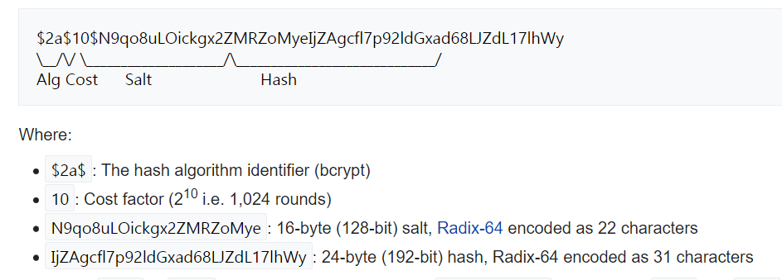
Password verification using Bcrypt algorithm
https://bcrypt-generator.com/

Slide 19
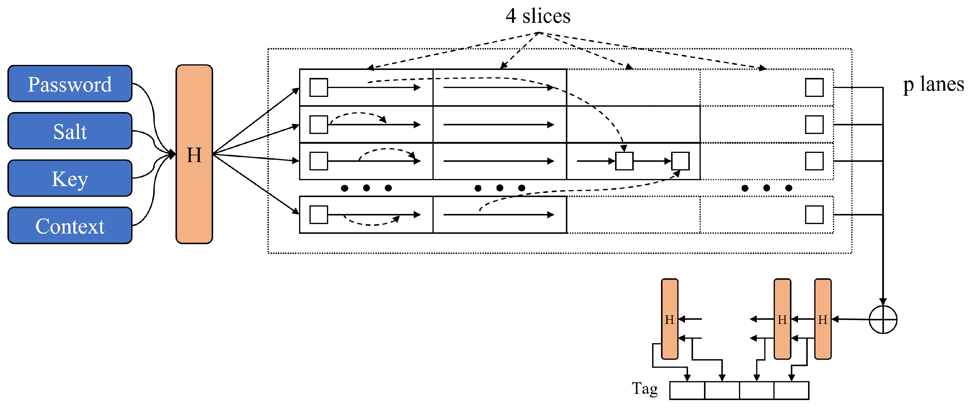
Argon2
https://www.mdpi.com/2076-3417/13/16/9295#:~:text=Argon2%20is%20an%20advanced%20cryptographic,processing%20(e.g.%2C%20GPU)
Initialization: The algorithm first creates an initial block using input values received from the user such as password, salt, and optionally provided secret data (associated data). This initial block fills a sequence of blocks using memory.
Block Filling: The algorithm then populates these memory blocks up to the set memory amount. Each block’s computation depends on previous blocks, making this stage data-dependent. Argon2d and Argon2i take distinct approaches during this block-filling process.
Final Block Creation: After filling all blocks, the algorithm selects one block as the final block.
Hash Generation: Finally, the algorithm passes this final block to a hash function to generate the final password hash.

Slide 20
patrickfav/bcrypt Library
String password = "1234";
String bcryptHashString = BCrypt.withDefaults().hashToString(12, password.toCharArray());
BCrypt.Result result = BCrypt.verifyer().verify(password.toCharArray(), bcryptHashString);
result.verified → true / false
<dependency> <groupId>at.favre.lib</groupId> <artifactId>bcrypt</artifactId> <version>0.9.0</version> <scope>compile</scope> </dependency>

Slide 21
Argon2
https://javadoc.io/doc/de.mkammerer/argon2-jvm/2.6/de/mkammerer/argon2/Argon2.html
Argon2Factory
static Argon2 create​(Argon2Factory.Argon2Types type, int defaultSaltLength, int defaultHashLength)
Argon2
String ​ hash(int iterations, int memory, int parallelism, char[] password)
boolean verify​(java.lang.String hash, char[] password)
<!-- https://mvnrepository.com/artifact/de.mkammerer/argon2-jvm --> <dependency> <groupId>de.mkammerer</groupId> <artifactId>argon2-jvm</artifactId> <version>2.11</version> </dependency>

Slide 22
Authentication Controller
protected void doPost(HttpServletRequest request, HttpServletResponse response) throws … { String password = request.getParameter("password"); String userName = request.getParameter("userName"); if(userName==null || userName.trim().length()==0) { response.sendError(HttpServletResponse.SC_BAD_REQUEST); return; } CustomerRepository customerRepository = new CustomerRepository(); Customer customer = customerRepository.findByName(userName); if (customer==null) { response.sendError(HttpServletResponse.SC_FORBIDDEN); } else { } }
Argon2 argon2 = Argon2Factory.create(Argon2Factory.Argon2Types.ARGON2d, 16,16);
char[] passwordArray = password.toCharArray();
boolean isOk = argon2.verify(customer.getPassword(), passwordArray);
if (! isOk) { response.sendError(HttpServletResponse.SC_UNAUTHORIZED); } else { request.getSession().setAttribute("user", customer); }
BCrypt.Result result = BCrypt.verifyer().verify(password.toCharArray(), customer.getPassword()); if (!result.verified) { response.sendError(HttpServletResponse.SC_UNAUTHORIZED); } else { request.getSession().setAttribute("user", customer); }

Slide 23
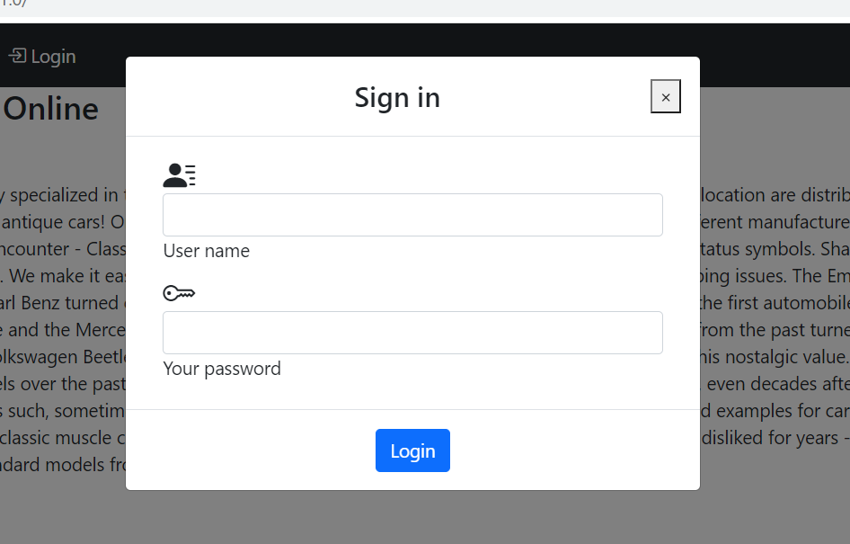
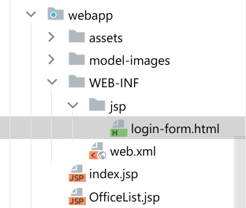
Login Form

Slide 24
View: Login Form (1/2)
<div class="modal fade" id="modalLoginForm" tabindex="-1" role="dialog"
aria-labelledby="myModalLabel" aria-hidden="true"> <div class="modal-dialog" role="document"> <div class="modal-content"> <div class="modal-header text-center"> <h4 class="modal-title w-100 font-weight-bold">Sign in</h4> <button type="button" class="close" onclick="$('#modalLoginForm').modal('hide')">&times;</span> </button> </div> <div class="modal-body mx-3"> <div class="md-form mb-2"> <i class="bi bi-person-lines-fill h3"></i> <input type="email" id="defaultForm-user" class="form-control validate"> <label data-error="wrong" data-success="right"
for="defaultForm-user">User name</label> </div>

Slide 25
View: Login Form (2/2)
<div class="md-form mb-2"> <i class="bi bi-key h3"></i> <input type="password" id="defaultForm-pass"
class="form-control validate"> <label data-error="wrong" data-success="right"
for="defaultForm-pass">Your password</label> </div> <div class="md-form mt-2"> <label class="text-danger" id="login-message"></label> </div> </div> <div class="modal-footer d-flex justify-content-center"> <button class="btn btn-primary" onclick="login($('#defaultForm-user').val(),
$('#defaultForm-pass').val())">Login</button> </div> </div> </div> </div>

Slide 26
function showLoginForm() { let menu = document.getElementById("login-menu").innerHTML; if (menu.includes('Logout')) { logout(); } else { $('#modalLoginForm').modal('show'); } }
function logout() { const xhttp = new XMLHttpRequest(); xhttp.onload = function () { location.reload(); } xhttp.open("GET", "logout"); xhttp.send(); }

Slide 27
function login(userName, password) { if (userName == '' || password == '' || userName == undefined) { document.getElementById("login-message").innerHTML = "Invalid user name or password !!!"; } setLoading('on’)
const xhttp = new XMLHttpRequest();
xhttp.onload = function () { setLoading('off'); if (xhttp.status == 200) { $('#modalLoginForm').modal('hide'); document.getElementById("login-menu").innerHTML =
"<i class='bi bi-box-arrow-left'></i> Logout" } else if (xhttp.status > 400) { document.getElementById("login-message").innerHTML = xhttp.statusText; } else { document.getElementById("login-message").innerHTML = "Wrong user name or password !!!"; } }

Slide 28
let urlEncodedData = "", urlEncodedDataPairs = []; urlEncodedDataPairs.push(encodeURIComponent("userName") + '=‘ + encodeURIComponent(userName)); urlEncodedDataPairs.push(encodeURIComponent("password") + '=‘ + encodeURIComponent(password)); urlEncodedData = urlEncodedDataPairs.join('&').replace(/%20/g, '+'); xhttp.open("POST", "login"); xhttp.setRequestHeader('Content-Type', 'application/x-www-form-urlencoded'); xhttp.send(urlEncodedData); }

