Slide 1
Local grocery
Localite
(a great promotional offer)

Slide 2
Content
Creating a dataset
Machine Learning
2.1 Training and testing dataset
2.2 Feature Engineering
2.3 Model1 (Regression)
2.4 Model2 (Classification)
2.5 Feature Importance
Model/dataset Conclusion
3.1 Target customers 1
3.2 Target customers 2
3.3 Target customers 3

Slide 3
Content
Creating a dataset
Machine Learning
2.1 Training and testing dataset
2.2 Feature Engineering
2.3 Model1 (Regression)
2.4 Model2 (Classification)
2.5 Feature Importance
Model/dataset Conclusion
3.1 Target customers 1
3.2 Target customers 2
3.3 Target customers 3

Slide 4
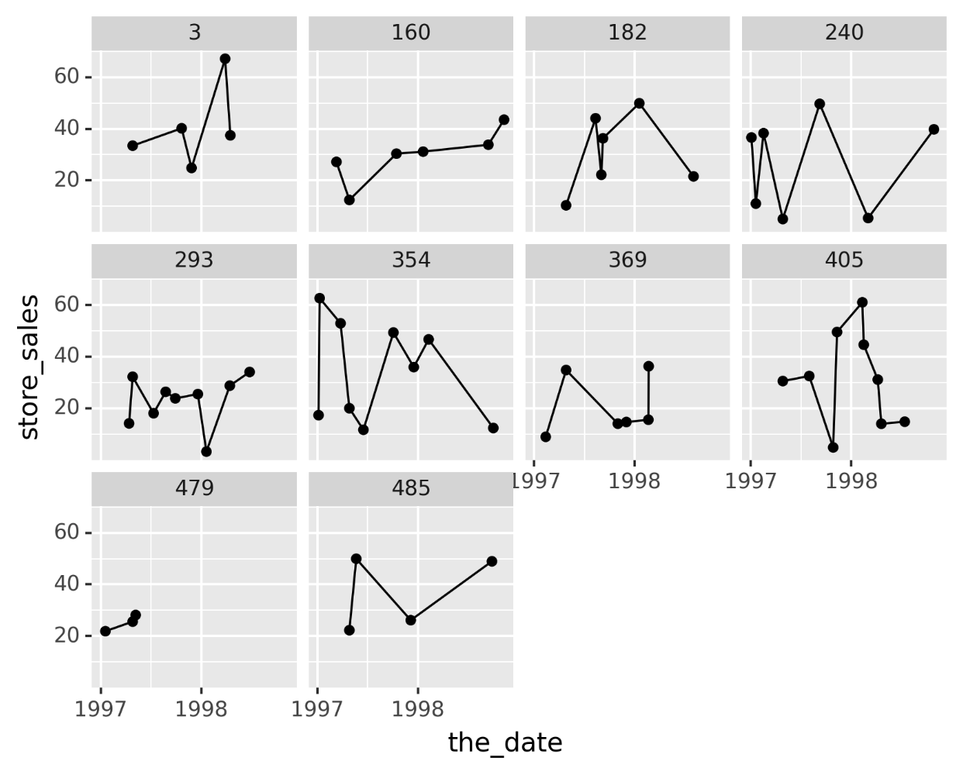
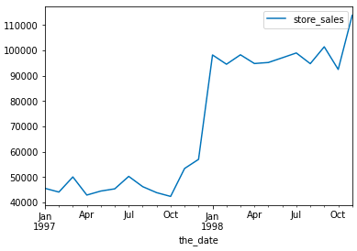
Creating a dataset
Merging the datasets into one
Setting date into right format
Customers Initial Purchases
Selecting 10 customers

Slide 5
Content
Creating a dataset
Machine Learning
2.1 Training and testing dataset
2.2 Feature Engineering
2.3 Model1 (Regression)
2.4 Model2 (Classification)
2.5 Feature Importance
Model/dataset Conclusion
3.1 Target customers 1
3.2 Target customers 2
3.3 Target customers 3

Slide 6
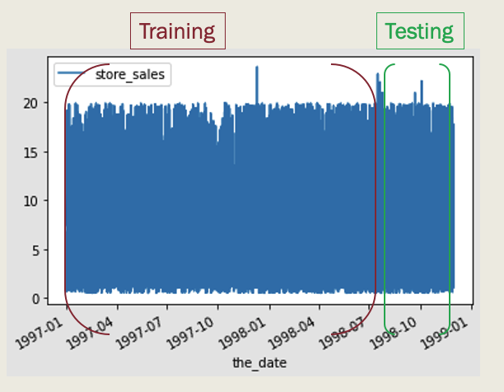

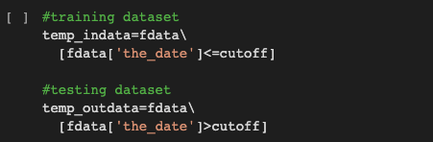
Training and Testing dataset
Testing: max_date= 30th November, 1998
cutoff_date=1st September, 1998
Which is used to come with targets features
(spend_90_total) and (spend_90_flag)
Training: It is used to come up with features (REF)

Slide 7
Content
Creating a dataset
Machine Learning
2.1 Training and testing dataset
2.2 Feature Engineering
2.3 Model1 (Regression)
2.4 Model2 (Classification)
2.5 Feature Importance
Model/dataset Conclusion
3.1 Target customers 1
3.2 Target customers 2
3.3 Target customers 3

Slide 8
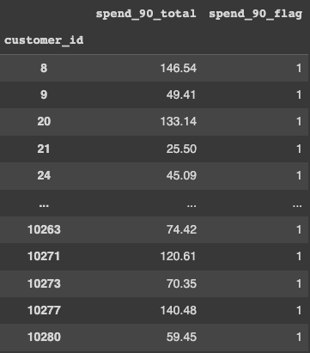
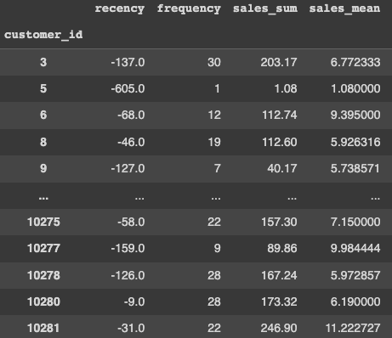
Feature Engineering
Making Targets from testing data
spend_90_total
spend_90_flag
2. Making REF features from training data
1. recency
2. frequency
3. Monetary
a. sales_sum
b. sales_mean

Slide 9
Feature Engineering
Making Targets from testing data
spend_90_total
spend_90_flag
2. Making REF features from training data
1. recency
2. frequency
3. Monetary
a. sales_sum
b. sales_mean
Combine

Slide 10
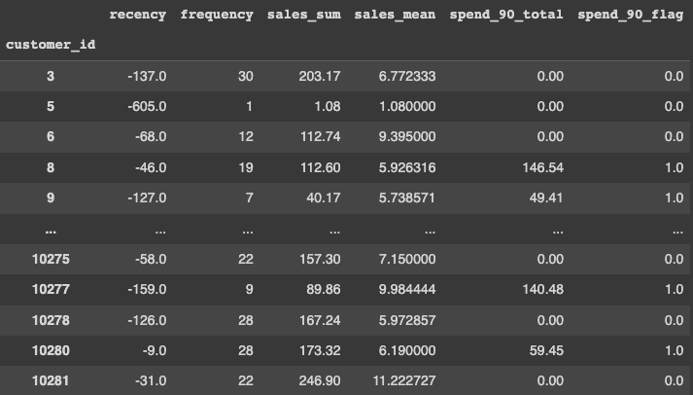
Feature Engineering

Slide 11
Content
Creating a dataset
Machine Learning
2.1 Training and testing dataset
2.2 Feature Engineering
2.3 Model1 (Regression)
2.4 Model2 (Classification)
2.5 Feature Importance
Model/dataset Conclusion
3.1 Target customers 1
3.2 Target customers 2
3.3 Target customers 3

Slide 12


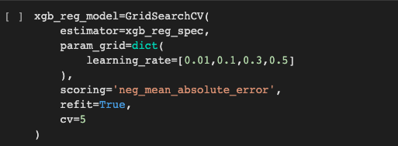
Model 1
Predict how much customer will spend in next N days (N=90)

Slide 13
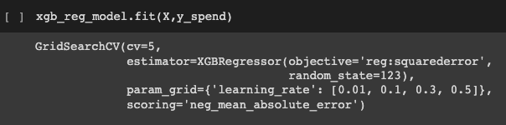

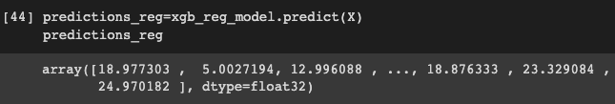
Model 1
Predict how much customer will spend in next N days (N=90)

Slide 14
Content
Creating a dataset
Machine Learning
2.1 Training and testing dataset
2.2 Feature Engineering
2.3 Model1 (Regression)
2.4 Model2 (Classification)
2.5 Feature Importance
Model/dataset Conclusion
3.1 Target customers 1
3.2 Target customers 2
3.3 Target customers 3

Slide 15

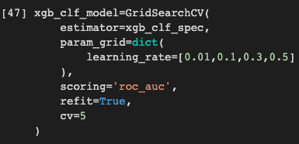
Model 2
Next 90 day probability, here instead of predicting the amount spend we would rather see if they are going to spend or not

Slide 16
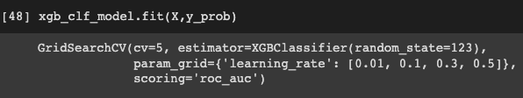

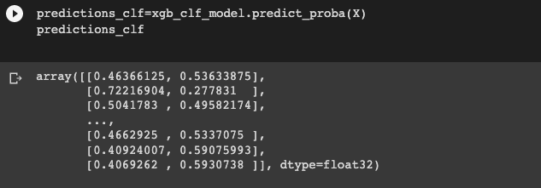
Model 2

Slide 17
Content
Creating a dataset
Machine Learning
2.1 Training and testing dataset
2.2 Feature Engineering
2.3 Model1 (Regression)
2.4 Model2 (Classification)
2.5 Feature Importance
Model/dataset Conclusion
3.1 Target customers 1
3.2 Target customers 2
3.3 Target customers 3

Slide 18
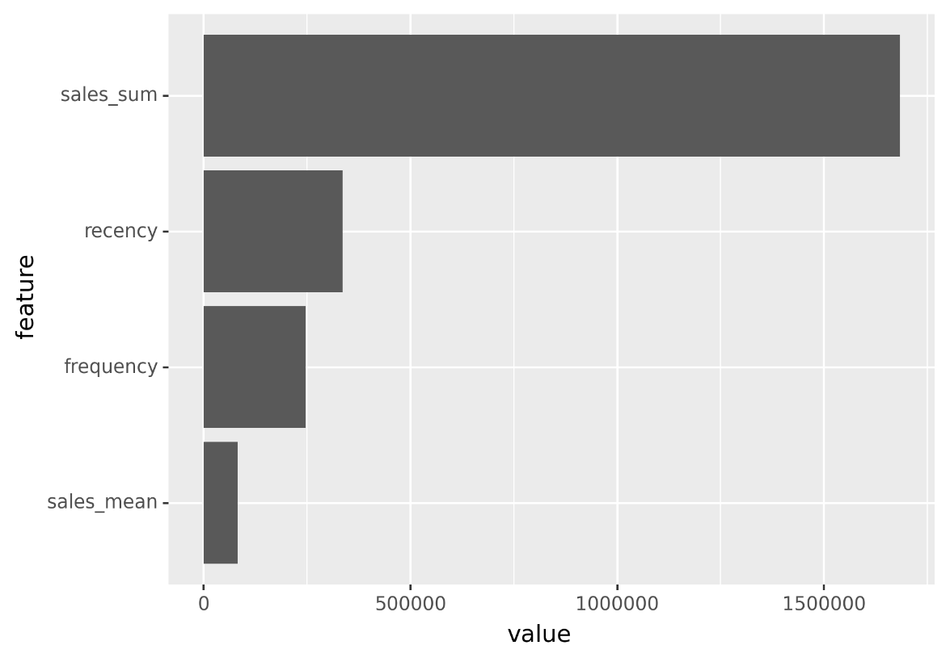
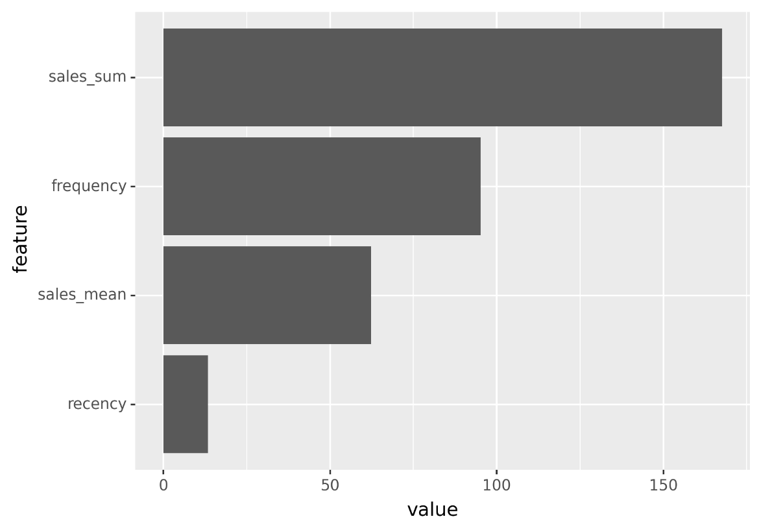
Feature Importance
Model – 1
Model – 2

Slide 19
Content
Creating a dataset
Machine Learning
2.1 Training and testing dataset
2.2 Feature Engineering
2.3 Model1 (Regression)
2.4 Model2 (Classification)
2.5 Feature Importance
Model/dataset Conclusion
3.1 Target customers 1
3.2 Target customers 2
3.3 Target customers 3

Slide 20
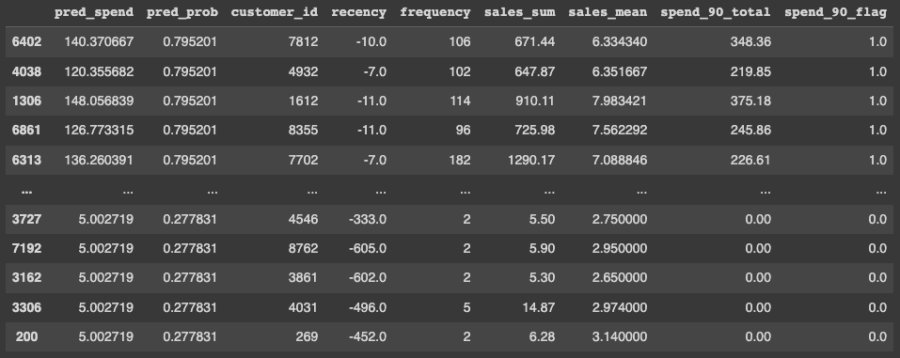
Model/Dataset Conclusion
Target Customer 1: Which customers have the highest spend probability in the next 90-days? target for new products similar to what they have purchased in the past.

Slide 21
Content
Creating a dataset
Machine Learning
2.1 Training and testing dataset
2.2 Feature Engineering
2.3 Model1 (Regression)
2.4 Model2 (Classification)
2.5 Feature Importance
Model/dataset Conclusion
3.1 Target customers 1
3.2 Target customers 2
3.3 Target customers 3

Slide 22
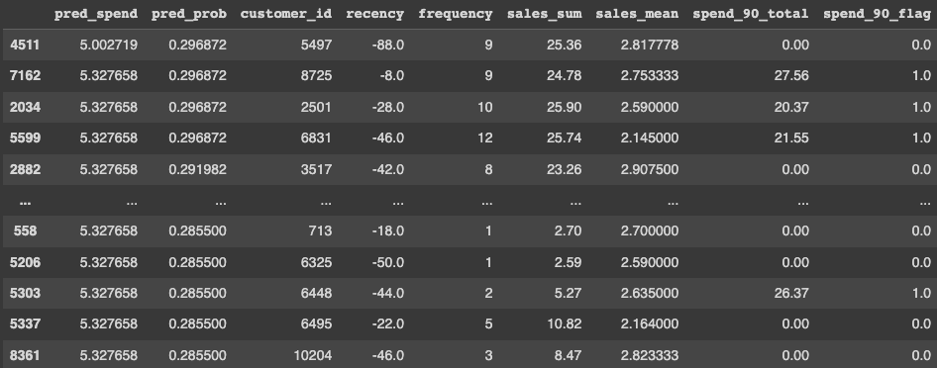
Model/Dataset Conclusion
Target Customer 2: Which customers have recently purchased but are unlikely to buy? - Incentivize actions to increase probability - provide discounts, encourage referring a friend, nurture by letting them know what’s coming

Slide 23
Content
Creating a dataset
Machine Learning
2.1 Training and testing dataset
2.2 Feature Engineering
2.3 Model1 (Regression)
2.4 Model2 (Classification)
2.5 Feature Importance
Model/dataset Conclusion
3.1 Target customers 1
3.2 Target customers 2
3.3 Target customers 3

Slide 24
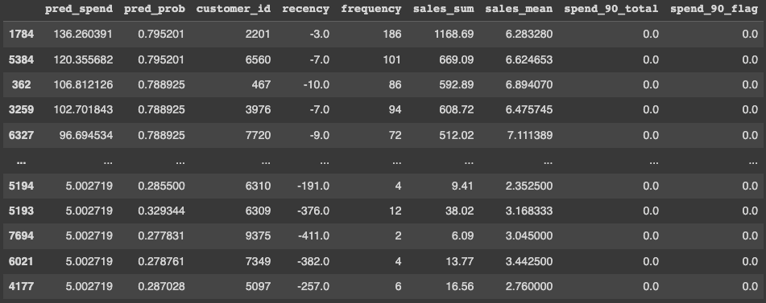
Model/Dataset Conclusion
Target Customer 3:"Missed Opportunities" -big spenders that could be unlocked ---------
- Send bundle offers encouraging volume purchases
- Focus on missed opportunities

Slide 25
Localite
There are 2 versions of Localite that will release a total of 1000 promotional offers
First 500 offers will go to the targeted customers – 1
Regular customers - Good pred_spend and high frequency
A discount offer on repeated items (after achieving desired frequency)
The count feature!!
A big gift at the end of the year
2. Second 500 offers will go to the targeted customers – 2
1. High spenders, have high spend probability and have high frequency
2. Emailing
Notes:
1 keep them churning

Slide 26
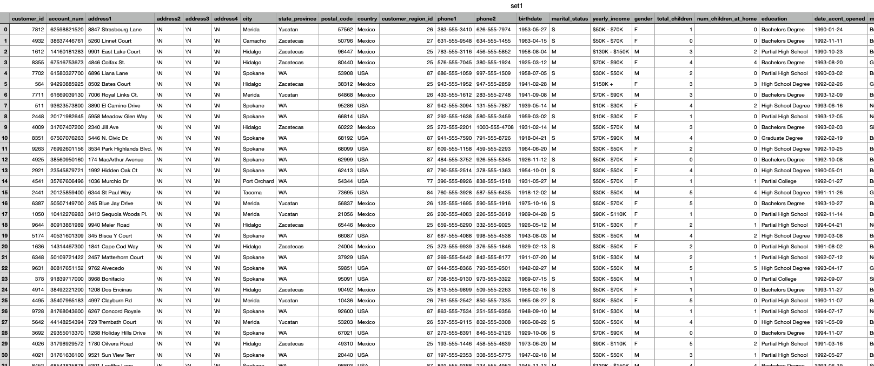

Slide 27
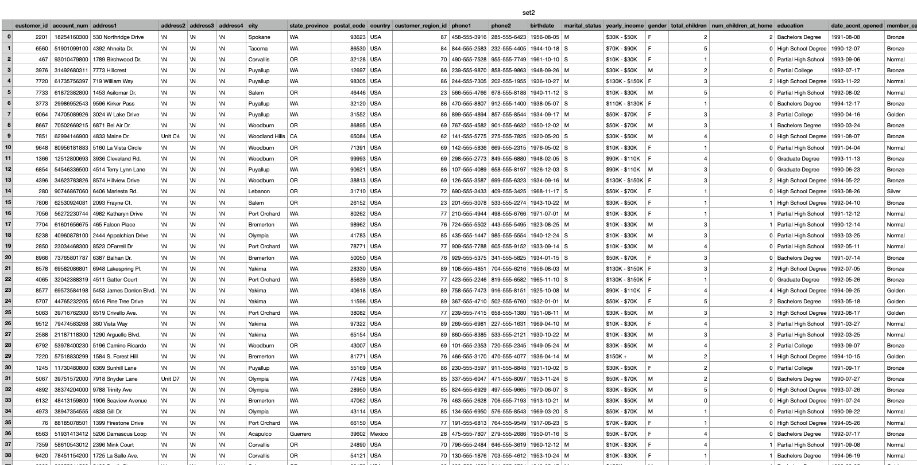

Slide 28
Thank you
Questions?

