Slide 1

Media Bazaar App GROUP 4
Çelik, Servet can S.C.
Hadnagy, Robert R.
Rodriguez Rosero, Melissa M.
Welles, Lloyd L. (Team Lead)

Slide 2
What we promised
Create account/ login
Scheduling
Re-shelving
Managing employee information
Managing Stock information

Slide 3
What we have achieved
Login, and change password
Employees are be able to send re-shelving requests.
Depo employees are able to see re-shelving request.
Employees are be able to see their schedule on the App and the Website
Administration and depo workers should be able to see/ modify stock information
Managers are be able to generate schedules manually and automatically
HR is able to create, edit and remove employee.
Managers are be able to see details of employees including contract history
Employees can send shift preferences on the website

Slide 4
Latest features
Manager are be able to generate schedules automatically
Employees can send schedule shifts preferences
Employees can login via website to see their schedule online.
HR and Managers are be able to see the contract history of employees.
Final Iteration

Slide 5
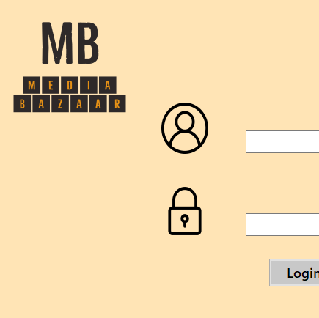
DEMO

Slide 6


