Slide 1
NATIONAL PORTAL FRAMEWORK
(Novatore)
(MIST-2,team-14)

Slide 2
The Concept
Citizen will get the necessary information and services from our application web portal.

Slide 3
The Features
-ই-বুক
জাতীয় ই-তথ্যকোষ
সরকারি ফর্ম ডাউনলোড
জাতীয় ই-সেবা সিস্টেম,জেলা প্রশাসন
নাগরিক আবেদন
দাপ্তরিক আবেদন
নকলের জন্য আবেদন
সর্বশেষ অবস্থা জানুন
অন্যান্য ই-সেবা
কৃষি তথ্য সার্ভিস
গুরুত্বপূর্ণ ওয়েবসাইট
অন্যান্য আইন
তথ্যপ্রযুক্তি আইন
ই-ডিরেক্টরী
মানচিত্র

Slide 4
What we developed in GDG
Solutions and features:
People can easily access information of National Portal Framework from anywhere they want with the application.
Database will be more enriched with the increase of users.
Awareness will be created.

Slide 5
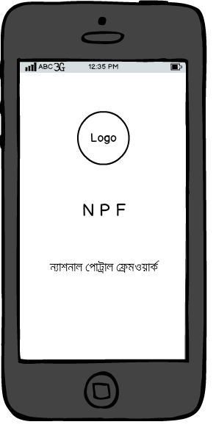
What we developed in GDG
This is our splash screen or landing screen.

Slide 6
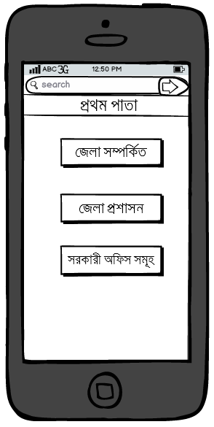
This is the screen where we will select the main menu options for our National Portal Framework.

Slide 7
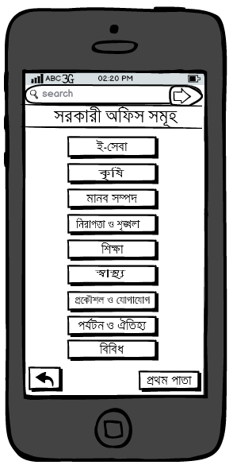
This is the page for our Government office option from where we can access its sub options.

Slide 8
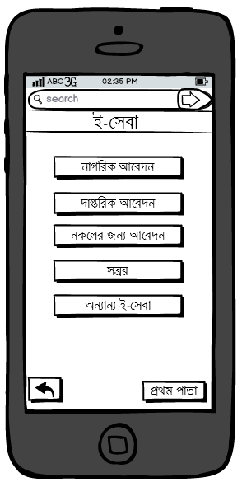
This is the page for our e-service option from where we can access its sub options.

Slide 9
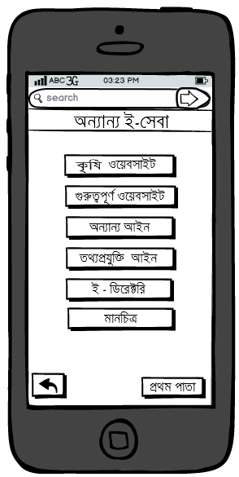
This is the page for our other e-service option from where we can access its sub options.

Slide 10
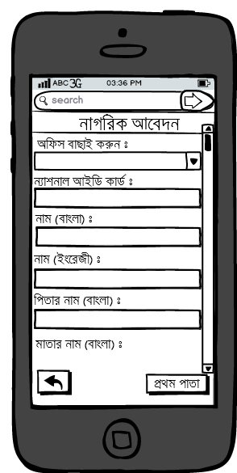
This is the application for the “citizen form”.

Slide 11
Final Vision
We will incorporate all the facilities of the existing National Portal Framework into our mobile application.
The complete project will take about four months. It will be developed as step by step prototypes leading to the completion of the project.

Slide 12
Supports We Need
NPF API
NPF database access

Slide 13
Team Details
Md. Wahiduzzaman Khan(Lead)
Contact no: 01672289937
Lead Gitlink: https://github.com/avy63
Rashid Saadman Karim
Contact no: 01710976885
Rafi Imran Noor
Contact no: 01684442734

