Slide 1
মা ও শিশু
Group : IIT_KnockOut
Sharifur Rahman
Rayhan Hossain
Habibur Rahman

Slide 2
The Concept
মা ও শিশু is an android mobile app which provides necessary information for pregnant and child bearer mother. It also sends automated alert messages about pregnancy date, vaccination date, seasonal diseases etc. time to time through SMS and push notification.

Slide 3
The Features
provides information for pregnant & child bearer mother and child:
1. Health tips
2. Food and Nutrition tips
3. Health services

Slide 4
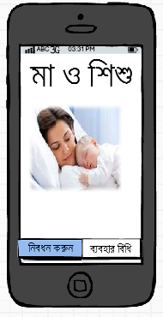
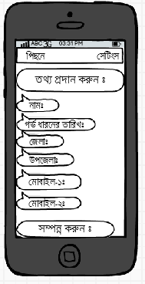
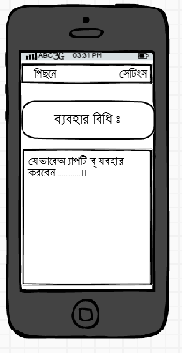
What we developed in GDG

Slide 5
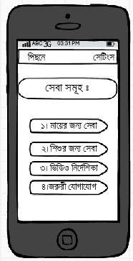
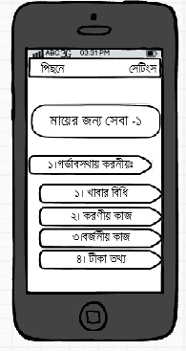
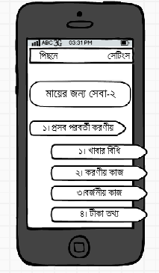
What we developed in GDG

Slide 6
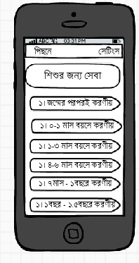
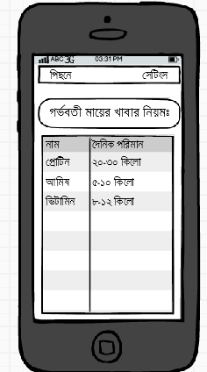
What we developed in GDG

Slide 7
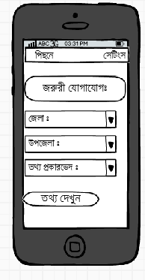
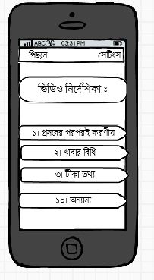
What we developed in GDG

Slide 8
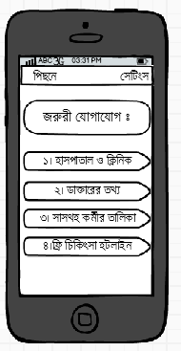
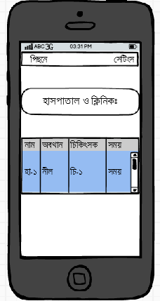
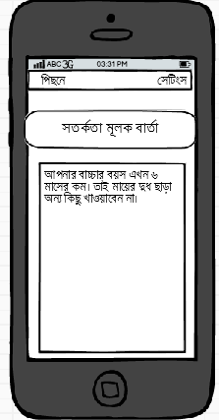
What we developed in GDG

Slide 9
Final Vision
An app which will contain all necessary information about pregnant and child bearer mother.
All type of assistance of health services and doctors info.
Service location of nearby hospitals and healthcare center.
Alert notification in a sequential time period.
15-20 Working days

Slide 10
Supports We Need
APIs
Database Access
Financial Support

Slide 11
Team Details
Name | Contact | Git Link
Sharifur Rahman | 01933841016 | Github.com/androidcodehunter
Rayhan Hossain | 01746969164
Habibur Rahman | 01520090526

