Slide 1
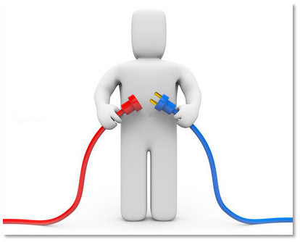

Slide 2

Nitto Khobor
Audacity IT Solution
TEAM 17

Slide 3
The Concept
Problem : Information Communication gap between Government & Common people.
Solution : A mobile application to make a brigde which lets user to know latest information

Slide 4


Slide 5


Slide 6


Slide 7
The Features
Provide latest market price.
Provide Electricity , Water , Gas bill unit price.
Government holidays notification.
Today’s Top news.
Notification from Government.
T

Slide 8
Final Vision
App with all category contents.
Customize newsfeed.
Instant Notification.
60 Working Days
T

Slide 9
Supports We Need
1. Graphics Designer.
2. Content of www.bangladesh.gov.bd .
3. Domain & Server.

Slide 10
Team Details
Saqib Rezwan
Md Sahib Bin Ron
Zahidur Rahman Faisal
Siddiq Abu Bakkar

