Slide 1

AAMAR E-BOI
Orindom
Team 2

Slide 2
The Concept
A fun method of learning with a window for English textbook

Slide 3
The Features
Smart learning by pictures and animations
Letters and numbers presented by animation
Rhymes for pre-school children
Writing technique practices
English textbooks available
Self evaluation about their vocabulary
Assisting with synonyms, antonyms, pronunciation etc.
Audible learning process
Related media files available

Slide 4
What we developed in GDG
Aamar eBoi

Slide 5
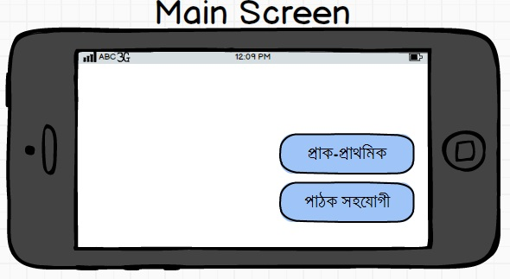
What we developed in GDG

Slide 6
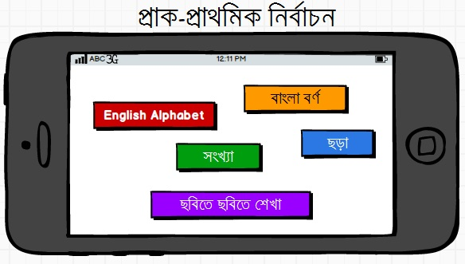
What we developed in GDG

Slide 7
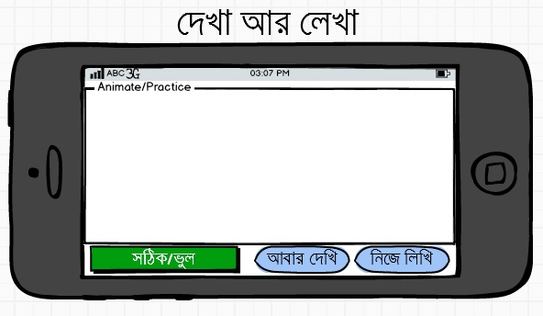
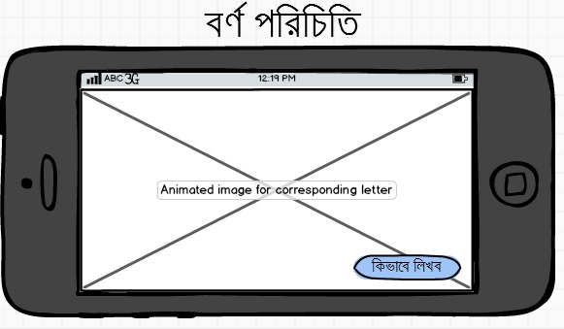
What we developed in GDG

Slide 8
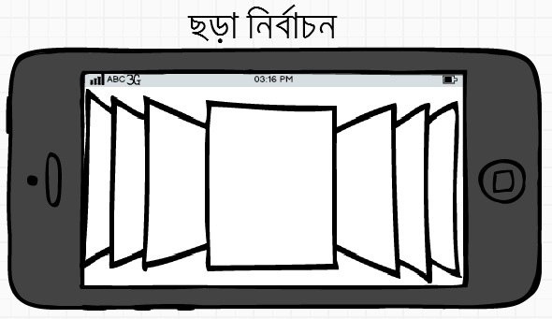
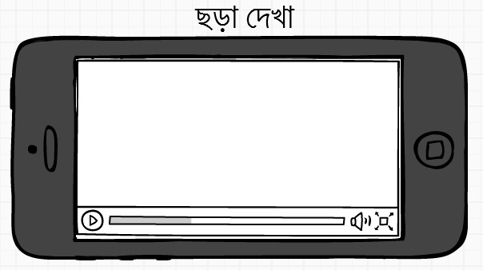
What we developed in GDG

Slide 9
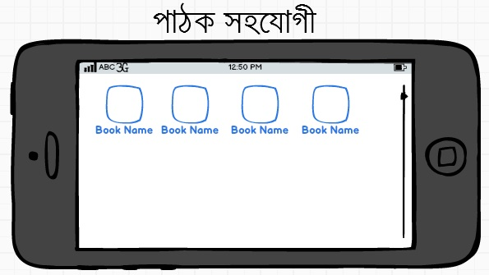
What we developed in GDG

Slide 10
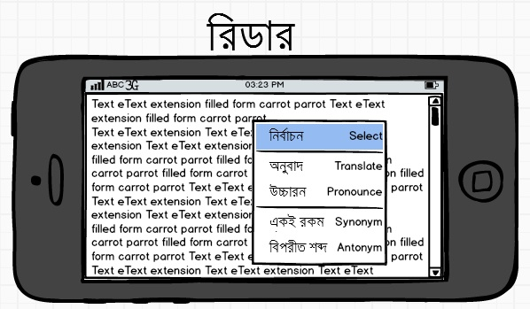
What we developed in GDG

Slide 11
Final Vision
Easy learning for pre-school children
Advantage for teachers and guardians
An assistance in reading
20 days required

Slide 12
Supports We Need
Database, Contents, Ideas to attract children and student, Government support regarding pre-primary project.

Slide 13
Team Details
Nafeh Bin Mosharraf (nbm14021@ymail.com) (nbm21)
Sadaf Noor (sadaf2605@gmail.com) (sadaf2605)
Shamima Nasrin Tumpa (tumpa.mci@gmail.com) (tumpa)
Tasnim Manzur Ankon (tm_ankon@yahoo.com) (ankon048)
Guided by – Bishwojit Saha
Mentored by – Md. Shahab Uddin

