Slide 1

AmarBangladesh
Po5tm3n
Team 25

Slide 2
The Concept
Our country’s tourism sector is neglected by our younger generation. It also is not much appreciated by the tourists and locals of abroad. So, to make them interested in our versatile monuments and natural attractions it is our little effort to develop this app.

Slide 3
The Features
Vast tourist information from district portal of Bangladesh government
Location presented with wonderful tourist display
GPS location
Assistance provided to visit the nearest proximity

Slide 4
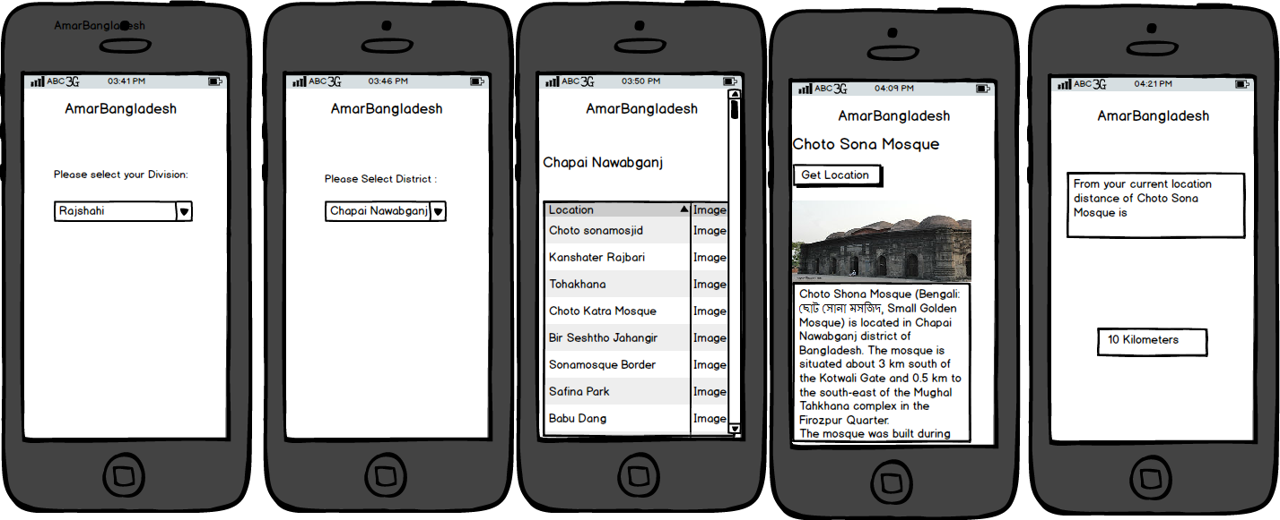
Wireframe

Slide 5
What we developed in GDG
Drew DFD
Wireframing

Slide 6
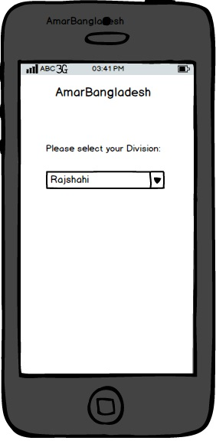

Slide 7
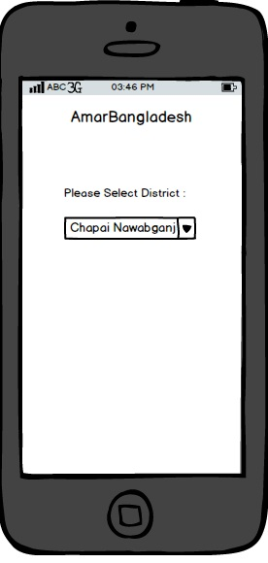

Slide 8
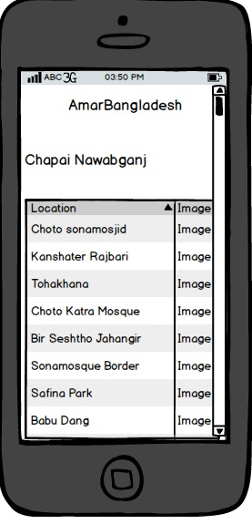

Slide 9
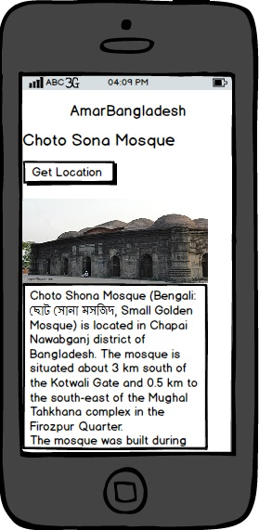

Slide 10
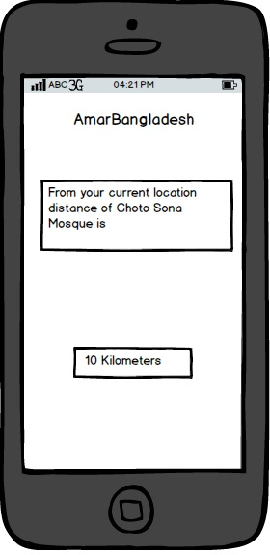

Slide 11
Final Vision
Real time GPS locator
Full web portal support
Completition of project: 60 Working Days

Slide 12
Supports We Need
API of the district portals
Expert advice from government officials

Slide 13
Team Details
Md. Farhan Hamid
01927150396
github.com/fash33
Md. Asiful Haque
01717887196
github.com/ali453
B. M. Abir
01915601505
Github.com/ananto-alive

