Slide 1
Shikkhok Batayon
RipubliCats
Team #4

Slide 2
The Concept
An App for accessing and using the National Shikkhok Batayon

Slide 3
The Features
Instant notification on device
Preview, Comment and rate presentations and blog post
Download presentations to Memory Card (View with other office suite)
Upload presentations directly from device's office suite

Slide 4
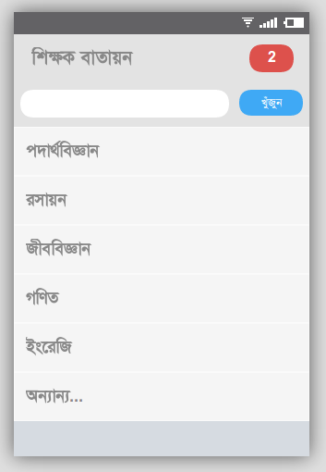
Main Activity
Activity displaying the list
of presentation categories

Slide 5
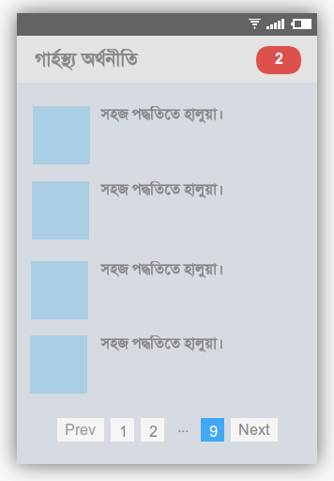
Browsing
Presentation listing

Slide 6
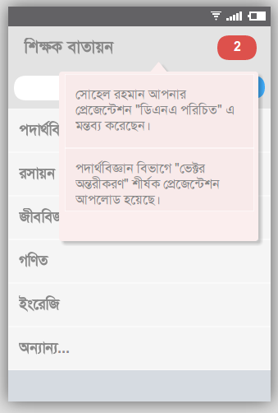
Notifications
Default Android Notifications and a quick one click notification access button.

Slide 7
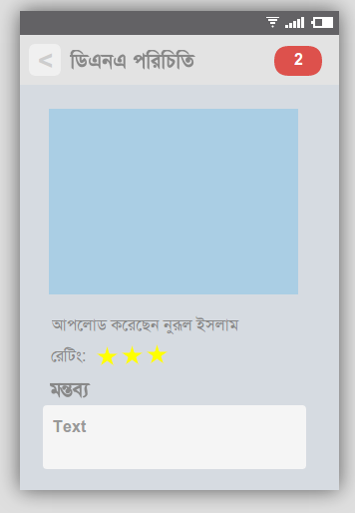
Viewer
Click on presentation and
preview that on a third-party viewer. Rate and comment to engage.

Slide 8
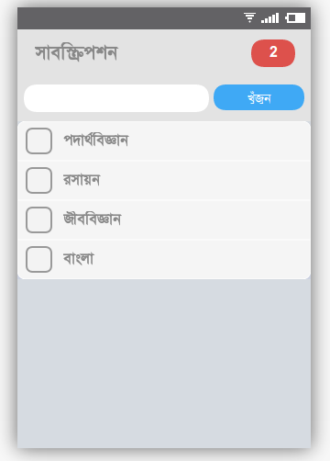
Subscription
Subscribe to different categories to get notified of newly uploaded content.

Slide 9
Final Vision
View / Download Presentations
Presentation rating, comment
Blog post reader

Slide 10
Support We Need
JSON / XML API for site data
Front page list of categories
Paged list of content in categories
Blog Posts

Slide 11
Team Details
Aniruddha Adhikary (aniruddha@adhikary.net)
Ershadul Hakim Rayhan
Iftekhar Mohammad
github.com/aniruddha-adhikary

Slide 12
Team Details
Aniruddha Adhikary (aniruddha@adhikary.net)
Ershadul Hakim Rayhan
Iftekhar Mohammad
github.com/aniruddha-adhikary

