Slide 1
Shikkhok Batayon
RipubliCats
Team #4

Slide 2
The Concept
An App for accessing and using the National Shikkhok Batayon

Slide 3
The Features
Preview, Comment and rate presentations and blog posts
Bangla does not break when viewing presentations
Download presentations to Memory Card
Upload presentations directly from device's office suite

Slide 4
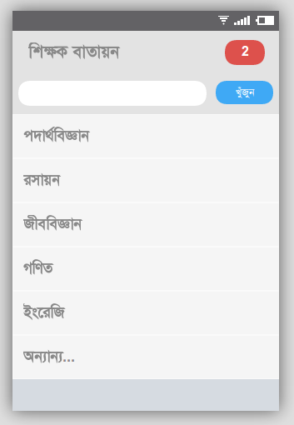
Main Activity
Activity displaying the list
of presentation categories

Slide 5
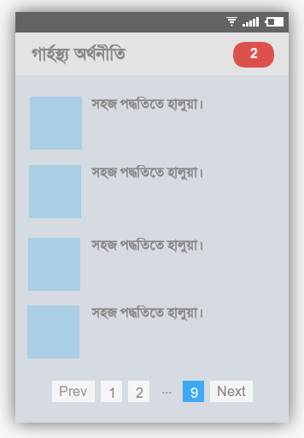
Browsing
Presentation listing in
Respective categories

Slide 6
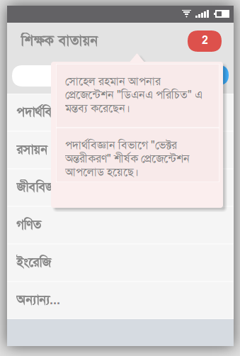
Notifications
Default Android Notifications
and a quick one click
notification access button.

Slide 7
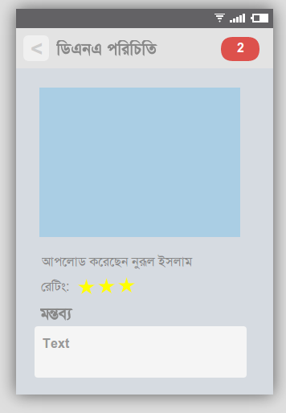
Viewer
Click on presentation and
preview that (Bangla doesn’t
Break). Rate and comment
to engage.

Slide 8
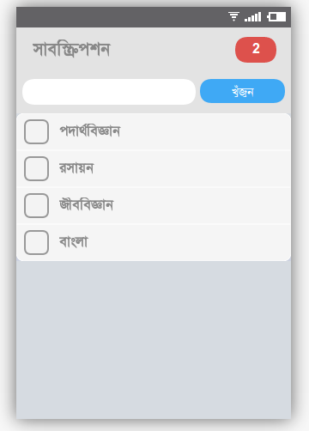
Subscription
Subscribe to different
categories to get notified
of newly uploaded content.

Slide 9
Final Vision
View Presentations on Device
Upload presentations from device
Projection will no longer require computers
Decrease digital divide cost-effectively

Slide 10
Support We Need
JSON / XML API for site data
Front page list of categories
Paged list of content in categories
Blog Posts

Slide 11
Team Details
Aniruddha Adhikary
Team Lead
aniruddha@adhikary.net
github.com/aniruddha-adhikary
Iftekhar Mohammad
Team Member
im.toufiq@gmail.com
Ershadul Hakim Rayhan
Team Member
ershadul100@gmail.com

