Slide 1
Product Leadership Presentation System
A reusable master for strategy, research, planning, performance and decision decks. Choose the job, pick the layout, replace the content.
WALMART ADS · MASTER TEMPLATE · V1
Notes:
Start here. Delete the system slides (1–20) when you build a real deck; keep the layouts, which live in Home → Layout.

Slide 2
Decide what you are trying to say. The system decides how it looks.
HOW TO USE THIS TEMPLATE
START HERE
01 · CHOOSE THE JOB
Start, tell, prove, explain, decide, plan, measure, compare, operate, update or close. The layout picker (slide 10) maps each job to layouts.
02 · PICK THE LAYOUT
Home → New Slide → pick by number and name. Every layout has named slots, so nothing needs positioning by hand.
03 · REPLACE THE CONTENT
Type into the placeholders. Duplicate a worked example when it already has the components you need.
04 · WHEN IT DOES NOT FIT
Tighten the copy → use the dense layout → change layout → split the slide → only then reduce type, within the minimums.
Notes:
The overflow order is the most important rule in the system: never shrink until it fits.

Slide 3
Foundations
FOUNDATIONS
SYSTEM 01
The grid, zones, type, colour and spacing every layout inherits. Change them here and only here.

Slide 4
One content frame, twelve columns, four fixed zones
FOUNDATIONS · GRID
FOUNDATIONS
Every region shares the same left and right edges. Container width controls alignment; text width controls readability.
01
02
03
04
05
06
07
08
09
10
11
12
12
8 + 4
7 + 5
6 + 6
4 + 4 + 4
3 + 3 + 3 + 3
3 + 9
2 + 10
Supported combinations: 12 · 8+4 · 7+5 · 6+6 · 4+4+4 · 3+3+3+3 · 3+9 · 2+10. Shared headline treatments sit at identical coordinates on every layout.
Canvas 13.333 × 7.5 in (1920 × 1080 authoring px). Margins 80px. Gutter 32px. Column 117px. Zones: context 72, message 112–344, content 384–944, source 952, footer 1008.

Slide 5
Twenty-four semantic text styles, each with a size, a line limit and a job
STYLE | FACE · SIZE · LEADING · LINES | SAMPLE
Display / Hero | Headline Light 44pt · 1.02× · max 3 | Adoption is growing
Section headline | Headline Light 40pt · 1.05× · max 2 | Adoption is growing
Statement | Headline Light 32pt · 1.12× · max 4 | Adoption is growing
Slide headline | Headline Light 28pt · 1.1× · max 2 | Adoption is growing
Dense headline | Headline Light 22pt · 1.1× · max 1 | Adoption is growing
Supporting headline | Headline Light 18pt · 1.2× · max 3 | Adoption is growing
Body large | UI 14pt · 1.35× · max 6 | Adoption is growing
Body | UI 12pt · 1.35× · max 8 | Adoption is growing
Body small | UI 10.5pt · 1.35× · max 10 | Adoption is growing
Data hero | Headline Light 96pt · 0.9× · max 1 | Adoption is growing
Data | Headline Light 40pt · 0.95× · max 1 | Adoption is growing
Data label | UI Medium 11pt · 1.25× · max 2 | Adoption is growing
STYLE | FACE · SIZE · LEADING · LINES | SAMPLE
Card title | UI Medium 14pt · 1.2× · max 2 | Adoption is growing
Card body | UI 11pt · 1.35× · max 5 | Adoption is growing
Eyebrow | Mono 8pt · 1× · max 1 | EXAMPLE LABEL
Label / section label | Mono 8pt · 1× · max 1 | EXAMPLE LABEL
Pill / tag | Mono 7.5pt · 1× · max 1 | EXAMPLE LABEL
Table header | Mono 8pt · 1× · max 2 | EXAMPLE LABEL
Table body | UI 10.5pt · 1.25× · max 3 | Adoption is growing
Chart label | UI 9pt · 1× · max 1 | Adoption is growing
Chart annotation | UI 10pt · 1.3× · max 3 | Adoption is growing
Quote | Light 26pt · 1.2× · max 5 | Adoption is growing
Quote attribution | Mono 8pt · 1× · max 1 | EXAMPLE LABEL
Source / footnote | UI 8pt · 1× · max 2 | Adoption is growing
Everyday Sans (Headline Light, UI, UI Medium, Light Italic, Mono). Minimum 10pt for reading text; 7.5pt only for mono labels and pills.

Slide 6
Colour carries meaning, so each colour has exactly one job
FOUNDATIONS · COLOUR
FOUNDATIONS
Navy is ink and dark grounds. True Blue is the thing that matters. Status colours never appear without a shape or a word.
Primary
Secondary
Accent
Background
Surface
Surface alt
Border
#001E60 · Text, dark grounds
#0053E2 · Emphasis, key rules, labels
#4DBDF5 · Accent on dark grounds only
#F5F6F8 · Page
#FFFFFF · Raised panels
#E9EEF3 · Cards, bands, zones
#DEE1E6 · Hairlines
Primary text
Secondary text
Muted text
Positive
Warning
Negative
Informational
#001E60 · Headlines, body
#3D4A63 · Body, descriptions
#5E636E · Sources, meta
#128A08 · On track, gains
#B25E00 · At risk
#DE1C24 · Off track, losses
#0053E2 · Neutral notices
CHART & DIAGRAM RAMP
Highlight the key series in True Blue and mute the rest in #C3C6CD. Use the ramp in order for ordinal data only; nominal categories take one colour.
#001E60
#0053E2
#4DBDF5
#A9DDF7
#CFE0FF
#C3C6CD
Walmart design system tokens. #E9EEF3 is the quiet structural surface for cards, bands, zones and comparison areas.

Slide 7
An 8-point scale, three radii and three line weights
FOUNDATIONS · SPACING & SHAPE
FOUNDATIONS
Arbitrary spacing is the fastest way to make a system look improvised. Pick from the scale.
XS
4px
RADIUS
S
8px
SMALL · PILL
Medium · card
Large · hero container
M
16px
L
24px
XL
32px
LINE WEIGHTS
2XL
48px
0.75pt hairline · rows, dividers
3XL
64px
4XL
80px
1pt rule · header underline
5XL
96px
1.5pt emphasis · the rule that matters
Radii: small = pills (full), medium = cards and panels (12px), large = hero containers (24px). Lines: 0.75pt hairline, 1pt rule, 1.5pt emphasis. Nothing thinner survives export.

Slide 8
Light, standard and dense are different compositions, not different font sizes
FOUNDATIONS · DENSITY
FOUNDATIONS
LIGHT
Hero statement, single metric, single quote, section transition. Use for visual rest and for the lines the room should remember.
STANDARD
The default. One headline, one composition, 40–90 words of support. Most slides in a leadership deck.
DENSE
Layout 26. A compact header and a larger content zone for tables, logs and appendix material. Never a standard slide with smaller type.
OVERFLOW ORDER
Tighten copy → higher-density variant → change layout → split the slide → reduce type within the minimums. Never shrink until it fits.

Slide 9
Layout picker
LAYOUT PICKER
SYSTEM 02
What kind of slide do I need? Start from the communication job, not from the gallery.

Slide 10
Fourteen communication jobs, each mapped to the layouts that serve it
JOB | USE WHEN YOU ARE… | LAYOUTS
START | Opening the deck or a section | 01 Cover — Minimal · 02 Cover — Editorial · 03 Cover — Visual · 04 Agenda · 05 Section Divider · 06 Section Divider — Statement
TELL | Landing one idea or a narrative beat | 07 Hero Statement · 10 Title + Body · 15 Label Rail
PROVE | Showing evidence behind a claim | 08 Statement + Evidence · 12 Split 8 + 4 · 23 Chart + Insight · 24 Chart — Full
EXPLAIN | Frameworks, systems, workflows, diagrams | 09 Title Only · 15 Label Rail · 17 Grid 2 × 2 · 18 Grid 3 × 2 · 19 Process · 29–30 Screenshot
CUSTOMER | Research, quotes, pain points, journeys | 27 Quote — Hero · 28 Quote Wall · 18 Grid 3 × 2 · 19 Process (journey) · 25 Table (research)
STRATEGY | Pillars, choices, principles, vision | 13 Three Column · 14 Four Column · 07 Hero Statement · 15 Label Rail
PRIORITIZE | Ranking and sequencing what matters | 20 Now / Next / Later · 25 Table · 09 Title Only (2×2 matrix)
DECIDE | Getting a decision in the room | 32 Options — 3 · 31 Recommendation · 25 Table (decision log)
PLAN | Roadmaps, milestones, dependencies | 20 Now / Next / Later · 19 Process · 09 Title Only (timeline, swimlane) · 26 Dense
MEASURE | KPIs, performance, success frameworks | 21 Hero Metric · 22 KPI Row — 4 · 23 Chart + Insight · 25 Table (KPI)
COMPARE | Side by side, current vs future, gaps | 11 Two Column · 16 Current → Future · 25 Table · 32 Options — 3
OPERATE | Operating models, ownership, loops | 09 Title Only (loop, hub, layers) · 15 Label Rail · 25 Table (RACI)
UPDATE | Status, progress, readiness | 22 KPI Row — 4 · 25 Table (status) · 15 Label Rail (wins / risks / next) · 26 Dense
CLOSE | Takeaways, asks, next steps, appendix | 33 Closing — Takeaways & Ask · 31 Recommendation · 34 Appendix Divider
Numbers are layout numbers in Home → New Slide. The full pattern catalog (≈150 named patterns → layout + variant) is in USAGE.md next to this file.

Slide 11
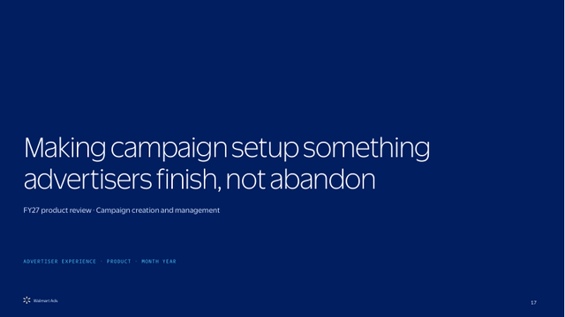
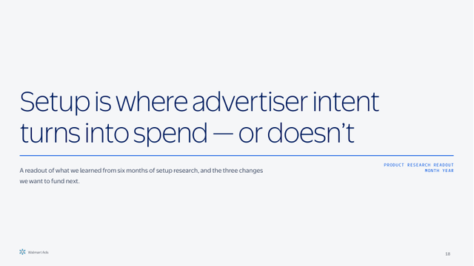

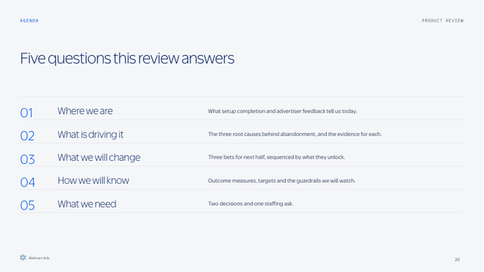
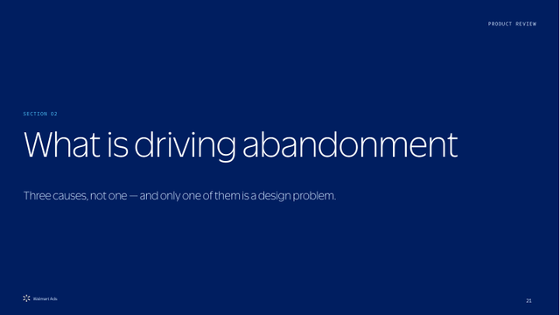
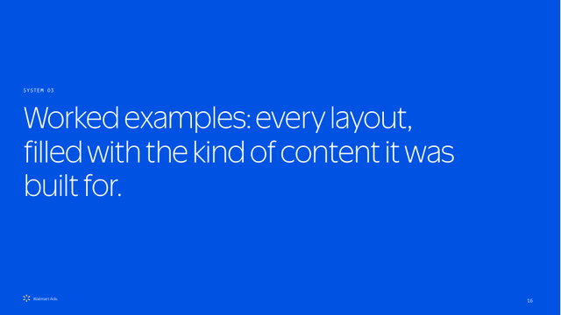
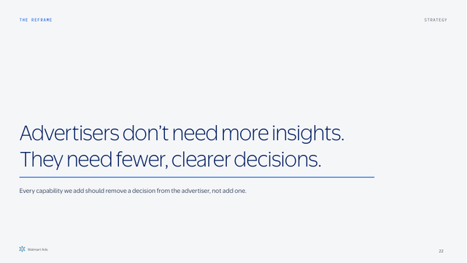
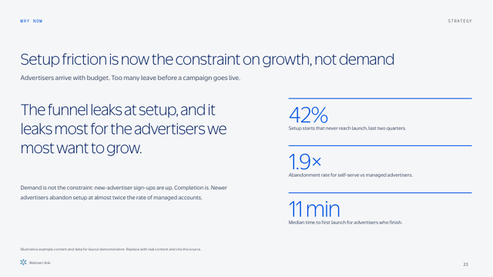
Layout catalog 1 of 5: 01–08
01 Cover — Minimal
02 Cover — Editorial
03 Cover — Visual
04 Agenda
START · IDEAL TITLE ≤ 12 WORDS
START · IDEAL TITLE ≤ 14 WORDS
START · IDEAL TITLE ≤ 10 WORDS
START · IDEAL 4–6 ITEMS
Deck cover on a dark ground
Cover for a document-style or leave-behind deck
Cover led by a product image or screenshot
Agenda, content map, section map
05 Section Divider
06 Section Divider — Statement
07 Hero Statement
08 Statement + Evidence
START · IDEAL NAME ≤ 5 WORDS, ARGUMENT ≤ 20
START · IDEAL ≤ 18 WORDS
TELL · IDEAL ≤ 20 WORDS
PROVE · IDEAL 1 CLAIM + 3 PROOF POINTS
Section transition that carries the section’s argument
Transition that lands a statement, visual rest
Hero statement, big question, key takeaway, north star, vision line
Statement + evidence, situation → implication, why now

Slide 12
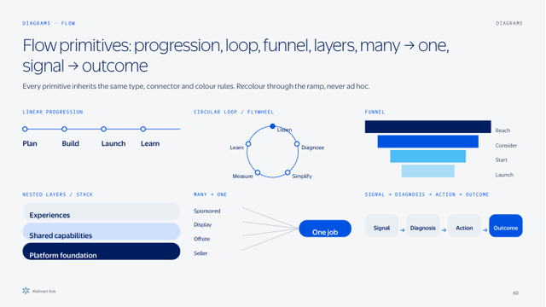
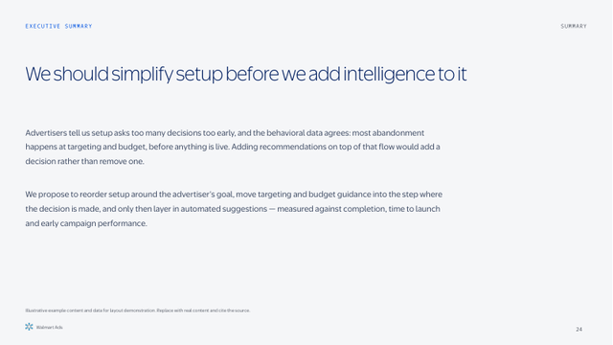
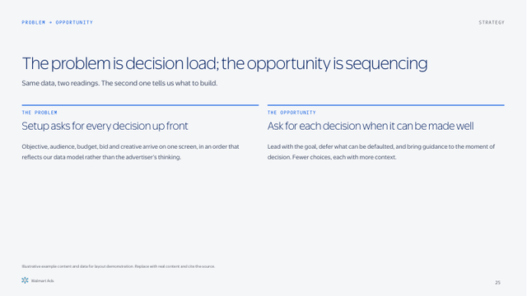
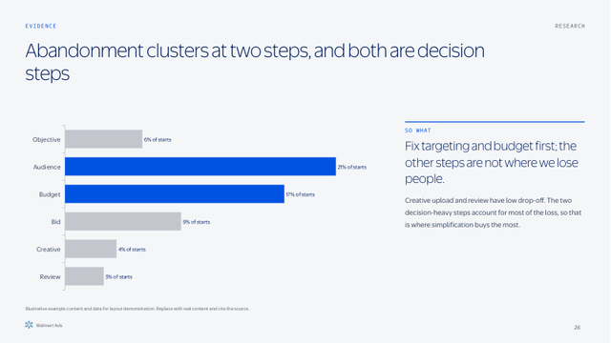
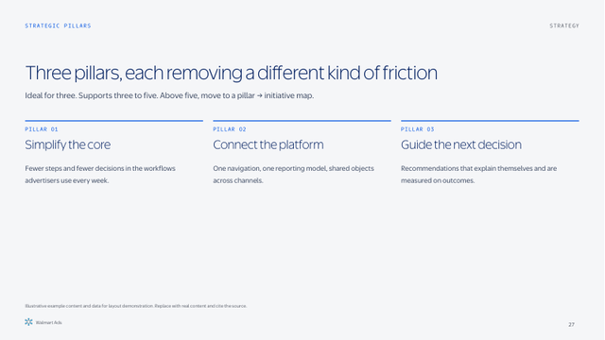
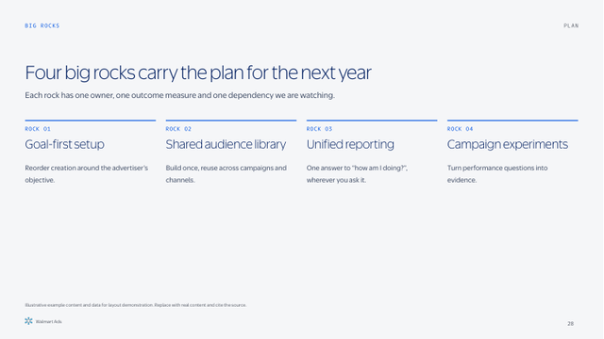
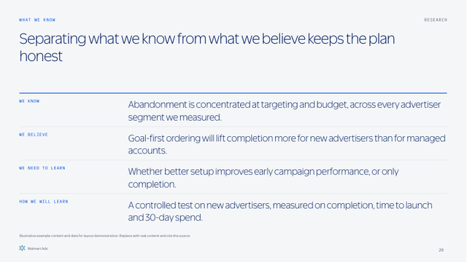
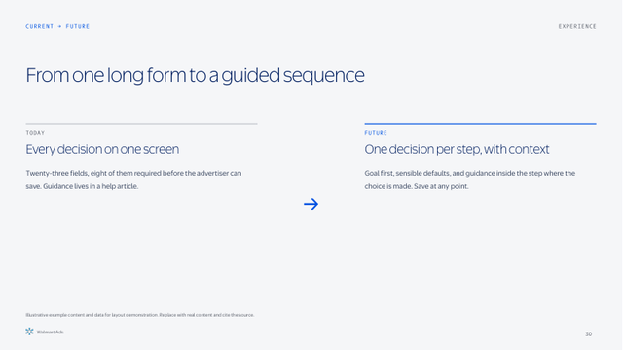
Layout catalog 2 of 5: 09–16
09 Title Only
10 Title + Body
11 Two Column
12 Split 8 + 4
EXPLAIN · IDEAL ONE DIAGRAM
TELL · IDEAL 60–90 WORDS
COMPARE · IDEAL 2 × 40 WORDS
PROVE · IDEAL 1 VISUAL + 40-WORD READ
Workhorse for diagrams, charts, components and infographic primitives
Narrative prose, executive summary text, context
Side-by-side, problem → opportunity, pros / cons, similarities / differences
Content + so-what: chart, screenshot, table or diagram with interpretation
13 Three Column
14 Four Column
15 Label Rail — 4 Rows
16 Current → Future
STRATEGY · IDEAL 3 × 30 WORDS
STRATEGY · IDEAL 4 × 25 WORDS
EXPLAIN · IDEAL 3–4 ROWS × 20 WORDS
COMPARE · IDEAL 2 × 40 WORDS
Strategic pillars, themes, recommendations, options, research findings, principles
Big rocks, KPI categories, four themes, four phases
Principles, what we know / believe / need to learn, wins / risks / next, assumptions
Current vs future, before / after, today → tomorrow, current-state → future-state workflow

Slide 13
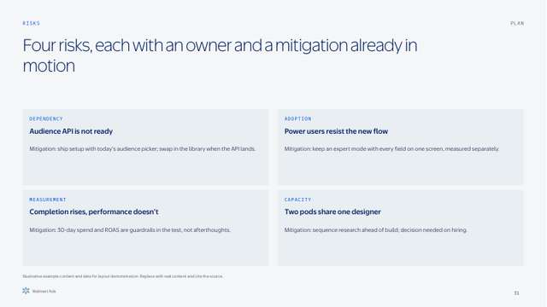
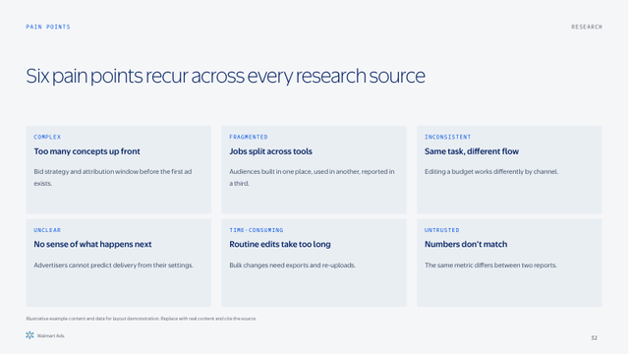
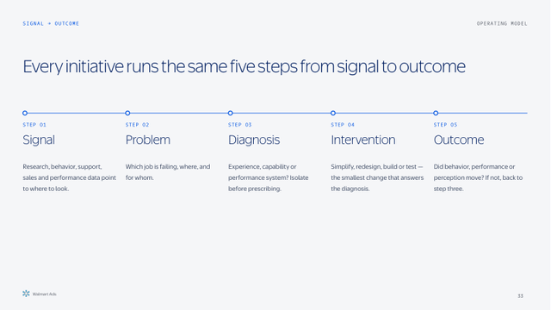
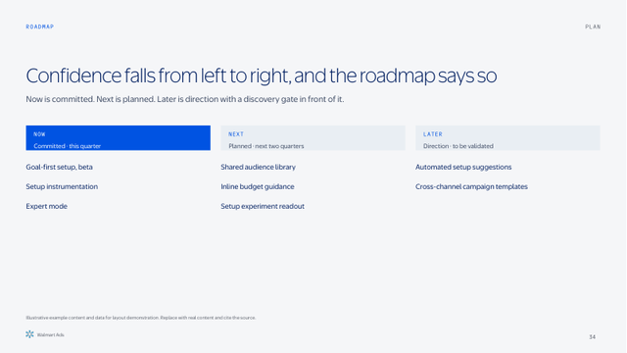
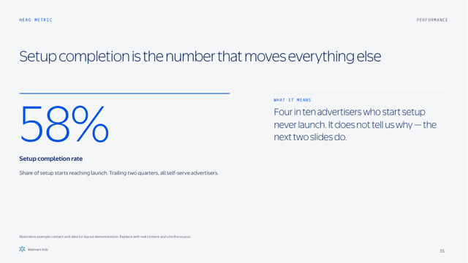
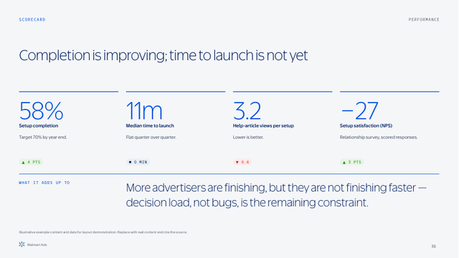
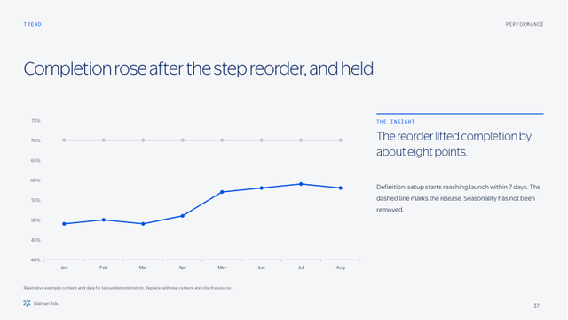
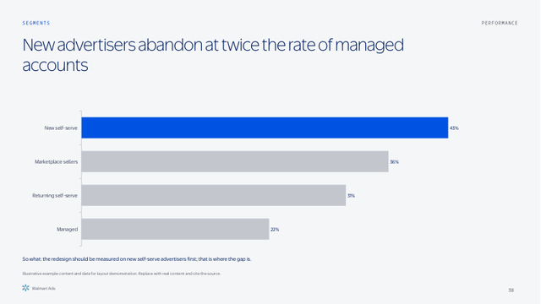
Layout catalog 3 of 5: 17–24
17 Grid 2 × 2
18 Grid 3 × 2
19 Process — 5 Steps
20 Now / Next / Later
EXPLAIN · IDEAL 4 × 25 WORDS
EXPLAIN · IDEAL 6 × 20 WORDS
EXPLAIN · IDEAL 4–5 STEPS
PLAN · IDEAL 3–5 ITEMS PER LANE
Four findings, four risks, four segments, 2×2 framework cells
Six capabilities, six pain points, persona traits, initiative snapshots
Linear progression, phased journey, sequence / unlocks, signal → diagnosis → action → outcome, intake → execution
Now / next / later, horizon model, strategic roadmap, must / should / could
21 Hero Metric
22 KPI Row — 4
23 Chart + Insight
24 Chart — Full
MEASURE · IDEAL 1 NUMBER + INTERPRETATION
MEASURE · IDEAL 3–4 METRICS
PROVE · IDEAL 1 CHART, 1 HIGHLIGHTED SERIES
PROVE · IDEAL 1 CHART
Single metric, hero metric, metric + drivers
KPI scorecard, multi-metric hero, target vs actual, before / after
Annotated chart, trend, segment performance, adoption / conversion funnel
Full-width chart: trend, cohort, waterfall, multi-series

Slide 14
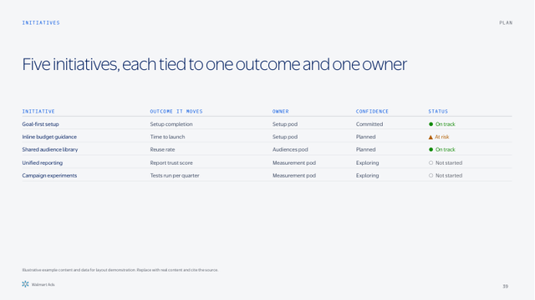
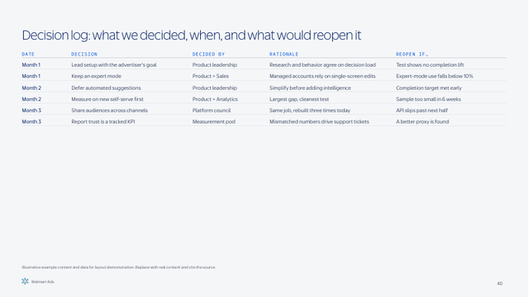
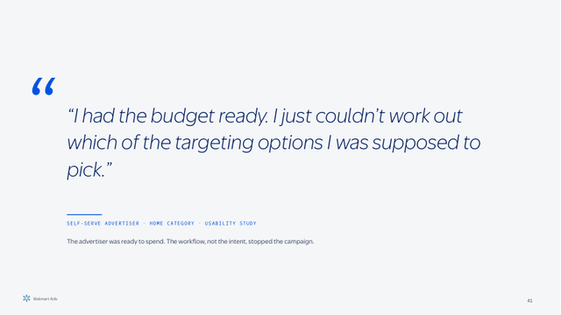
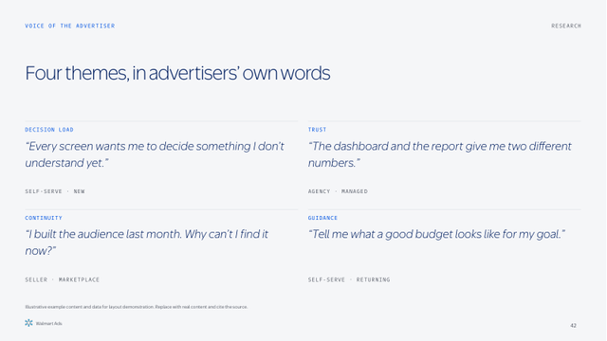
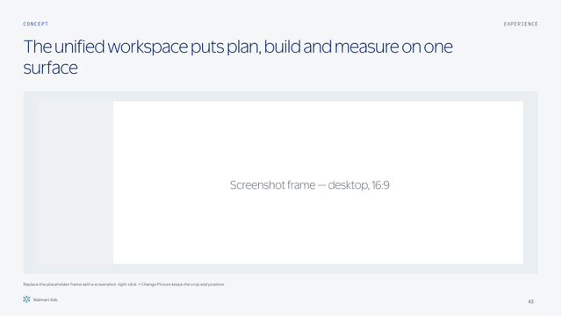
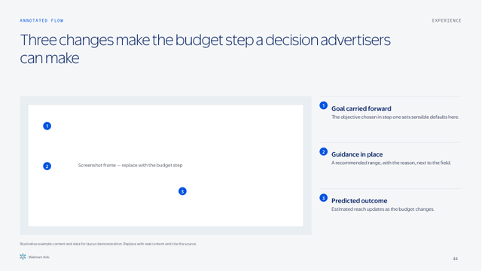
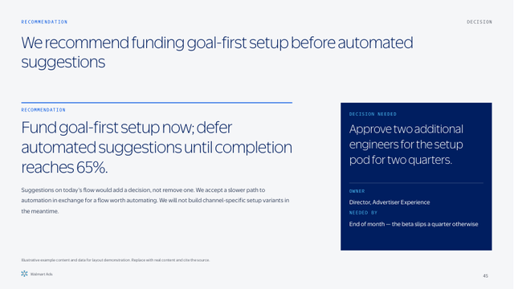
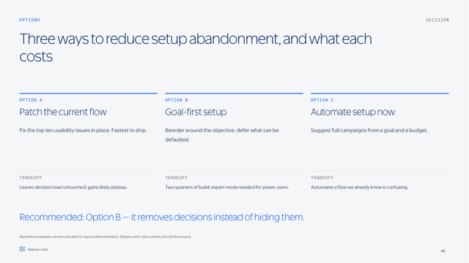
Layout catalog 4 of 5: 25–32
25 Table
26 Dense — Title + Body
27 Quote — Hero
28 Quote Wall — 4
COMPARE · IDEAL 5–7 ROWS × 4–5 COLUMNS
UPDATE · IDEAL REFERENCE MATERIAL
CUSTOMER · IDEAL ≤ 35 WORDS
CUSTOMER · IDEAL 4 QUOTES ≤ 30 WORDS
Executive, comparison, initiative, KPI, decision, risk and research tables
Purpose-built dense slide: appendix tables, detailed timelines, decision logs
Singular quote, quote + implication
Quote wall, voice-of-customer themes, dense quote themes
29 Screenshot — Hero
30 Screenshot + Annotations
31 Recommendation
32 Options — 3
EXPLAIN · IDEAL 1 SCREENSHOT
EXPLAIN · IDEAL 3 ANNOTATIONS
DECIDE · IDEAL 1 RECOMMENDATION + 1 DECISION
DECIDE · IDEAL 3 OPTIONS
Product screenshot hero, product concept
Annotated screenshot, workflow step, before / after product
Recommendation, decision slide, recommendation + ask, strategic choice
Options comparison, strategic choices, tradeoff slide, three-way comparison

Slide 15
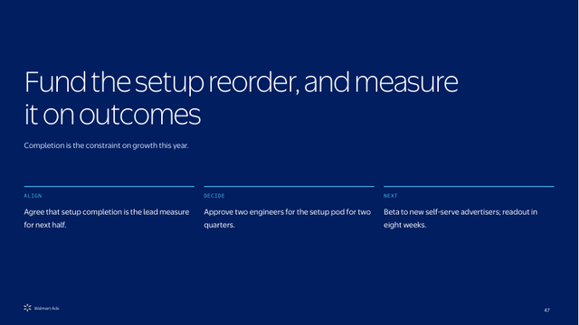

Layout catalog 5 of 5: 33–35
33 Closing — Takeaways + Ask
34 Appendix Divider
35 Blank
CLOSE · IDEAL 3 ASKS
CLOSE · IDEAL —
EXPLAIN · IDEAL —
Key takeaways, recommendation + ask, next steps, leadership decisions
Appendix divider, Q&A
Free canvas with footer, for one-off working canvases

Slide 16
Worked examples: every layout, filled with the kind of content it was built for.
SYSTEM 03

Slide 17
Making campaign setup something advertisers finish, not abandon
FY27 product review · Campaign creation and management
ADVERTISER EXPERIENCE · PRODUCT · MONTH YEAR

Slide 18
Setup is where advertiser intent turns into spend — or doesn’t
A readout of what we learned from six months of setup research, and the three changes we want to fund next.
PRODUCT RESEARCH READOUT
MONTH YEAR

Slide 19
One place to plan, buy and measure
Concept review for the unified campaign workspace
DESIGN REVIEW · MONTH YEAR

Slide 20
Five questions this review answers
AGENDA
PRODUCT REVIEW
01
Where we are
What setup completion and advertiser feedback tell us today.
02
What is driving it
The three root causes behind abandonment, and the evidence for each.
03
What we will change
Three bets for next half, sequenced by what they unlock.
04
How we will know
Outcome measures, targets and the guardrails we will watch.
05
What we need
Two decisions and one staffing ask.

Slide 21
What is driving abandonment
PRODUCT REVIEW
SECTION 02
Three causes, not one — and only one of them is a design problem.

Slide 22
Advertisers don’t need more insights. They need fewer, clearer decisions.
THE REFRAME
STRATEGY
Every capability we add should remove a decision from the advertiser, not add one.

Slide 23
Setup friction is now the constraint on growth, not demand
WHY NOW
STRATEGY
Advertisers arrive with budget. Too many leave before a campaign goes live.
The funnel leaks at setup, and it leaks most for the advertisers we most want to grow.
42%
Setup starts that never reach launch, last two quarters.
1.9×
Abandonment rate for self-serve vs managed advertisers.
Demand is not the constraint: new-advertiser sign-ups are up. Completion is. Newer advertisers abandon setup at almost twice the rate of managed accounts.
11 min
Median time to first launch for advertisers who finish.
Illustrative example content and data for layout demonstration. Replace with real content and cite the source.

Slide 24
We should simplify setup before we add intelligence to it
EXECUTIVE SUMMARY
SUMMARY
Advertisers tell us setup asks too many decisions too early, and the behavioral data agrees: most abandonment happens at targeting and budget, before anything is live. Adding recommendations on top of that flow would add a decision rather than remove one.
We propose to reorder setup around the advertiser’s goal, move targeting and budget guidance into the step where the decision is made, and only then layer in automated suggestions — measured against completion, time to launch and early campaign performance.
Illustrative example content and data for layout demonstration. Replace with real content and cite the source.

Slide 25
The problem is decision load; the opportunity is sequencing
PROBLEM → OPPORTUNITY
STRATEGY
Same data, two readings. The second one tells us what to build.
THE PROBLEM
THE OPPORTUNITY
Setup asks for every decision up front
Ask for each decision when it can be made well
Objective, audience, budget, bid and creative arrive on one screen, in an order that reflects our data model rather than the advertiser’s thinking.
Lead with the goal, defer what can be defaulted, and bring guidance to the moment of decision. Fewer choices, each with more context.
Illustrative example content and data for layout demonstration. Replace with real content and cite the source.

Slide 26
Abandonment clusters at two steps, and both are decision steps
EVIDENCE
RESEARCH
SO WHAT
Fix targeting and budget first; the other steps are not where we lose people.
Creative upload and review have low drop-off. The two decision-heavy steps account for most of the loss, so that is where simplification buys the most.
Illustrative example content and data for layout demonstration. Replace with real content and cite the source.

Slide 27
Three pillars, each removing a different kind of friction
STRATEGIC PILLARS
STRATEGY
Ideal for three. Supports three to five. Above five, move to a pillar → initiative map.
PILLAR 01
PILLAR 02
PILLAR 03
Simplify the core
Connect the platform
Guide the next decision
Fewer steps and fewer decisions in the workflows advertisers use every week.
One navigation, one reporting model, shared objects across channels.
Recommendations that explain themselves and are measured on outcomes.
Illustrative example content and data for layout demonstration. Replace with real content and cite the source.

Slide 28
Four big rocks carry the plan for the next year
BIG ROCKS
PLAN
Each rock has one owner, one outcome measure and one dependency we are watching.
ROCK 01
ROCK 02
ROCK 03
ROCK 04
Goal-first setup
Shared audience library
Unified reporting
Campaign experiments
Reorder creation around the advertiser’s objective.
Build once, reuse across campaigns and channels.
One answer to “how am I doing?”, wherever you ask it.
Turn performance questions into evidence.
Illustrative example content and data for layout demonstration. Replace with real content and cite the source.

Slide 29
Separating what we know from what we believe keeps the plan honest
WHAT WE KNOW
RESEARCH
WE KNOW
Abandonment is concentrated at targeting and budget, across every advertiser segment we measured.
WE BELIEVE
Goal-first ordering will lift completion more for new advertisers than for managed accounts.
WE NEED TO LEARN
Whether better setup improves early campaign performance, or only completion.
HOW WE WILL LEARN
A controlled test on new advertisers, measured on completion, time to launch and 30-day spend.
Illustrative example content and data for layout demonstration. Replace with real content and cite the source.

Slide 30
From one long form to a guided sequence
CURRENT → FUTURE
EXPERIENCE
TODAY
FUTURE
Every decision on one screen
One decision per step, with context
Twenty-three fields, eight of them required before the advertiser can save. Guidance lives in a help article.
Goal first, sensible defaults, and guidance inside the step where the choice is made. Save at any point.
Illustrative example content and data for layout demonstration. Replace with real content and cite the source.

Slide 31
Four risks, each with an owner and a mitigation already in motion
RISKS
PLAN
DEPENDENCY
ADOPTION
Audience API is not ready
Power users resist the new flow
Mitigation: ship setup with today’s audience picker; swap in the library when the API lands.
Mitigation: keep an expert mode with every field on one screen, measured separately.
MEASUREMENT
CAPACITY
Completion rises, performance doesn’t
Two pods share one designer
Mitigation: 30-day spend and ROAS are guardrails in the test, not afterthoughts.
Mitigation: sequence research ahead of build; decision needed on hiring.
Illustrative example content and data for layout demonstration. Replace with real content and cite the source.

Slide 32
Six pain points recur across every research source
PAIN POINTS
RESEARCH
COMPLEX
FRAGMENTED
INCONSISTENT
Too many concepts up front
Jobs split across tools
Same task, different flow
Bid strategy and attribution window before the first ad exists.
Audiences built in one place, used in another, reported in a third.
Editing a budget works differently by channel.
UNCLEAR
TIME-CONSUMING
UNTRUSTED
No sense of what happens next
Routine edits take too long
Numbers don’t match
Advertisers cannot predict delivery from their settings.
Bulk changes need exports and re-uploads.
The same metric differs between two reports.
Illustrative example content and data for layout demonstration. Replace with real content and cite the source.

Slide 33
Every initiative runs the same five steps from signal to outcome
SIGNAL → OUTCOME
OPERATING MODEL
STEP 01
STEP 02
STEP 03
STEP 04
STEP 05
Signal
Problem
Diagnosis
Intervention
Outcome
Research, behavior, support, sales and performance data point to where to look.
Which job is failing, where, and for whom.
Experience, capability or performance system? Isolate before prescribing.
Simplify, redesign, build or test — the smallest change that answers the diagnosis.
Did behavior, performance or perception move? If not, back to step three.

Slide 34
Confidence falls from left to right, and the roadmap says so
ROADMAP
PLAN
Now is committed. Next is planned. Later is direction with a discovery gate in front of it.
NOW
NEXT
LATER
Committed · this quarter
Planned · next two quarters
Direction · to be validated
Goal-first setup, beta
Setup instrumentation
Expert mode
Shared audience library
Inline budget guidance
Setup experiment readout
Automated setup suggestions
Cross-channel campaign templates
Illustrative example content and data for layout demonstration. Replace with real content and cite the source.

Slide 35
Setup completion is the number that moves everything else
HERO METRIC
PERFORMANCE
58%
WHAT IT MEANS
Four in ten advertisers who start setup never launch. It does not tell us why — the next two slides do.
Setup completion rate
Share of setup starts reaching launch. Trailing two quarters, all self-serve advertisers.
Illustrative example content and data for layout demonstration. Replace with real content and cite the source.

Slide 36
Completion is improving; time to launch is not yet
SCORECARD
PERFORMANCE
58%
11m
3.2
−27
Setup completion
Median time to launch
Help-article views per setup
Setup satisfaction (NPS)
Target 70% by year end.
Flat quarter over quarter.
Lower is better.
Relationship survey, scored responses.
▲ 4 PTS
■ 0 MIN
▼ 0.6
▲ 3 PTS
WHAT IT ADDS UP TO
More advertisers are finishing, but they are not finishing faster — decision load, not bugs, is the remaining constraint.
Illustrative example content and data for layout demonstration. Replace with real content and cite the source.

Slide 37
Completion rose after the step reorder, and held
TREND
PERFORMANCE
THE INSIGHT
The reorder lifted completion by about eight points.
Definition: setup starts reaching launch within 7 days. The dashed line marks the release. Seasonality has not been removed.
Illustrative example content and data for layout demonstration. Replace with real content and cite the source.

Slide 38
New advertisers abandon at twice the rate of managed accounts
SEGMENTS
PERFORMANCE
So what: the redesign should be measured on new self-serve advertisers first; that is where the gap is.
Illustrative example content and data for layout demonstration. Replace with real content and cite the source.

Slide 39
Five initiatives, each tied to one outcome and one owner
INITIATIVES
PLAN
INITIATIVE | OUTCOME IT MOVES | OWNER | CONFIDENCE | STATUS
Goal-first setup | Setup completion | Setup pod | Committed | ● On track
Inline budget guidance | Time to launch | Setup pod | Planned | ▲ At risk
Shared audience library | Reuse rate | Audiences pod | Planned | ● On track
Unified reporting | Report trust score | Measurement pod | Exploring | ○ Not started
Campaign experiments | Tests run per quarter | Measurement pod | Exploring | ○ Not started
Illustrative example content and data for layout demonstration. Replace with real content and cite the source.

Slide 40
Decision log: what we decided, when, and what would reopen it
DATE | DECISION | DECIDED BY | RATIONALE | REOPEN IF…
Month 1 | Lead setup with the advertiser’s goal | Product leadership | Research and behavior agree on decision load | Test shows no completion lift
Month 1 | Keep an expert mode | Product + Sales | Managed accounts rely on single-screen edits | Expert-mode use falls below 10%
Month 2 | Defer automated suggestions | Product leadership | Simplify before adding intelligence | Completion target met early
Month 2 | Measure on new self-serve first | Product + Analytics | Largest gap, cleanest test | Sample too small in 6 weeks
Month 3 | Share audiences across channels | Platform council | Same job, rebuilt three times today | API slips past next half
Month 3 | Report trust is a tracked KPI | Measurement pod | Mismatched numbers drive support tickets | A better proxy is found
Illustrative example content and data for layout demonstration. Replace with real content and cite the source.

Slide 41
“I had the budget ready. I just couldn’t work out which of the targeting options I was supposed to pick.”
SELF-SERVE ADVERTISER · HOME CATEGORY · USABILITY STUDY
The advertiser was ready to spend. The workflow, not the intent, stopped the campaign.

Slide 42
Four themes, in advertisers’ own words
VOICE OF THE ADVERTISER
RESEARCH
DECISION LOAD
TRUST
“Every screen wants me to decide something I don’t understand yet.”
“The dashboard and the report give me two different numbers.”
SELF-SERVE · NEW
AGENCY · MANAGED
CONTINUITY
GUIDANCE
“I built the audience last month. Why can’t I find it now?”
“Tell me what a good budget looks like for my goal.”
SELLER · MARKETPLACE
SELF-SERVE · RETURNING
Illustrative example content and data for layout demonstration. Replace with real content and cite the source.

Slide 43
The unified workspace puts plan, build and measure on one surface
CONCEPT
EXPERIENCE
Screenshot frame — desktop, 16:9
Replace the placeholder frame with a screenshot: right-click → Change Picture keeps the crop and position.

Slide 44
Three changes make the budget step a decision advertisers can make
ANNOTATED FLOW
EXPERIENCE
Goal carried forward
The objective chosen in step one sets sensible defaults here.
1
Guidance in place
2
Screenshot frame — replace with the budget step
A recommended range, with the reason, next to the field.
3
Predicted outcome
Estimated reach updates as the budget changes.
Illustrative example content and data for layout demonstration. Replace with real content and cite the source.

Slide 45
We recommend funding goal-first setup before automated suggestions
RECOMMENDATION
DECISION
RECOMMENDATION
DECISION NEEDED
Fund goal-first setup now; defer automated suggestions until completion reaches 65%.
Approve two additional engineers for the setup pod for two quarters.
Suggestions on today’s flow would add a decision, not remove one. We accept a slower path to automation in exchange for a flow worth automating. We will not build channel-specific setup variants in the meantime.
OWNER
Director, Advertiser Experience
NEEDED BY
End of month — the beta slips a quarter otherwise
Illustrative example content and data for layout demonstration. Replace with real content and cite the source.

Slide 46
Three ways to reduce setup abandonment, and what each costs
OPTIONS
DECISION
OPTION A
OPTION B
OPTION C
Patch the current flow
Goal-first setup
Automate setup now
Fix the top ten usability issues in place. Fastest to ship.
Reorder around the objective, defer what can be defaulted.
Suggest full campaigns from a goal and a budget.
TRADEOFF
TRADEOFF
TRADEOFF
Leaves decision load untouched; gains likely plateau.
Two quarters of build; expert mode needed for power users.
Automates a flow we already know is confusing.
Recommended: Option B — it removes decisions instead of hiding them.
Illustrative example content and data for layout demonstration. Replace with real content and cite the source.

Slide 47
Fund the setup reorder, and measure it on outcomes
Completion is the constraint on growth this year.
ALIGN
DECIDE
NEXT
Agree that setup completion is the lead measure for next half.
Approve two engineers for the setup pod for two quarters.
Beta to new self-serve advertisers; readout in eight weeks.

Slide 48
Appendix
Method, definitions and the full research inventory behind this review.

Slide 49
Components: copy them, don’t redraw them. A recommendation should look like a recommendation on every slide.
SYSTEM 04

Slide 50
Pills are fixed-height and monospaced, so they never need resizing by hand
COMPONENTS · PILLS, STATUS, DELTAS
COMPONENTS
Status always pairs colour with a shape. Deltas pair colour with a direction glyph.
CATEGORY / CHANNEL
SPONSORED
DISPLAY
OFFSITE
MARKETPLACE
STATUS
DELTAS
On track
▲ 12 PTS
PRIORITY / PHASE
P1
P2
P3
DISCOVERY
BETA
GA
At risk
▼ 3 PTS
Off track
■ 0 PTS
SENTIMENT
POSITIVE
NEUTRAL
NEGATIVE
WATCH
✓
Complete
PRODUCT
DESIGN
ENGINEERING
SALES
Not started
OWNER / META
Pill: 28px high, 12px side padding, full radius, Mono 7.5pt caps. Keep labels ≤ 18 characters.

Slide 51
One card anatomy, four treatments, each with a meaning
COMPONENTS · CARDS
COMPONENTS
Eyebrow → title → optional metric → body → optional footer. Padding is 24px everywhere; equal rows are equal height.
RULE CARD
SURFACE CARD
EMPHASIS CARD
DECISION
Default peer module
Grouped content
The recommended option
Approve two engineers for two quarters
Top rule, no fill. Use for pillars, themes and any row of equals.
Quiet #E9EEF3 surface. Use for findings, risks, snapshots.
Everyday Blue border. One per row, only with a reason on the slide.
Navy is reserved for the decision the room must make.
Owner · Date
Needed by: end of month
Compact state: drop the body and keep eyebrow + title. Dense state: 16px padding and Body small, used only on layout 26.
Rule = default peer module (deck-native). Surface = grouped content. Emphasis = the one pick among peers — never the last step of a sequence. Dark = a decision.

Slide 52
Semantic cards: the same job always wears the same card
COMPONENTS · SEMANTIC CARDS
COMPONENTS
Metric, insight, recommendation, risk, initiative, evidence, pain point and quote.
METRIC
INSIGHT
RECOMMENDATION
RISK
58%
Abandonment clusters at decision steps
RECOMMENDED
HIGH · OWNER PM
Setup completion
Lead setup with the goal
Audience API not ready
Targeting and budget, not creative upload.
Defer what can be defaulted.
Ship with today’s picker.
Trailing two quarters.
INITIATIVE
EVIDENCE
PAIN POINT
QUOTE
NOW
TRIANGULATED
UNCLEAR
“Tell me what a good budget looks like.”
Goal-first setup
3 of 5 sources agree
Numbers don’t match
Moves: completion.
UXR, Pendo, support tickets.
Same metric, two reports.
Self-serve · returning
Illustrative example content and data for layout demonstration. Replace with real content and cite the source.

Slide 53
Annotation parts share one marker, one leader line and one spacing
COMPONENTS · MARKERS, CONNECTORS, CALLOUTS
COMPONENTS
Numbers mark the order of reading. Connectors are 1pt True Blue with a small arrowhead. Callouts never cover the product UI.
NUMBER MARKERS
CALLOUT
1
2
3
4
5
1
Leader line to the element
CONNECTORS
Flow / causation
The marker sits beside the UI, never on it.
Reference line only
TIMELINE MARKERS
Done
Next
Planned
Gate
SECTION LABEL · SOURCE BLOCK
SECTION 02 · WHAT IS DRIVING IT
Source: Setup funnel, Pendo, trailing two quarters, n = 18,400 setup starts.
Source block: 8pt, bottom of the slide, name · date range · sample size. Legends only when a direct label will not fit.

Slide 54
Bars rank and compare; highlight the one that carries the point
CHARTS · RANKING & COMPOSITION
CHARTS
Direct labels, no gridlines, no legend for one series, one colour unless a series is the point.
HORIZONTAL BAR · HIGHLIGHT ONE
100% STACKED BAR · COMPOSITION
Abandonment by setup step
Where advertisers finish setup, by segment
Illustrative example content and data for layout demonstration. Replace with real content and cite the source.

Slide 55
Lines show trends; mute the context series and label the one that matters
CHARTS · CHANGE OVER TIME
CHARTS
Consistent baselines when charts are compared. Annotate the event, not the axis.
MULTI-LINE · HIGHLIGHT ONE SERIES
WATERFALL · CONTRIBUTION TO CHANGE
Completion by segment, monthly
What moved completion from 50% to 58%
+5 reorder · +2 defaults · +1 guidance. The base series takes the page colour; label the deltas directly.
Illustrative example content and data for layout demonstration. Replace with real content and cite the source.

Slide 56
Funnels, progress bars and heatmaps cover the rest of the everyday charts
CHARTS · FUNNELS, PROGRESS, PATTERNS
CHARTS
Funnel = sorted bars. Progress = a track and a target. Heatmap = a table with a single-hue ramp.
FUNNEL
PROGRESS / BULLET
HEATMAP · COHORT
Setup started
100%
Completion
M0
M1
M2
M3
Q1
100
72
61
55
Objective set
91%
58% of plan · target 70%
Time to launch
Q2
100
75
66
60
Audience set
70%
40% of plan · target 60%
Q3
Budget set
58%
Reuse rate
100
81
72
68
Launched
58%
22% of plan · target 40%
Retention by launch cohort. Darker = higher. Numbers stay on the cells.
Illustrative example content and data for layout demonstration. Replace with real content and cite the source.

Slide 57
Start with the insight, then choose the chart that shows it
CHARTS · RULES
CHARTS
CHOOSE
Bars rank. Lines trend. Dot plots compare precisely. Heatmaps show patterns. Waterfalls show contribution. Never 3D.
HIGHLIGHT
One series, segment or delta in True Blue; everything else in #C3C6CD. Direct labels beat legends.
REMOVE
Gridlines, borders, tick marks, extra decimals and default styling. Keep baselines consistent across compared charts.
VARIANTS
Standard · annotated insight · comparison · highlight one series · dense appendix. Every chart has a source and a so-what zone.

Slide 58
Tables are structured by type and whitespace, not by gridlines
TABLES · KPI & RISK
TABLES
Narrative columns get width; numbers are right-aligned; status carries a shape.
KPI TABLE
RISK TABLE
METRIC | ACTUAL | TARGET | Δ QOQ
Setup completion | 58% | 70% | +4 pts
Median time to launch | 11 min | 8 min | 0
Help views per setup | 3.2 | 2.0 | −0.6
Report trust score | 61 | 75 | +3
RISK | LIKELIHOOD | IMPACT | MITIGATION
Audience API slips | Medium | High | Ship with current picker
Power users resist | High | Medium | Keep expert mode
No performance lift | Medium | High | Guardrail metrics in test
Illustrative example content and data for layout demonstration. Replace with real content and cite the source.

Slide 59
Dense appendix table: purpose-built for reference, still readable at 10.5pt
SOURCE | TYPE | PERIOD | SAMPLE | WHAT IT CONTRIBUTES | STATUS
Setup usability study | Moderated UXR | Month 1 | 12 advertisers | Where and why advertisers stall | Linked
Setup funnel | Pendo behavior | 2 quarters | 18,400 starts | Step-level abandonment | Linked
Relationship survey | VOC | 2 quarters | 1,350 scored | Satisfaction and verbatims | Linked
Support tickets | Operational | 2 quarters | 2,900 tickets | Setup-related contact drivers | Needs link
Sales field notes | Qualitative | Month 2 | 14 sellers | Account-level escalations | Needs link
Competitive teardown | Desk research | Month 2 | 4 platforms | Setup step counts and defaults | Check figure
Expert-mode interviews | UXR | Month 3 | 8 managed accounts | What power users need to keep | Linked
Experiment design review | Analytics | Month 3 | — | Power and guardrails for the test | Linked
Design critique notes | Internal | Month 3 | 3 sessions | Open questions for the beta | Linked
Illustrative example content and data for layout demonstration. Replace with real content and cite the source.

Slide 60
Flow primitives: progression, loop, funnel, layers, many → one, signal → outcome
DIAGRAMS · FLOW
DIAGRAMS
Every primitive inherits the same type, connector and colour rules. Recolour through the ramp, never ad hoc.
LINEAR PROGRESSION
CIRCULAR LOOP / FLYWHEEL
FUNNEL
Listen
Reach
Plan
Build
Launch
Learn
Learn
Diagnose
Consider
Start
Measure
Simplify
Launch
NESTED LAYERS / STACK
MANY → ONE
SIGNAL → DIAGNOSIS → ACTION → OUTCOME
Experiences
Sponsored
Display
Signal
→
Diagnosis
→
Action
→
Outcome
Shared capabilities
One job
Offsite
Platform foundation
Seller

Slide 61
Structure primitives: 2 × 2, hub and spoke, hierarchy, pyramid, value chain, before → future
DIAGRAMS · STRUCTURE
DIAGRAMS
2 × 2 MATRIX
HUB AND SPOKE
HIERARCHY / TREE
Quick wins
Big bets
North star
Deprioritize
Maybe later
Core
Pillar 1
Pillar 2
Pillar 3
EFFORT →
PYRAMID
VALUE CHAIN
BEFORE → TRANSITION → FUTURE
Vision
Before
Transition
Future
Strategy
Plan
Buy
Serve
Measure
Optimize
Initiatives
Delivery

Slide 62
Time primitives: a milestone timeline and a swimlane roadmap
DIAGRAMS · TIME
DIAGRAMS
Quarters, not dates, unless the dates are committed. Confidence is shown, not implied.
MILESTONE TIMELINE
Q1
Q2
Q3
Q4
Q1 +1
Research readout
Beta to new advertisers
Expert mode
GA decision gate
Suggestions pilot
SWIMLANE ROADMAP
Q1
Q2
Q3
Q4
Setup
Goal-first setup
Expert mode
Audiences
Shared audience library
Measurement
Instrumentation
Experiments
Committed · Planned · Exploring — fill weight carries confidence.
Illustrative example content and data for layout demonstration. Replace with real content and cite the source.

Slide 63
The system works when routine edits need no design work
DO / DON’T
USAGE
DO
DON’T
Duplicate, replace, delete, present
Nudge, shrink, recolour, decorate
Pick the layout by job. Type into placeholders. Delete unused modules rather than moving the rest. Keep peers the same length. Cite every number in the source zone. Repeat a layout when the job repeats.
Don’t drag placeholders off the grid, shrink text to make it fit, invent a colour, add gradients, shadows or accent stripes, or fill one card among peers without a stated reason.

Slide 64
The thinking changes. The design system does not.
Make the correct design choice the easiest one.
START
BUILD
CHECK
Pick the communication job on the layout picker.
Use the numbered layouts and the component slides.
Three-second test, swap test, export test before it goes out.

