Slide 1
Laboratory Information Management System
(LIMS)

Slide 2
Introduction
BHP’s current Laboratory Information System (LIS) was developed in-house in 2003 and hosted on an HP server acquired in 2000.
Through the LIS, BHHRL processes samples from various research projects and protocols conducted at BHP. This means the entire sample processing life cycle of a specimen is processed and managed by the laboratory using the LIS.

Slide 3
The Life cycle of a sample
Clinic/Project makes an Analysis Request for a sample from research project participant
A Sample is received at the lab which is a process called Sample Reception
A Plan is made for the sample by the lab to schedule the required analysis/tests to be conducted and also determine if part of that sample is to be stored or not.
The sample is sent for testing and results are generated and fed back to the LIS. This process is called Resulting.
If there are challenges processing the sample, results are either rejected/retracted and another set of analysis is requested as necessary. If the results meet testing requirements and do not present any challenges they are then verified by the lab manager to indicate that the results are correct and accurate and can be released. This process is called Results Verification
The results are released upon approval and published, which involves remitting the results back to the originating clinic/study.

Slide 4
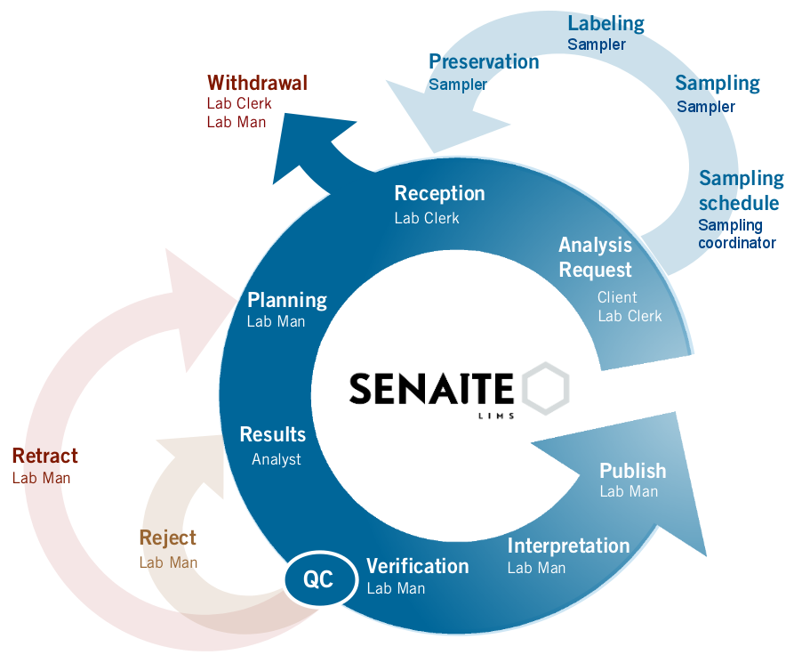

Slide 5
The process above is done to ensure that International Organization for Standardization (ISO) and sponsor requirements for the laboratory are adhered to and upheld. The process also ensures that quality assurance standards are upheld and the integrity of chain of custody of all the samples is maintained, and the release of results is undertaken in a procedurally correct and compliant manner.
The LIS is therefore integral and central to the success of clinical research projects conducted at BHP and is a critical component of BHP’s research infrastructure.

Slide 6
Problem
BHP’s current LIS ceased functioning on the 7th June 2018, disrupting all laboratory processes and procedures involved in processing sample specimens for over half of the research projects and protocols in BHP’s portfolio of grants.
All data previously collected for storage and testing is available and intact within the databases, with the primary challenge being lack of an interface to efficiently and effectively interact with the data for the analysis and reporting required to meet research project and research protocol objectives, and or collection of any new data.
BHP has had to resort to manually retrieving and accessing existing data, and manually inputting new data into the system. This process is time consuming, inefficient, and requires increased personnel to maintain standard levels of quality control.
Thardware that was hosting the actual source code for the web interface system failed, necessitating manual interfacing with the data.

Slide 7
Strategy and Proposed Activities
The BHP Software Engineering and Data Management Centre Department (SE & DMC) and the Laboratory Management Team duly assessed and considered various options and solutions for developing and implementing a new LIS, that would be easy and quick to implement while proving cost effective.
The team undertook benchmarking visits of similar laboratories in South Africa, Mozambique, Malawi and Zimbabwe to review first-hand, the various LIS systems being utilized.
After due consideration of the pros-and-cons of 5 systems that are being used effectively in comparable laboratories in the region, the team narrowed the considerations for developing a new LIS down to three primary options being

Slide 8
Strategy and Proposed Activities Conti…
Develop an LIS in-house
This was deemed a good approach and the most cost effective, with the major disadvantage being the duration it was expected take to develop a system ready for use. Therefore, given the existing crisis, this option was rejected.
Purchase a Commercial, Off-the-Shelf system
The major disadvantage with this solution is the high cost of purchasing commercial off the shelf systems, as these require payments for annual licensing fees over and above the initial cost of purchase, and in the long run are deemed costly to maintain.
In addition, the systems that were identified did not allow for migration of 15 years’ worth of stored data into the new systems.
This is valuable for research as BHP currently has an inventory of 1.3 million samples and is an excellent resource for Principal Investigators interested in utilizing BHP’s sample repository.
Customization of an open source system
An open source system can be customized and maintained by the local SE & DMC team to avoid maintenance fees. This was deemed the best option available, given the time frame required to have a system up and running to avoid compromising laboratory procedures and standards.
This option will also enable BHP to migrate all existing data on samples and integrate the data into the new system.

Slide 9
Strategy and Proposed Activities Conti…
Recommendation and Conclusion: Option 3 was deemed the best option.
The identified new system is called Senaite LIMS.
Advantages of this system:
This system is an open source system used in similar laboratories and is developed and supported by 4 international communities: in Spain, South Africa, Germany, and Zimbabwe.
The system is developed in Python and Plone which is advantageous as BHPs SE & DMC development team has sound experience using Python which reduces the learning curve.
This system will not result in license fees.
The system will also negate long term support costs arising from trouble shooting, as support is readily available from the existing communities at convenient time zones. Since this is a community project all sites will benefit from periodic updates and upgrades to the system.
Another benefit of the Senaite system is that the majority of BHP’s laboratory machines will be able to transmit results directly to the system, minimizing the risk of human error. For the machines that do not have this compatible functionality, the SE & DMC team will be able to develop local implement interfaces for them, which will in turn benefit the other communities.

Slide 10
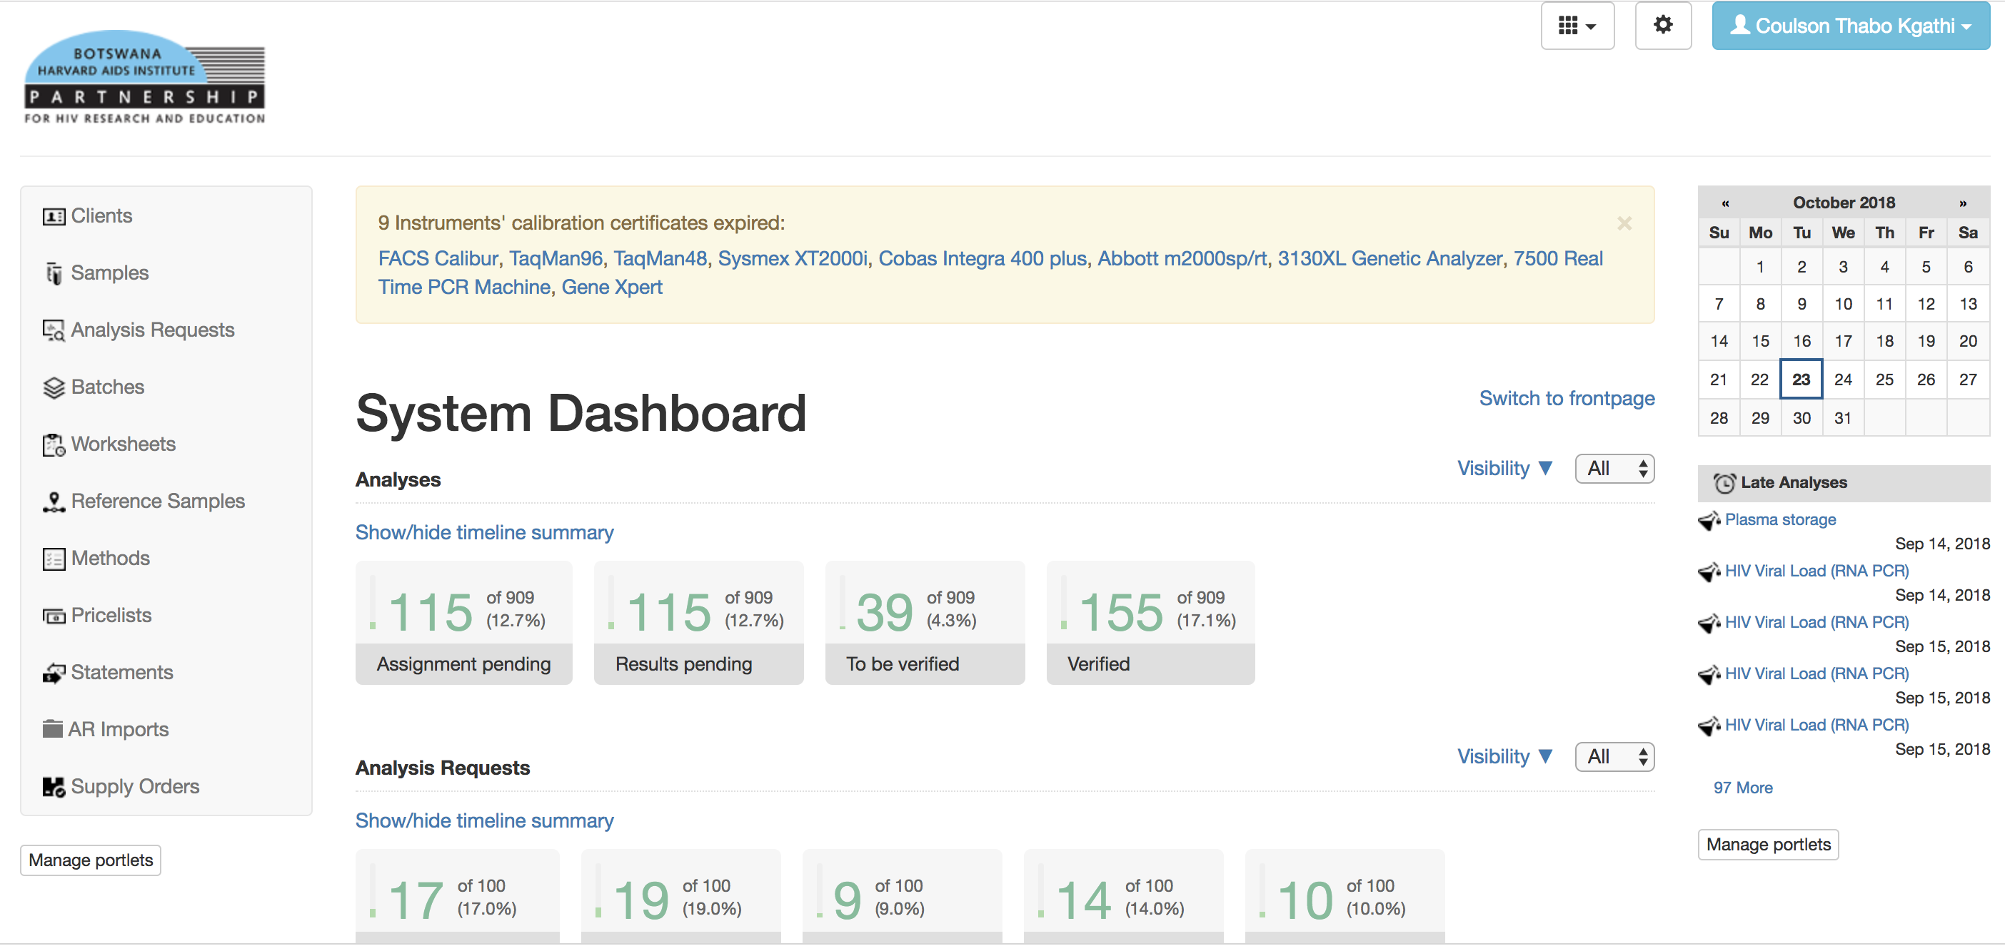
Senaite LIMS: Home

Slide 11
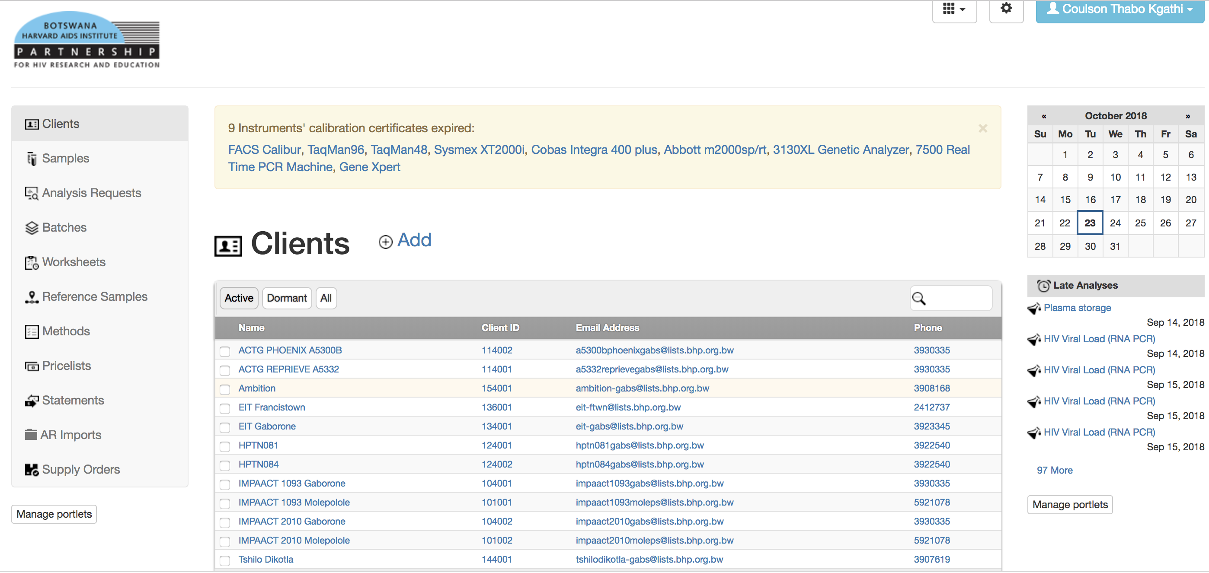
Clients

Slide 12
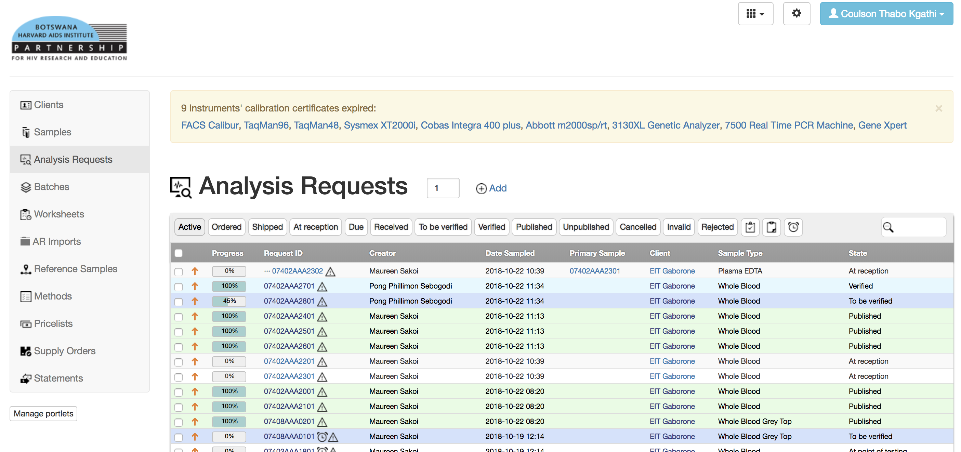
Analysis Request

Slide 13
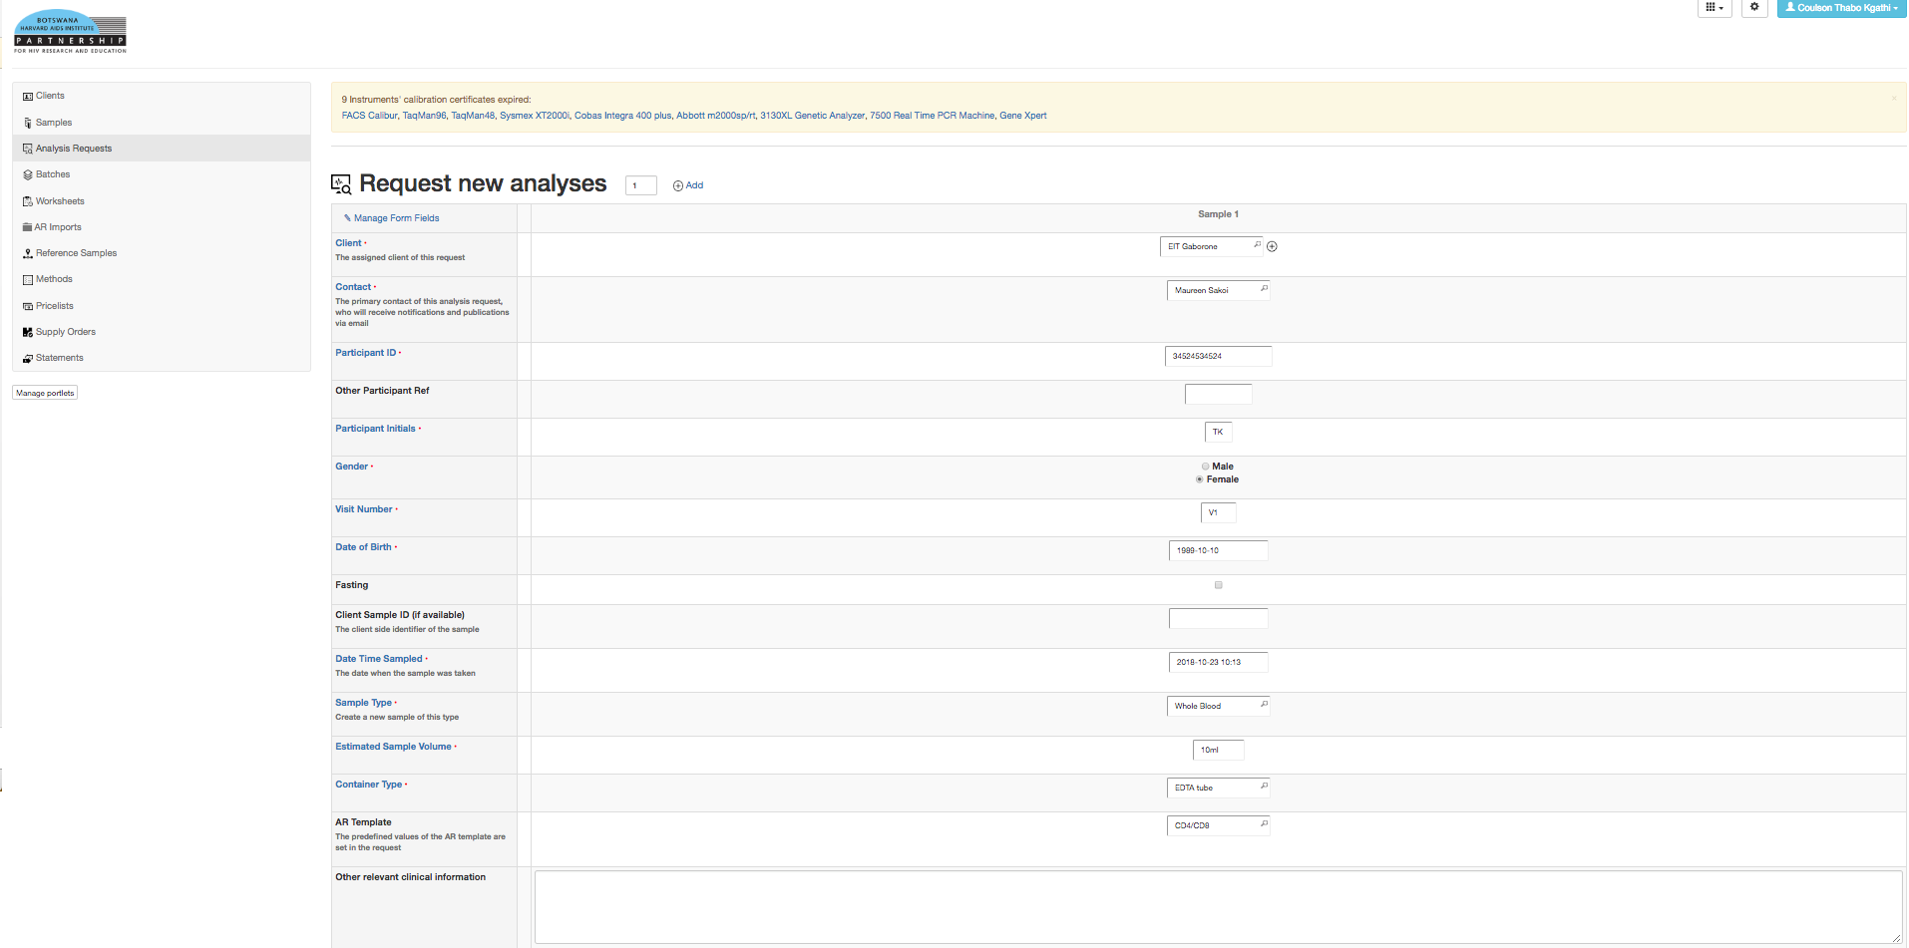
Add Analysis Request

Slide 14
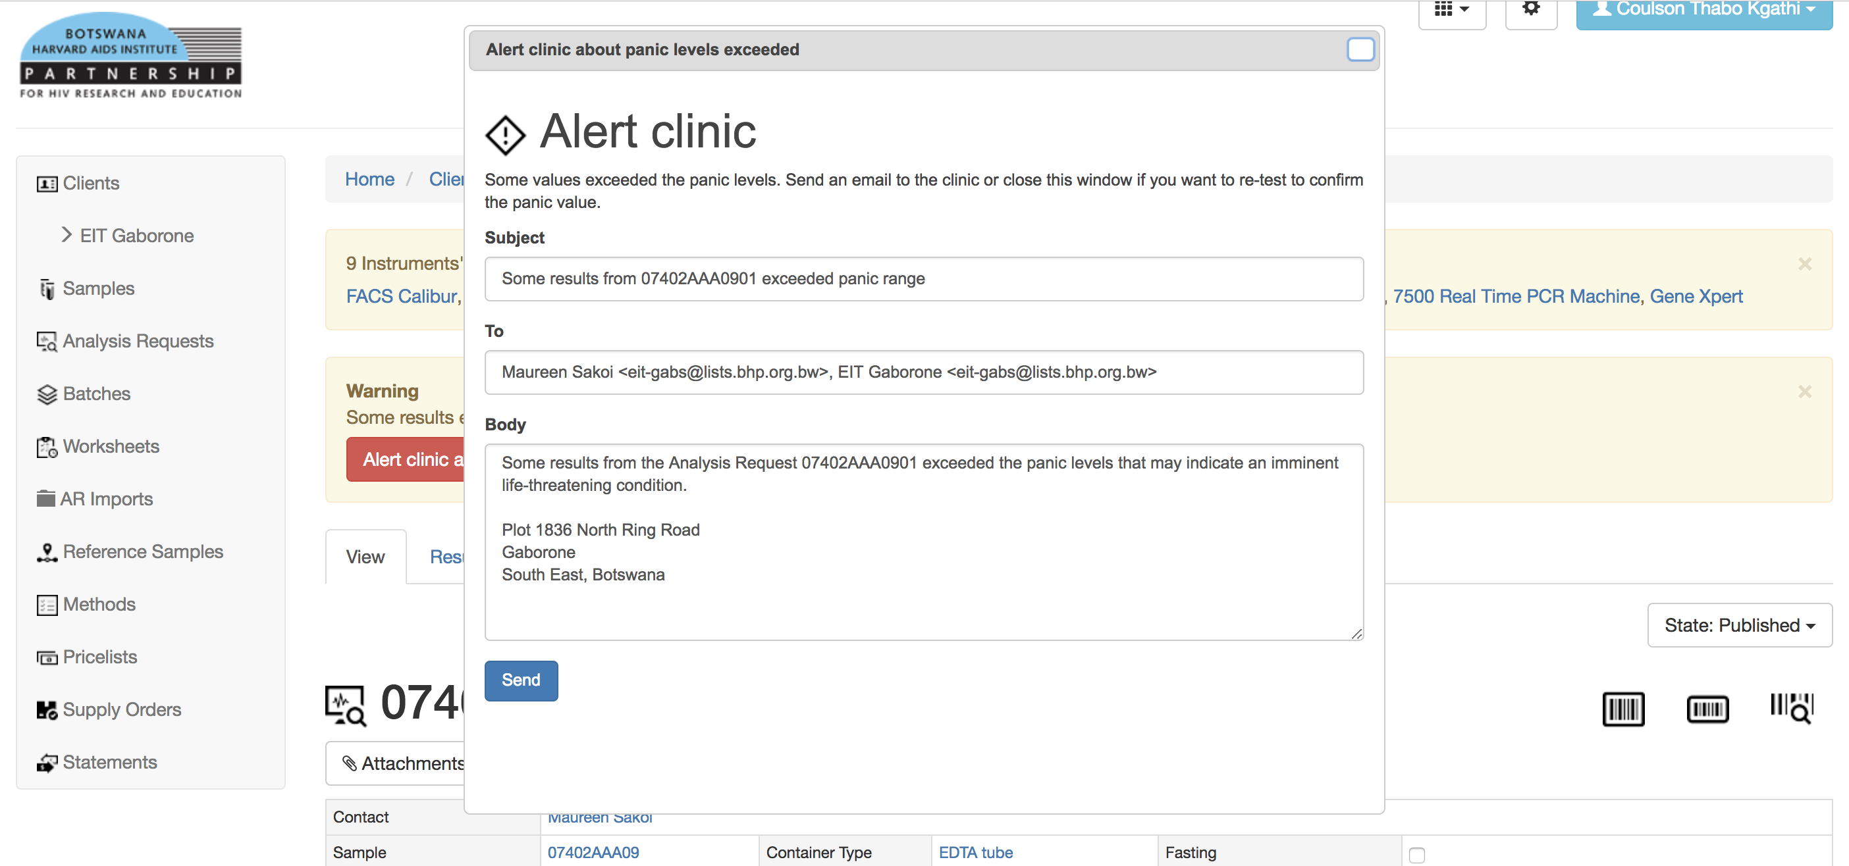
Panic Levels

Slide 15
Reports
The following will be passed around to show examples from the system
Requisition Form
Delivery Report
Results Report

Slide 16
Pending Work
Even though a lot of work has been covered, there is still more that needs to be done
Storage module
Integrations with other systems (Training has been done)
Auto import of results with other systems(Developed and to be confirmed)
Issues that are pending from testing the system
Data take on

