Slide 1
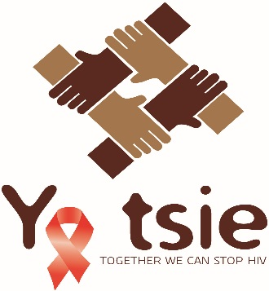
The Botswana Combination Prevention Project (BCPP / Ya Tsie)
Data Dissemination and Orientation
August 20-21, 2019
Participating Institutions: Harvard T.H. Chan School of Public Health, Botswana-Harvard AIDS Institute Partnership (BHP), Centers for Disease Control and Prevention (CDC), Botswana Ministry of Health (MOH)
Funded by the U.S. President’s Emergency Plan for AIDS Relief (PEPFAR) and the Office of the Global AIDS Coordinator (OGAC)
Sponsored through the U.S. Centers for Disease Control and Prevention (CDC)

Slide 2

Objectives
Honor the data sharing agreement between the Botswana Ministry of Health, Harvard School of Public Health/Botswana Harvard AIDS Institute Partnership (BHP), and the U.S. Centers for Disease Control and Prevention (CDC) by the following:
Provide an overview of the BCPP Study and protocols
Provide guidance on data use and data requests
Explain the structure and contents of the analytical datasets
Detail the data architecture and data management processes
Explain an algorithm approach to measuring key study outcomes
Provide lessons learned from using PIMS and IPMS
Notes:
Mochudi Project - Gates
8 October 2008
2

Slide 3
What is the Botswana Combination Prevention Project (BCPP)?
Notes:
Mochudi Project - Gates
8 October 2008
3

Slide 4
BCPP Study Overview
The Botswana Combination Prevention Project is a community randomized trial (15 intervention and 15 control communities) evaluating the impact of prevention interventions including early and universal ART on HIV incidence
Primary Research Objectives:
To significantly reduce population-level, cumulative HIV incidence in adults over approximately 30 months
To estimate population-level coverage of Knowledge of HIV-positive status, Treatment and Viral Suppression
Notes:
Mochudi Project - Gates
8 October 2008
4

Slide 5
BCPP Study Design Overview
Pair-matched community-randomized trial in 30 communities in Botswana (15 intervention and 15 standard of care)
Designed to evaluate the impact of a package of HIV prevention and treatment interventions on population-level HIV incidence
Baseline and annual surveys conducted in adult 16-64 year old residents of random sample of ~20% of households in all 30 communities, to evaluate:
HIV incidence
Uptake of components of interventions over time
Rapid scale-up of interventions in intervention communities, immediately following enrollment of HIV incidence cohort at baseline
Study started in October 2013, interventions ended in March 2018, follow-up completed in June 2018
Notes:
Mochudi Project - Gates
8 October 2008
5

Slide 6

Study Interventions
Interventions in the 15 intervention communities:
Community mobilization
Home-based / mobile HIV testing campaigns, targeted testing
Linkage to care support: scheduled clinic appointment, SMS reminder, active tracing if missed appointment
Expanded antiretroviral treatment (ART):
Universal ART as of June 2016 (with treatment started at first clinic visit)
Previously, expanded ART for residents with CD4 351-500, or with CD4 >500 + HIV-1 RNA≥10,000
Strengthened male circumcision (MC) services
Interventions were delivered at government clinics
In the 15 standard of care communities:
ART for persons with CD4<350, WHO III/IV disease or pregnancy until June 2016, when transitioned to universal ART

Slide 7

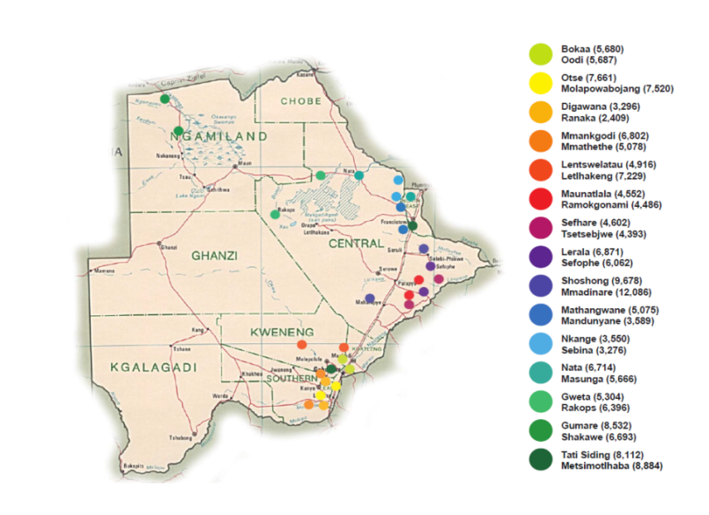
Participating Communities
Average community population 6,000
Total population ~180,800 (nearly 10% of entire Botswana population)

Slide 8
Protocols
Protocol 1: Evaluation
1st primary aim: HIV incidence by randomized study arm
2nd primary aim: Comparison of uptake of (“coverage” by) intervention components by study arm over time
Protocol 3: Intervention
To implement the combination prevention (CP) intervention package in combination prevention communities (CPC)
Describe HTC, ART, and VL suppression coverage at baseline and by end of intervention, in the intervention communities

Slide 9
Ke a leboga!
Questions?
Notes:
Mochudi Project - Gates
8 October 2008
9

