Slide 1
Lab 1
683L – Advanced GIS
Introduction to Python scripting for Spatial Analysis and Modeling
Monday, September 8, 2014

Slide 2
Lecture 1 Overview
Python Basics
Requesting user inputs
print command
String formatting operators
Looping
if/elif/else, if/else, while, and for
Built-In Functions
len()
max()
open()
round()
Numbers
Types: float, integer
Math shortcuts: +=1
Operations: add, subtract, multiply, division

Slide 3
Lecture 2 Overview
Sequences
Lists and Tuples
Strings
Dictionaries
Using Modules
math, string, random, and os.path
File Management
open, close, read, write, and pickling

Slide 4
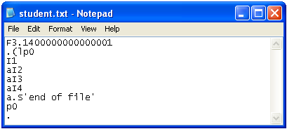
Pickling
The argument of write has to be a string
To write a number to a file you have to convert it to a string. Thus, everything in a file becomes a string
To preserve original data types within a file, use pickling
>>> import pickle
>>> f = open("student.txt", "w")
>>> pickle.dump(3.14, f)
>>> pickle.dump([1,2,3,4], f)
>>> f.close()
>>> pickFile = open("student.txt", "r")
>>> item1 = pickle.load(pickFile)
>>> item1
3.1400000000000001
>>> item2 = pickle.load(pickFile)
>>> item2
[1, 2, 3, 4]
>>> type(item1)
<type 'float‘
>>>> type(item2)
<type 'list‘
>>>> pickFile.close()
Demo 12

Slide 5
os.path
Allows for reference and parsing of file names
Import os or os.path
os.path.basename returns file name & extension
os.path.dirname returns directory name
To retrieve only the file name before the “.”, you can split the text:
os.path.splitext((your file basename))[0]

Slide 6
Lab Report (template on blackboard)
Name
Lab
Date
Lab Objective
Approach
Topics Learned
Conclusion
Enclosures

Slide 7
LAB 1

Slide 8
BONUS
Working with CSVs

Slide 9
Modules
csv: needed for most csv operations, including writing, reading, appending
os: for working with file and path names
shutil: easily allows you to move files from one folder to another

Slide 10
Suppose you have…
Multiple CSV files you would like to iterate through to generate a report
Large files you only want some columns or rows from

Slide 11
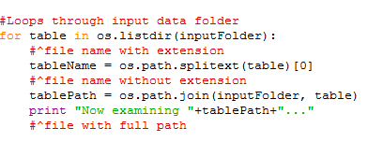
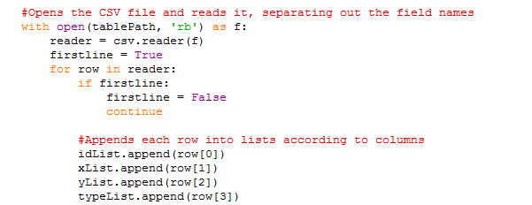
In this example (csvdemo.py)
Iterate through data files in a folder
Open CSV files to read contents into lists

Slide 12
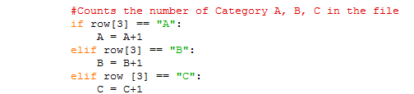
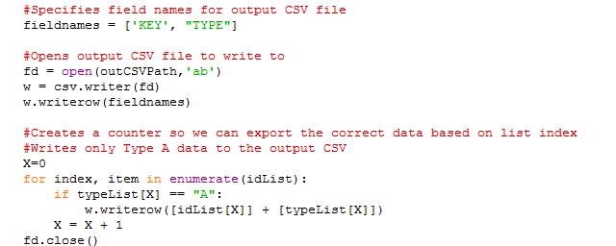
Also in this example (csvdemo.py)
Summarize data, append to existing CSV report
Export selected data to new CSV files

Slide 13
CSV DEMO

