Slide 1




BP
Navigation
Testimonials
Footer
Notes:
Homepage
There will be a graphic within the clouds with a lady filling the word BP with oil
There will a graphic with the times the gas station is open
The green bottom will be the footer
The testimonials will be in block quotes; these will be collected via facebook and a form on the site if wanted
The owner will take these comments and manually post quotes

Slide 2



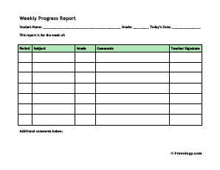
Calendar
Form for appt.
Footer
Notes:
Appointments page
The calendar will have links to specials and services page- we will attempt to create an array that will reflect specials that day
The form will be connected to the Owner’s email so that responses can managed from a personal email

Slide 3

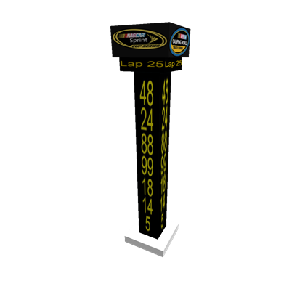


“Honest, Reliable”
Image of Owner
Bio about Brandis’ mom…………………………..
………………………………………..
…………………………………..
…………………………………………………….
Notes:
About page
The nascar scoreboard will have the services that are offered at BP
There is a car graphic going toward the bio

Slide 4

Navigation bar for the coupon categories
Featured coupons
xxxx
xxxxx
xxxxxxx
xxxxxxxx
xxxxx
Featured coupons (about to expire)
Garage coupons
Inspections
Food/snacks
Notes:
Specials page
This page will have coupons within a grid that will supply the expiration date, service and link to a printable site

Slide 5



Facebook Newsfeed
BP in the news
Notes:
Social Media page
The BP in the news graphic will have links to the article sources
We will attempt to create a snippet of the facebook homepage status board

