Slide 1
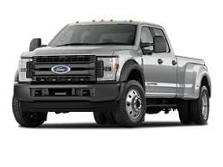
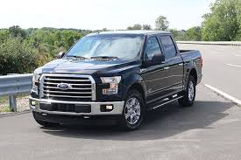
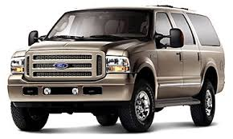
Murphy Auto
For women by women

Slide 2
Navigation
View a full line of vehicles
for your lifestyle
Vehicle registry
Most know Vehicle terms!
Comparable pricing for diagnostics
Clear, unbiased options without over masculine fluff! Choose the car that works for you not your man.
Reference information: Location, phone number, deals, etc.

Slide 3

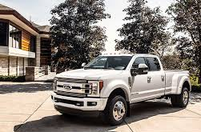
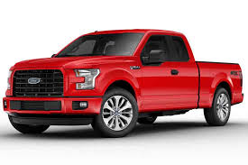
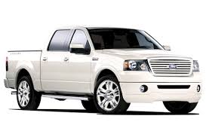
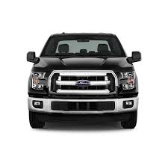
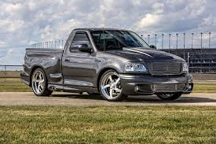
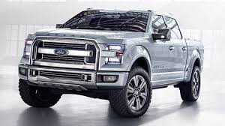
Trucks navigation
Info
Info
Info
Info
Info
Info
Info
Info
Info
Info
Reference information: location, deals etc.
Notes:
The layout will be a grid so that there is transparency. The customer can see exactly the kind of truck they are looking for and compare favorites. I am planning in designing the rows by kind of truck; heavy duty, multiple passenger and small frame.

