Slide 1
Objectives
X education wants to know most promising leads.
For that they want to build a Model which identifies the hot leads.
Deployment of the model for the future use.

Slide 2
Methodology
Check and handle duplicate data.
Check and handle NA values and missing values.
Drop columns, if it contains large amount of missing values and not useful for the analysis.
Imputation of the values, if necessary.
Check and handle outliers in data. 

Slide 3
6 .EDA 1. Univariate data analysis: value count, distribution of variable etc.
7. Bivariate data analysis: correlation coefficients and pattern between the variables etc.
8.Feature Scaling & Dummy Variables and encoding of the data.
9.Classification technique: logistic regression used for the model making and prediction. Validation of the model.

Slide 4
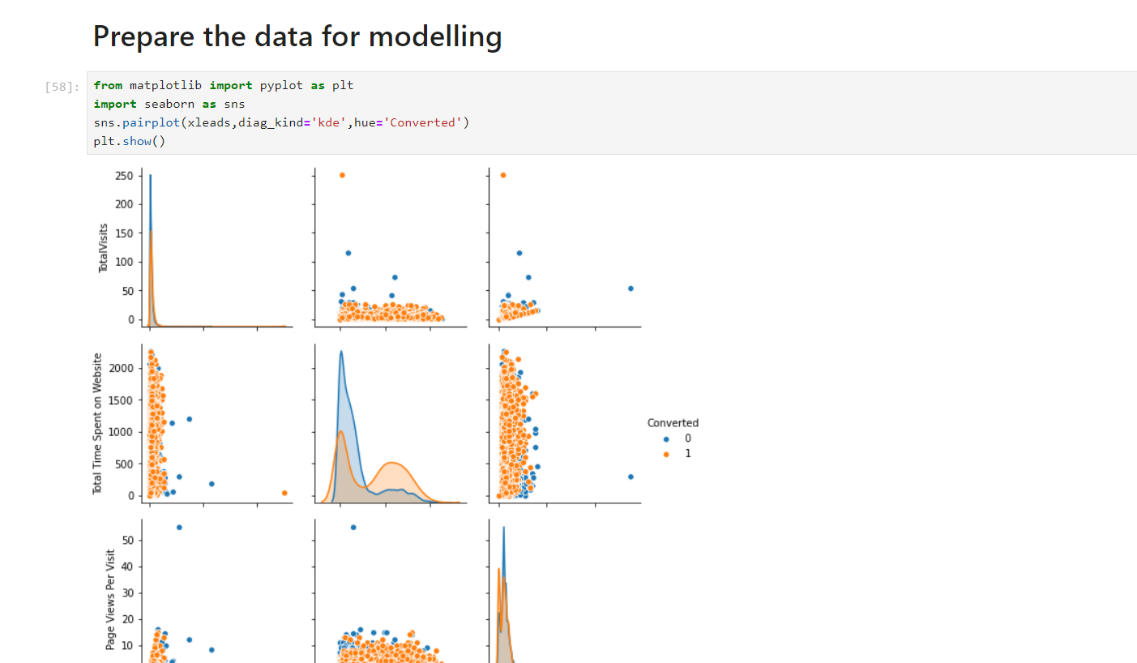

Slide 5
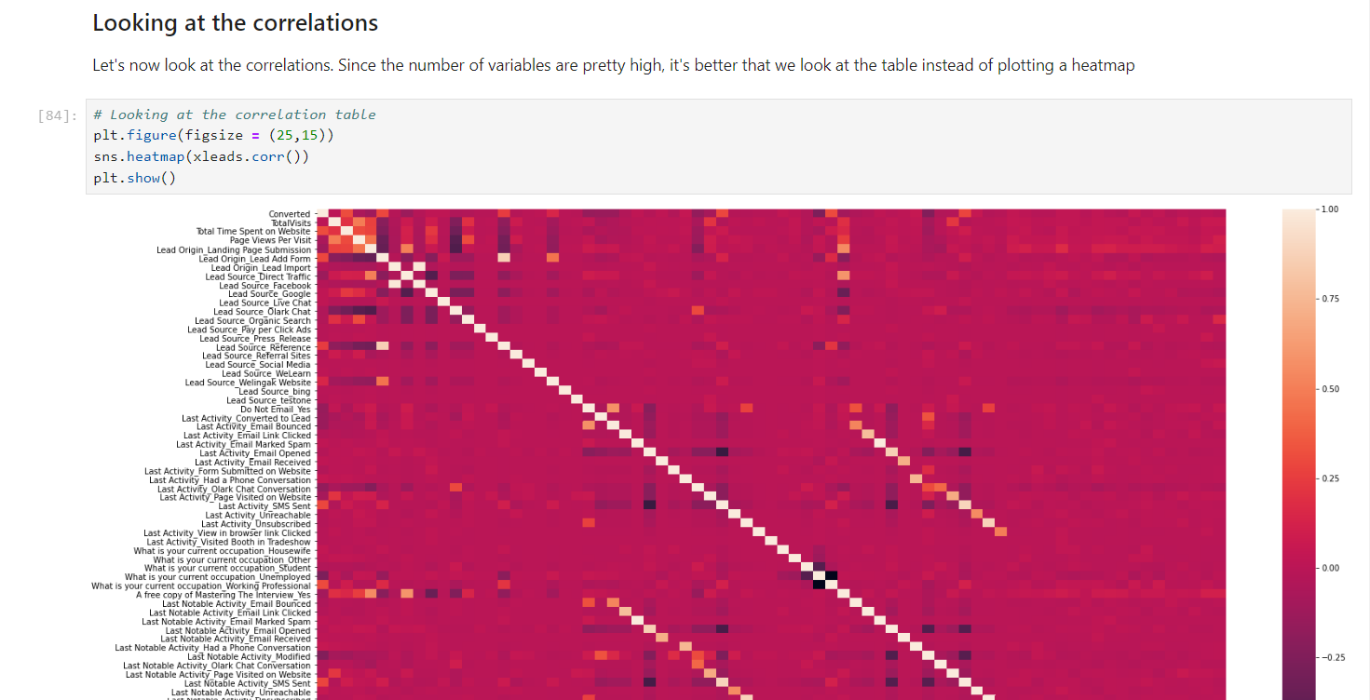

Slide 6
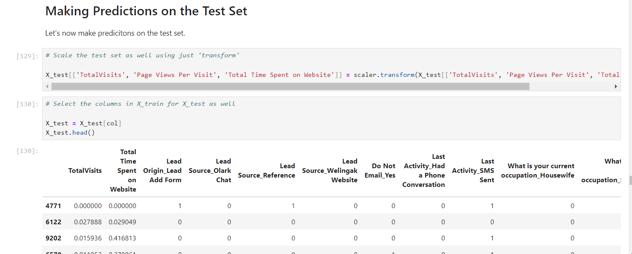

Slide 7
