Slide 1
Unit 2 Cellular Architecture
Dr.M.Manimegalai

Slide 2
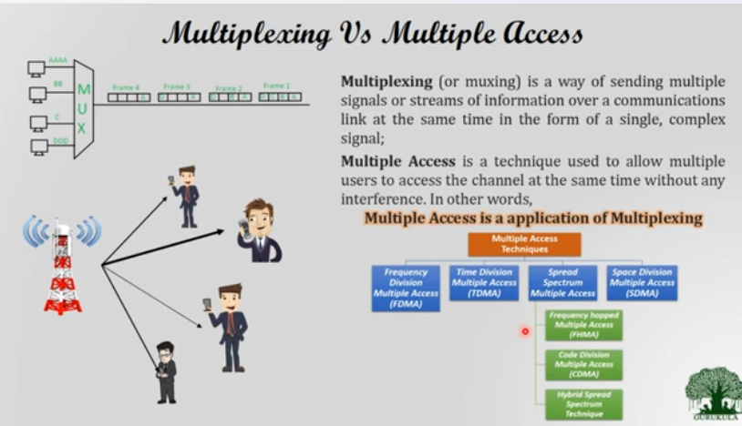

Slide 3
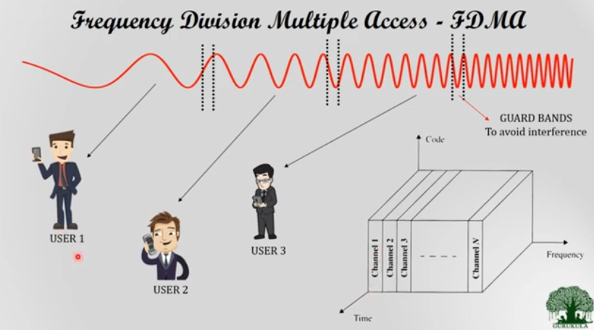

Slide 4
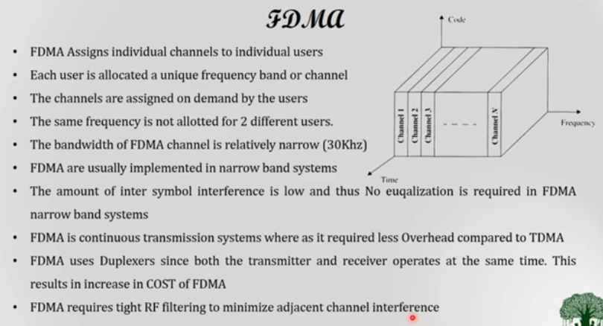

Slide 5
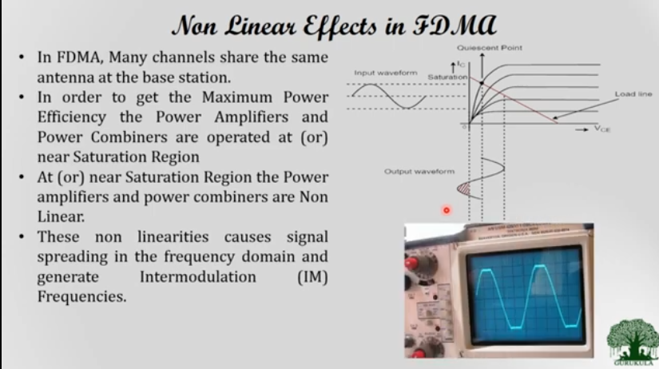

Slide 6
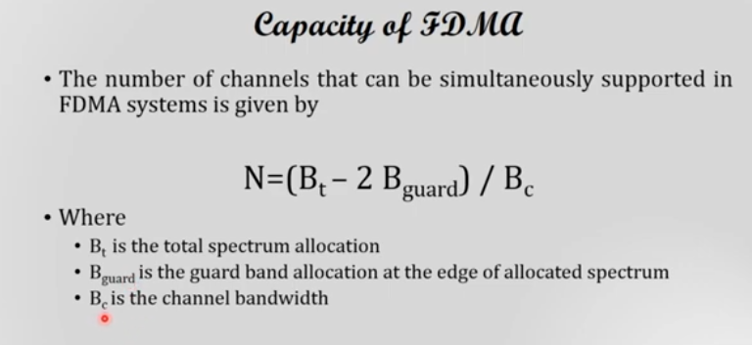

Slide 7
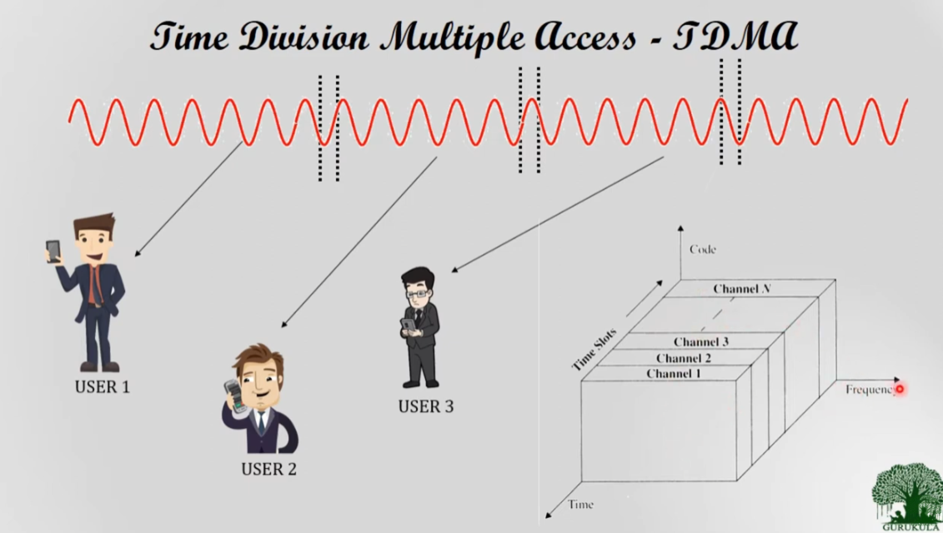

Slide 8
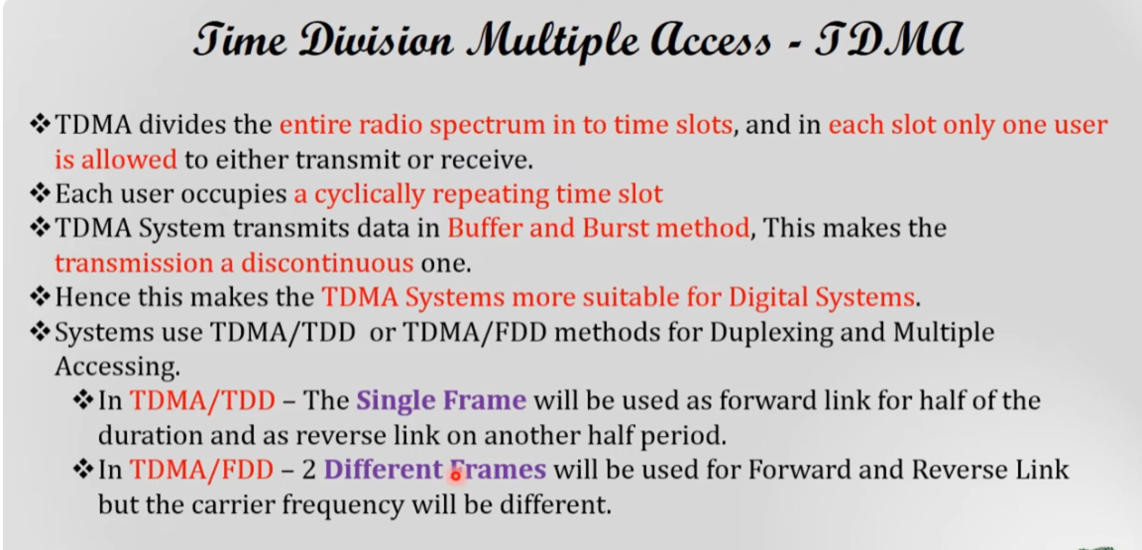

Slide 9
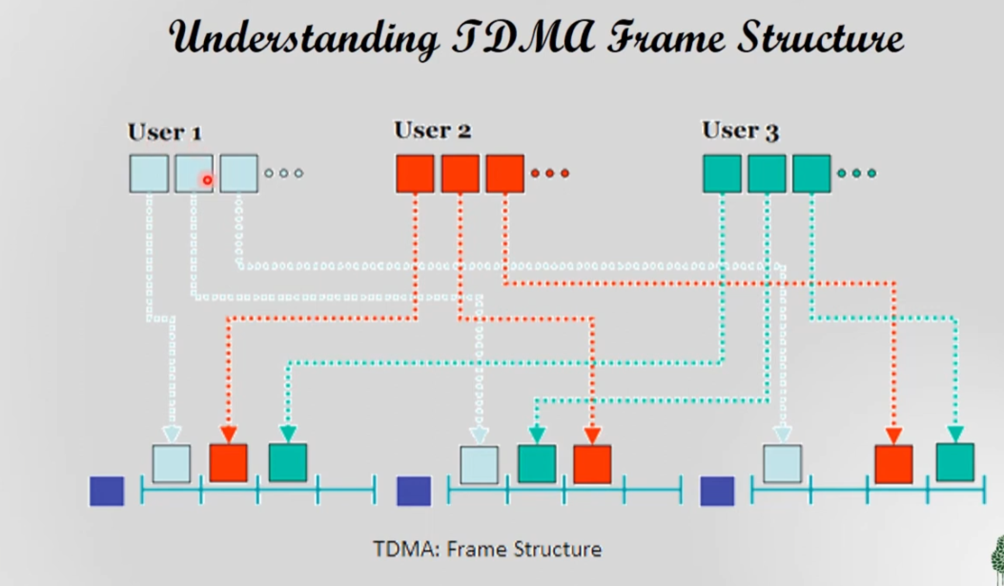

Slide 10
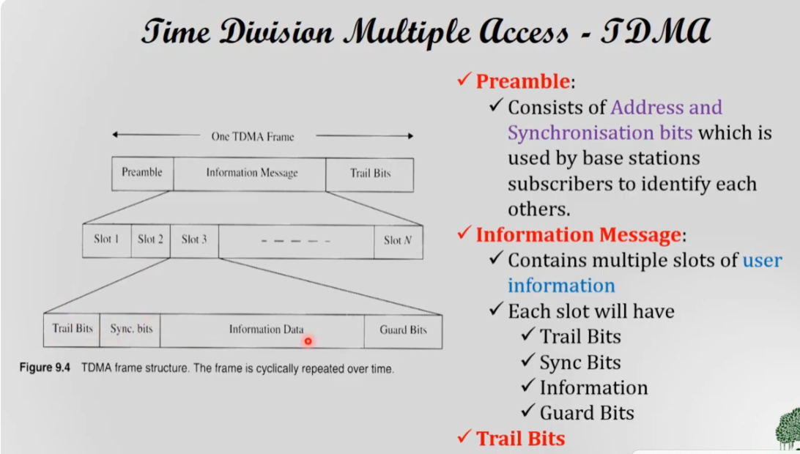

Slide 11
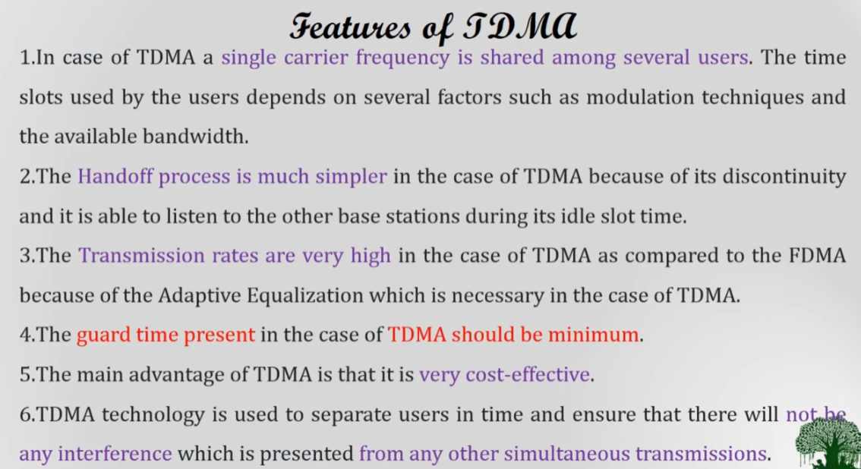

Slide 12
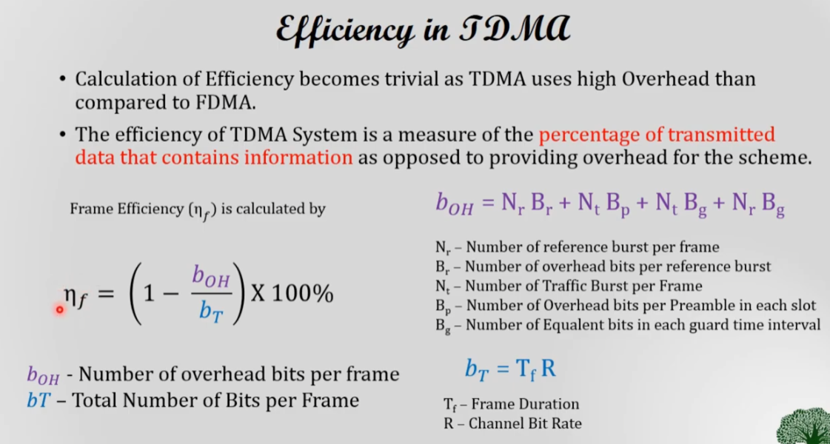

Slide 13
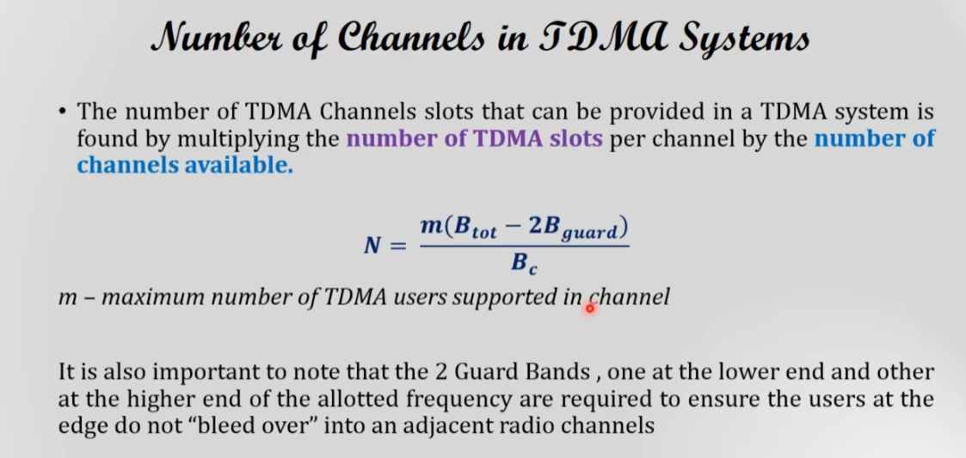

Slide 14
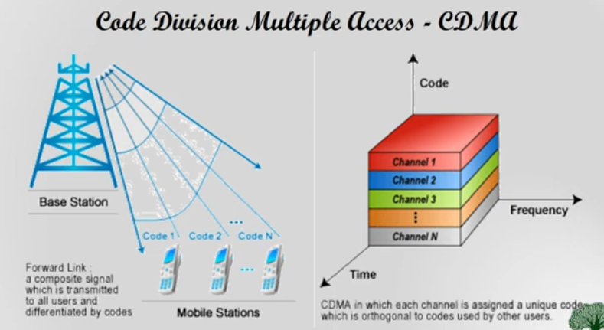

Slide 15
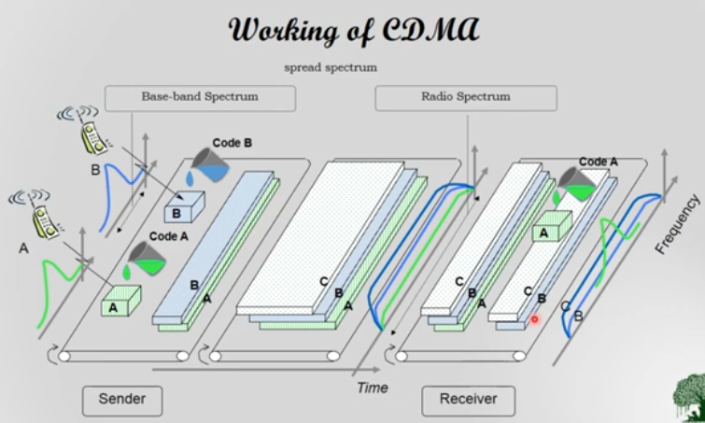

Slide 16
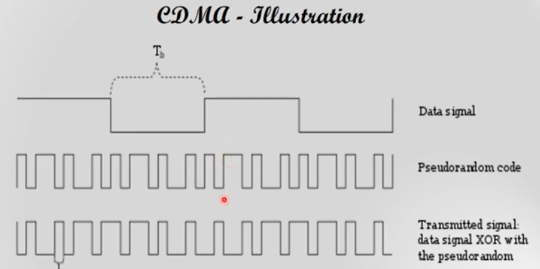

Slide 17
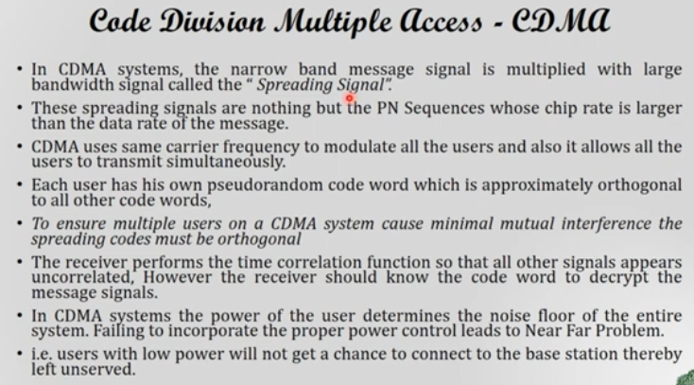

Slide 18
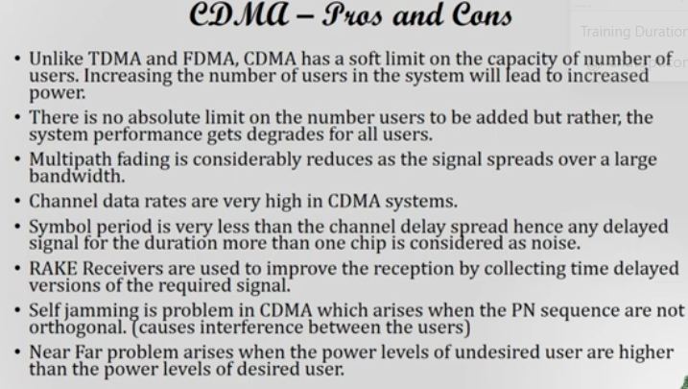

Slide 19
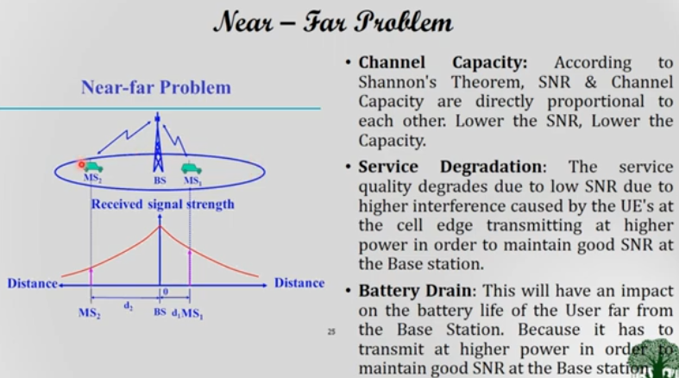

Slide 20
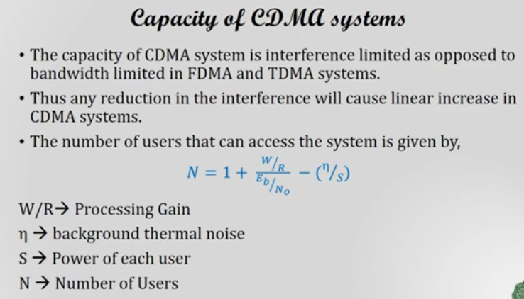

Slide 21
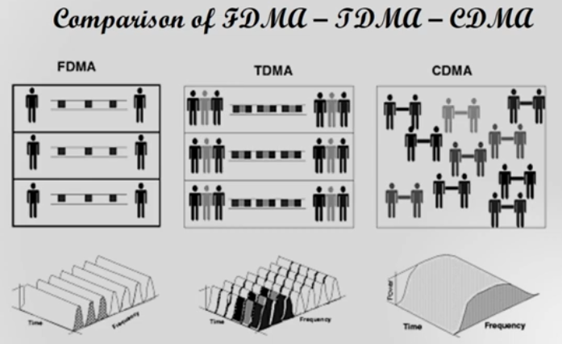

Slide 22
Cellular concept

Slide 23
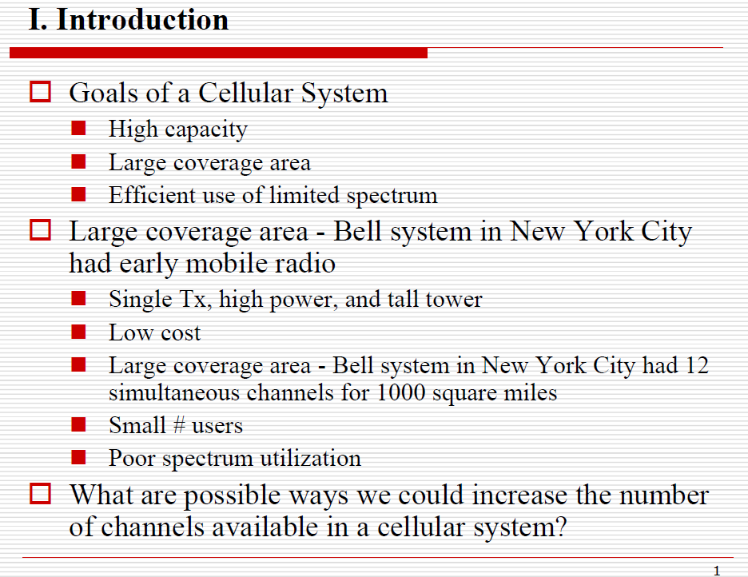

Slide 24
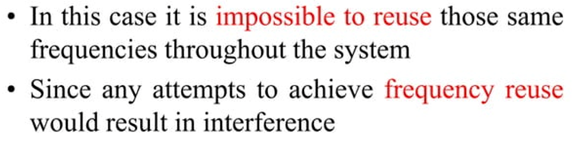
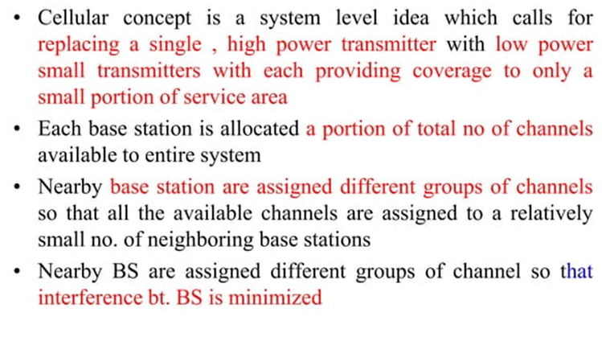

Slide 25
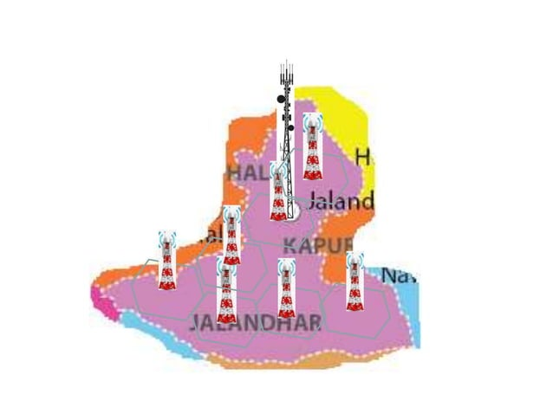

Slide 26
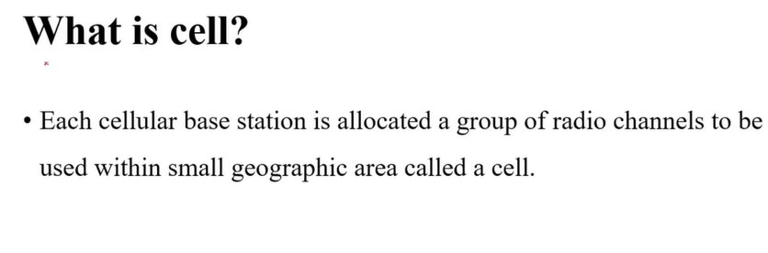
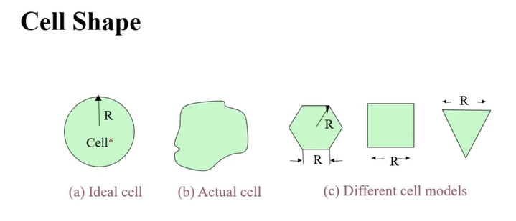

Slide 27
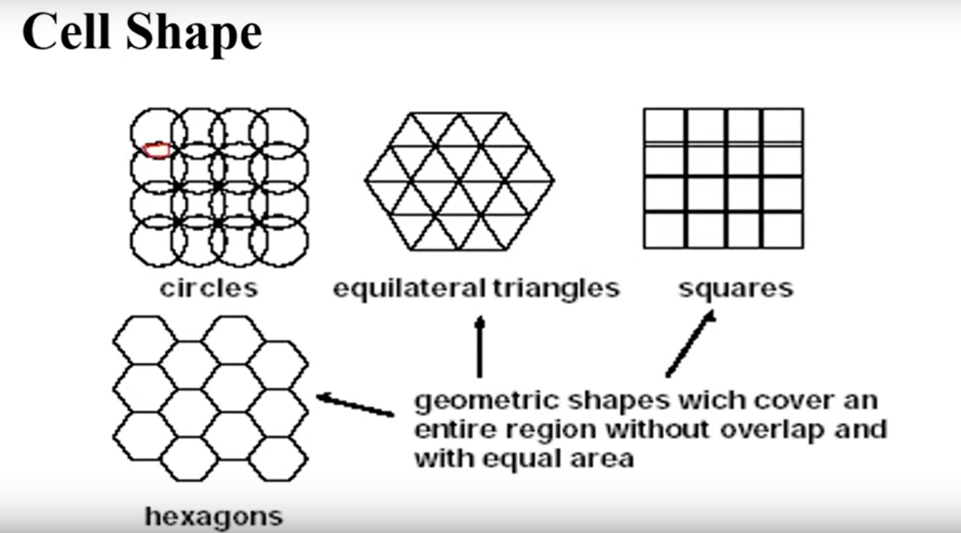

Slide 28
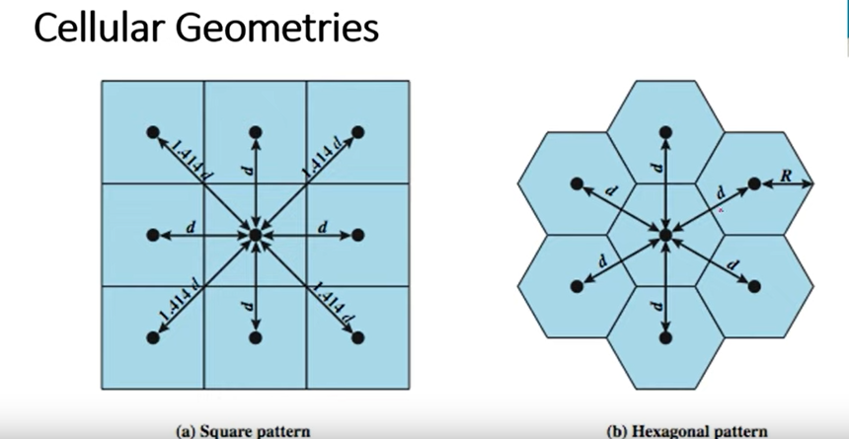

Slide 29
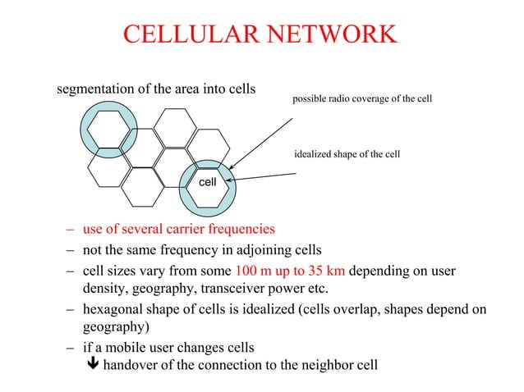

Slide 30
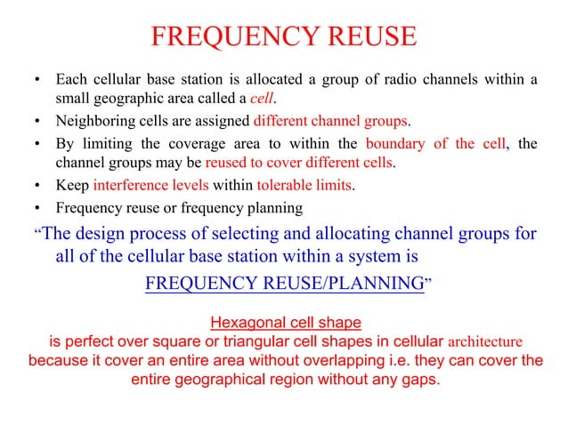

Slide 31
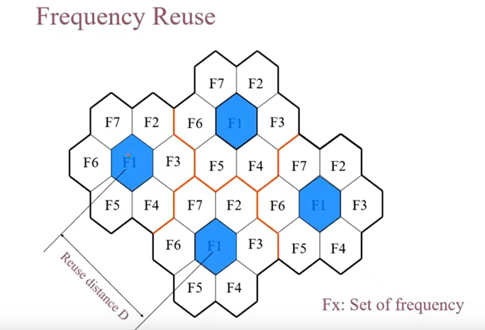

Slide 32
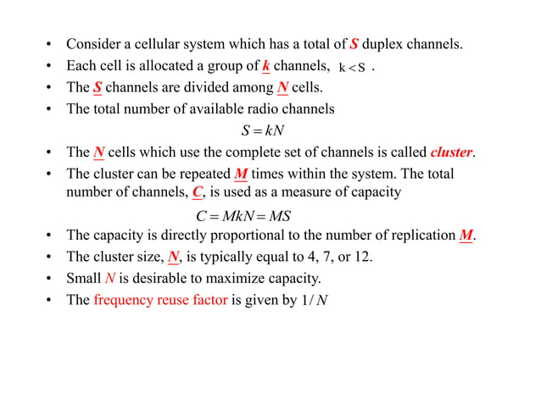

Slide 33
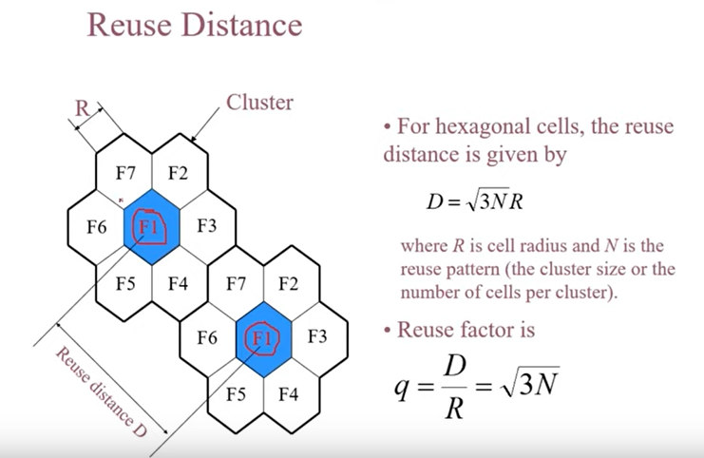

Slide 34
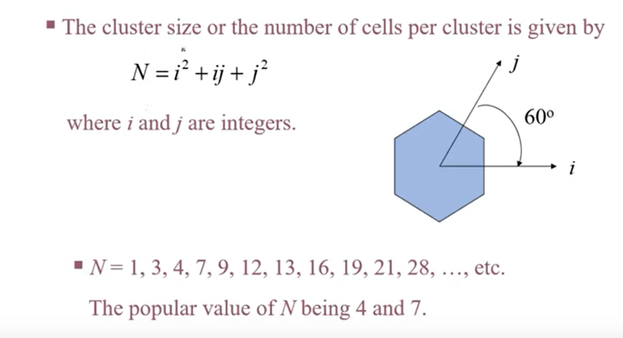
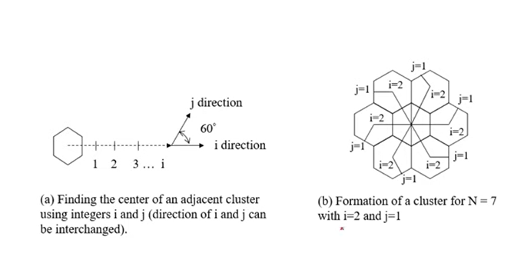

Slide 35
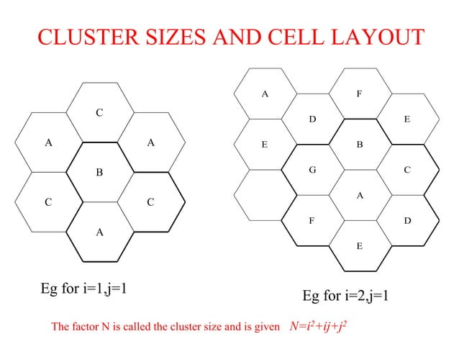

Slide 36
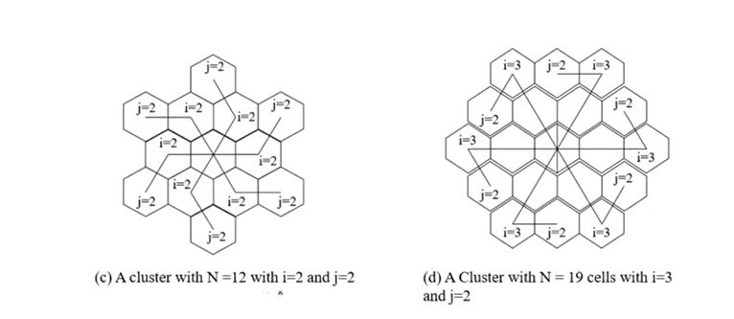

Slide 37
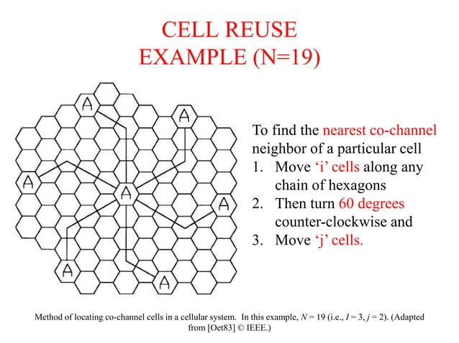

Slide 38
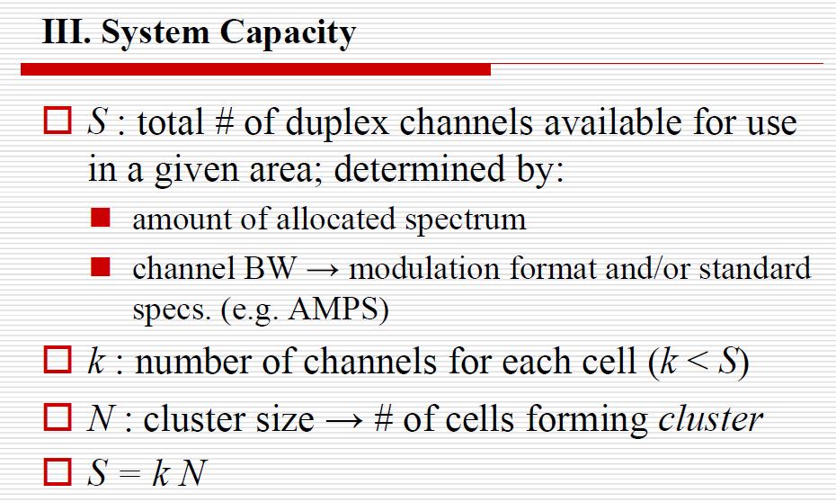

Slide 39
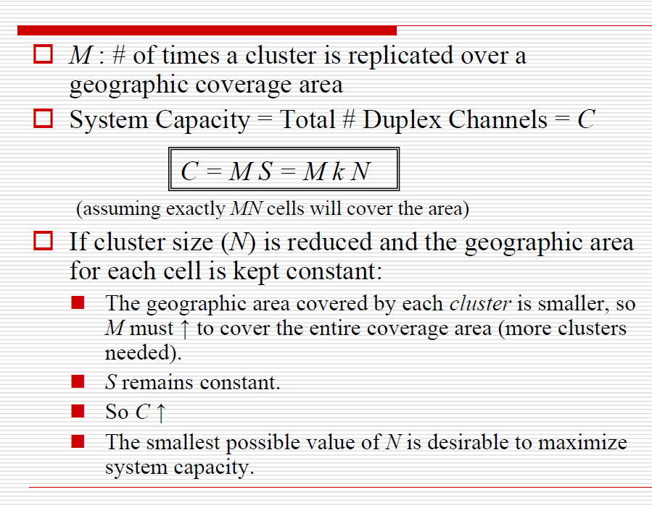

Slide 40
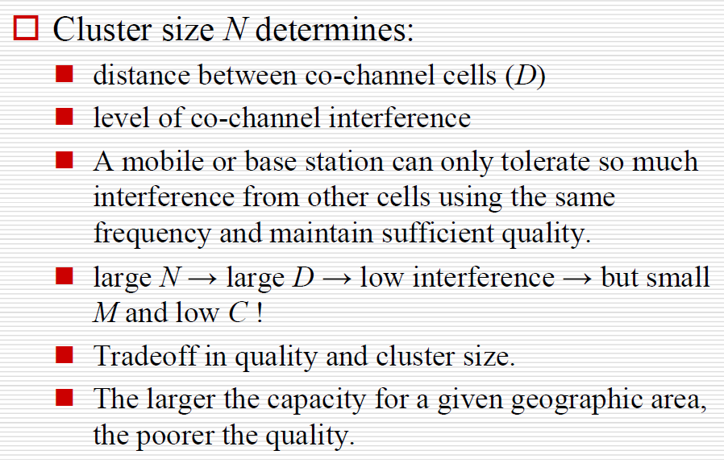

Slide 41
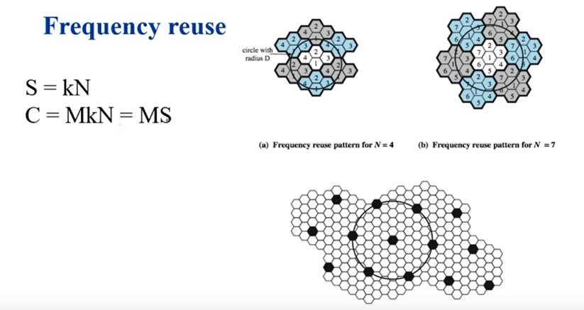

Slide 42
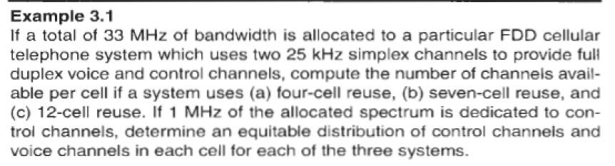

Slide 43
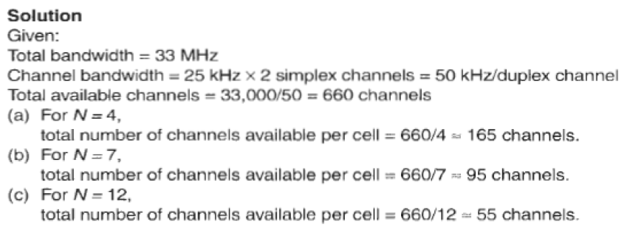

Slide 44
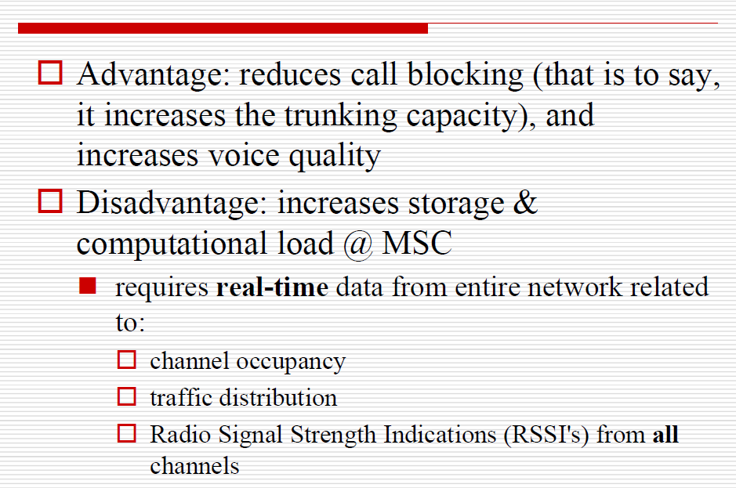

Slide 45
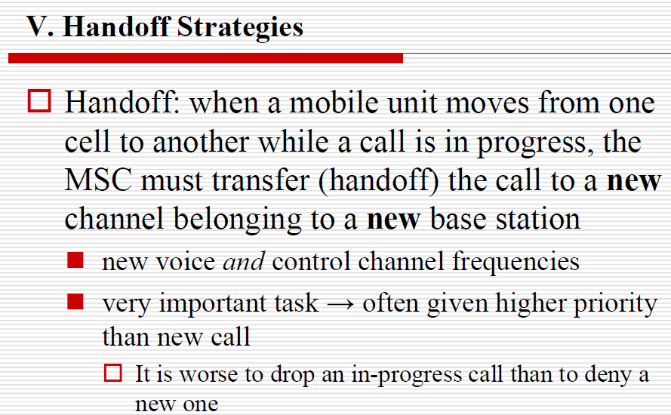

Slide 46
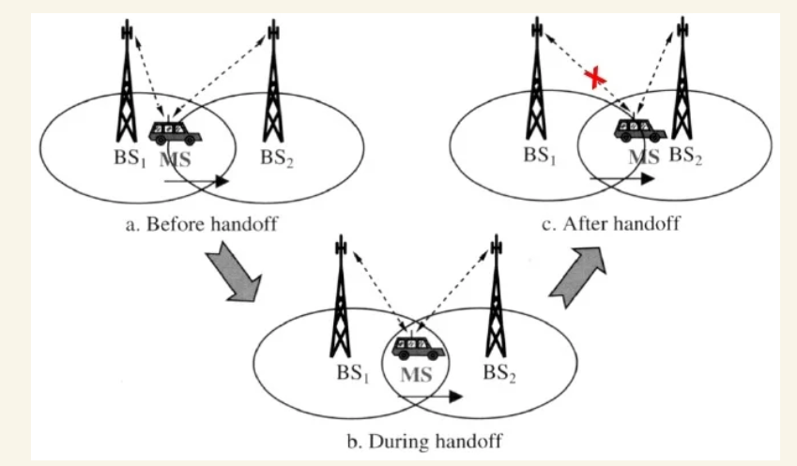

Slide 47
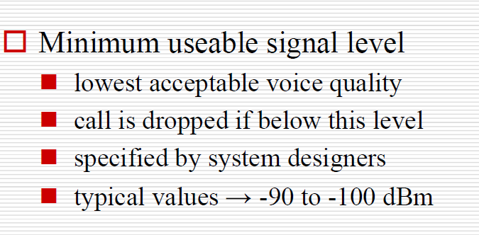

Slide 48
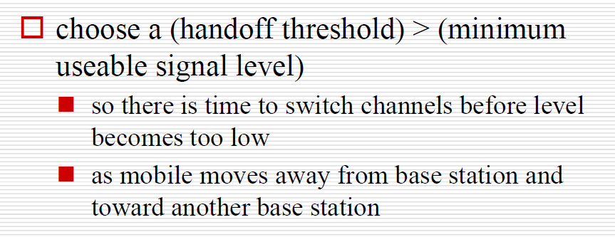

Slide 49
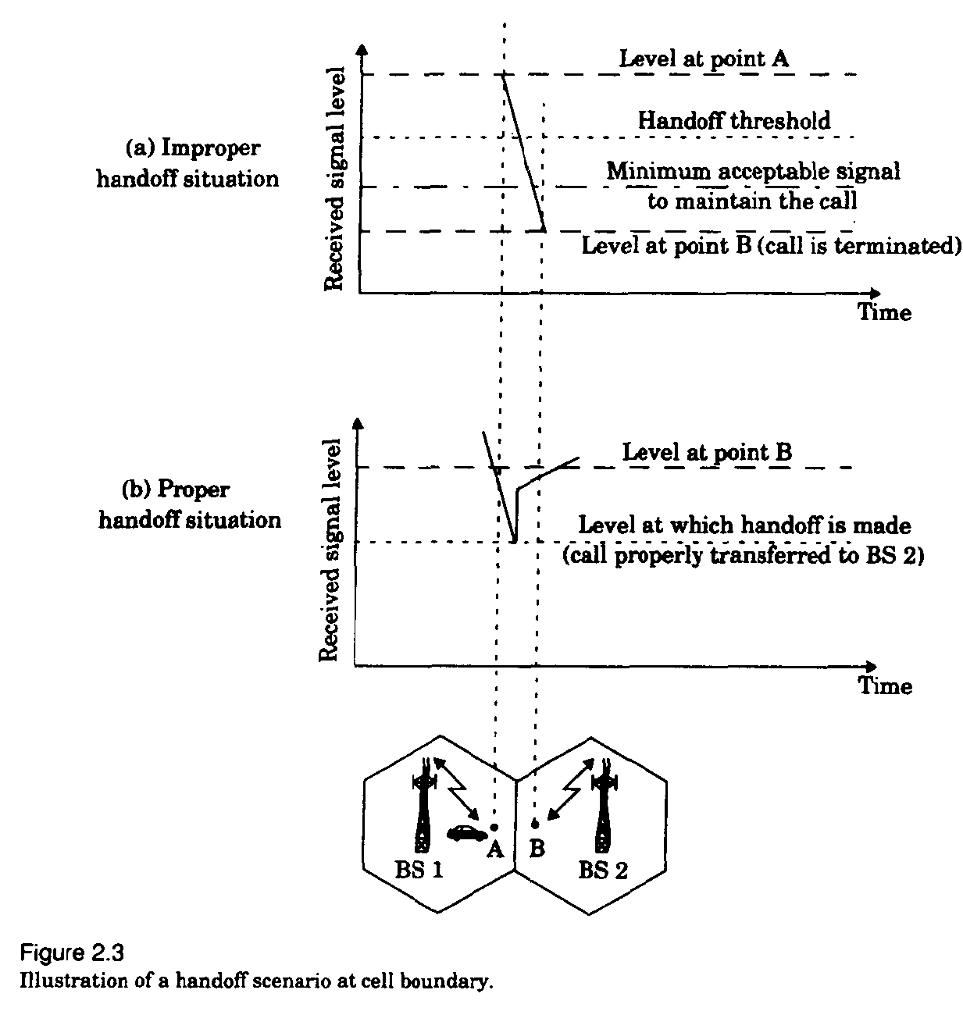

Slide 50


Slide 51


Slide 52


Slide 53


Slide 54



Slide 55


Slide 56


Slide 57


Slide 58


Slide 59


Slide 60


Slide 61


Slide 62


Slide 63


Slide 64



Interference and system capacity

Slide 65


Slide 66


Slide 67


Slide 68


Slide 69


Slide 70


Slide 71


Slide 72


Slide 73


Slide 74


Slide 75


Slide 76


Slide 77


Slide 78


Slide 79


Slide 80
Coverage & Capacity Improvement
As the demand for wireless service increases, the no. of channels assigned to a cell is not sufficient to support the users.
To provide more channels per unit coverage area
Techniques used to improve coverage and capacity
Cell Splitting
Cell Sectoring
Coverage Zone

Slide 81
1.CELL SPLITTING
Cell Splitting :It is the process of subdividing the congested cell
into smaller cells.
Each of the smaller cells will have their own base station with a
reduction in antenna height and transmitted power.
The smaller cells are known as Microcells.
Cell Splitting increases the capacity of the cellular system as it increases the number of times the channels are reused
The increased number of cells would increase the number of clusters over the coverage region, which in turn increase the number of channels, and thus capacity in the coverage area
Cell Splitting allows the system to grow by replacing large cells with smaller cells without changing the co-channel re-use ratio Q

Slide 82


Slide 83


Slide 84


Slide 85


Slide 86


Slide 87


Slide 88


Slide 89


Slide 90


Slide 91
Cell Splitting Drawbacks
In practice not all cells are split simultaneously, therefore we may have cells of different sizes.
Also the handoff between the cells and microcells has to be taken care off so that high speed and low speed mobiles are equally served.
Decreasing cell size results in more handoffs per call and higher processing load per subscriber. Thus, the handoff rate will increase exponentially

Slide 92

2.Sectoring
The co-channel interference in a cellular system can be decreased by replacing the omni directional antenna at the base station by several directional antennas, each radiating within a specified sector.
The process of reducing the co-channel interference and thus increasing the capacity of the system by using directional antennas is known as Sectoring.
In general a cell is partitioned into three 120 degree sectors or six 60 degree sectors.
When sectoring is employed, the channels used in a particular cell are broken down into sectored groups and are used only in a particular sector.

Slide 93

Sectoring improves S/I

Slide 94


Slide 95


Slide 96


Slide 97


120⁰ Sectoring

Slide 98

60⁰ Sectoring

Slide 99
The Improvement in (S/I) suggests that the minimum required (S/I) of 18 dB can be easily achieved with 7-cell reuse by employing 120 degree sector technique when compared to 12-cell reuse
Therefore Sectoring reduces interference and increases the capacity by an amount of (12/7)
i.e 1.714
In general, the reduction in interference by sectoring enables planners to reduce the cluster size N, and provides an additional freedom in assigning channels

Slide 100
Disadvantages:
Increased number of antennas at each base station
Decrease in trunking efficiency due to channel sectoring at each base station
As sectoring reduces the coverage area of a particular group of channels, the number of handoffs increase.

Slide 101


Slide 102


Slide 103
ADVANTAGES OVER SECTORING
As the mobile travels from one zone to another within the cell, it retains the same channel.Thus, a handoff is not required at the MSC
A given channel is active only in the particular zone in which the mobile is traveling and hence the base station radiation is localised and interference is reduced
The co-channel interference is also reduced as a large base station is replaced by several lower powered transmitters on the edges of the cell

Slide 104
Techniques used to expand the capacity of Cellular system
Increasing the amount of spectrum used
More efficient modulation formats & coding
Better source coding
Discontinuous voice transmission
Multiuser detection
Adaptive modulation and coding
Reduction of cell radius
Use of sector cells
Use of an overlay structure
Multiple antennas
Fractional loading
Partial frequency reuse

