Slide 1
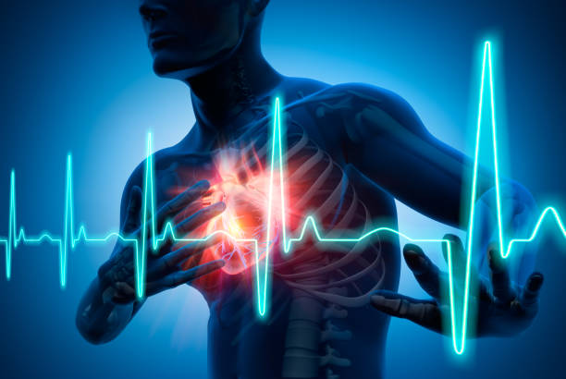
Heart Attack Risk Prediction
GROUP-G

Slide 2

THE TEAM
Maguluri Manoj Sai
Nagarkunta Karishma
Golrilla Pragnya Devi
Syamala Seshi Reddy

Slide 3

introduction
The Heart Attack Risk Prediction Dataset is a valuable resource for understanding the factors that contribute to heart attack risk and developing strategies for prevention and management. By conducting data analysis on this dataset, we can gain insights into the complex relationship between heart health and lifestyle choices. This knowledge can be used to improve the lives of individuals and communities around the world.

Slide 4

BUSINESS QUESTIONS
What are the key predictors of heart attack risk among patients in this dataset?
Can we build a predictive model to assess an individual's risk of a heart attack based on their characteristics and lifestyle factors?
Are there significant differences in heart attack risk between different age groups and genders?
Are there specific medical factors, such as previous heart problems, medication use, and triglyceride levels, that strongly influence heart attack risk?

Slide 5
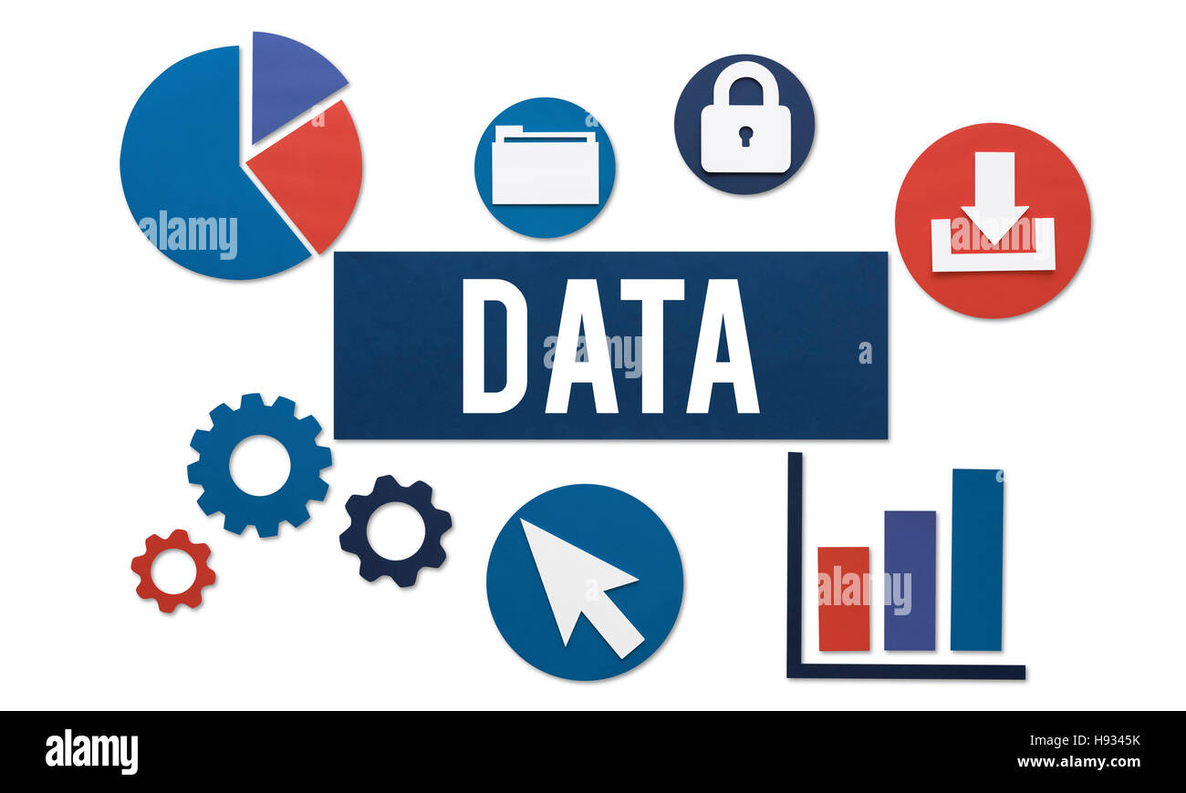
Data details
The dataset contains 8,763 records. Details of the data that will be analyzed:
Patient ID: A unique identifier for each patient (not used in analysis).
Age: The age of the patient, a numerical variable.
Sex: The gender of the patient (categorical: Male, Female).
Cholesterol: Cholesterol levels of the patient, a numerical variable.
Blood Pressure: Blood pressure of the patient, given in the format "Systolic/Diastolic."
Heart Rate: The heart rate of the patient, a numerical variable.
Diabetes: Whether the patient has diabetes (categorical: 0 for No, 1 for Yes).
Family History: Whether there is a family history of heart disease (categorical: 0 for No, 1 for Yes).

Slide 6

Data details
Smoking: Smoking habits of the patient (categorical: 0 for No, 1 for Yes).
Obesity: Indicates whether the patient is obese (categorical: 0 for No, 1 for Yes).
Alcohol Consumption: The level of alcohol consumption (numerical variable).
Exercise Hours Per Week: Number of hours per week patient exercises (numerical).
Diet: The dietary preference of the patient (categorical: Unhealthy, Healthy, Average).
Previous Heart Problems: Indicates whether the patient has had previous heart problems (categorical: 0 for No, 1 for Yes).
Medication Use: Indicates whether the patient is on medication (categorical).
Stress Level: The stress level of the patient (numerical variable).
Sedentary Hours Per Day: The number of hours per day the patient spends in a sedentary state, a numerical variable.

Slide 7
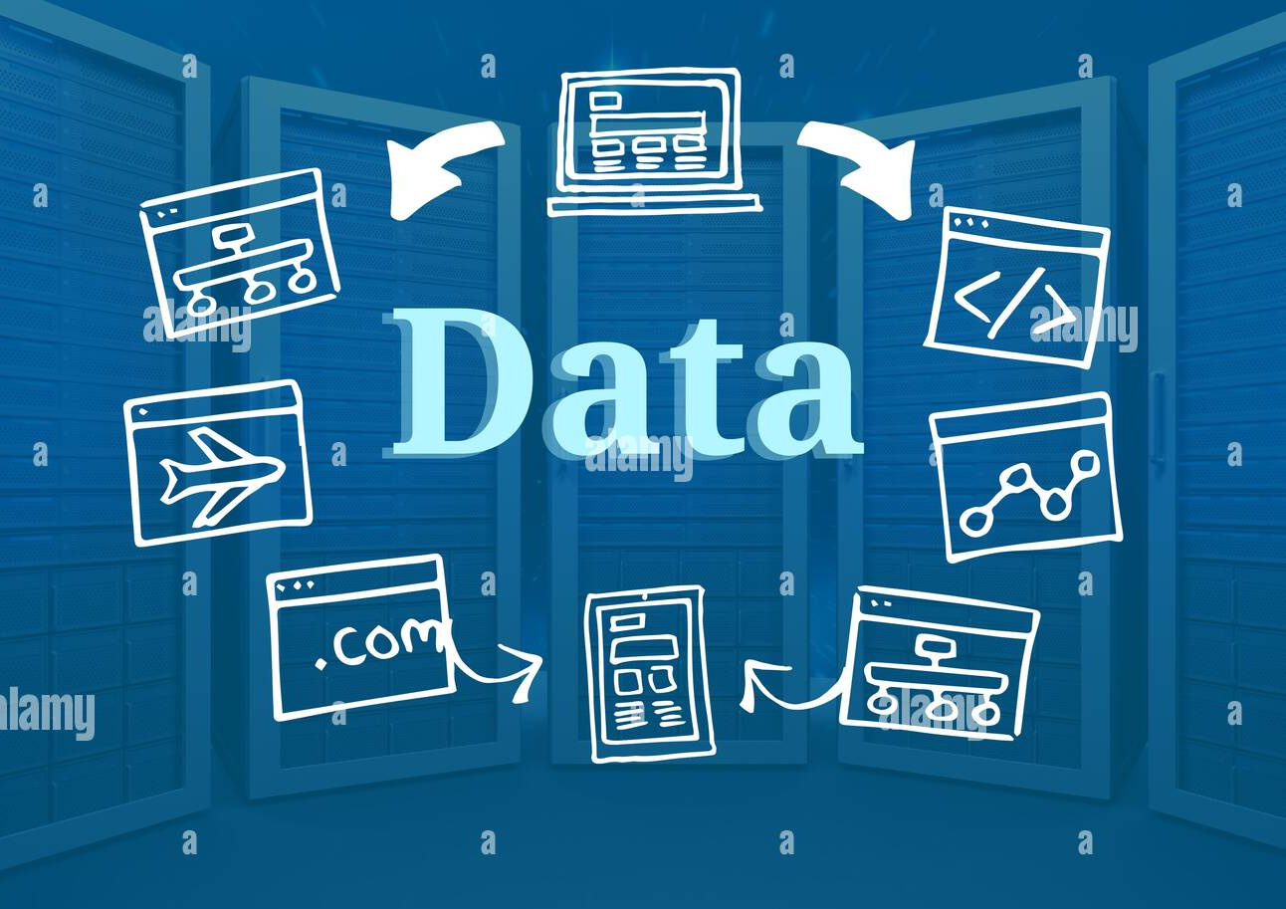
Data details
Income: The income of the patient, a numerical variable.
BMI (Body Mass Index): A numerical measure of a person's weight in relation to their height.
Triglycerides: The level of triglycerides in the patient's blood, a numerical variable.
Physical Activity Days Per Week: Number of days per week patient engages in physical activity (numeric).
Sleep Hours Per Day: The number of hours per day the patient sleeps, a numerical variable.
Country: The country where the patient resides (categorical).
Continent: The continent where the patient's country is located (categorical).
Hemisphere: The hemisphere in which the patient's country is located (categorical).
Heart Attack Risk: The binary classification feature denoting the presence (1) or absence (0) of a heart attack risk.

Slide 8

Data analysis
Data Preprocessing:
Handling missing values.
Converting the categorical variables into numerical representations (one-hot encoding or label encoding).
Exploratory Data Analysis (EDA):
Visualizing the distribution of key numerical variables (Age, Cholesterol, BMI, etc.).
Examining the distribution of categorical variables through bar plots and counts.

Slide 9

Data analysis
Correlation Analysis:
Computing correlations between variables to identify potential associations.
Visualizing correlations using correlation matrices and heatmaps.
Predictive Modeling:
Building a binary classification model to predict heart attack risk based on patient characteristics and lifestyle factors.
Evaluating model performance using metrics like accuracy, precision, recall, and F1 score.

Slide 10
Data IMBALANCE
8763
6111
2652
TOTAL records
MAJORITY CLASS
MINORITY class
Both the Gender combined
Male
Female

Slide 11
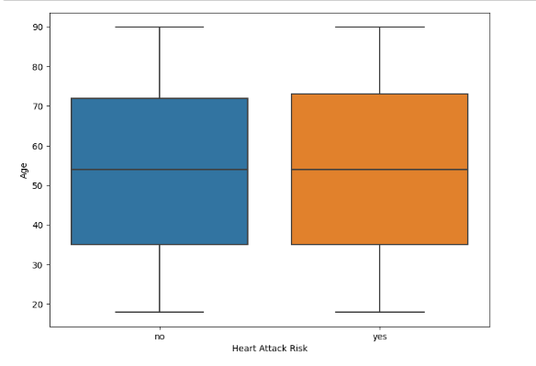
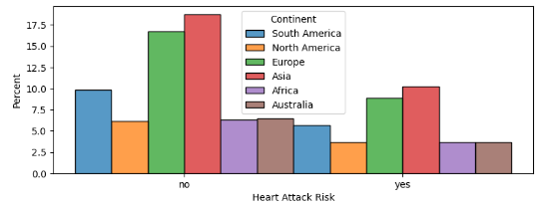
RESULTS
Box Plot:
Continuous Independent variables are alone not affecting the Dependent Variable i.e., Heart Attack Risk. This conclusion is derived from the Box Plot results.
Histogram Plot:
Histogram Plot is used to predict the relation between Categorical Variables and Heart Attack Risk. As there is an imbalance in the Dataset we can’t accurately predict the relation between the Categorical Variables and Dependent Variable i.e., Heart Attack Risk.

Slide 12
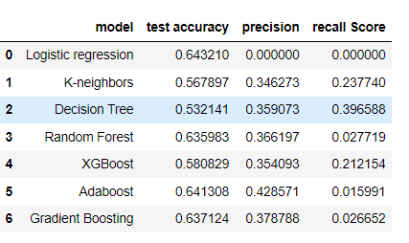
RESULTS
MODELS
Metrics Scores
CLASSIFIER MODEL
K-nn Model
Decision Tree
Logistic Regression
Hyper parameter tuning
ENSEMBLE TECHNIQUES
Random Forest
Gradient Boosting
ADA Boost
XGBoost

Slide 13
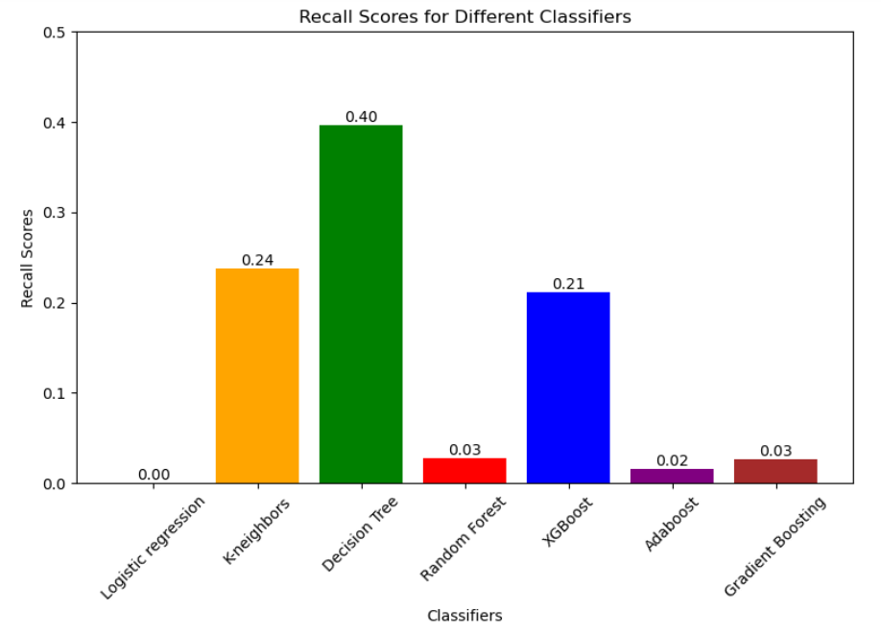
RESULTS
MODEL SELECTION
RECALL SCORES OF ALL CLASSIFIERS
BEST MODEL
Decision Tree seems to be the best model for the Dataset due to its balanced performance across various metrics like Accuracy, Precision and Recall scores
BEST RECALL SCORE
Recall Score = 0.40

Slide 14
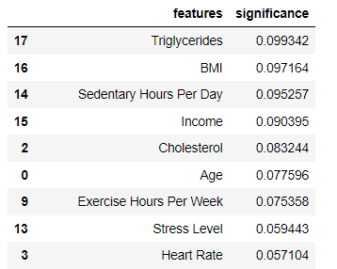
RESULTS
FEATURE IMPORTANCE
FEATURE IMPORTANCE Scores
The feature importances attribute represents the relative importance of each feature in the model. The values provides a quick way to identify the most influential features used by the model during the training process.
From the Feature Importance scores we can conclude that Sedentary Hours Per Day, BMI, Triglycerides features have more impact on the model's predictions and these Features are more important in the model's decision-making process.

Slide 15


Applications and future scope
APPLICATIONS
Identifying individuals at high risk, enabling early intervention strategies.
identify high-risk populations in specific regions.
Future scope
Incorporating diverse data sources to enhance predictive capabilities.
Integration of predictive models with health apps to offer personalized lifestyle recommendations for preventing heart attacks.

Slide 16
Thank You

