Slide 1
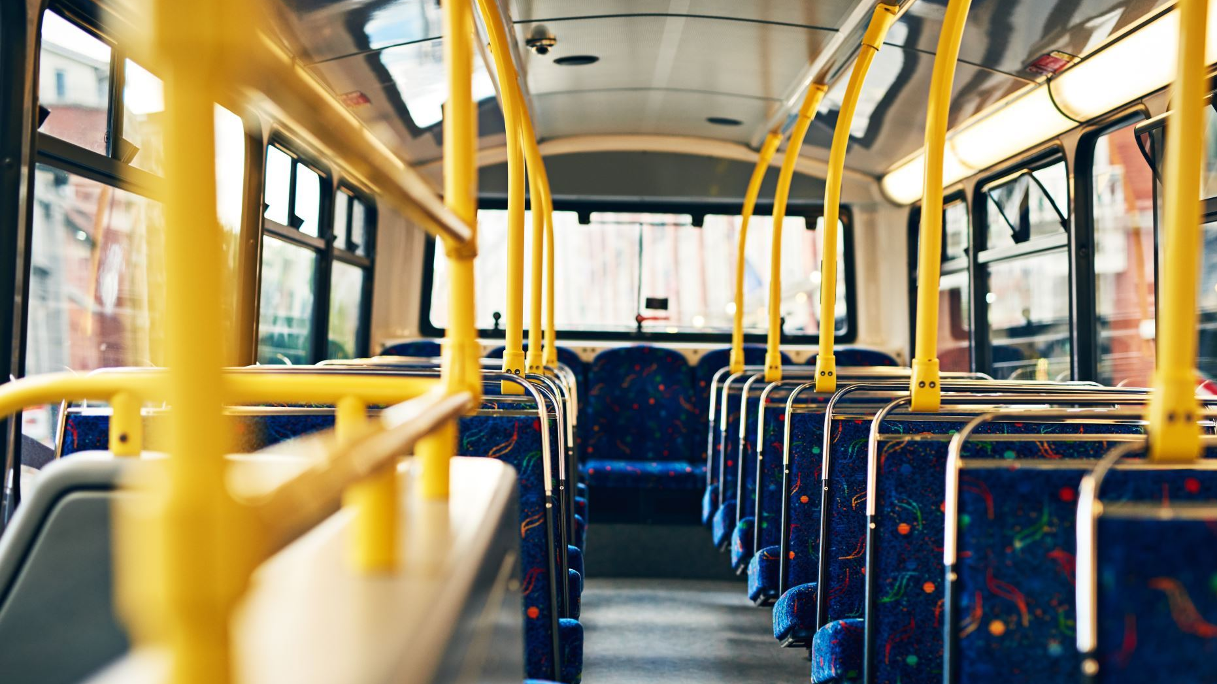
Hop on the Bus Gus
Robert Eason
Michael Flynn
Seshu Miriyala
Mohamad Nayal
Ben Reeve
Bibhuti Timalsina
Notes:
Test note

Slide 2
Introducing the Data
Sources
American Public Transportation Association
Infrastructure Database
National Transit Database
Monthly ridership report

Slide 3
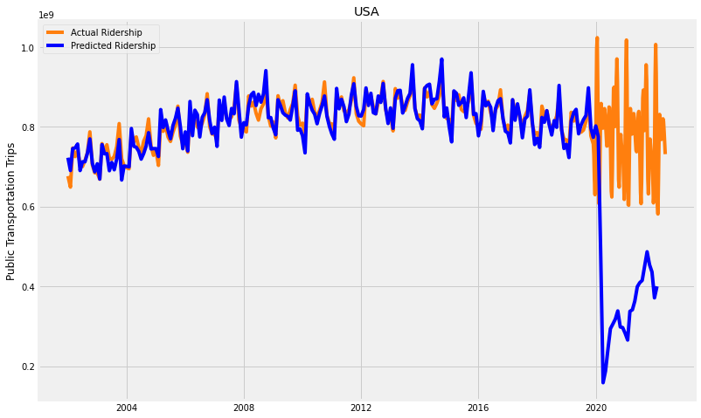
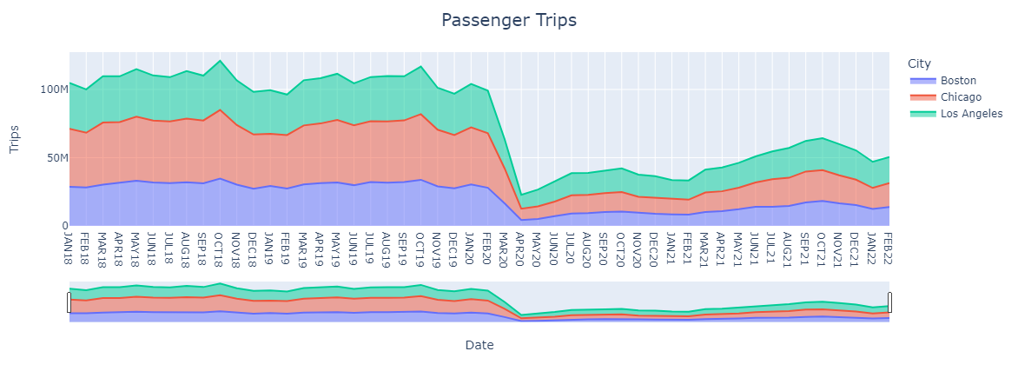
Defining the problem
Plummet in ridership due to the pandemic
Where should we be by 2022?
Where should cities focus their efforts?

Slide 4
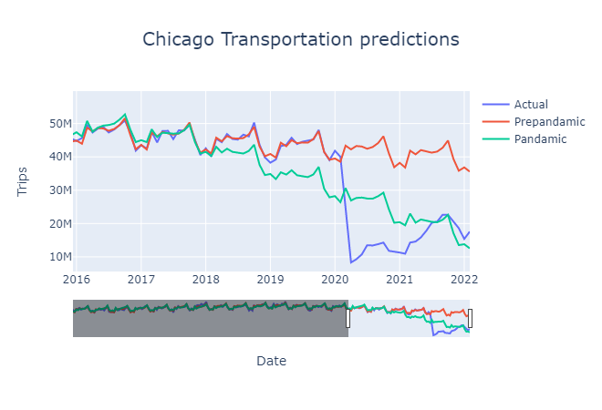
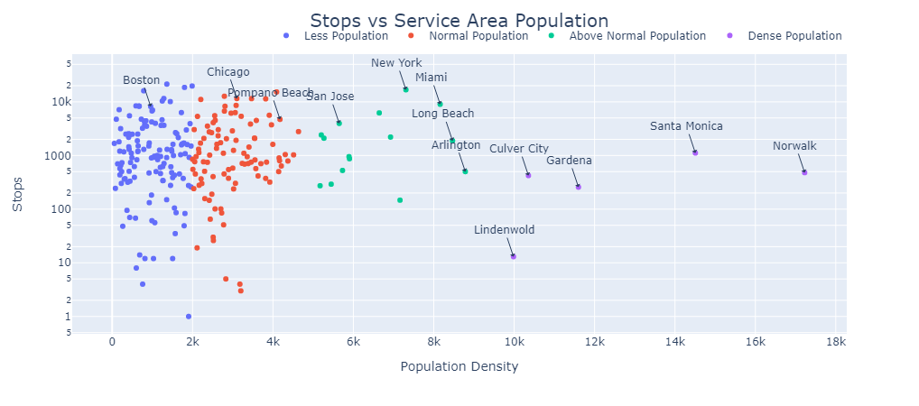
Does transportation depend on populations?

Slide 5
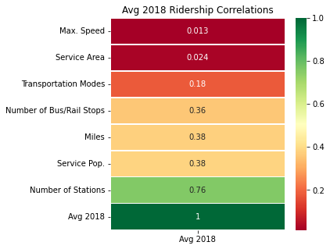
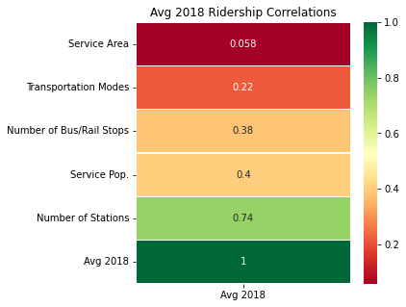
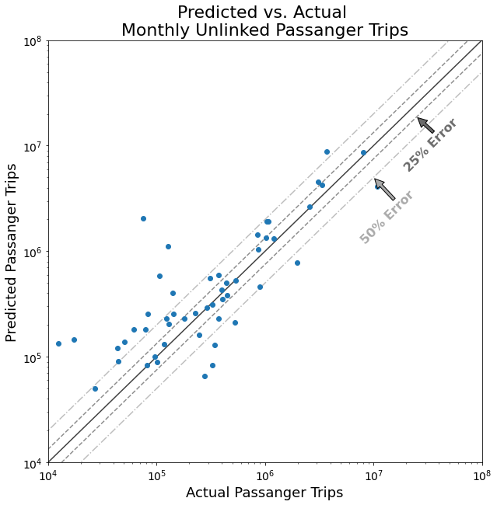
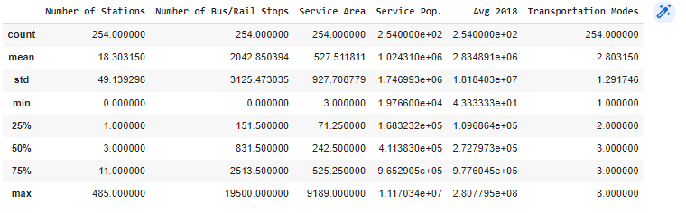

Connectivity
Can connectivity of a mass transit network be used to predict ridership
From 57
to 254
records
Removing Miles and Max. Speed
Notes:
Root Mean Squared Error: 1,271,203

Slide 6
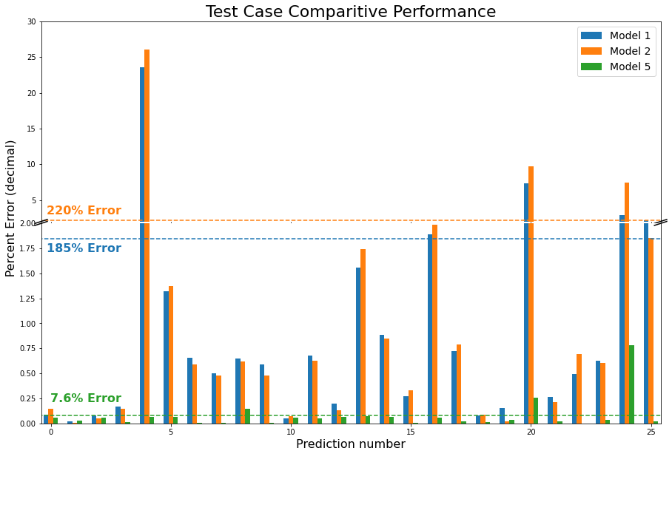
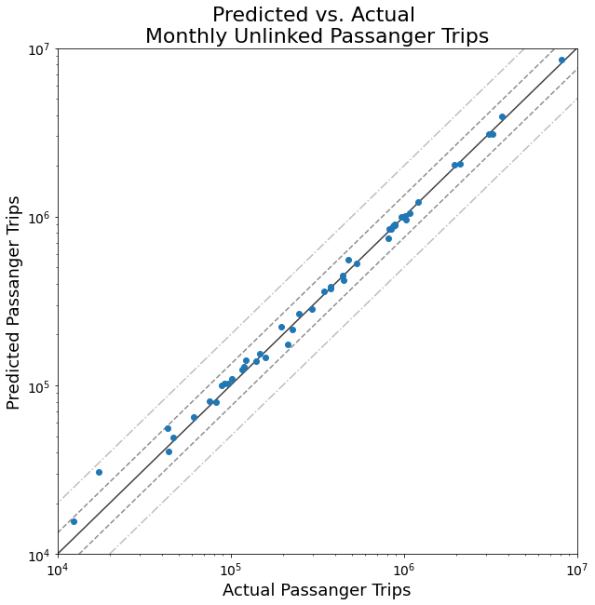
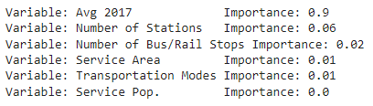
Connectivity Models
Basing prediction off 2017 riders as well
Notes:
Root Mean Squared Error: 939,826.7 trips

Slide 7
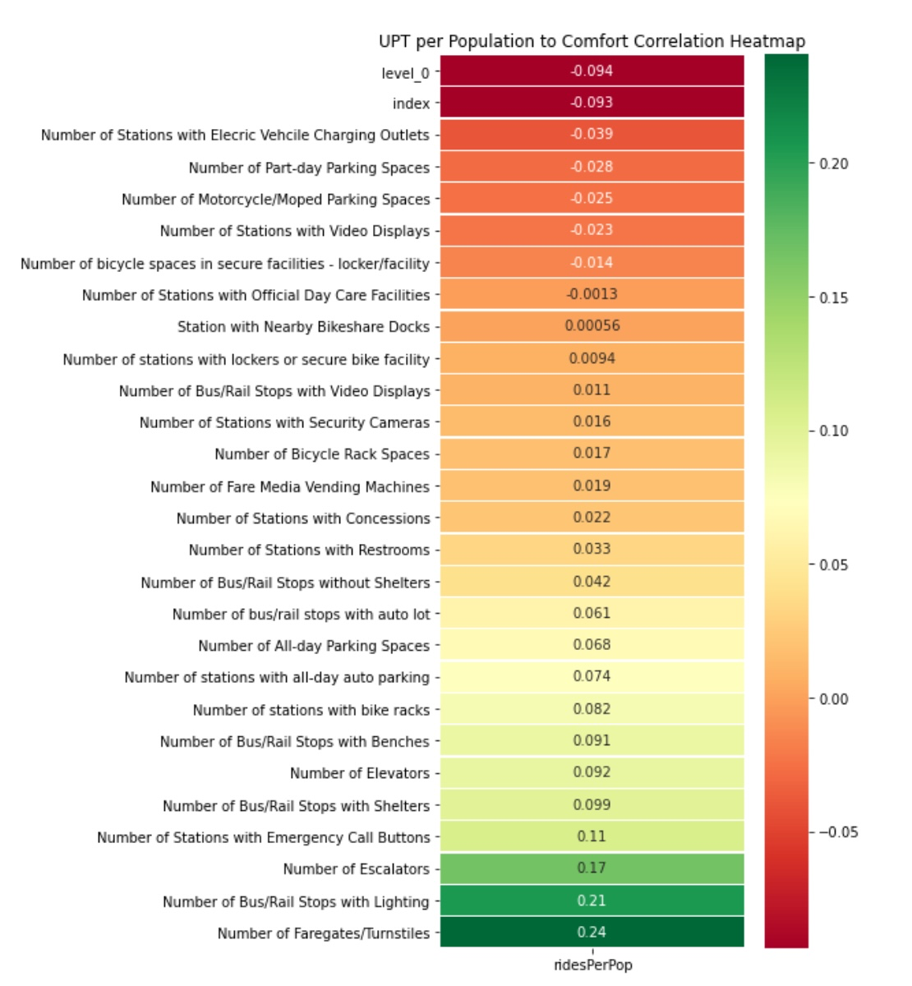
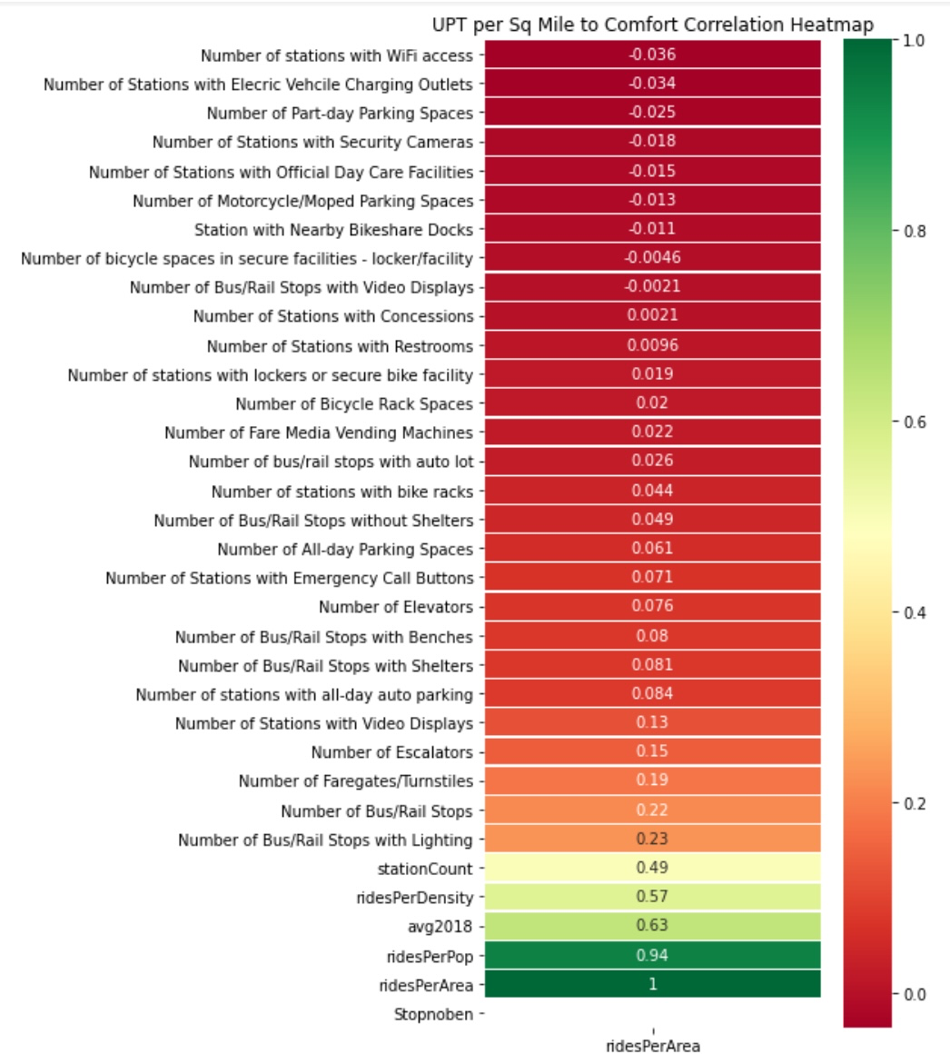
Creature Comforts

Slide 8
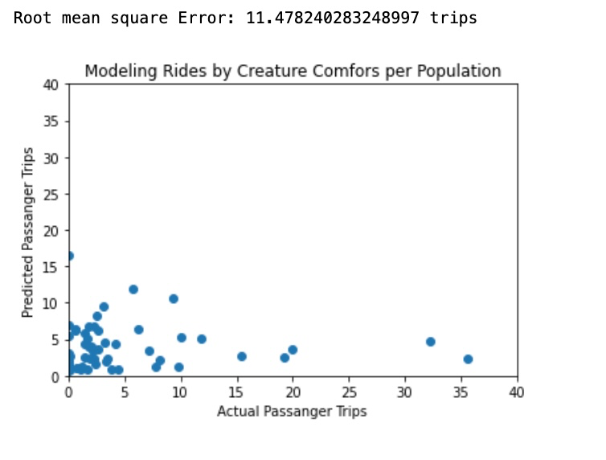

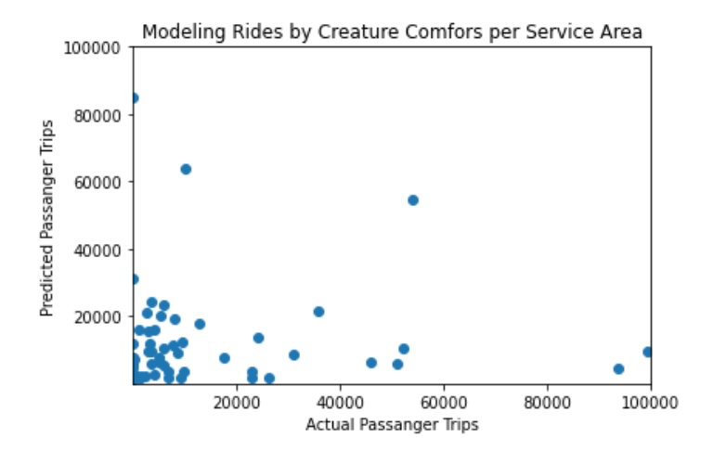
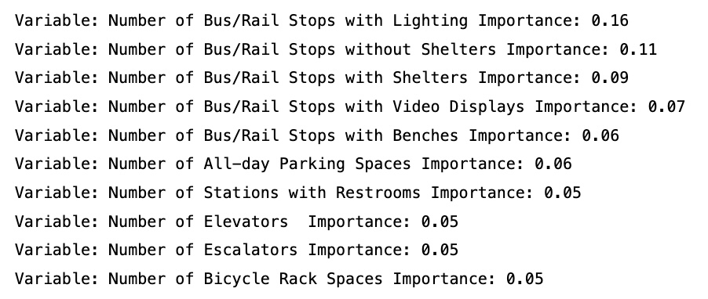
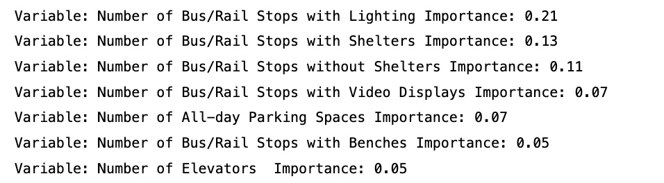
Predicting Ridership From Creature Comforts
Notes:
Random Forest Regression Models were created to predict the ridership by Creature Comforts for both the Population and the Service area sq. miles. Looking at the Root Mean Square Error for the Population model, we see it has a root mean square error of 11.48 , meaning that the average error per estimate is 11.4782 trips off from the actual trips. We also see the Service area model has a root mean square error of 30531.93 trips off the actual. This shows that the population model fits the data better than the service area model.
We also wanted to see which features were more important in predicting ridership…here we see that lighting, stops with and without shelters, stops with video displays and stops with benches were the top 5 features when predicting ridership

Slide 9
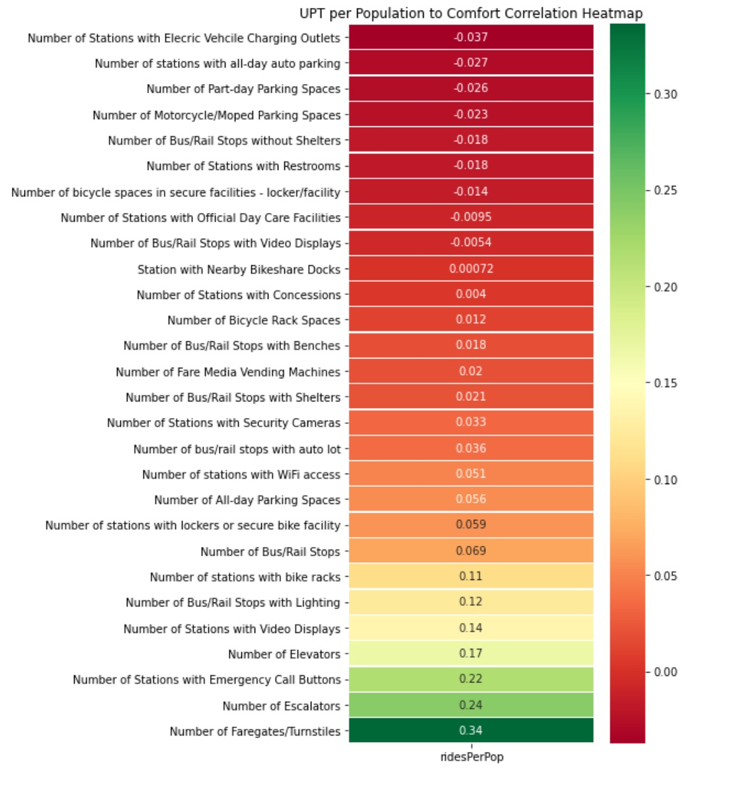
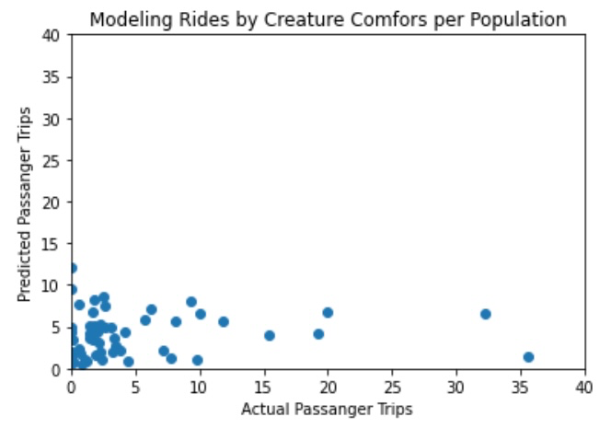
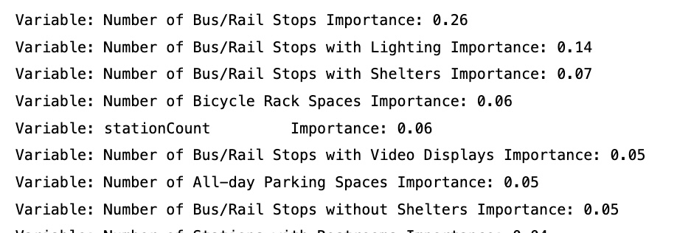
Combined Modeling of Comforts and Connectivity
Including Station Counts, Bus stop Counts, and Type of Facility
No significant improvement in accuracy
Number of Bus / Rail Stops does contribute to random forest model

Slide 10
Recommendation
Highest increase in ridership at lowest cost comes from adding rider peace of mind and comforts:
Improving lighting in stations and Bust stops
Increasing percentage of Bus stops with Shelters
Increase bus stops with benches
Increase bike rack spaces at bus stops and rail stations
Increasing number of stops contributes to ridership
Potential adding of riders in broader geographic area

