Slide 1

Hello, we are team over time
Jessica Tan, NTU Accountancy and Business
Joyce Gao, NTU Communication Studies
Nicholas Phang, NTU Business and Computer Engineering
Wang Zhenyu, NTU Maritime Studies

Slide 2
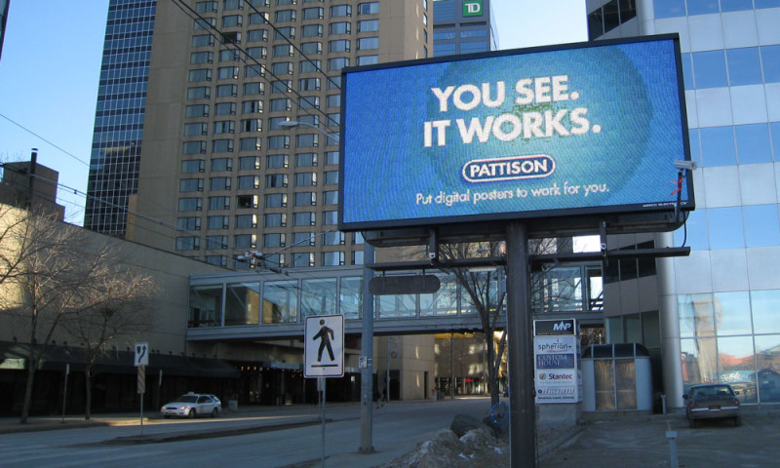
problem statement
How do we entice clients to turn to outdoor advertising to build their brand?
Notes:
Outdoor advertising is not dead, and as an advertising platform, we want our clients to benefit from it.
In the long run, we aim to be the Google Adword of outdoor advertising.
The common gripe we hear is that companies find it tough to measure the performance of their outdoor ads reliably.
A spike in sales may be caused by so many factors, other than your outdoor ads.
Hence, we are going to use footfall and demographical data to prove that it is possible to know, how many target audience have seen their outdoor ads.
This provides info for our clients to refine their marketing strategy to their target audience, and eventually, increase sales.

Slide 3

STEp 1 bidding for a place
Notes:
Bidding for a place against OTHER companies that want to advertise stuff

Slide 4
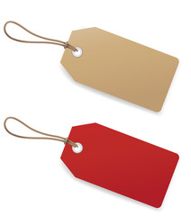
Feature Tags
We give tags to what our clients are advertising over our advertising platform.
Feature tags are meant to match our data dimensions using our smart advertising system.
Location, gender, income, nationality
Notes:
Explain what the tags are: nationality, gender, income, age, other demographical data of your target audience, where your target audience are at when
We give you advice on which slots to bid for, in order for you to maximise your return on investments (ROI). Google Adwords doesn't do that, hence the infamous Google Idiot Tax.

Slide 5
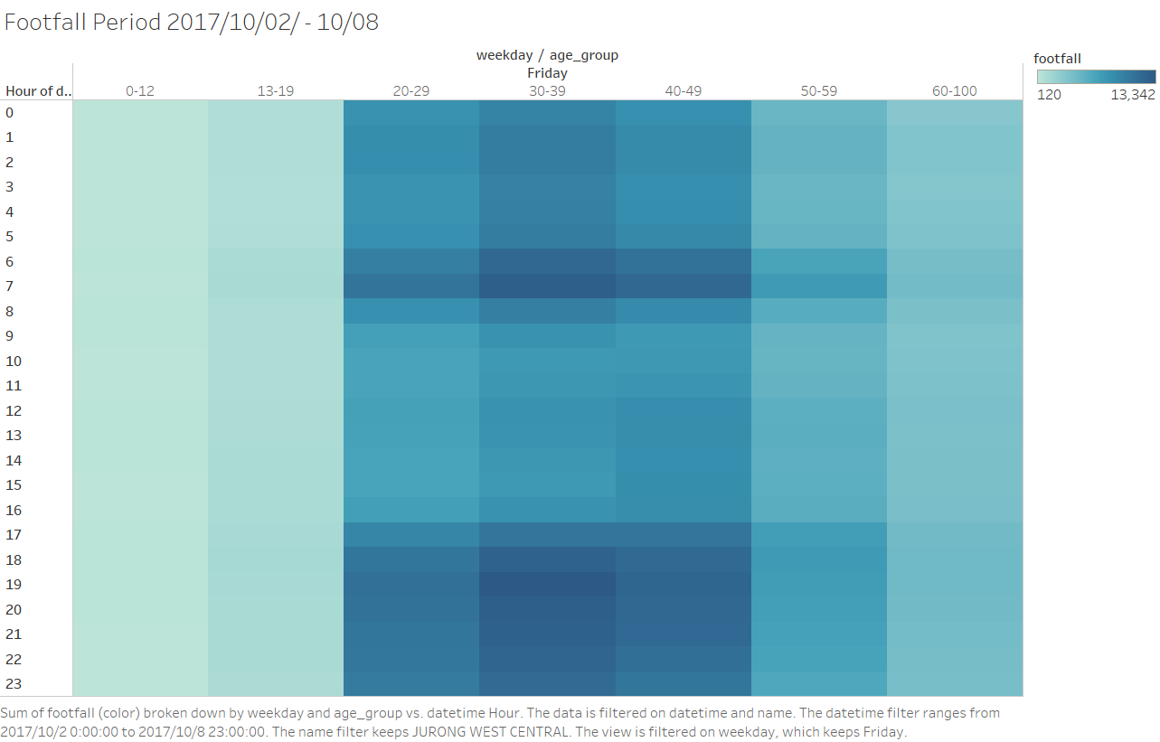
Notes:
Add footfall data map here: this shows the age group of people at these specific subzones at this specific date and time

Slide 6
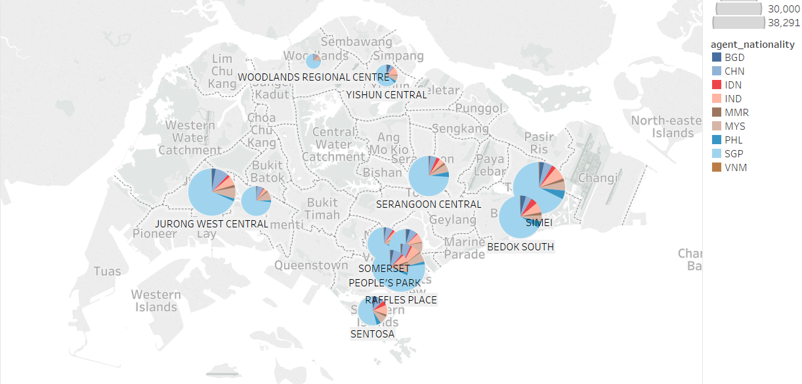
Notes:
Heatmap at a certain location across a weekly schedule: gives you info on how MANY people are at a place at a particular time
Now that you have these precious info, it's bidding time. May the odds be ever in your favour.

Slide 7
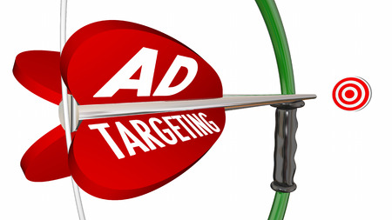
Step 2: release your ad!
Notes:
If no, don't worry. We don't charge you a single cent. No costs on you.
If you manage to get your slot, congrats!

Slide 8

How are my clients charged?
Precision score: have your target audience seen your ad?
Footfall level: how many of your target audience have seen your ad?
Price = Precision score x Footfall level
Notes:
Precision score: matching feature tags we assigned to your advertised stuff, to the people who were in the subzone where your ad/s is/are
The more matches, the higher the precision score

Slide 9

You pay by the number of targeted audience who saw your ad!
Notes:
Even Google Adword is not as precise! Number of clicks does not mean that a large number of target audience have seen your ad!

