Slide 1
INTELLIGENT HIRING
SYSTEM
Guide
Presented by
Sestin Sibi
Divya S B
Department of Computer Applications
S3 MCA
MANGALAM COLLEGE OF ENGINEERING, ETTUMANOOR
Register No : MLM25MCA-2048
Academic Year : 2026–27

Slide 2




Introduction
Project Introduction
Background
The Intelligent Hiring System is an AI-based web application that automates resume screening, online aptitude and personality tests, and candidate ranking.
Recruiters receive hundreds of applications for every role. Manual screening is slow, inconsistent and open to unconscious bias.
Purpose of the System
Importance
To give HR a single platform that evaluates candidates objectively and produces a ranked shortlist from measurable criteria.
Faster, fairer and data-backed hiring cuts HR workload, shortens time-to-hire and improves the quality of selection.
INTELLIGENT HIRING SYSTEM
2

Slide 3




Abstract
Project Overview
An AI-based web platform that evaluates job applicants through resume analysis, an aptitude test and a personality test.
Problem Addressed
Manual resume screening is time-consuming, subjective and inconsistent, and it overloads HR teams.
Proposed Solution
An integrated system that scores every candidate on objective criteria and ranks them on a central HR dashboard.
Technologies
Python, Django, HTML, CSS, JavaScript, Bootstrap and SQLite, developed through requirement analysis, design, data collection, evaluation, scoring and ranking.
Expected Outcome
Candidates register, upload resumes and take tests online; the system generates an overall score and a ranked shortlist that supports the final HR decision.
INTELLIGENT HIRING SYSTEM
3

Slide 4


Problem Definition
“
Manual recruitment is slow, inconsistent and prone to bias, and HR teams lack a single, objective system to screen, assess and rank candidates at scale.
Slow Screening
Subjective Evaluation
No Unified Platform
Resumes are read one at a time, stretching the hiring cycle.
Reviewers apply different standards to similar candidates.
Screening, testing and ranking are handled as separate steps.
INTELLIGENT HIRING SYSTEM
4

Slide 5


Objectives
Main Objective
Specific Objectives
Develop an AI-based Intelligent Hiring System that automates and standardizes candidate screening and selection.
Automate resume screening
Assess candidates with aptitude and personality tests
Generate a ranked shortlist from measurable criteria
Build a scalable system for different job roles
Expected Outcome
Benefits to Users
Objective, bias-free evaluation of candidates and a shorter time-to-hire across roles.
HR: less manual workload and data-driven decisions
Candidates: fair, consistent online assessment
INTELLIGENT HIRING SYSTEM
5

Slide 6



Existing System
Current Method
Current Workflow
Manual / Inefficient Processes
Recruitment is handled manually. HR teams read resumes one at a time and decide on personal judgement.
Collect resumes
Screen them one by one
Schedule tests and interviews separately
Reviewers decide subjectively
Resume screening, scheduling and score comparison are done by hand, adding repetitive work for HR.
Problems in the Existing System
Limitations
Slow decision finalization
Subjective, reviewer-dependent evaluation
No standardized scoring across candidates
Little data to support process improvement
Does not scale as applicant volume grows
Unconscious bias can affect shortlisting
INTELLIGENT HIRING SYSTEM
6

Slide 7

Proposed System
Overview
How It Solves the Problem
An AI-based web system that analyses resumes, tests candidates online and ranks them objectively on one platform.
Automated analysis replaces one-at-a-time screening, and standard tests and scoring replace subjective judgement.
Key Features
Improvements
Resume analysis
Aptitude test
Personality test
Candidate scoring
Automated ranking
HR dashboard
Faster, automated shortlisting
Consistent, criteria-based scoring
Central data for HR decisions
INTELLIGENT HIRING SYSTEM
7

Slide 8


Scope of the Project
Target Users
Functional Coverage
Application Areas
Candidates / job applicants
HR recruiters
System administrators
Resume evaluation
Aptitude and personality assessment
Candidate ranking and HR dashboards
Corporate HR departments
Recruitment agencies
Campus placement cells
Included in the Project
Possible Future Applications
User authentication, job management, resume upload, online aptitude and personality tests, score-based ranking, notifications, and candidate and admin dashboards.
Extension to new job roles and larger applicant volumes, and integration with external hiring platforms.
INTELLIGENT HIRING SYSTEM
8

Slide 9
Literature Review
Title & Year | Author & Publication | Algorithm Used | Feature Extracted / Methodology | Performance Metric | Result / Findings
Application of LLM Agents in Recruitment: A Novel Framework for Automated Resume Screening (2024) | C. Gan, Q. Zhang, T. Mori; Journal of Information Processing | LLM agent framework (fine-tuned LLMs) | Summarizes, grades and classifies resume sentences; agents support offer decisions | Processing speed; F1-score | ~11x faster than manual screening; F1 of 87.73% in resume sentence classification
Resume Screening Using Ensemble Models (2025) | M. R. Dontha, S. Thaslim, M. Tripura; IEEE | Ensemble machine learning models | Resume classification and candidate ranking | Ranking accuracy | Better ranking and accuracy; needs more computing power and is complex
Resume Screening Using Large Language Models (2025) | Authors to be confirmed; IEEE | Large Language Models | LLM-based automated resume screening | Time saved | Automates screening and saves time; relies on paid AI tools and raises privacy concerns
Cracking the AI Recruitment Code: Striving for Transparency in Finding the Right Person–Job Fit (2024) | A. Chen, F. Han, X. Zhang, Y. Lu; Elsevier | None (research study) | Examines transparency and fairness in AI-driven recruitment decisions | Transparency; fairness | AI hiring becomes more transparent and fair; a research idea, not a complete system
Machine Learning in Recruiting: Predicting Personality from CVs and Short Text Responses (2024) | E. Grunenberg, H. Peters, M. J. Francis, M. D. Back, S. C. Matz; Frontiers | Machine-learning text models | Predicts personality from CV and short text responses | Prediction accuracy | Predicts personality at low cost; predictions are not always accurate
Research Gap: existing studies address individual recruitment tasks; there is no unified AI-based hiring platform.
Proposed Solution: Integrated Intelligent Hiring System.
INTELLIGENT HIRING SYSTEM
9

Slide 10

Technologies Used
Technologies used to design, build, and manage the system.
Frontend
Backend
Database
Tools
Client-side interface and interactions
Server-side logic and processing
Data storage and management
Development and design utilities
HTML
Python
SQLite
VS Code
CSS
Django
StarUML
Bootstrap
Draw.io
JavaScript
Git
Intelligent Hiring System
10

Slide 11

Software & Hardware Requirements
Software Requirements
Hardware Requirements
Operating System
Windows 10 / 11
Processor
Intel Core i3 or higher
Language
Python 3
RAM
4 GB minimum (8 GB recommended)
Web Framework
Django
Hard Disk
2 GB or more free space
Front-end
HTML, CSS, JavaScript, Bootstrap
Display
1366 × 768 or higher
Database
SQLite
Network
Internet connection for browser access
Web Browser
Google Chrome / Microsoft Edge
Input
Keyboard and mouse
INTELLIGENT HIRING SYSTEM
11

Slide 12
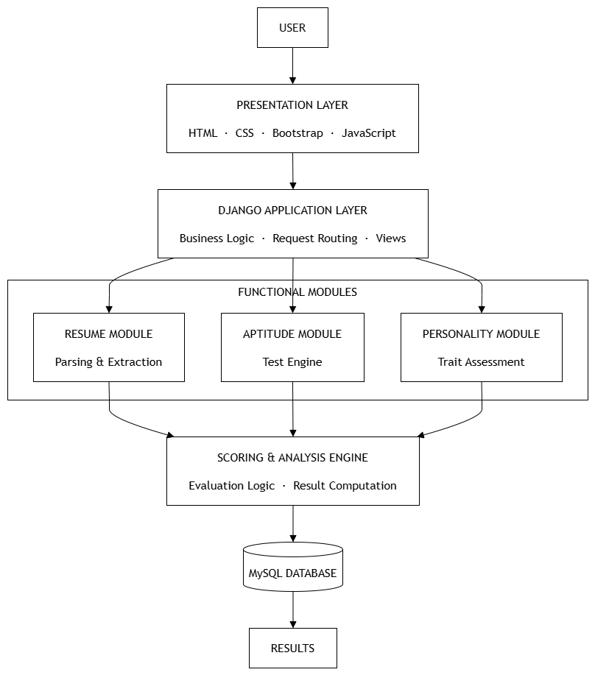




System Architecture
User
Frontend
Backend
Database
User Interaction
Candidates, HR and admin use browser pages for login, tests and dashboards.
Application Layer
HTML, CSS, Bootstrap and JavaScript front end (presentation layer).
Business Logic
Django views and routing run the resume, aptitude and personality modules and the scoring engine.
Database Layer
Stores users, jobs, resumes, test responses and scores.
External APIs / Services
Resume Parser API is integrated for resume data extraction. The extracted information is processed by Django for evaluation and scoring.
INTELLIGENT HIRING SYSTEM
12

Slide 13
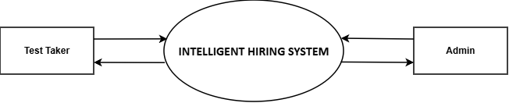
DFD – Level 0
Intelligent Hiring System
13

Slide 14
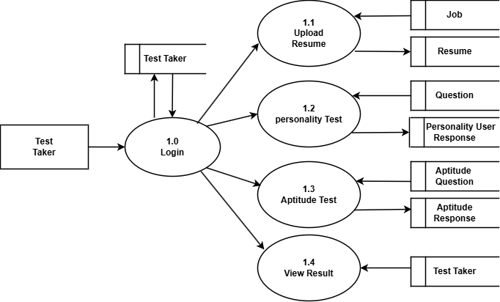
DFD – Level 1 (Test Taker)
Intelligent Hiring System
14

Slide 15
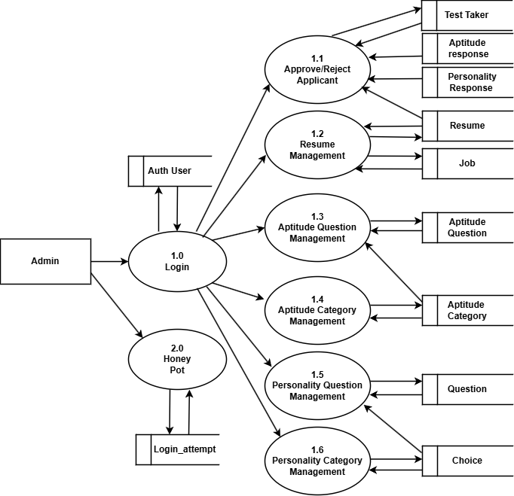
DFD – Level 1 (Admin)
Intelligent Hiring System
15

Slide 16
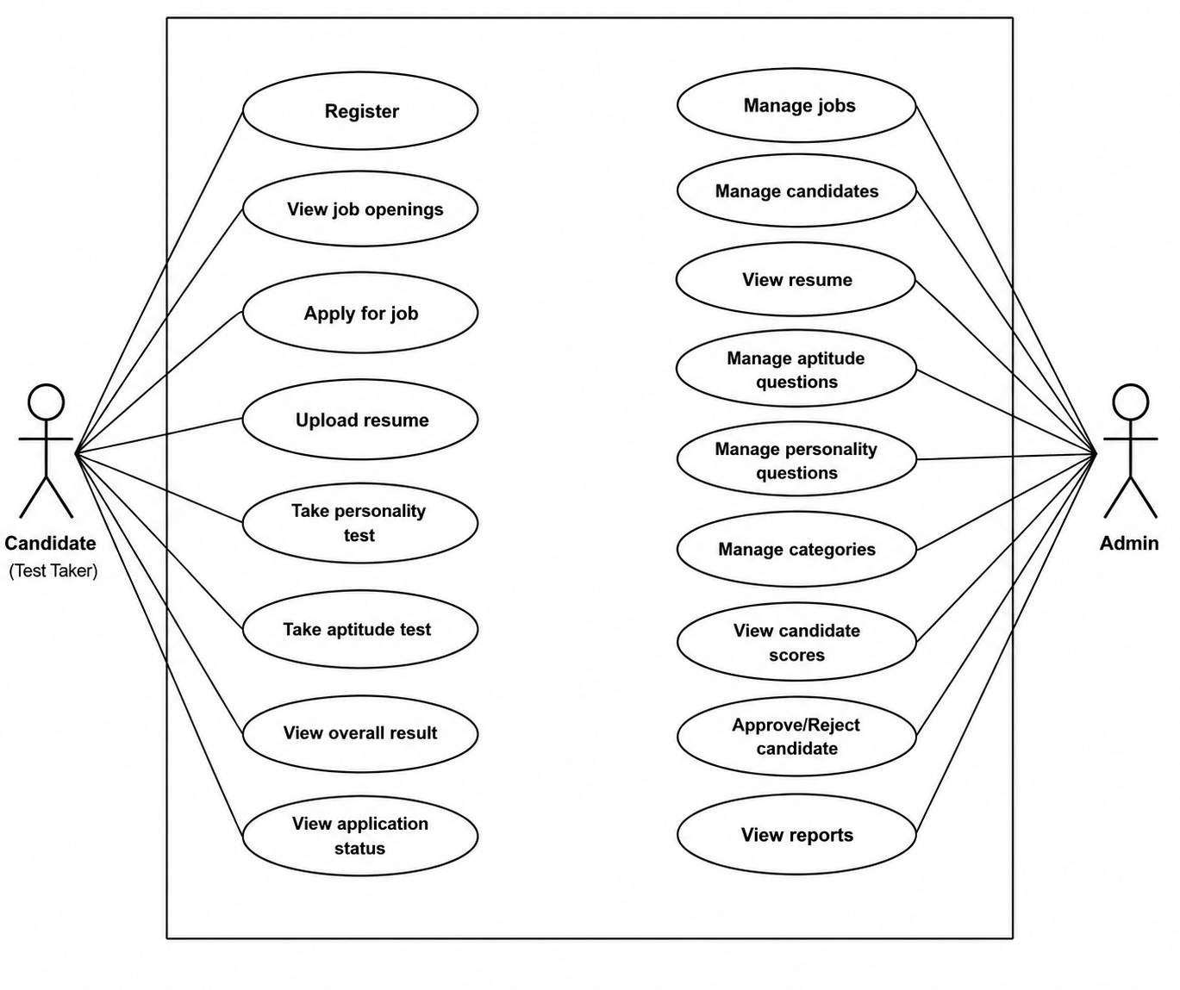
Use Case Diagram
Intelligent Hiring System
16

Slide 17
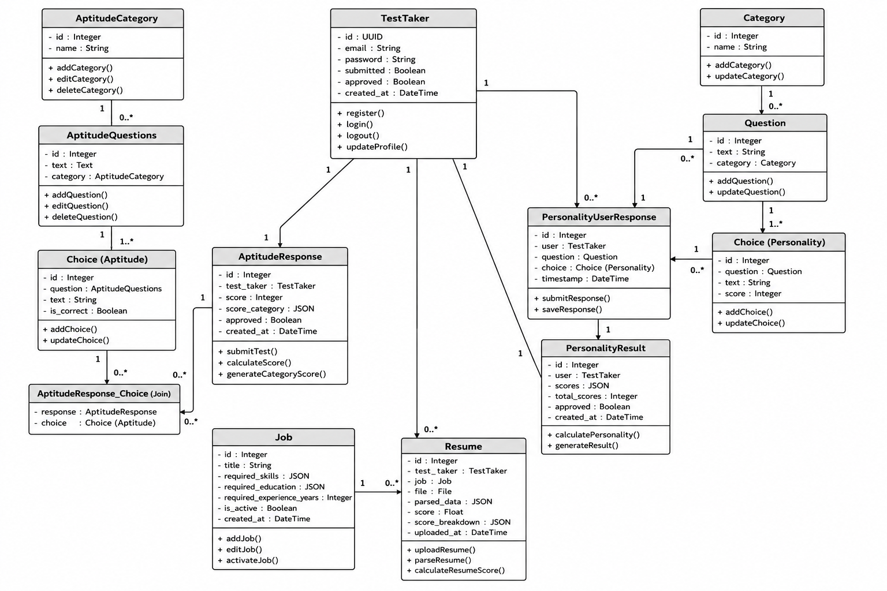
Class Diagram
Intelligent Hiring System
17

Slide 18
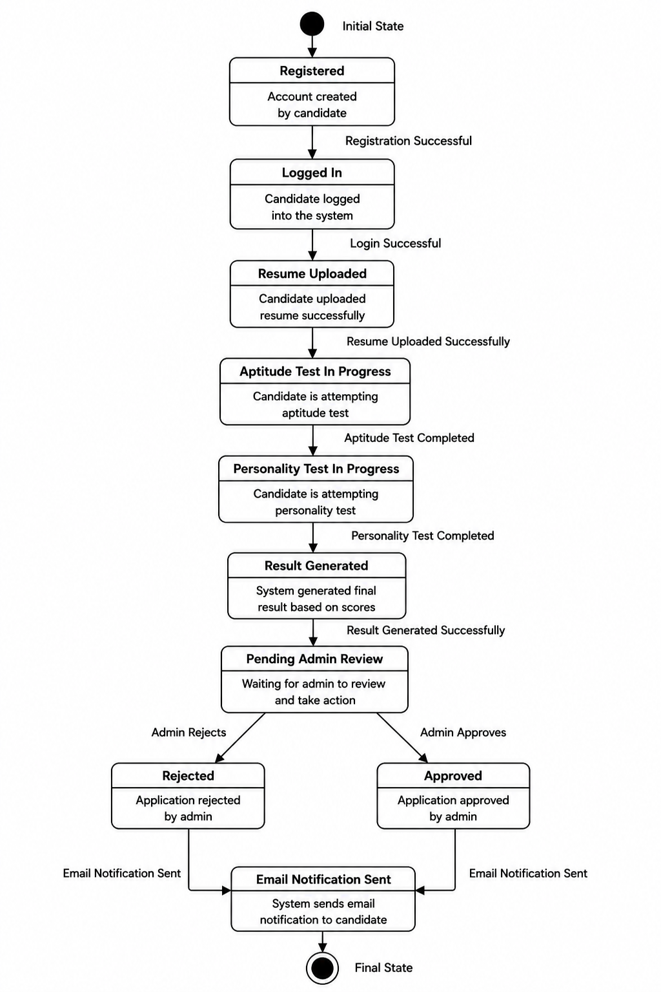
State Diagram
Intelligent Hiring System
18

Slide 19
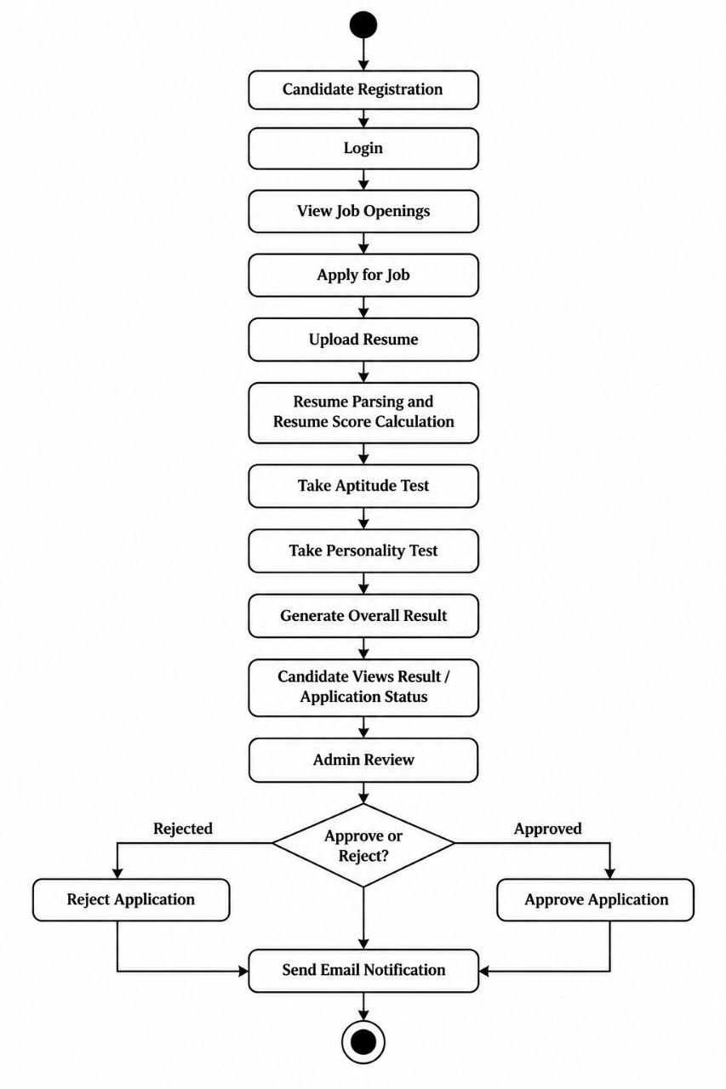
Activity Diagram
INTELLIGENT HIRING SYSTEM
19

Slide 20
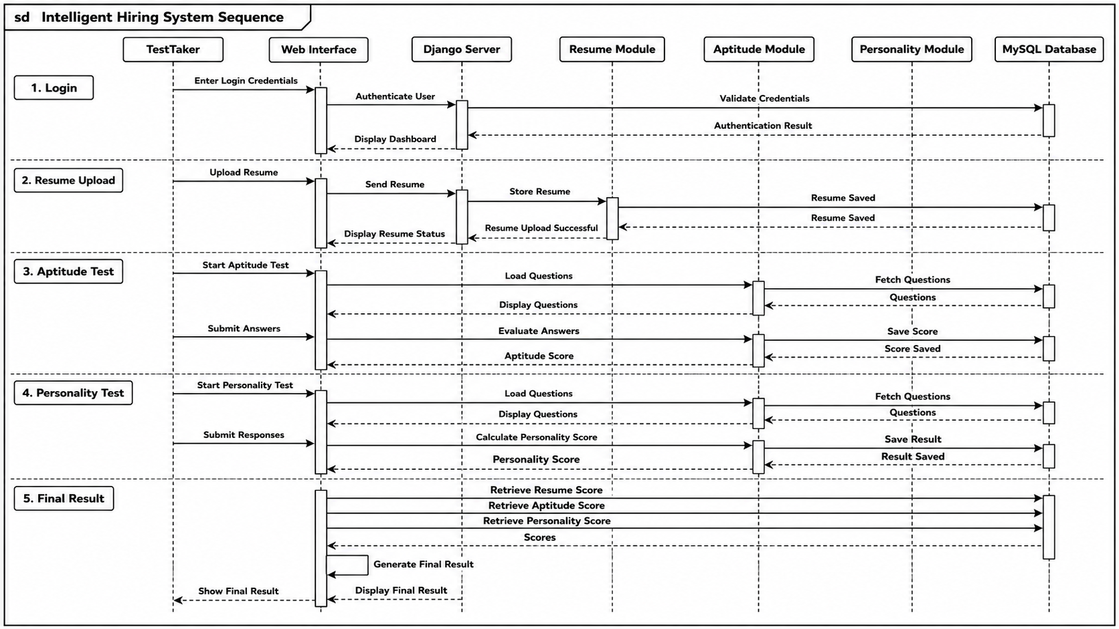
Sequence Diagram
Intelligent Hiring System
20

Slide 21
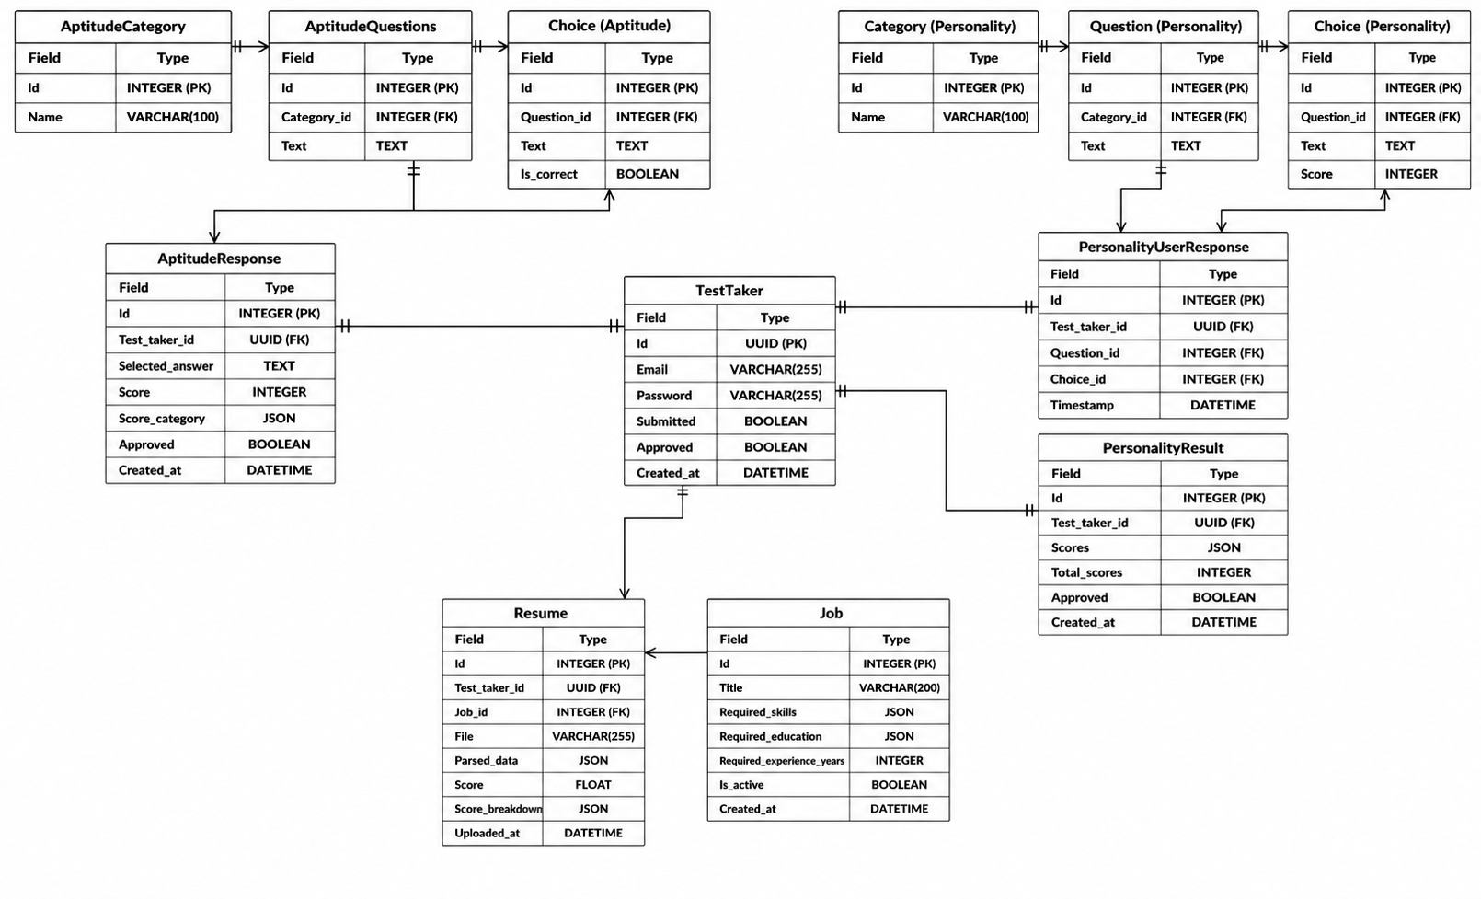
Entity Relationship (ER) Diagram
Intelligent Hiring System
21

Slide 22





Module Description
User Authentication
Job Management
Resume Management
Aptitude Assessment
Secure login for candidates, HR and admin
Create and manage open job postings
Candidates submit resumes online
Timed online skill-based tests
Personality Assessment
Recruitment Management
Candidate Evaluation
Notification
Behavioural fit questionnaire
Central monitoring and management view
Score-based shortlist generation
Automated status updates to candidates
INTELLIGENT HIRING SYSTEM
22

Slide 23
Methodology
Systematic approach followed for developing the proposed system.
01
Requirement Analysis
02
System Design
03
Candidate Data Collection
Identify system requirements and recruitment criteria.
Design the system architecture, modules, database and user interface.
Collect resumes and candidate assessment responses.
04
Candidate Evaluation
05
Scoring & Ranking
06
HR Decision
Analyze resumes and evaluate aptitude and personality.
Generate scores and rank candidates based on predefined criteria.
Provide evaluated candidate information to support the recruitment process.
INTELLIGENT HIRING SYSTEM
23

Slide 24
System Workflow
Step-by-step path of a candidate through the system.
Register / Login
Apply for Job
Upload Resume
1
2
3
System Evaluates Candidate
Take Aptitude Test
Take Personality Test
6
5
4
Overall Score Generated
Recruiter Reviews Candidate
Application Status Updated
7
8
9
INTELLIGENT HIRING SYSTEM
24

Slide 25

Implementation
Frontend Implementation
Backend Implementation
Database Implementation
HTML, CSS, Bootstrap and JavaScript pages for login, registration, dashboards, resume upload and tests.
Django (Python) views, models and URL routing handle authentication, applications, tests and scoring.
Relational schema in SQLite, managed through the Django ORM, storing users, jobs, resumes, responses and scores.
Important Functionalities
APIs / Integrations
Key Code Logic
Role-based secure login
Resume upload and analysis
Aptitude and personality tests
Score generation and ranking
Resume Parser API for resume data extraction.Extracted candidate details are processed by Django
Resume, aptitude and personality results are combined into an overall score; candidates are sorted by it to form the ranked shortlist.
INTELLIGENT HIRING SYSTEM
25

Slide 26
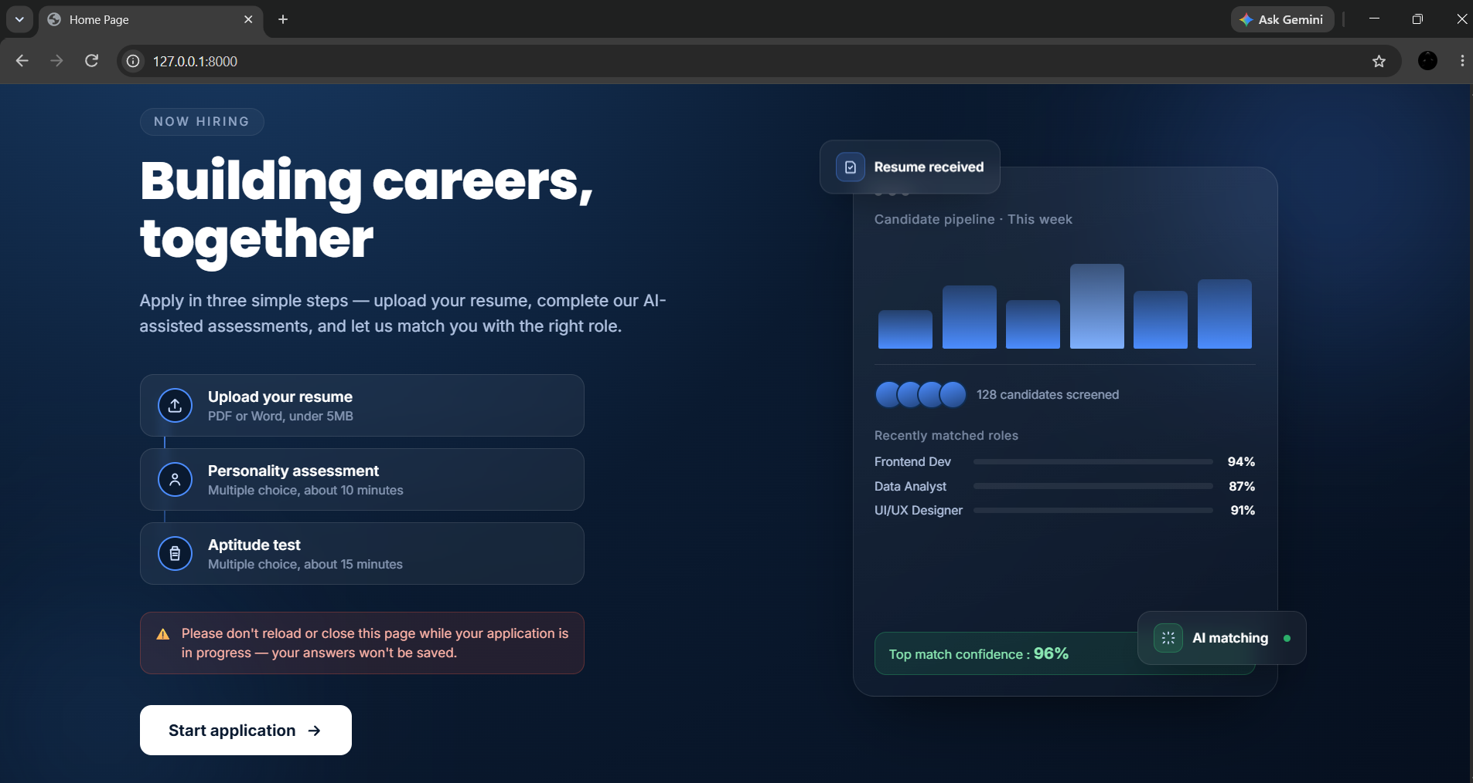
Screenshots
Home page
INTELLIGENT HIRING SYSTEM
26

Slide 27
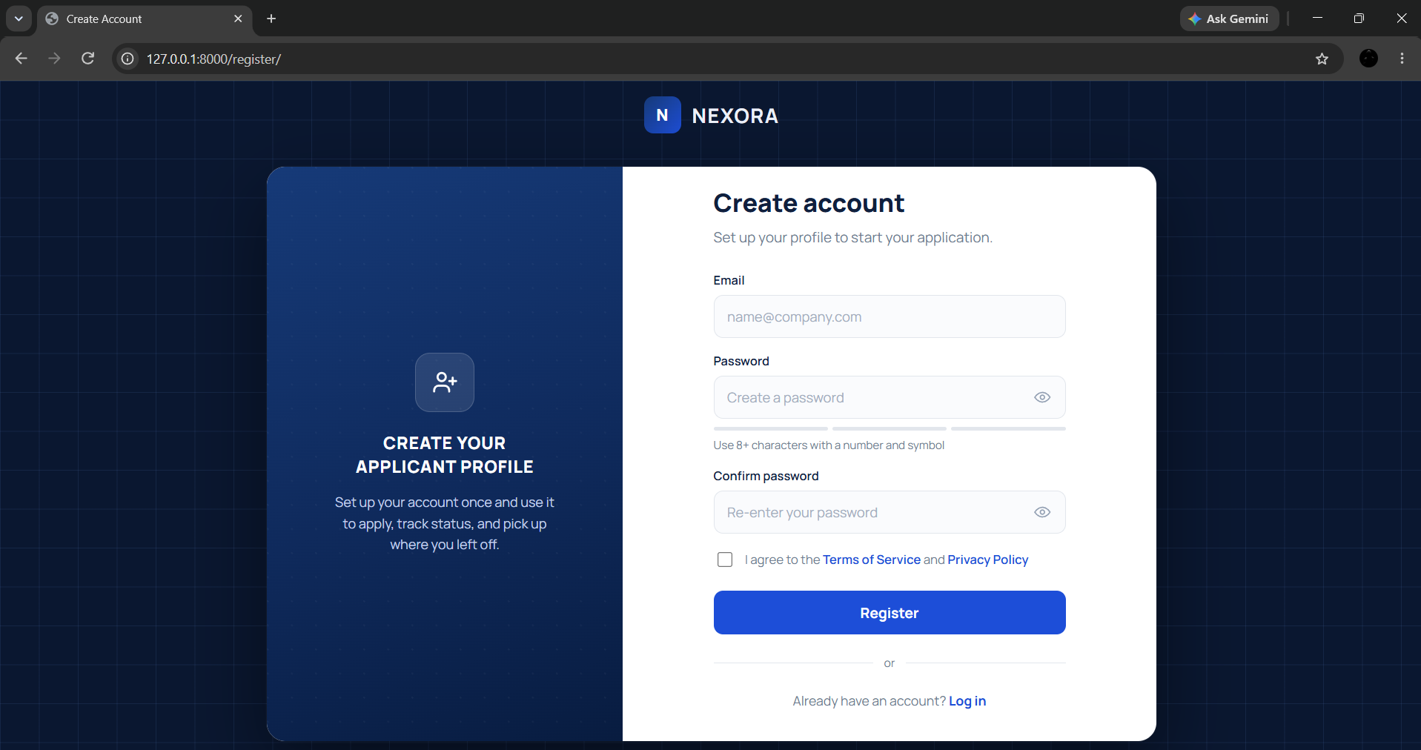
Screenshots
Registration page
INTELLIGENT HIRING SYSTEM
27

Slide 28
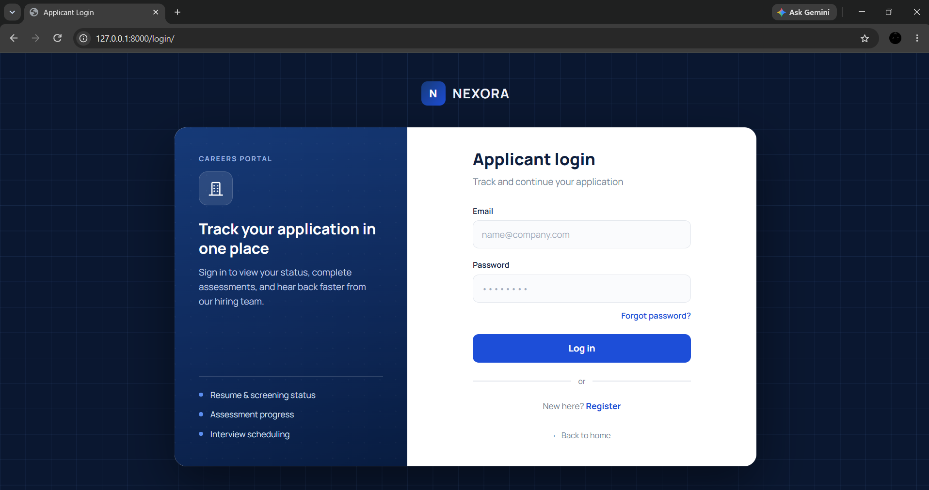
Screenshots
Login page
INTELLIGENT HIRING SYSTEM
28

Slide 29
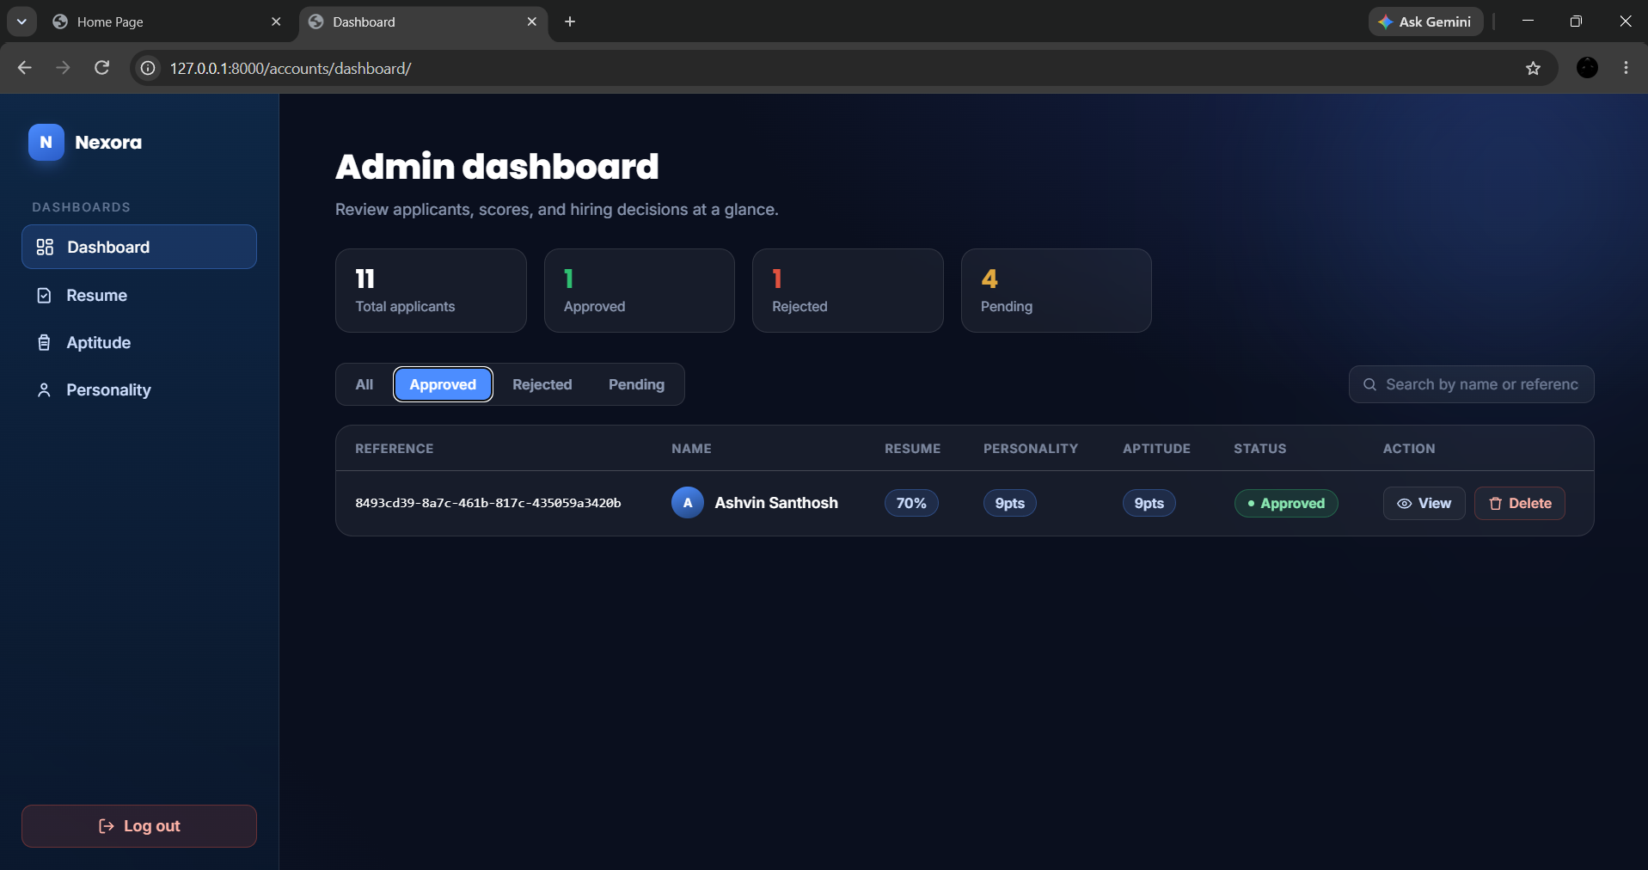
Screenshots
Admin dashboard
INTELLIGENT HIRING SYSTEM
29

Slide 30
Comparison with Existing System
Feature | Existing System | Proposed System
Processing | Manual, one resume at a time | Automated resume analysis and scoring
Accuracy | Subjective and reviewer-dependent | Consistent, criteria-based scoring for every candidate
Time | Slow; decisions take longer to finalize | Faster shortlisting through automated evaluation and ranking
Security | Manual record keeping with no role-based access | Secure, role-based login for candidates, HR and admin
Accessibility | Assessments and interviews scheduled separately | Online applications and tests available from any web browser
Reporting | Little to no process data | HR dashboard with scores and a ranked shortlist
INTELLIGENT HIRING SYSTEM
30

Slide 31
Testing
Modules were tested individually, then together, then as a complete system.
Unit Testing
Integration Testing
System Testing
Acceptance Testing
Individual functions, forms and views
Interaction between modules such as tests and scoring
End-to-end candidate and admin workflows
User acceptance feedback on usability
Test Case | Expected Result | Actual Result | Status
Valid Login | Login successful | Successful | Pass
Invalid Login | Error message | Error displayed | Pass
Candidate Registration | Account created | Account created | Pass
Resume Upload | Resume saved and listed | Uploaded successfully | Pass
Aptitude / Personality Test | Answers saved and result generated | Result generated | Pass
Candidate Ranking (Admin) | Candidates listed by score | Ranked list displayed | Pass
INTELLIGENT HIRING SYSTEM
31

Slide 32

Advantages
Faster Screening
Objective Evaluation
Reduced HR Workload
Automated resume analysis shortens the screening stage and reduces time-to-hire.
The same measurable criteria are applied to every candidate, reducing bias.
Repetitive screening is automated, so HR can focus on final decisions.
Consistent Ranking
Centralized Dashboard
Scalable and Low Cost
Ranked shortlists are generated automatically from combined scores.
HR sees candidates, scores and status in one place.
Built on open-source tools and designed to extend to new roles and higher volume.
INTELLIGENT HIRING SYSTEM
33

Slide 33
Limitations
Resume Format Dependence
Analysis quality depends on the format and clarity of the uploaded resumes.
Fixed Question Sets
Aptitude and personality tests use predefined question sets.
Indicative Personality Results
Personality assessment is indicative and cannot replace an interview.
HR Judgement Still Needed
The system supports, but does not replace, the final hiring decision made by HR.
Standalone System
No integration with external job portals or HR tools in the current version.
INTELLIGENT HIRING SYSTEM
34

Slide 34
Conclusion
The Intelligent Hiring System brings resume analysis, aptitude and personality assessment, and candidate ranking onto one platform, making recruitment faster, more consistent and more objective while keeping HR in control of the final decision.
Automated Screening
Objective Scoring
HR Decision Support
Less manual effort for HR teams.
Measurable criteria for every candidate.
Ranked, data-backed shortlists.
INTELLIGENT HIRING SYSTEM
35

Slide 35


Future Scope
Wider Job Roles
Advanced Resume Analysis
Explainable Scoring
Extend question banks and criteria to more job roles and larger applicant volumes.
Use NLP and LLM-based techniques for deeper understanding of resumes.
Show why a candidate received a score to improve transparency and fairness.
Portal Integration
Interview Support
Hiring Analytics
Connect with job portals and HR tools for end-to-end hiring.
Add interview scheduling and proctored online assessments.
Reports and trends from hiring data to improve the process over time.
INTELLIGENT HIRING SYSTEM
36

Slide 36
BIBLIOGRAPHY
References
[1]
C. Gan, Q. Zhang, and T. Mori, “Application of LLM agents in recruitment: A novel framework for automated resume screening,” J. Inf. Process., vol. 32, pp. 881–893, 2024.
[2]
M. R. Dontha, S. Thaslim, and M. Tripura, “Resume screening using ensemble models,” IEEE, 2025.
[3]
A. Chen, F. Han, X. Zhang, and Y. Lu, “Cracking the AI recruitment code: Striving for transparency in finding the right person–job fit,” Elsevier, 2024.
[4]
E. Grunenberg, H. Peters, M. J. Francis, M. D. Back, and S. C. Matz, “Machine learning in recruiting: Predicting personality from CVs and short text responses,” Front. Soc. Psychol., 2024.
[5]
Python Software Foundation, “Python documentation.” [Online]. Available: https://docs.python.org
[6]
SQLite Consortium, “SQLite documentation.” [Online]. Available: https://www.sqlite.org/docs.html
INTELLIGENT HIRING SYSTEM
37

Slide 37
THANK YOU

