Slide 1
Exercise 3
Eduard Kerkhoven
Christoph Börlin; Ivan Domenzain
KMG060 – 2019-10-04

Slide 2
Exercise 3
Learning goals
To get familiar with a MATLAB structure of genome-scale models
To realize how undetermined models of metabolism are.
To be able to find an optimal flux distribution under specific conditions.
To interpret flux distributions and find trends in metabolism
Book chapters 18, 19 and 21
Report deadline 13 October 23:55
Work in pairs, report solutions, figures and MATLAB file
Problem 4 is bonus question, for bonus points on exam

Slide 3
smallModel.mat
Represents yeast central carbon metabolism (CCM)
Pathways include
Glycolysis
Pentose phosphate pathway
TCA cycle
Respriation (NADHX and FADHX)
Production of byproducts: ethanol, glycerol and acetate
Biomass production reaction (bioRXN)
Non-Growth Associated Maintenance = NGAM (ATPX)
Exchange reactions
Glucose (glcEX), oxygen (o2EX), ethanol (ethEX), acetate (acEX), biomass (bioEX), CO₂ (co2EX), glycerol (glyEX)

Slide 4
Determined / Underdetermined problems
Degrees of freedom = N – M
Degrees of freedom = #variables – rank(matrix) (general case)
rank of a matrix is defined as the maximum number of linearly independent column or row vectors in the matrix, whichever is smaller
Can you measure F linear independent fluxes?
You basically reduce N until degrees of freedom = 0, to give a determined system --> MFA
Calculate using Sv = 0 --> v = S\b
Can you not measure F linear independent fluxes?
Underdetermined system --> FBA
Define objective function and solve using linprog()

Slide 5
Using linprog()
1 = solution found
Anything else = no solution
Solution
[]
[]
[x,f,flag] = linprog(c,Ai,bi,Ae,be,LB,UB);
Value objective function
ALWAYS MINIMIZES!
But remember:
Min f(x) = – Max f(x)

Slide 6
Problem 1: Finding a flux distribution
Load the model, inspect the content
Check (and correct?) reversibility
Where is reversibility stored?
Solve as determined system
Solve as underdetermined system

Slide 7
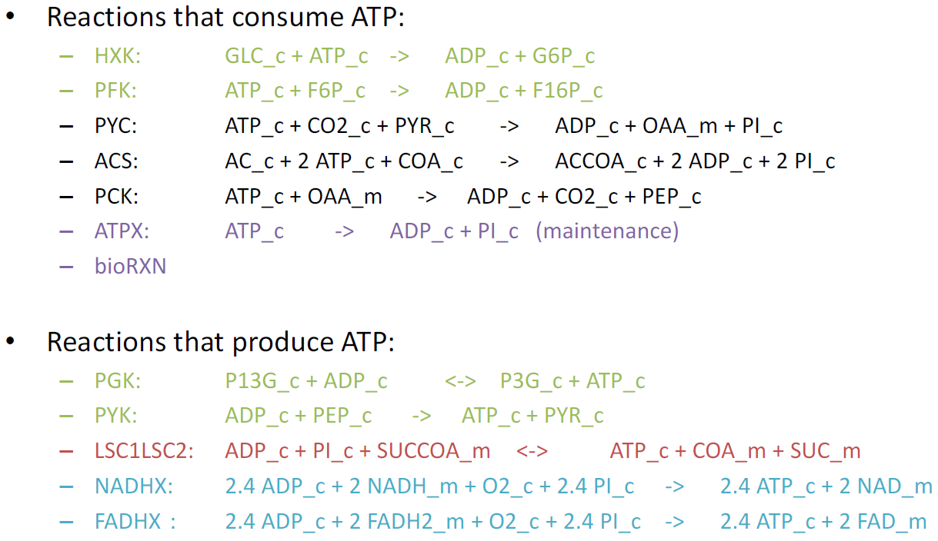
smallModel.mat

Slide 8
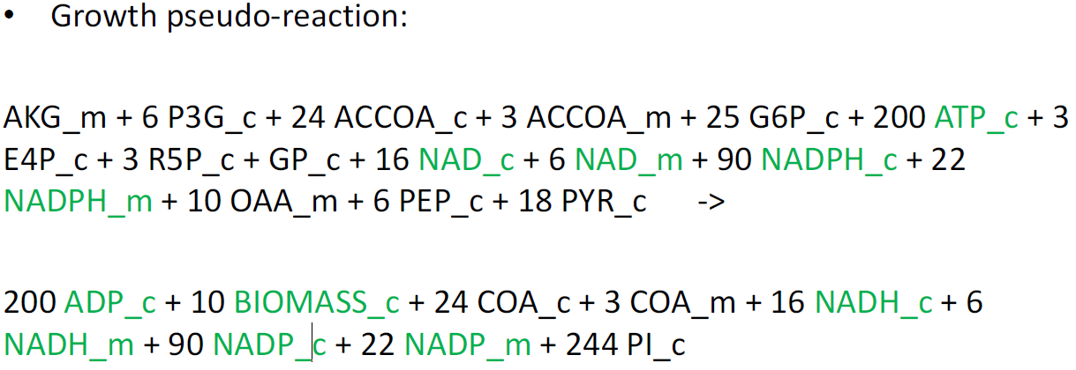
smallModel.mat

Slide 9
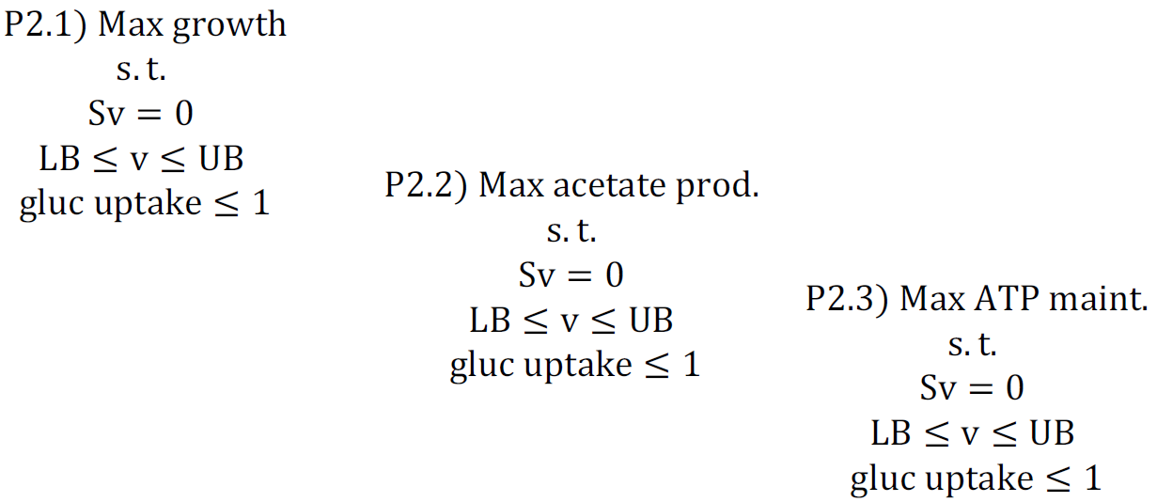
Problem 2: Changing objective functions

Slide 10
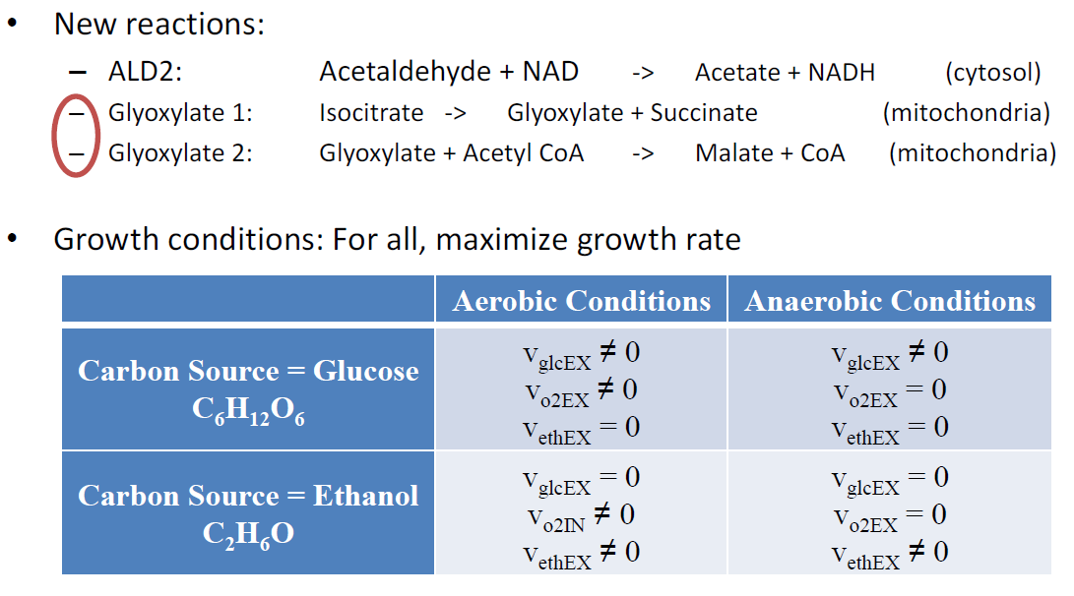
Problem 3: Changing growth conditions

Slide 11
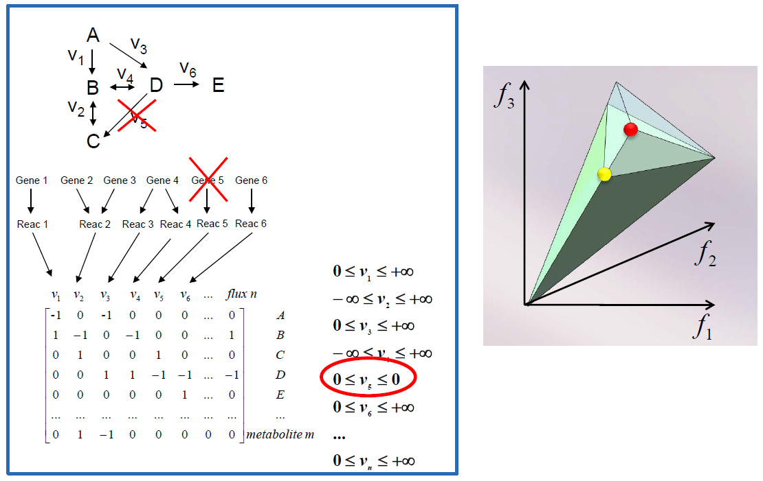
Problem 4: In silico gene deletions

