Slide 1
Computational models of metabolism Exercise 3 Introduction
Eduard J Kerkhoven

Slide 2
Learning goals covered by this exercise
To get familiar with a MATLAB structure of genome-scale models
To realize how undetermined models of metabolism are
To be able to find an optimal flux distribution under specific conditions
To interpret flux distributions and find trends in metabolism

Slide 3
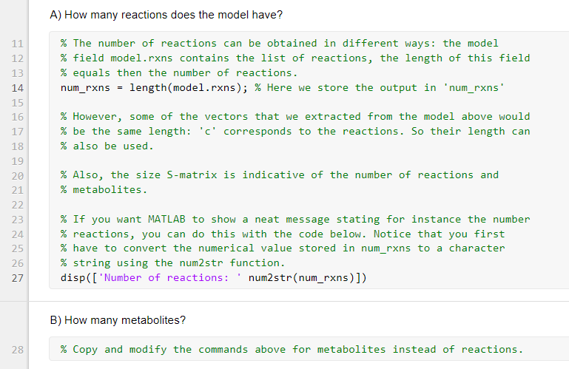
How to do Exercise 3?
Work in pairs (same as other exercises)
ZIP file with MATLAB code
models
scripts
exercise3.mlx
Answer the questions in the Live Script, changing code and writing notes
Fill in report template
Deadline is indicated on Canvas, at Exercise page
Upload both report and your modified Live Script!
Question 4 is non-compulsory, for bonus point on exam

Slide 4
smallModel.mat
Represents yeast central carbon metabolism (CCM)
Pathways include
Glycolysis
Pentose phosphate pathway
TCA cycle
Respiration (NADHX and FADHX)
Production of byproducts: ethanol, glycerol and acetate
Biomass production reaction (bioRXN)
Non-Growth Associated Maintenance = NGAM (ATPX)
Exchange reactions
Glucose (glcEX), oxygen (o2EX), ethanol (ethEX), acetate (acEX), biomass (bioEX), CO₂ (co2EX), glycerol (glyEX)

Slide 5
Determined / Underdetermined problems
Degrees of freedom F = N – M (№ reactions – № metabolites)
Degrees of freedom = #variables – rank(matrix) (general case)
rank of a matrix is defined as the maximum number of linearly independent column or row vectors in the matrix, whichever is smaller
Can you measure F linear independent fluxes?
Split S_{in} in S_{in,meas} and S_{in,cal}
You basically reduce N until F = 0, to give a determined system --> MFA
Calculate using Sv = 0 --> v = S\b
Can you not measure F linear independent fluxes?
Underdetermined system --> FBA
Define objective function and solve using linprog()

Slide 6
Using maximize() to run FBA
Vector indicating which reaction is objective function
Solution with flux values
v = maximize(c,S,b,LB,UB);
Vector indicating which metabolite is boundary metabolite

Slide 7
Problem 1: Finding a flux distribution
Load the model, inspect the content
Check (and correct?) reversibility
Where is reversibility stored?
Solve as determined system
Solve as underdetermined system

Slide 8
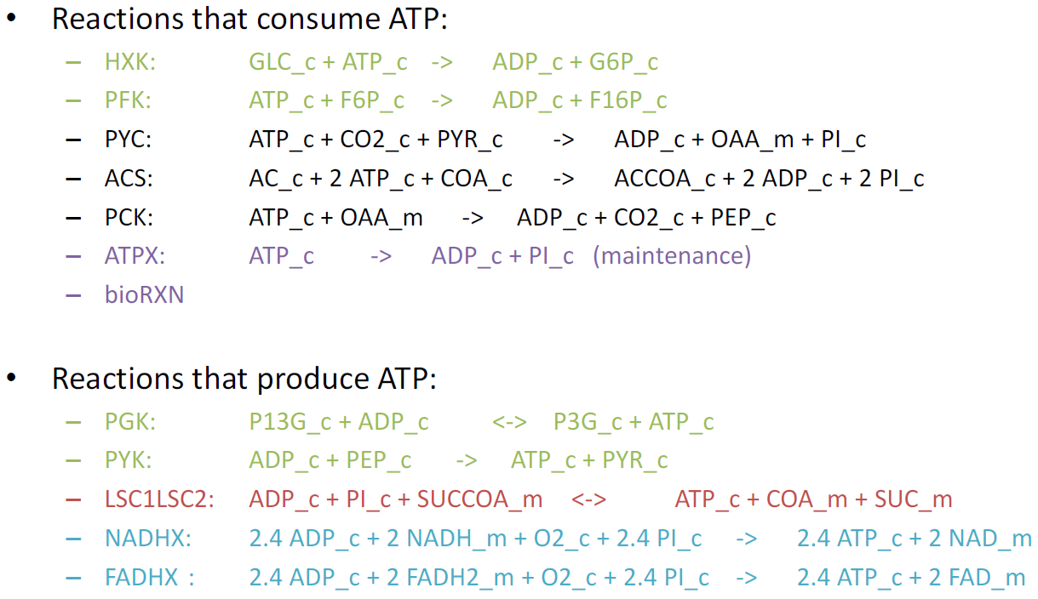
smallModel.mat

Slide 9
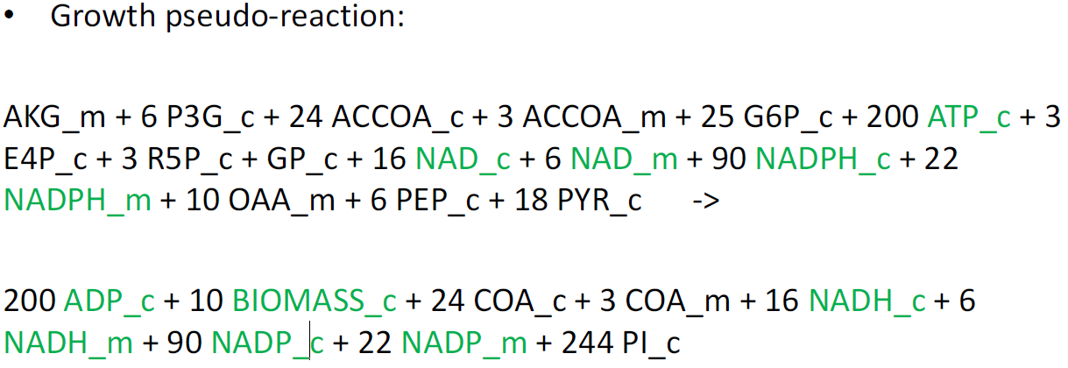
smallModel.mat

Slide 10
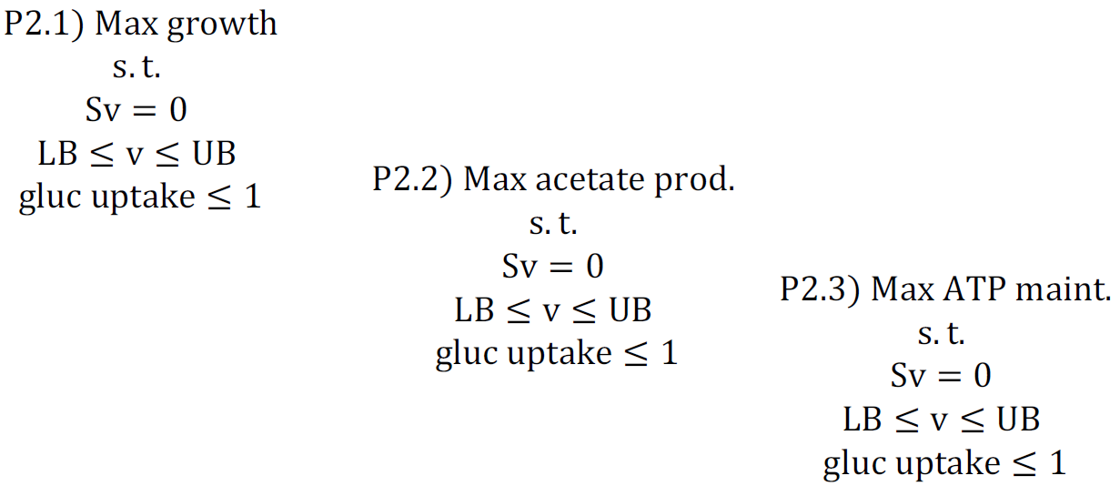
Problem 2: Changing objective functions

Slide 11
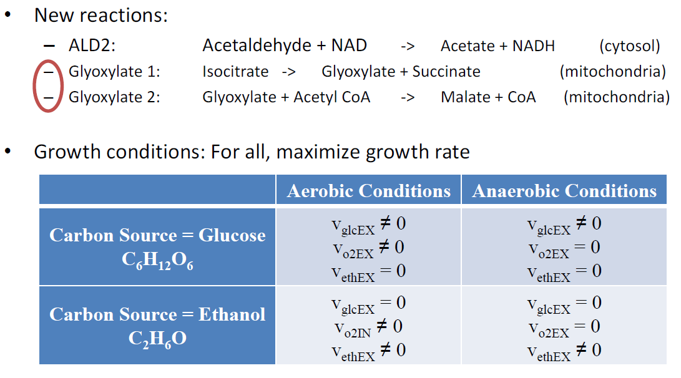
Problem 3: Changing growth conditions

Slide 12
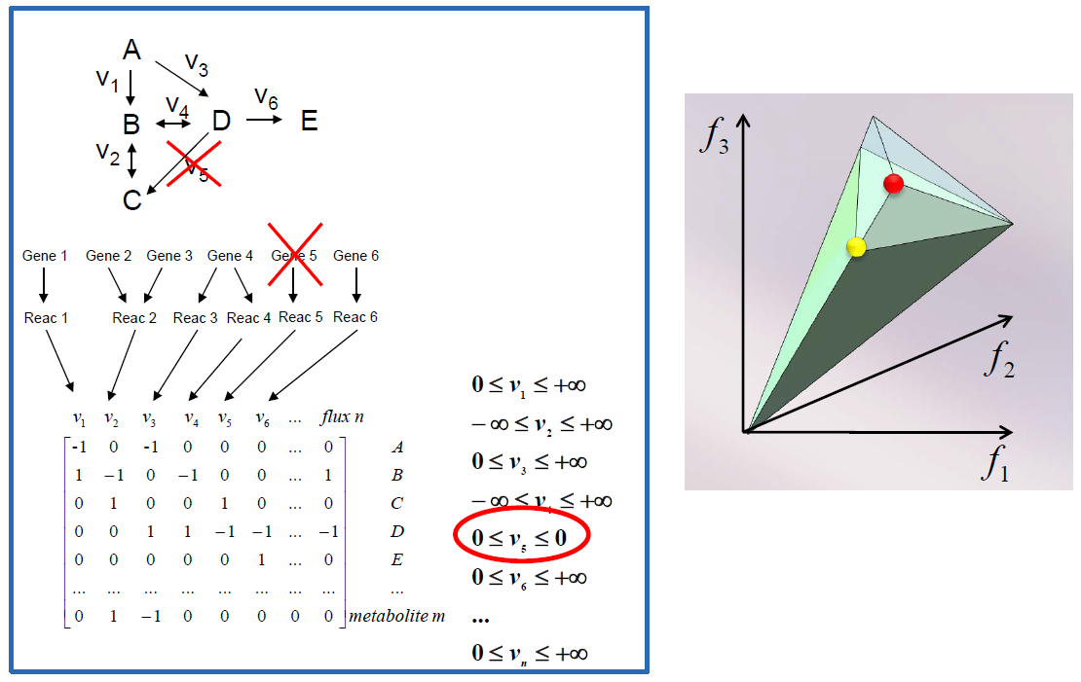
Problem 4: In silico gene deletions

Slide 13
Consultation
Two consultation times are scheduled

