Slide 1
Exercise 2 Introduction
Eduard J Kerkhoven

Slide 2
Learning goals covered by this exercise
Formulate an S-matrix in MATLAB
Rearrange an S-matrix and note the effect
Calculate the degrees of freedom and discuss its meaning
Perform metabolic flux analysis (using a MATLAB function, but you should know the equation)
Critically interpret the results from MFA calculations

Slide 3
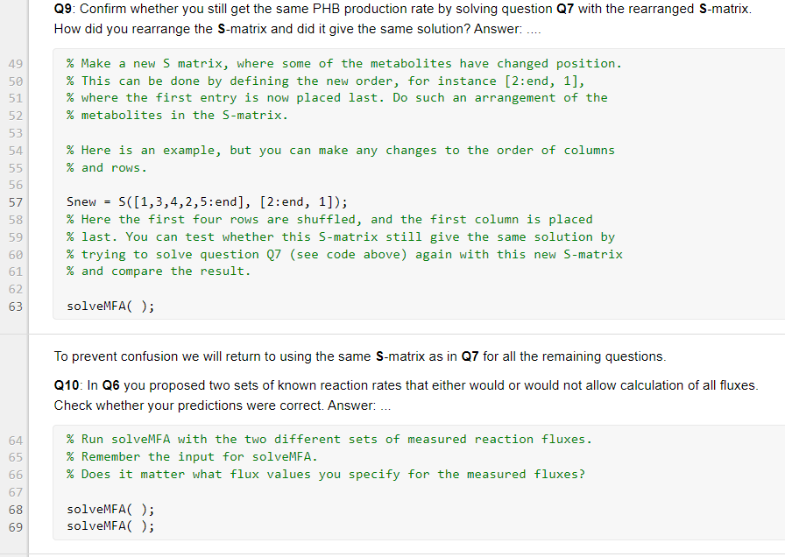
How to do Exercise 2?
Work alone or in pairs (same as Exercise 1?)
ZIP file with MATLAB code
exercise2_script.mlx
solveMFA.m
Answer the questions in the Live Script, changing code and writing notes
Finish this before the scheduled lecture for Exercise 2, when answers will be discussed
There is no hand-in, no grading

Slide 4
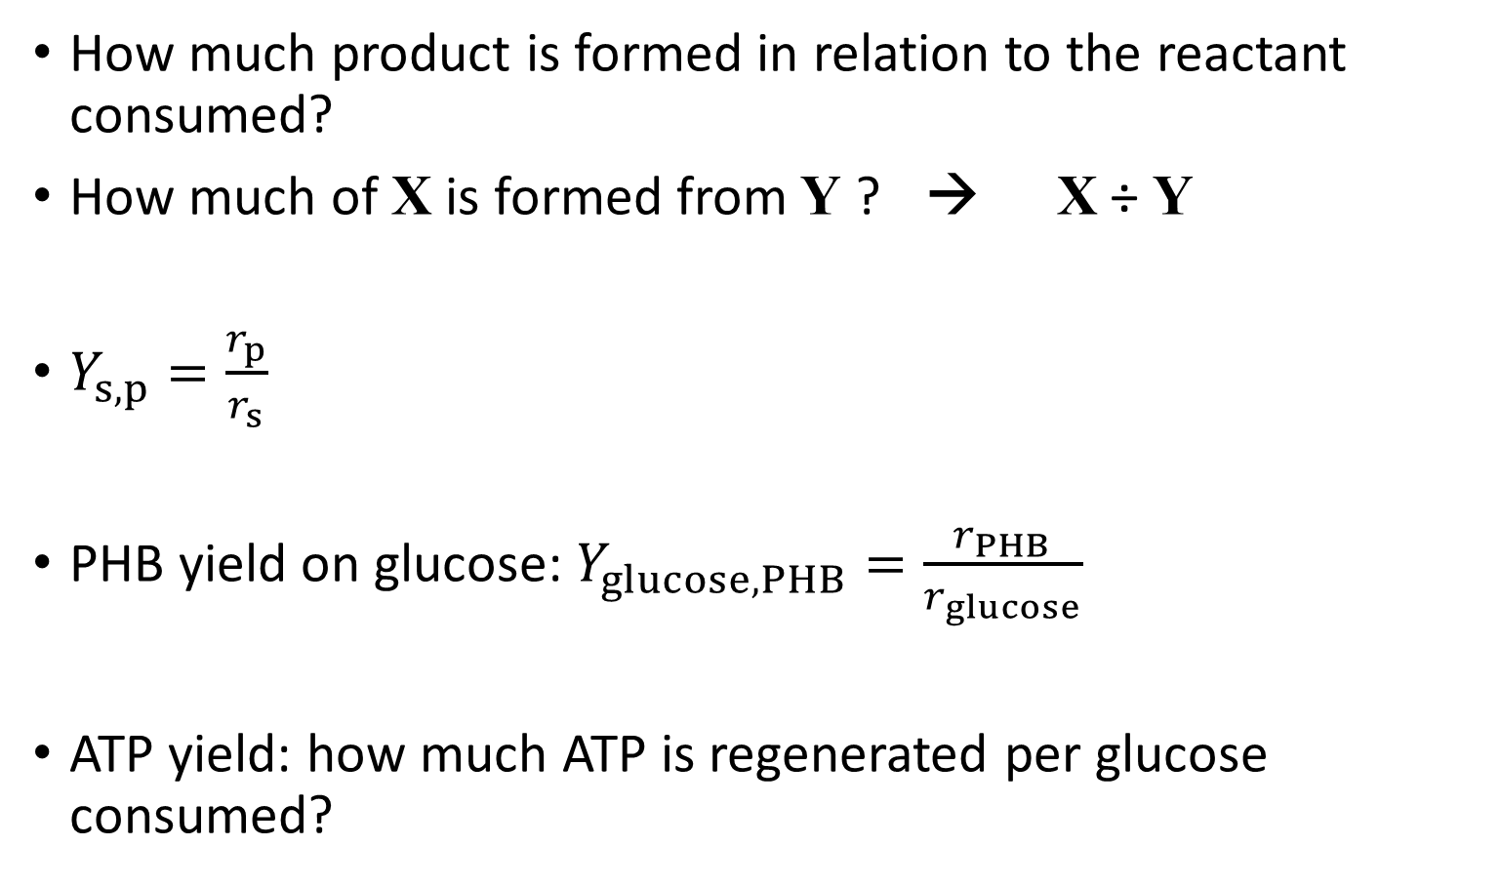
Some concepts: yield coefficient
How much product is formed in relation to the reactant consumed?
How much of X is formed from Y ? → X ÷ Y
$Y_{s,p}=\frac{r_{p}}{r_{s}}$
PHB yield on glucose: $Y_{glucose,PHB}=\frac{r_{PHB}}{r_{glucose}}$
ATP yield: how much ATP is regenerated per glucose consumed?

Slide 5
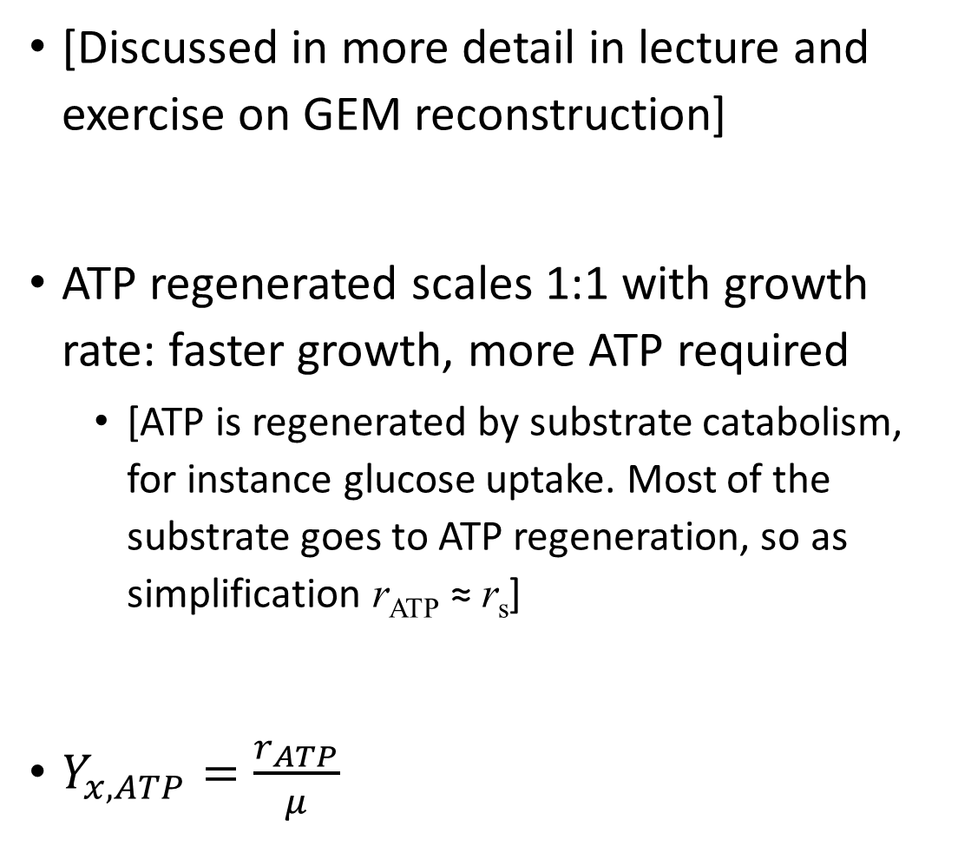
Does energy requirement scale with growth rate?
[Discussed in more detail in lecture and exercise on GEM reconstruction]
ATP regenerated scales 1:1 with growth rate: faster growth, more ATP required
[ATP is regenerated by substrate catabolism, for instance glucose uptake. Most of the substrate goes to ATP regeneration, so as simplification r_{ATP} ≈ r_{s}]
$Y_{x,ATP}=\frac{r_{ATP}}{μ}$
or r_{s}
r_{ATP}
Growth rate μ

Slide 6
At no growth: still maintenance
Biomass yield is not constant: there is still substrate uptake at (near-)zero growth
Why? If the cell does not grow, it still needs to maintain many processes that cost energy (see lecture on GEMs)
There is still a part of ATP requirement (= ATP regeneration = ATP turnover) that is constant with how much cells are produced
r_{s}
Growth rate μ

Slide 7
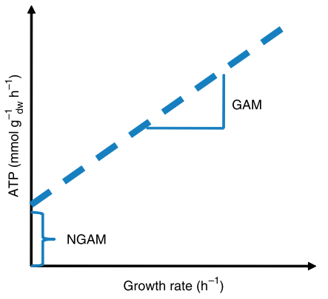
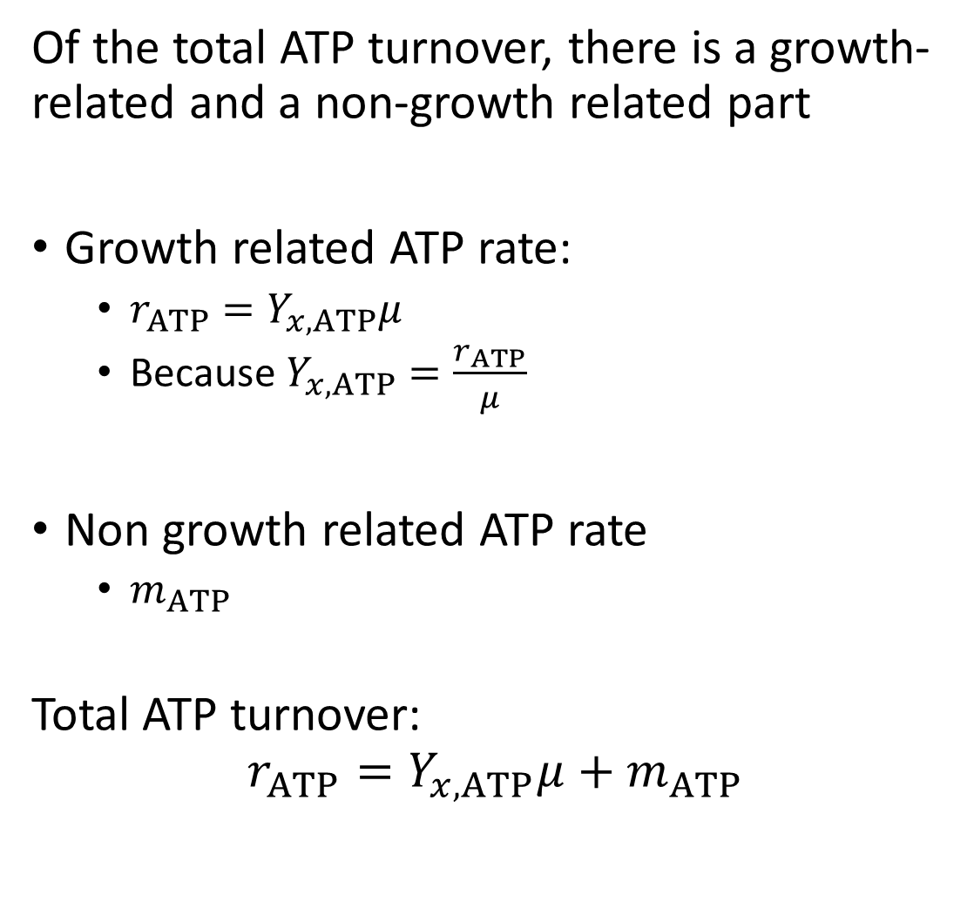


Total ATP turnover rate (= total cellular energy requirement)
Of the total ATP turnover, there is a growth-related and a non-growth related part
Growth related ATP rate:
$r_{ATP}=Y_{x,ATP}μ$
Because $Y_{x,ATP}=\frac{r_{ATP}}{μ}$
Non growth related ATP rate
$m_{ATP}$
Total ATP turnover:
$$r_{ATP}=Y_{x,ATP}μ+m_{ATP}$$
$$Y_{x,ATP}$$
$$m_{ATP}$$

